Slide 1
CS 250 Agile Presentation
Scrum Master
Christopher Meglen
Christopher.Meglen@snhu.edu
Notes:
Audience: leadership wants a clear contrast and a short recommendation.
Goal: explain roles and phases, contrast with waterfall, show sprint outcomes, give a recommendation.

Slide 2
Agile Roles
Product Owner orders the backlog and maximizes value
Scrum Master coaches the team and removes impediments
Developers deliver the increment and maintain quality
Testers design and automate checks aligned to acceptance criteria
Roles guidance: Scrum Guide 2020
Notes:
Example: Product Owner ordered a single backlog for Customer Profile.
My Scrum Master action: remove blockers and protect timeboxes.
Developers and testers: paired on risky code and designed acceptance checks.

Slide 3
Agile Phases in the SDLC
Refinement and planning: slice features and set a sprint goal
Execution: build in small batches with peer review and CI
Validation: demo a working increment and gather feedback
Improvement: run a retrospective and adjust the system of work
Phases and cadence: DORA 2024
Notes:
Use the SNHU Travel and Vision Quest examples when describing refinement and small batches.
Emphasize short feedback loops and a demo every sprint.

Slide 4
Waterfall vs Agile
Waterfall: sequential phases and late feedback. Works when scope is stable and risk is known
Agile: short cycles and early feedback. Fits evolving requirements and higher uncertainty
For SNHU Travel and Vision Quest, Agile fit better because fast feedback and change tolerance mattered
Tradeoffs: industry practice summaries 2023-2024
Notes:
Concrete contrast: in waterfall the profile slice would wait for a long design gate.
In Agile we shipped a working profile change and got privacy text feedback in the same sprint.

Slide 5
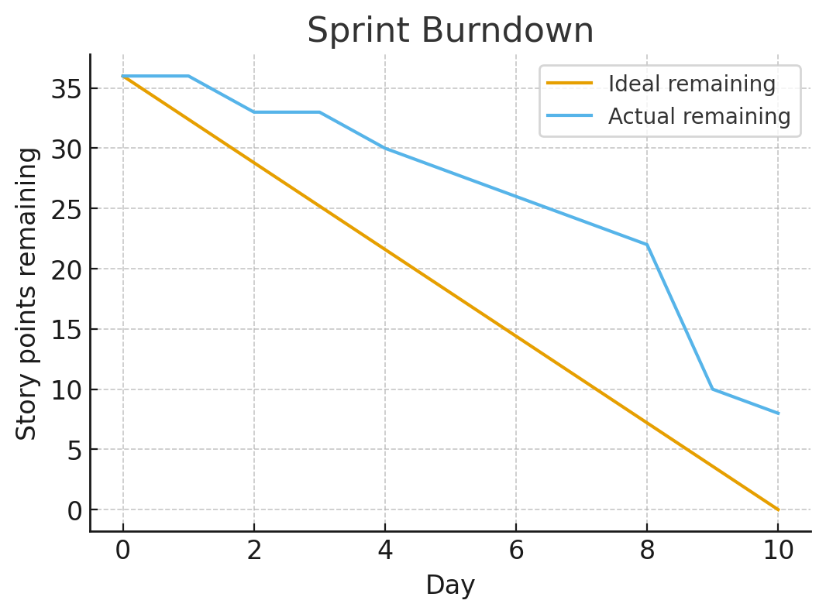
Sprint Review Highlights
Goal: deliver a Customer Profile slice end to end
Done: 7 of 9 stories including UI, service, validation, logging
Evidence: velocity 28, throughput 7, median review 6 hours, CI pass rate 92 percent
Next actions: add Blocked column, enable WIP limits, peer review before merge
Metrics approach: DORA 2023 and 2024
Notes:
Call out numbers: velocity 28, 7 stories, review time 6 hours, CI pass 92 percent.
State next actions: add Blocked column, WIP limits, peer review before merge.

Slide 6
References
DORA 2024. Accelerate State of DevOps Report 2024
DORA 2023. Accelerate State of DevOps Report 2023
Kostin et al. 2023. Communication in distributed Scrum teams
Lippert and Gritz 2022. Information radiators and awareness
DORA 2024; DORA 2023; Kostin et al. 2023; Lippert and Gritz 2022
Notes:
All sources are within 5 years and cited in APA on the slide.

