Slide 1
CS 250 Final Project
Sprint Review and Sprint Retrospective
Role: Scrum Master
Christopher Meglen

Slide 2
Agenda
Sprint goal and increment
Demo plan
Metrics and evidence
Communication and tools review
Retrospective actions
Next steps

Slide 3
Agile Roles
Product Owner: orders the backlog and maximizes product value
Scrum Master: coaches the team, removes impediments, protects timeboxes
Developers and Testers: plan and deliver the increment, maintain quality
Stakeholders: give feedback in review and help refine goals

Slide 4
Agile Process
Single ordered backlog feeds sprint planning
Sprint goal defines focus for two weeks
Daily standup focuses on flow and blockers
Short lived branches with peer review and CI
Review a working increment and run a retrospective

Slide 5
Waterfall Model
Phases: requirements, design, implementation, verification, maintenance
Big batches and late feedback risk an illusion of progress
Works best in low uncertainty domains with stable requirements

Slide 6
Waterfall to Agile for Vision Quest
Replace big plans with a single backlog and short sprints
Slice features into small testable stories
Use acceptance criteria to guide testing early
Keep integration risk low with CI and daily merges
Leaders attend reviews and judge progress by working software

Slide 7
Sprint Review Summary
Sprint goal: deliver a Customer Profile slice end to end
Completed: 7 of 9 stories including UI, endpoint, validation, logging
Not completed: report export and accessibility focus fix
Feedback: add confirmation banner and revise privacy copy

Slide 8
Demo Plan
Start from a clean account and open the profile page
Update email and preferences, save, show banner and audit entry
Show optimistic concurrency in the data store
Trigger invalid input, show validation, correct and save
Call the update endpoint to show contract and status codes

Slide 9
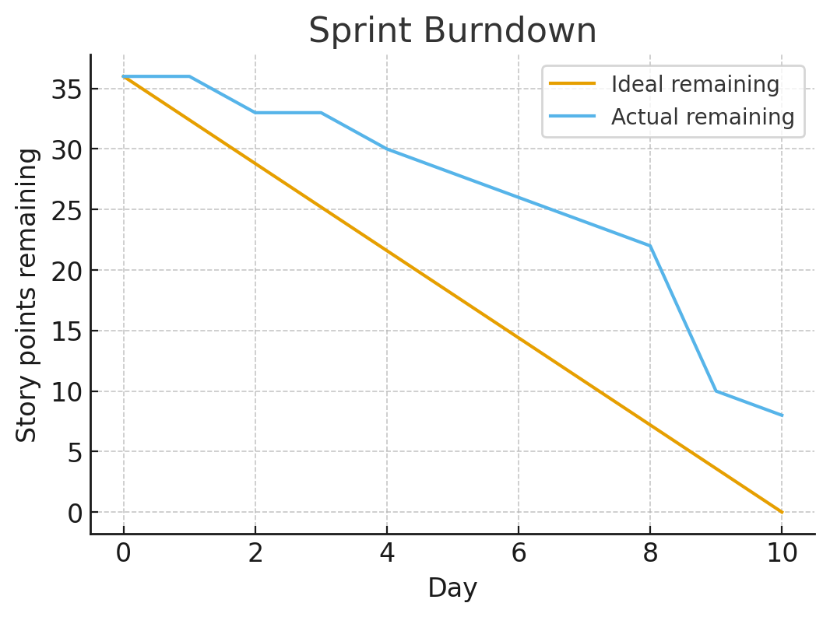
Metrics and Burndown
Velocity 28 points, throughput 7 stories
Average cycle time 3.2 days per story
Median code review time 6 hours
CI pass rate 92 percent
Two defects fixed inside the sprint

Slide 10
Communication Review
Worked: single shared online board and short standups
Worked: early tester involvement with Given When Then criteria
Gap: decisions buried in chat threads
Change: capture decisions on the board and link in the story

Slide 11
Tools Review
One backlog and a sprint board with simple states
Add WIP limits on In Progress and Code Review
Require peer review before merge
Run unit tests on each pull request in CI

Slide 12
Retrospective Actions
Add a Blocked column and update the board before standup
Enable WIP limits and enforce peer review before merge
Use Given When Then acceptance criteria in refinement
Plan one fewer story to reserve capacity for unplanned work
Schedule a cross site pairing window three afternoons a week

Slide 13
Next Steps
Apply feedback and create follow up stories
Start sprint with the updated working agreements
Inspect the impact of WIP limits in the next review

