Slide 1


Low-Cost Intelligent Real-Time ECG Monitoring System Using Artificial Intelligence
Guilherme Martins Specht
Prof. Laurent Latorre
MEA4
05/06/2026
Université de Montpellier / Polytech Montpellier

Slide 2

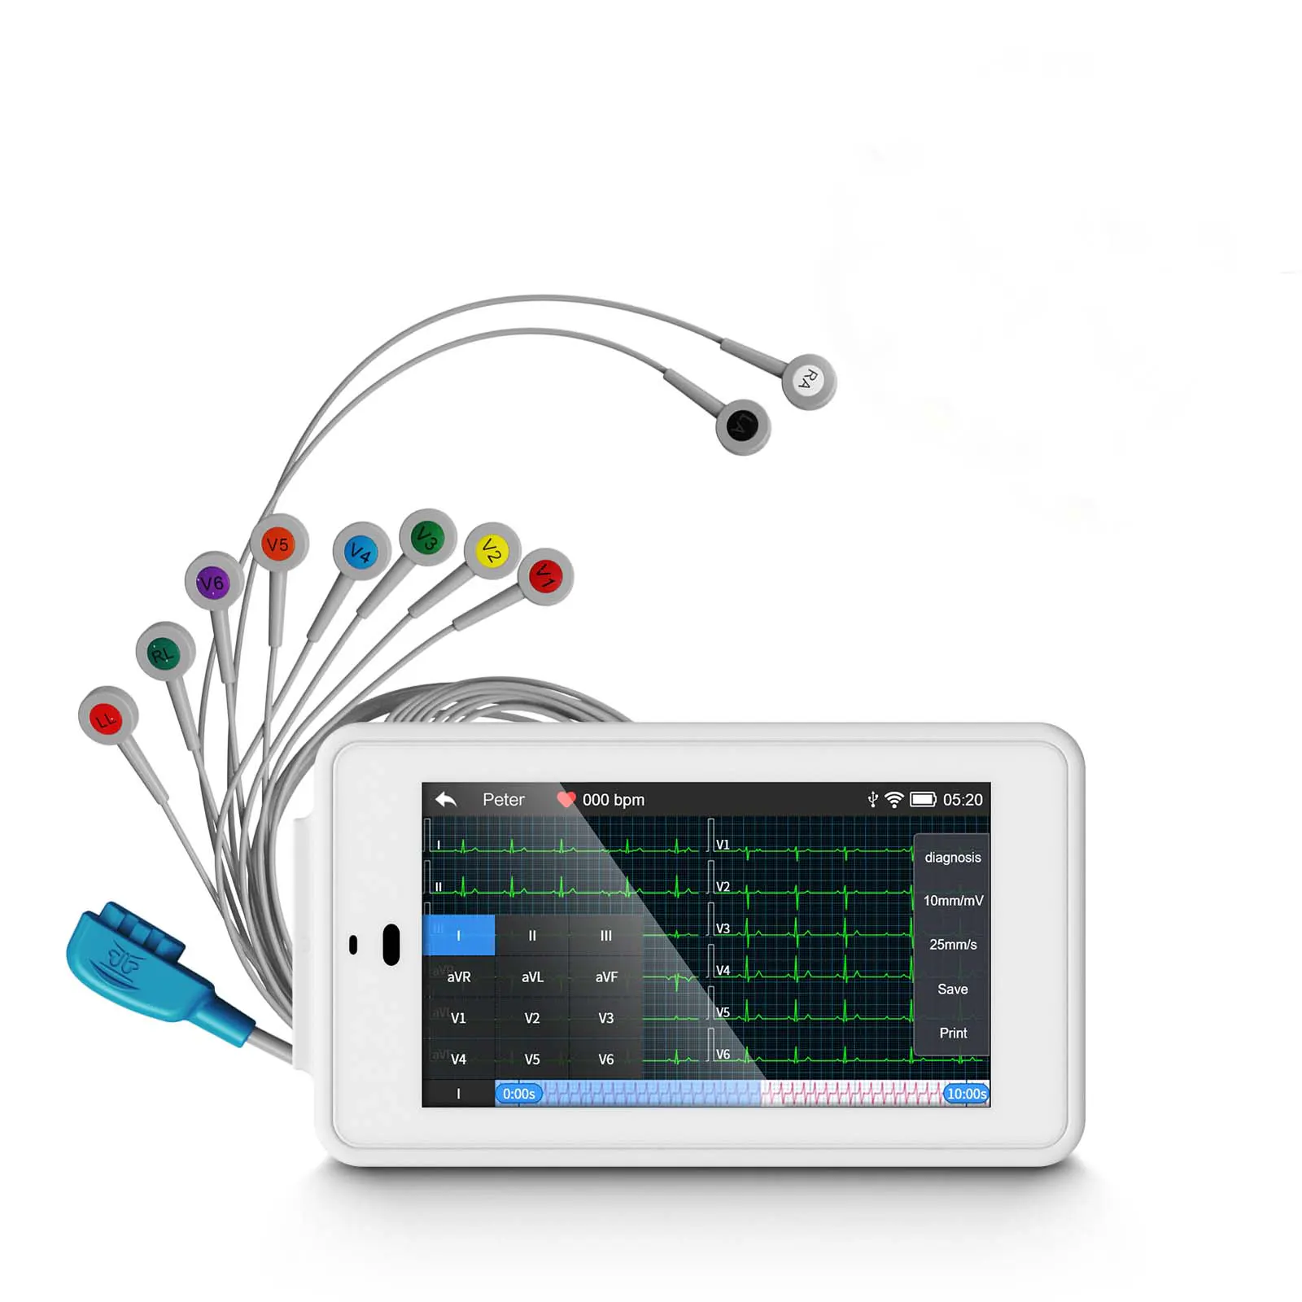
Motivation
Cardiovascular diseases are leading causes of death
Need for rapid ECG interpretation
Lack of low-cost intelligent systems
Importance in emergency and remote environments

Slide 3
Problem Statement
How to develop a low-cost embedded system capable of:
acquiring ECG signals,
processing them in real time,
and classifying cardiac rhythms using AI?

Slide 4
Objectives
General objective
Develop a real-time intelligent ECG monitor
Specific objectives
Acquire ECG with AD8232
Process ECG digitally
Detect R-peaks
Calculate BPM and RR
Classify rhythms using CNN
Create real-time monitoring interface

Slide 5
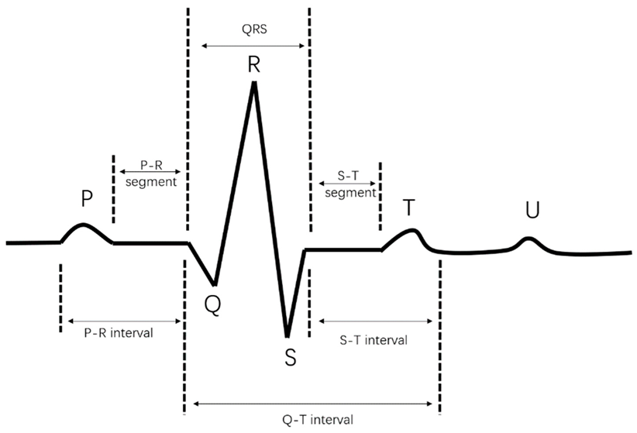

ECG Fundamentals
Image ECG:
P wave
QRS complex
T wave
$$BPM= \frac{60}{RR}$$

Slide 6
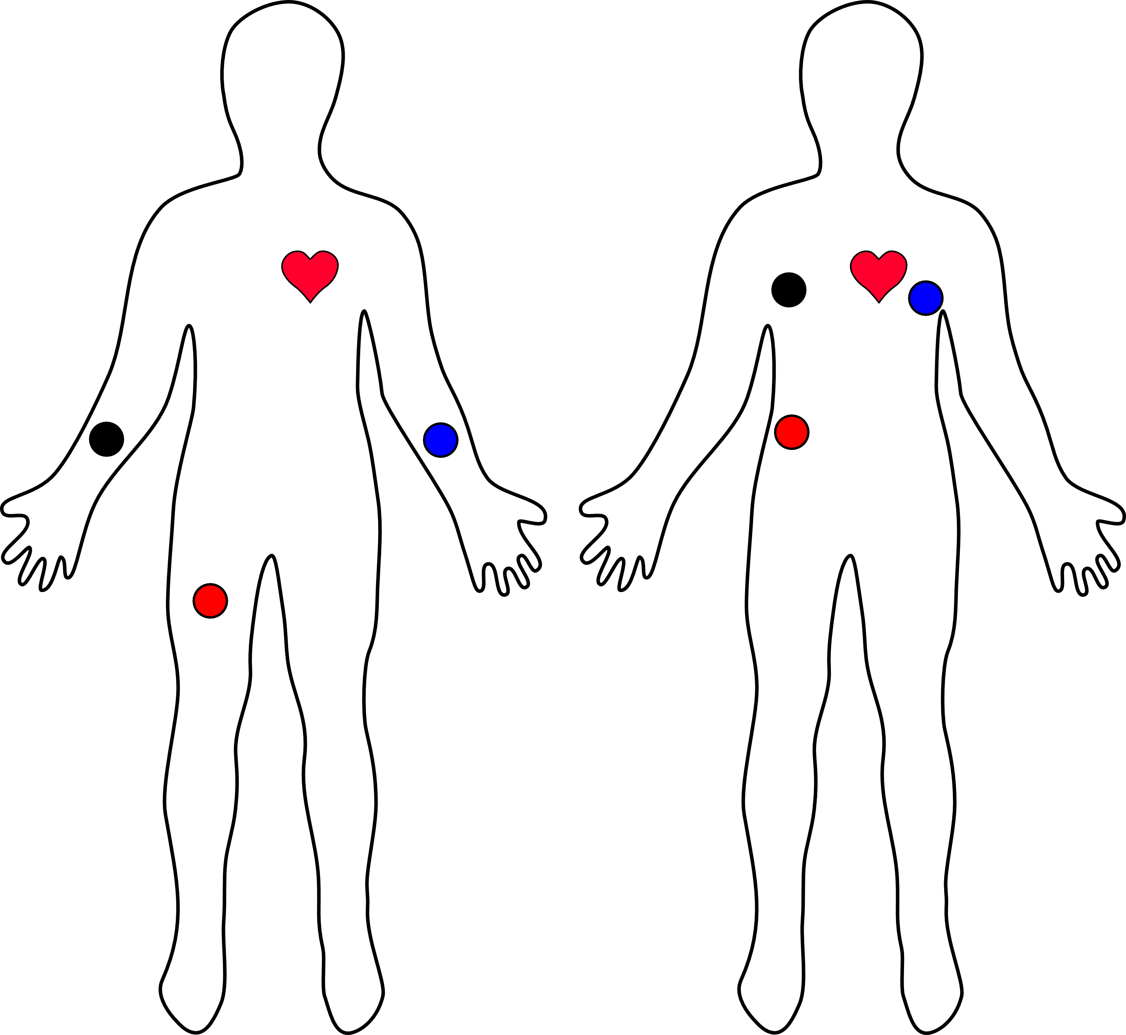
Cardiac Arrhythmias
RHYTHM | BPM
Bradycardia | < 60
Normal | 60 - 100
Tachycardia | > 100

Slide 7
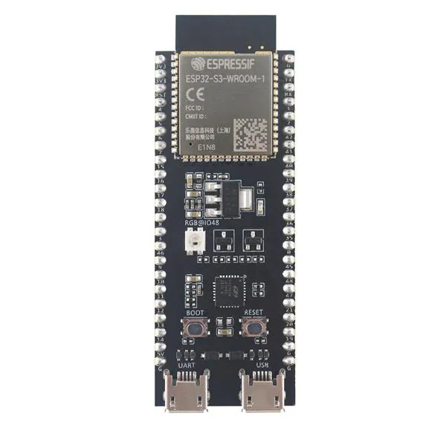
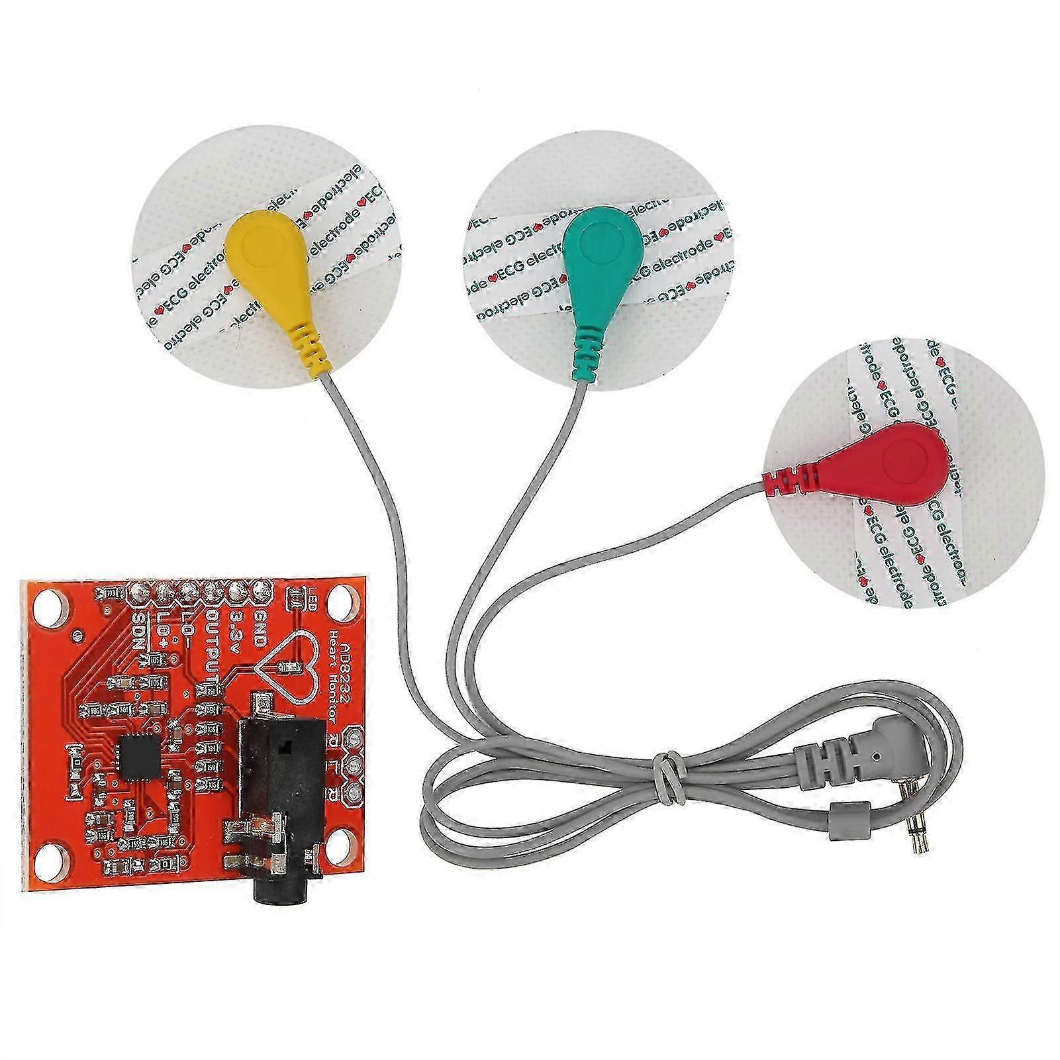
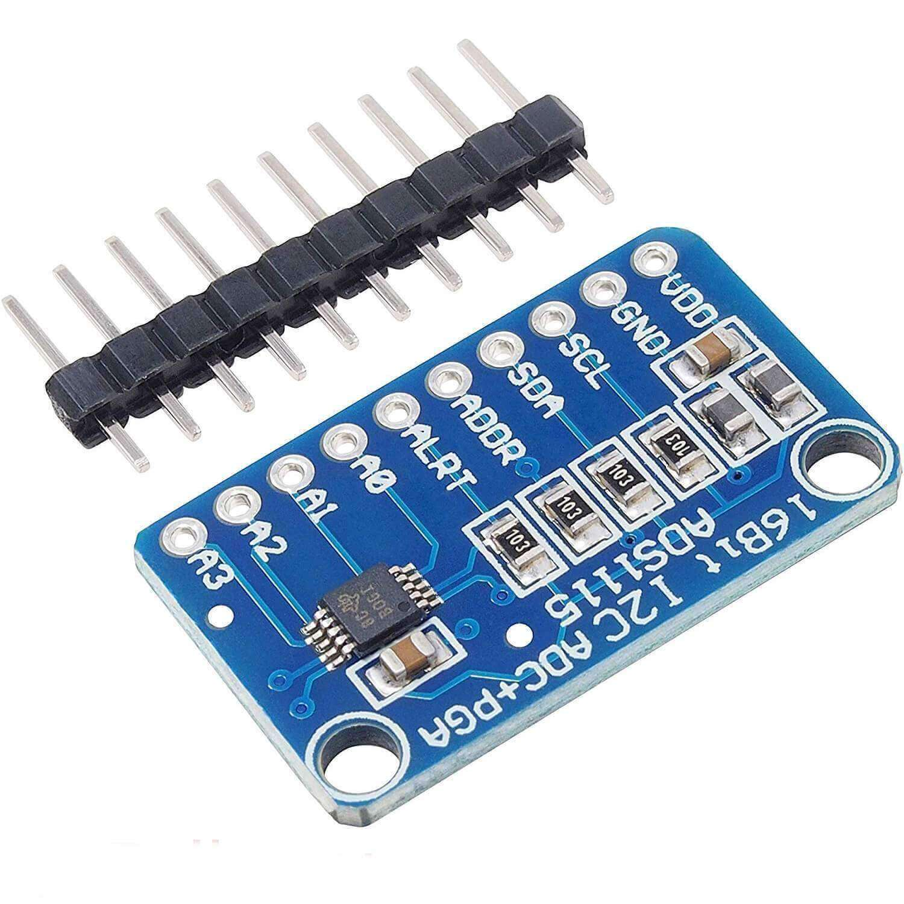
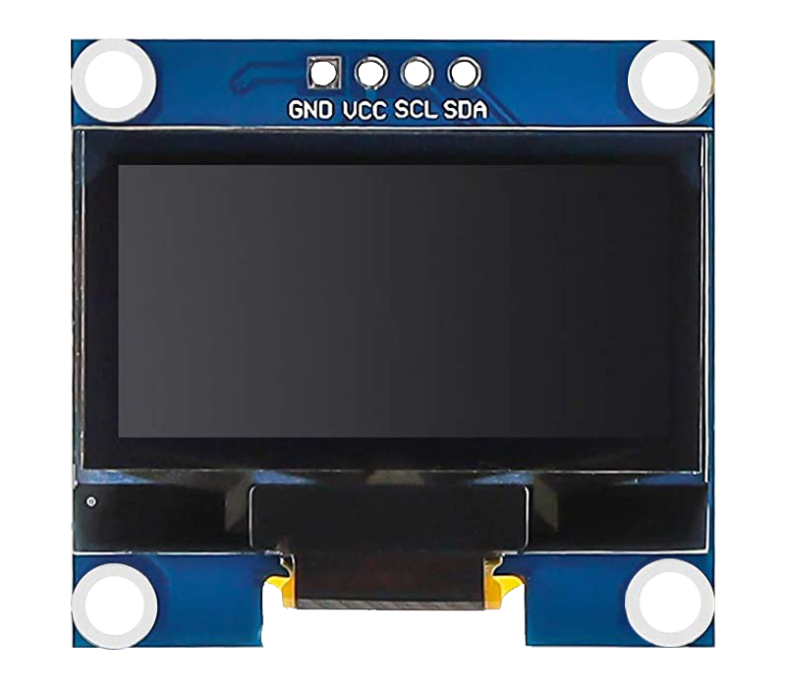
Components Used
ESP32-S3
AD8232
ADS1115
OLED

Slide 8
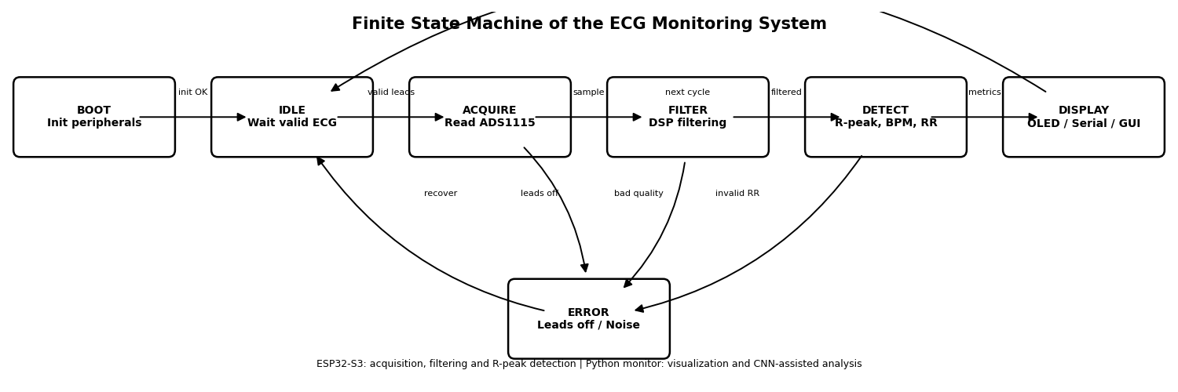
System Architecture

Slide 9
Signal Processing
Pipeline:
Raw ECG: Original electrical cardiac signal acquired from the electrodes, still containing noise and baseline variations. ↓ Derivative: Emphasizes rapid signal changes, helping to highlight the QRS complex. ↓ Squaring: Squares the signal values, enhancing large peaks and making all values positive. ↓ Moving Window Integration: Smooths the processed signal and emphasizes regions where heartbeats occur. ↓ Adaptive Threshold: Dynamically adjusts the detection threshold to distinguish real heartbeats from noise. ↓ R-Peak Detection: Identifies R peaks, which are used to calculate RR intervals, BPM, and support arrhythmia classification.

Slide 10
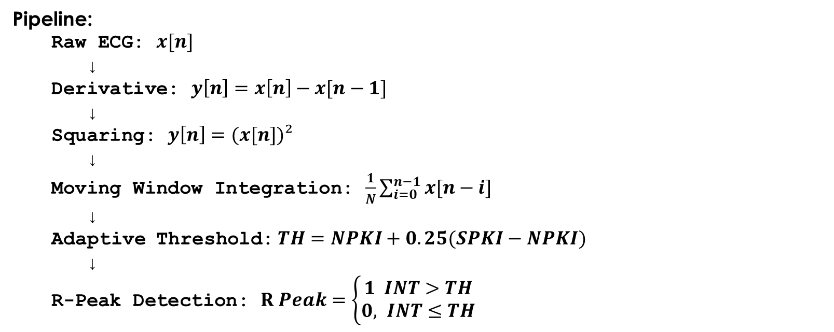
Signal Processing
Pipeline:
Raw ECG: $x[n]$ ↓ Derivative: $y\left[n\right]=x\left[n\right]−x[n−1]$ ↓ Squaring: $y\left[n\right]=(x[n])²$ ↓ Moving Window Integration: $\frac{1}{N}\sum_{i=0}^{n−1}{x[n−i]}$ ↓ Adaptive Threshold: $TH=NPKI+0.25(SPKI−NPKI)$ ↓ R-Peak Detection: $R Peak=\left\{\begin{aligned}1 INT>TH \\ &0, INT≤TH\end{aligned}\right.$

Slide 11
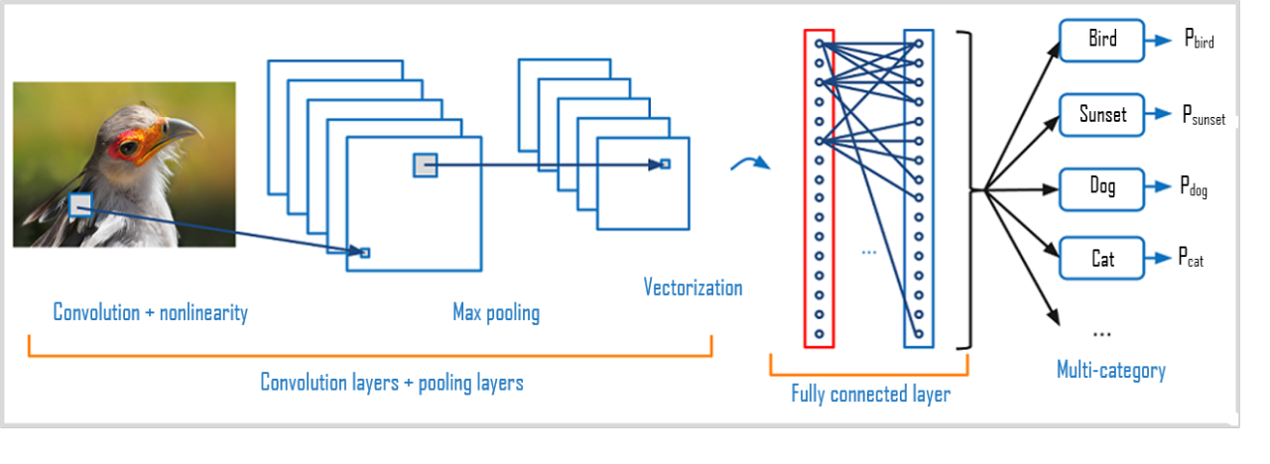
Artificial Intelligence
1D CNN
MIT-BIH dataset
Synthetic signals
Real-time classification

Slide 12
CNN Architecture
Conv1D: Extracts local patterns from the ECG signal, such as QRS morphology and waveform variations. ↓ MaxPooling: Reduces the signal size while keeping the most important features. ↓ Conv1D: Extracts deeper and more complex ECG features from the previous layer. ↓ Dense: Combines the extracted features to support the final rhythm decision. ↓ Softmax: Converts the final outputs into class probabilities, indicating the most likely ECG class.

Slide 13



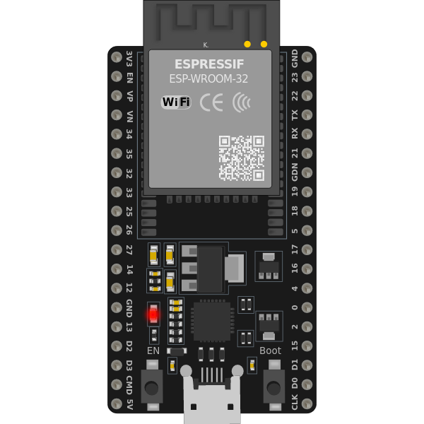




DETECT
MIT-BIH DATABASE
PAN-TOMPKINS
LEARN
RESULTS
RESULTS

Slide 14
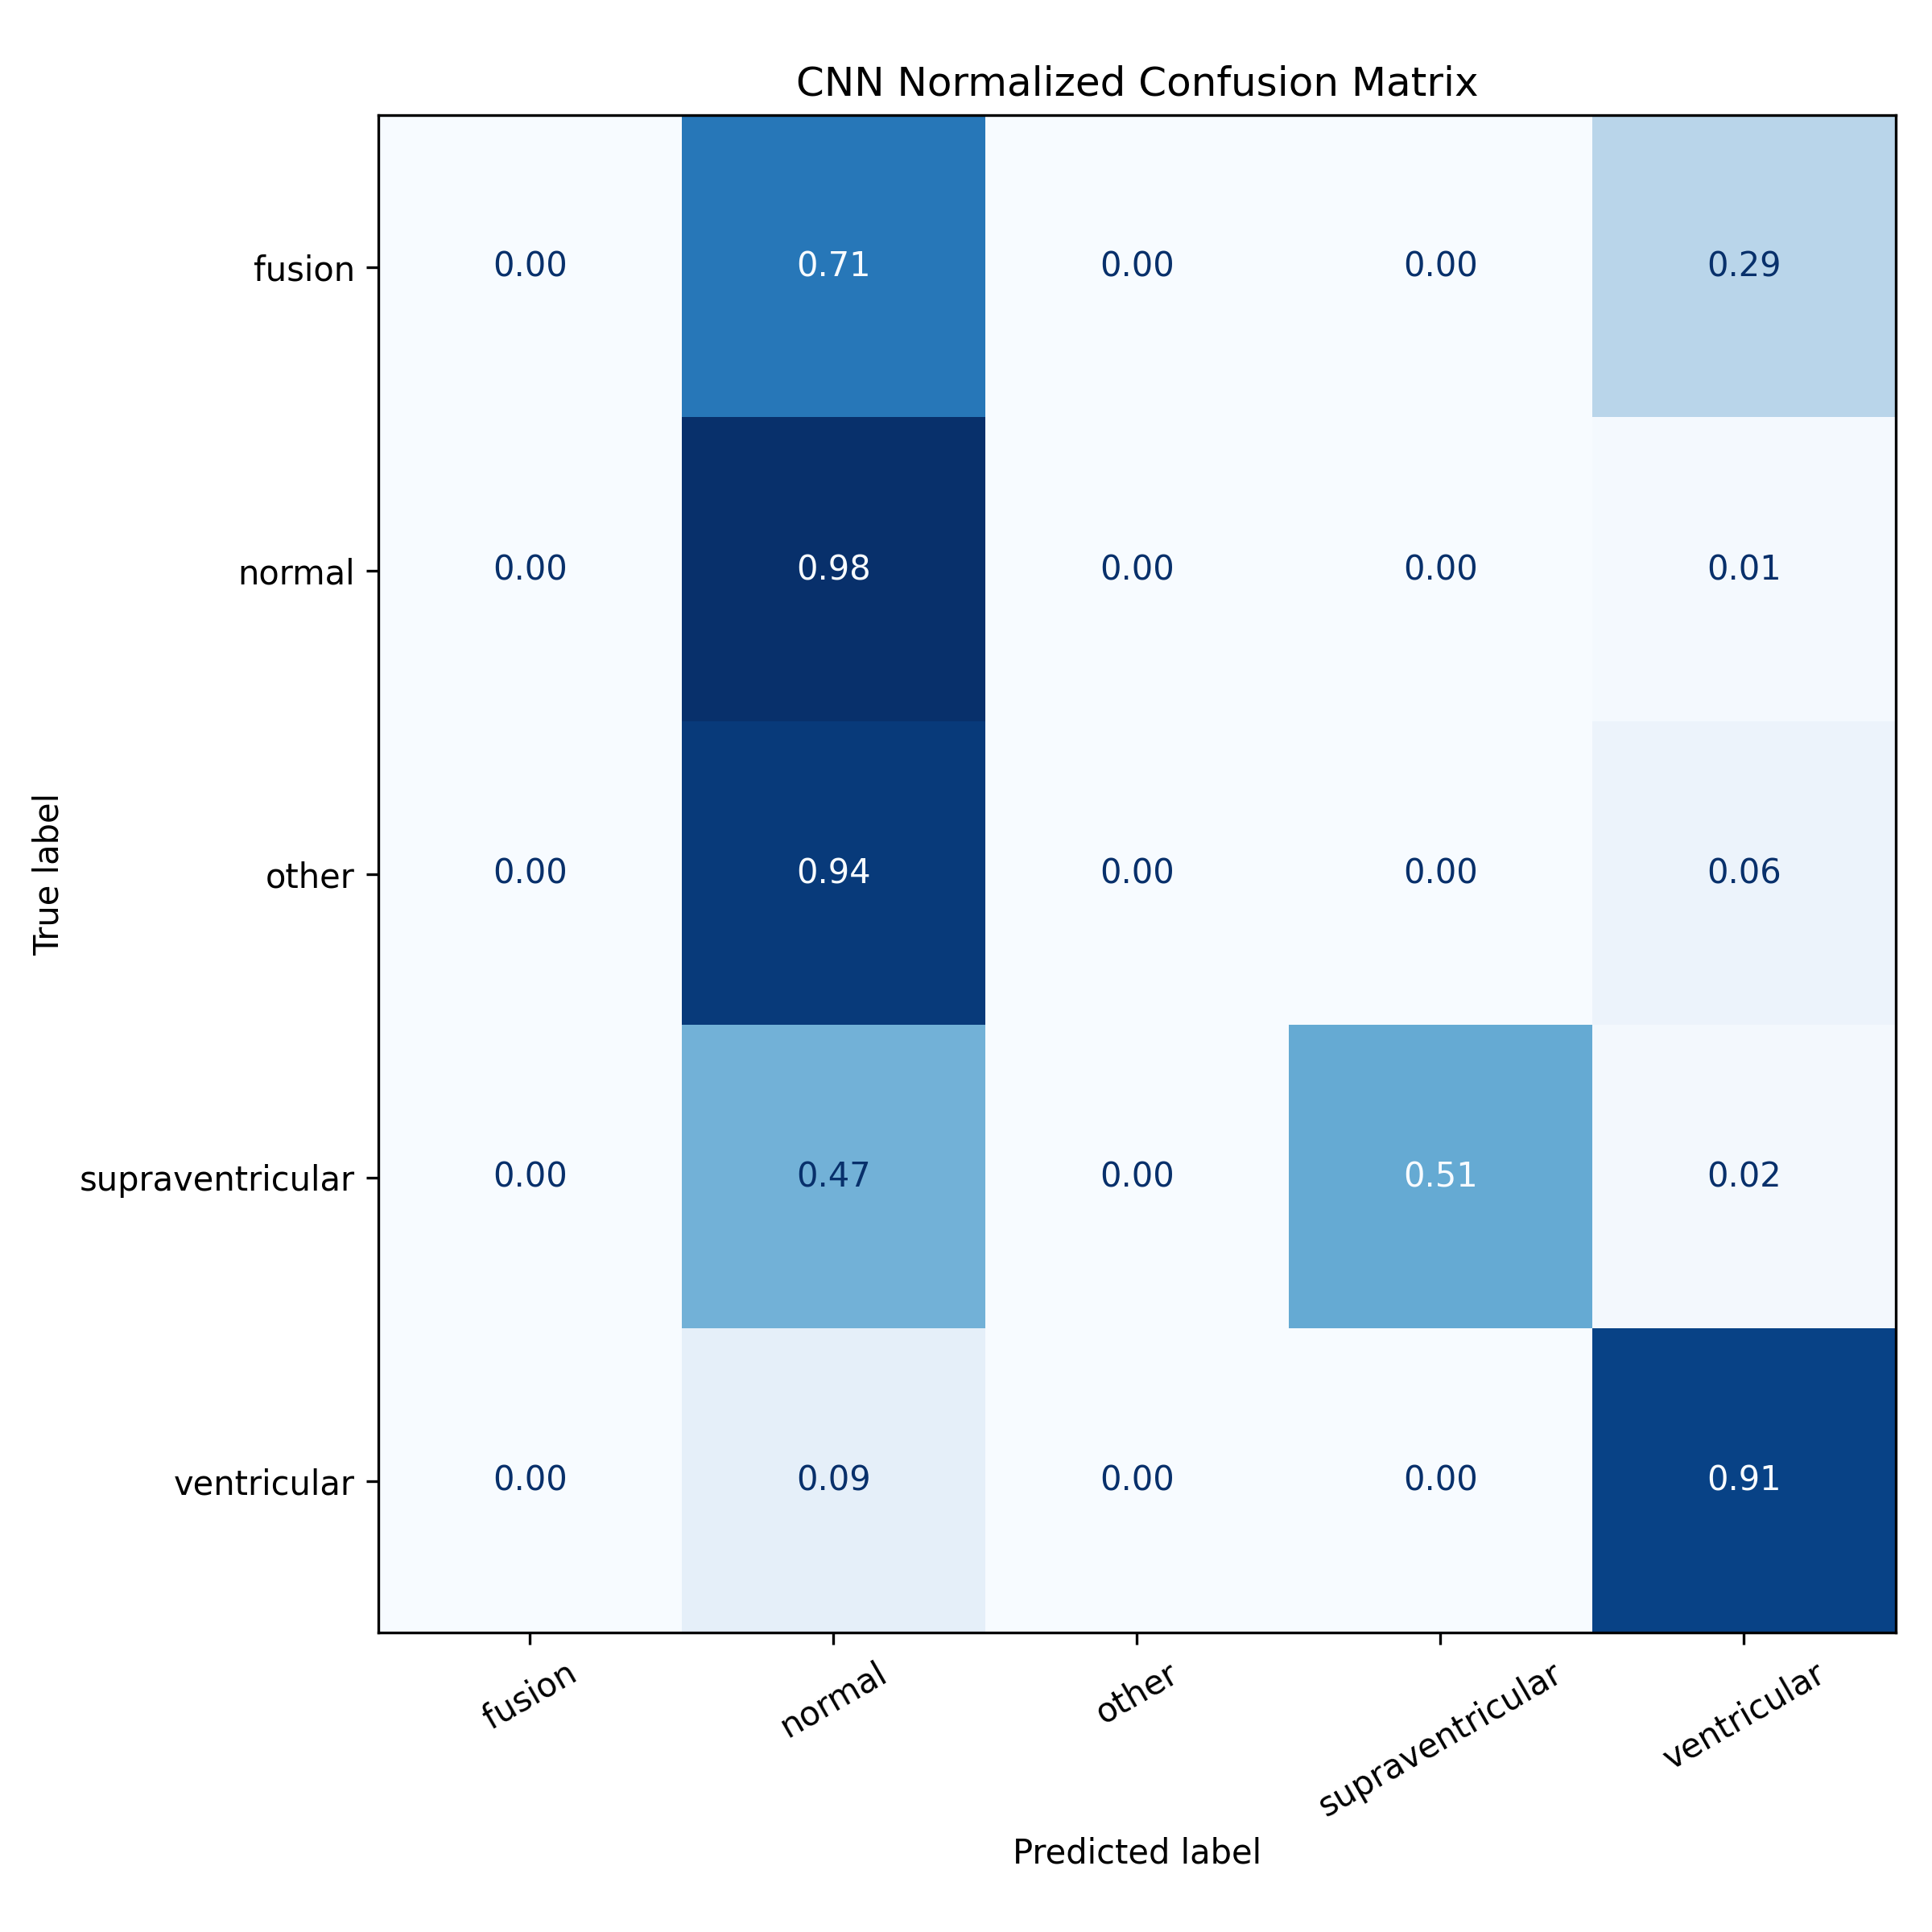
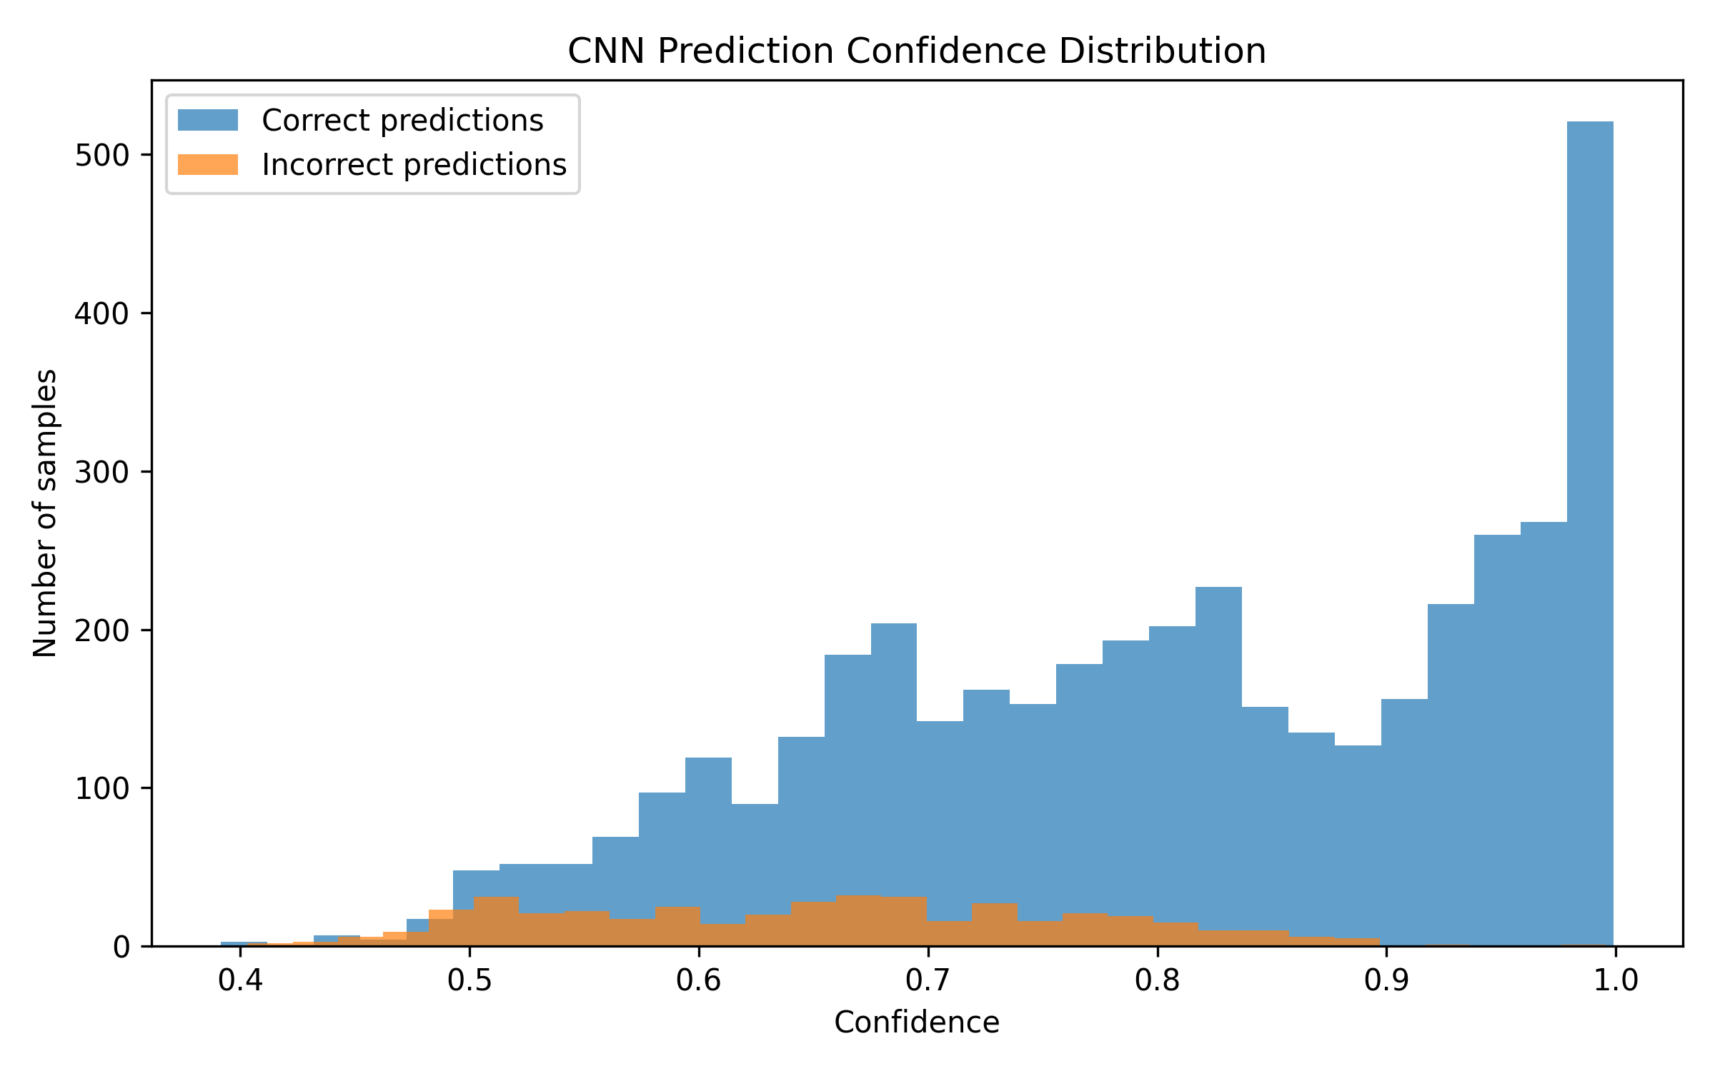
AI Results
CNN test set: MIT-BIH ECG windows
Final accuracy: 90.63%
Best performance: normal and ventricular classes
Limitation: minority classes affected by imbalance

Slide 15
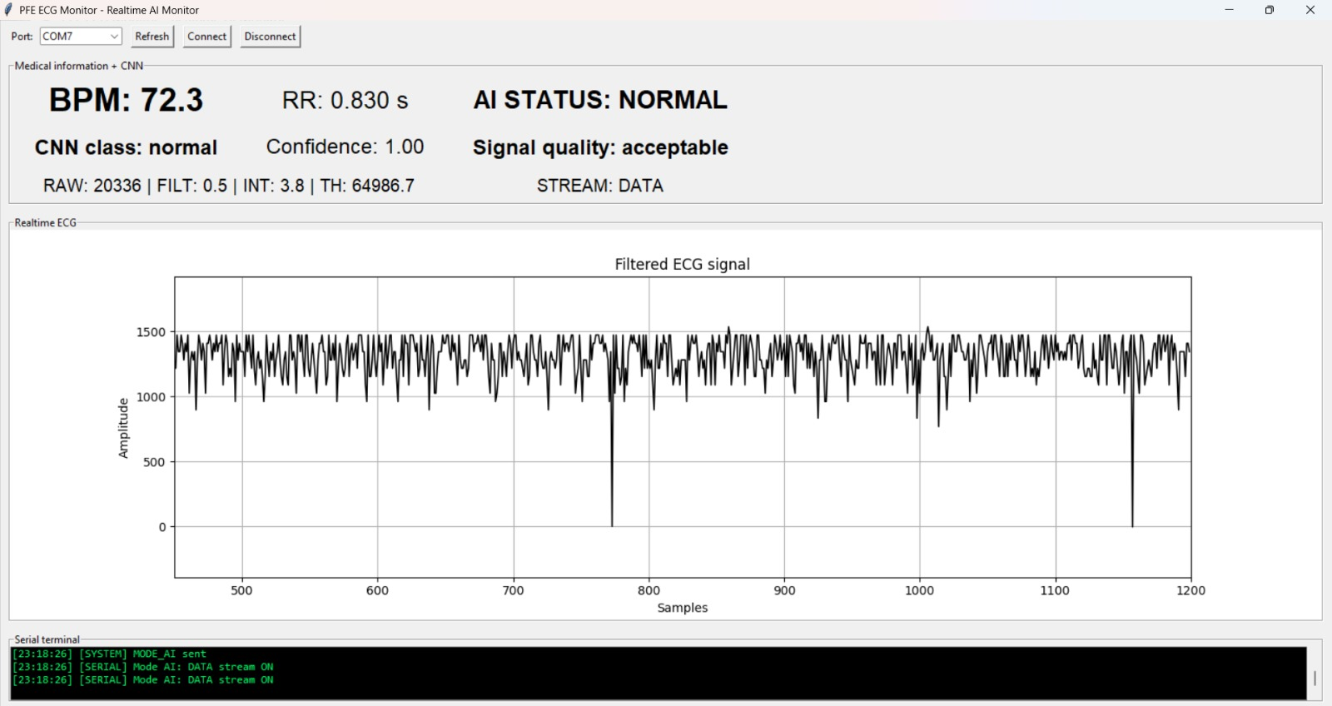
Real-Time Monitor

Slide 16
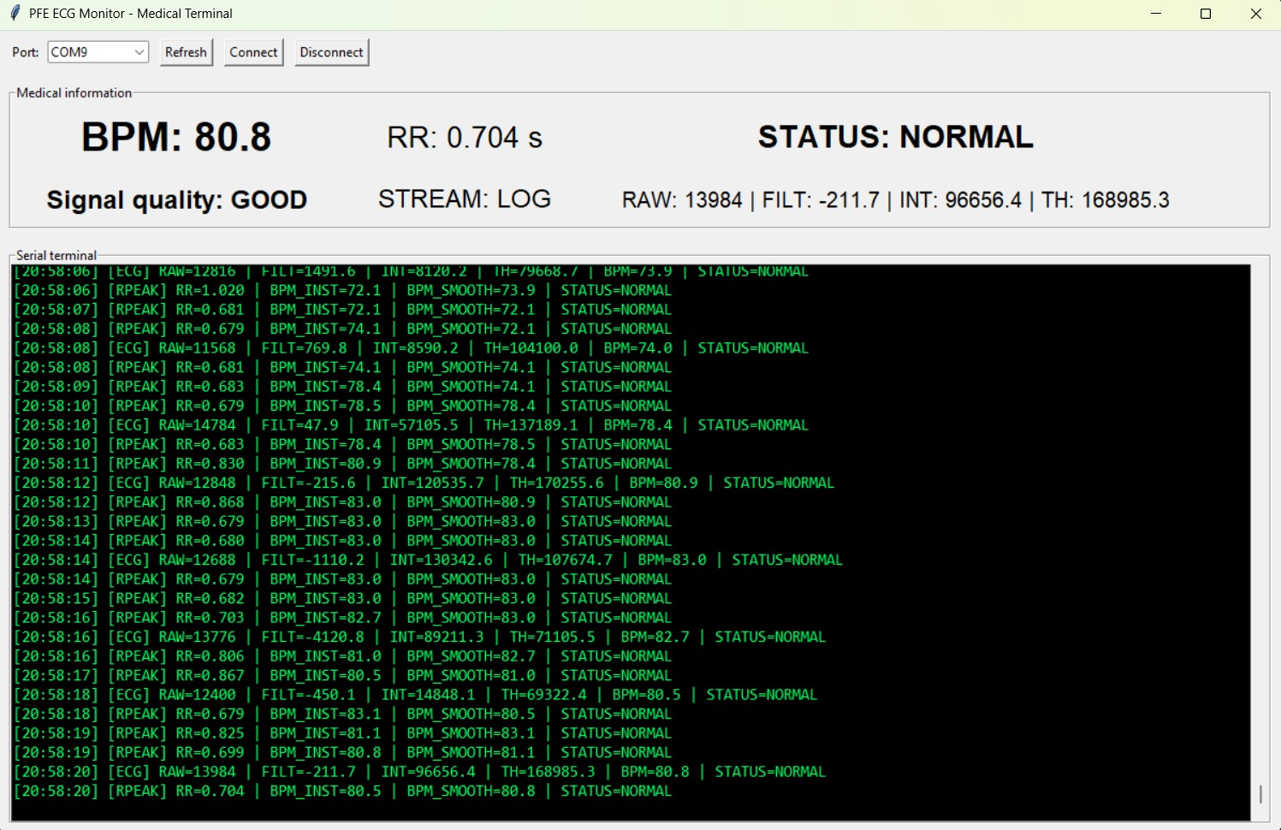
Real-Time Monitor

Slide 17
Future Work & Limitations
Development of a PCB;
Using a finger sensor;
Improving the analog front-end and electrode connection stability;
Using better filtering techniques for noise reduction;
Increasing the number of real ECG acquisitions;
Balancing the CNN dataset;
Improving classification of minority classes;
Deploying TinyML inference directly on the ESP32-S3;
Using MQTT, BLE, or WiFi communication;
Developing a mobile application;
Performing validation with controlled biomedical datasets;
Investigating clinical validation in partnership with healthcare professionals.
Noise sensitivity
No clinical validation
Limited dataset

Slide 18
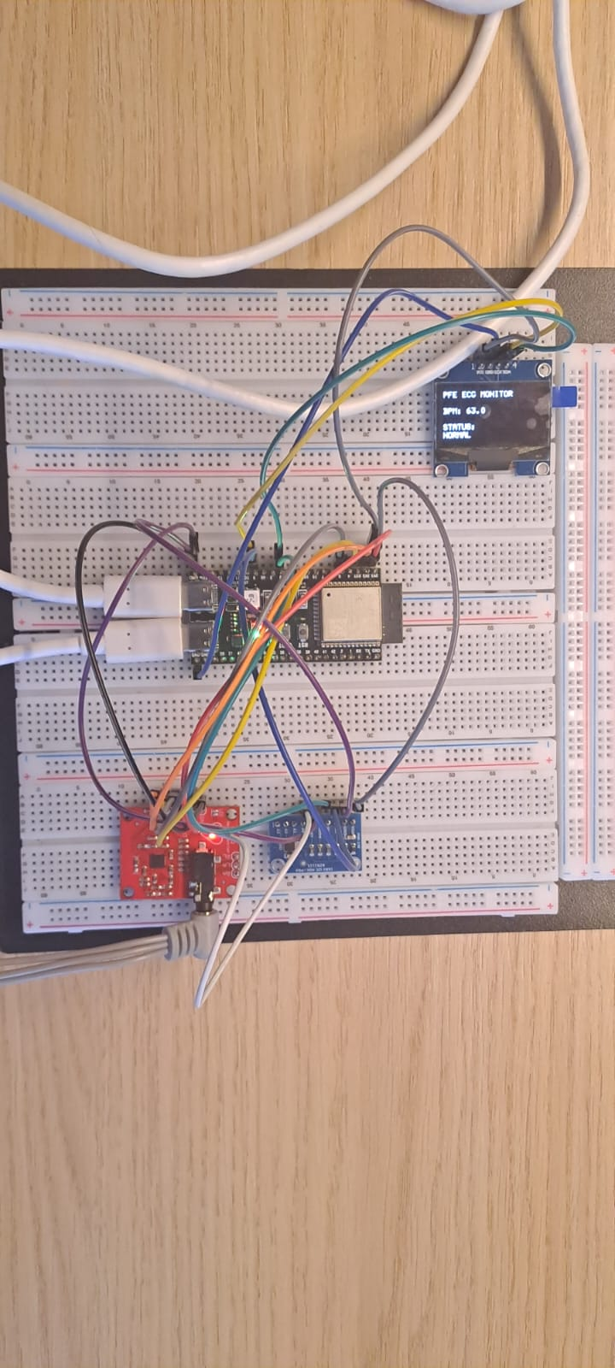
Conclusion
Functional system
Real-time ECG monitoring
AI-assisted analysis
Low-cost architecture

