Slide 1


SM4 - ShangMi 4
Analysis, attack and defense
Guilherme Martins Specht
PFE – MEA5
Polytech Montpellier
STMicroelectronics

Slide 2
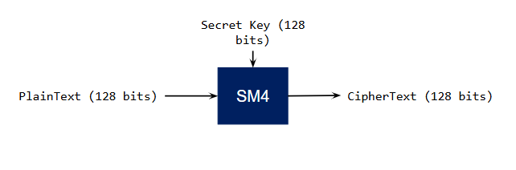
SM4 at a Glance
Block length: 128 bits.
4 words with 32 bits.
Key length: 128 bits.
Rounds: 32 rounds.
Symmetrical.
Key expansion algorithm to transform the cipher key into round keys.
S-Box: 32bits turn into 4 times 8-bit input and 8-bit output.

Slide 3
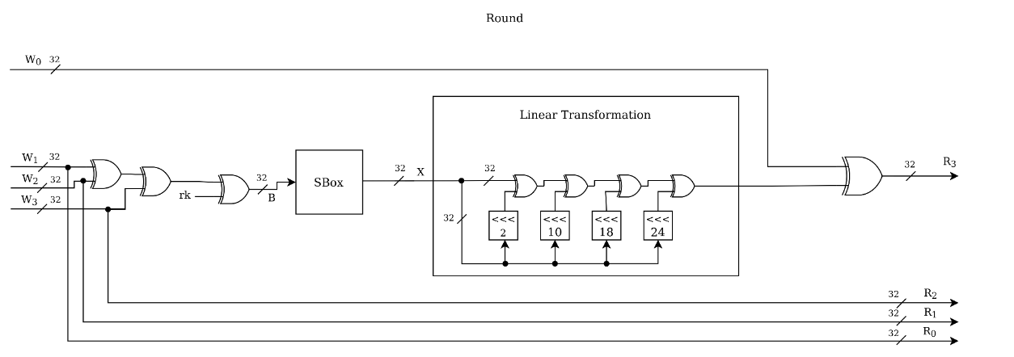
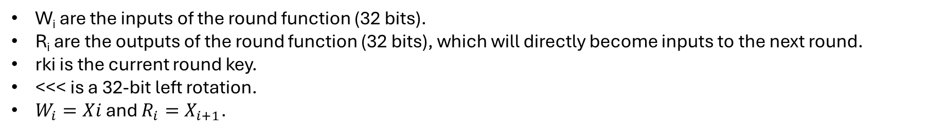
Encryption Structure
W_{i} are the inputs of the round function (32 bits).
R_{i} are the outputs of the round function (32 bits), which will directly become inputs to the next round.
rki is the current round key.
<<< is a 32-bit left rotation.
$W_{i}=Xi$ and $R_{i}=X_{i+1}$.
$$X_{i+4}=X_{i}⊕T(X_{i+1}⊕X_{i+2}⊕X_{i+3}⊕{rk}_{i})$$

Slide 4
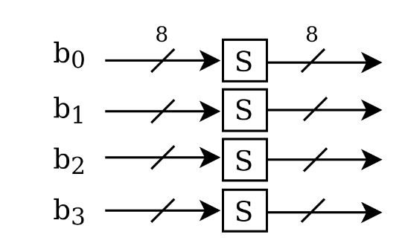
Nonlinear Transformation: S-box
The input to the S-Box is a 32-bit word.
It is divided into four bytes: B = (b0, b1, b2, b3)
Each byte passes independently through the SM4 S-box.
The results are combined again into a 32-bit word.

Slide 5
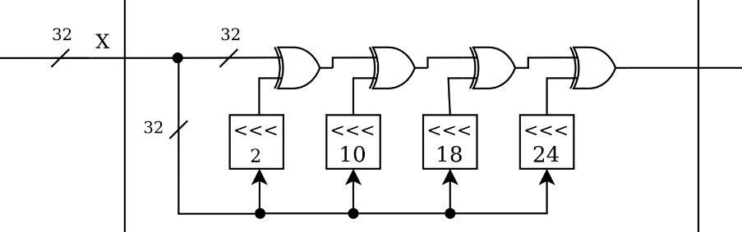
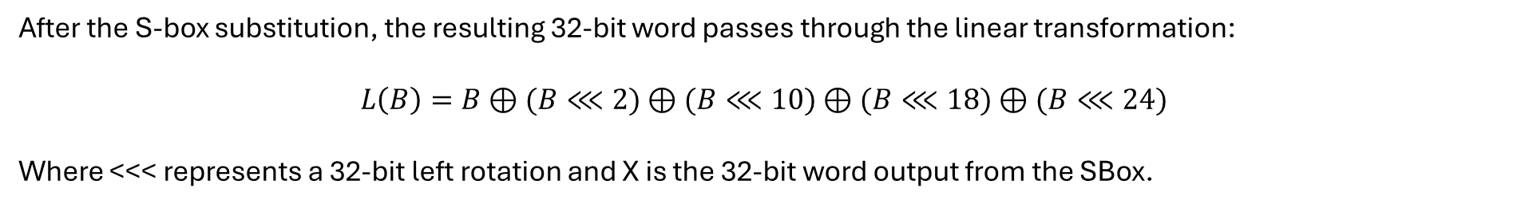
Linear Transformation
After the S-box substitution, the resulting 32-bit word passes through the linear transformation:
$$L\left(B\right)=B⊕(B⋘2)⊕(B⋘10)⊕(B⋘18)⊕(B⋘24)$$
Where <<< represents a 32-bit left rotation and X is the 32-bit word output from the SBox.

