Slide 1


SM4 Block Cipher
ShangMi 4
Guilherme Martins Specht
Lucas Dutra Luza
PFE – MEA5
Polytech Montpellier
STMicroelectronics

Slide 2
SM4 at a Glance
Block length: 128 bits.
4 words with 32 bits.
Key length: 128 bits.
Rounds: 32 rounds.
Symmetrical.
Key expansion algorithm an algorithm that transforms the cipher key into round keys.
S-Box: a permutation with 8-bit input and 8-bit output, represented as 𝑆𝑏𝑜𝑥(·).
Secret Key (128 bits)
SM4
PlainText (128 bits)
CipherText (128 bits)

Slide 3
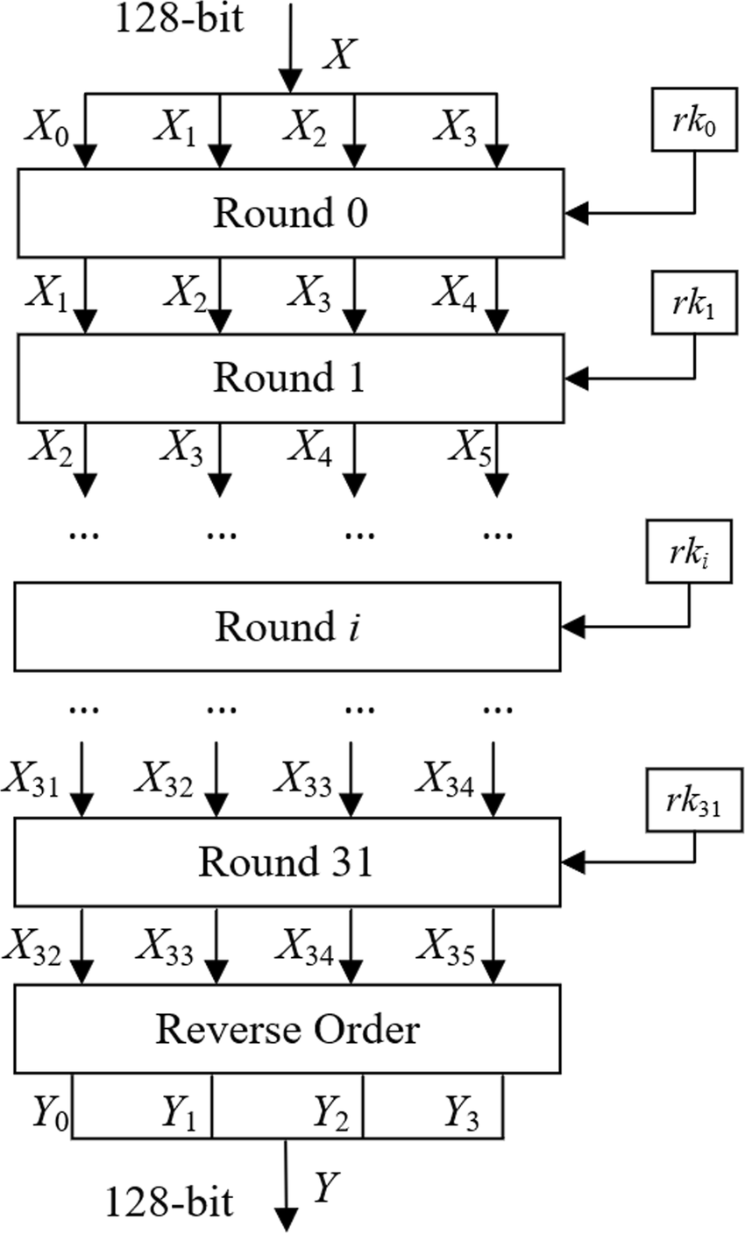
Encryption Structure
Xi+4 = Xi XOR T(Xi+1 XOR Xi+2 XOR Xi+3 XOR rki)
Xi represents a 32-bit state word.
rki is the 32-bit round key for round i.
XOR is the bitwise exclusive-OR operation.
T() is the SM4 nonlinear transformation.

Slide 4
The T Transformation
T(B) = L(tau(B))
tau() is the nonlinear S-box transformation.
L() is the linear transformation.
Input
Nonlinear transformation
S-box
Linear transformation L
Output

Slide 5
Nonlinear Transformation: S-box
The input to T() is a 32-bit word.
It is divided into four bytes:
B = (b0, b1, b2, b3)
Each byte passes independently through the SM4 S-box:
b0 ---> S-box ---> S(b0)
b1 ---> S-box ---> S(b1)
b2 ---> S-box ---> S(b2)
b3 ---> S-box ---> S(b3)
The results are combined again into a 32-bit word.
The S-box introduces nonlinearity into the cipher, which is an essential property for cryptographic security.
32 bits input
b0
b1
b2
b3
S()
S()
S()
S()
+
32 bits output

Slide 6
Linear Transformation
After the S-box substitution, the resulting 32-bit word B passes through the linear transformation L.
The encryption linear transformation is:
L(B) = B
XOR (B <<< 2)
XOR (B <<< 10)
XOR (B <<< 18)
XOR (B <<< 24)
where <<< represents a 32-bit circular left rotation.
The combination of the S-box and the linear transformation forms:
T(B) = L(tau(B))
B
+
B <<< 2
B <<< 2
B <<< 2
B <<< 2
L(B)

Slide 7
Complete SM4 Round
A complete round can therefore be expanded as:
Or mathematically:
B = Xi+1 XOR Xi+2 XOR Xi+3 XOR rki
Xi+4 = Xi XOR T(B)
Xi+1
+
Xi+2
Xi+3
+
B
S-Box
rki
tau
Linear Transformation
T(B)
Xi
+
Xi+4

Slide 8
Final Output
After the 32 rounds, the algorithm has generated:
X32, X33, X34, X35
SM4 reverses their order to produce the ciphertext:
Ciphertext = (X35, X34, X33, X32)
X0 X1 X2 X3
Round 0
rk0
...
Round 31
rk31
X32 X33 X34 X35
Reverse order
X35 X34 X33 X32
Ciphertext

Slide 9
Key Expansion
The 128-bit master key cannot be directly used as a single key for every round.
Instead, SM4 generates 32 different round keys.
The master key is initially divided into:
MK0, MK1, MK2, MK3
Four fixed system parameters, called FK, are first applied:
    K0 = MK0 XOR FK0
    K1 = MK1 XOR FK1
    K2 = MK2 XOR FK2
    K3 = MK3 XOR FK3
The following words are then generated recursively.
For each round i:
    Ki+4 = Ki XOR T'(Ki+1 XOR Ki+2 XOR Ki+3 XOR CKi)
    and:
    rki = Ki+4
where:
    CKi is a fixed constant associated with round i.
    T'() is a transformation used specifically for key expansion.

Slide 10
Key Expansion Transformation
The key expansion transformation is similar to the encryption transformation, but uses a different linear operation.
It is defined as:
T'(B) = L'(tau(B))
with:
L'(B) = B
XOR (B <<< 13)
XOR (B <<< 23)
Therefore, it is important to distinguish:
Encryption
T(B) = L(tau(B))
L(B) = B
XOR (B <<< 2)
XOR (B <<< 10)
XOR (B <<< 18)
XOR (B <<< 24)
Key Expansion
T'(B) = L'(tau(B))
L'(B) = B
XOR (B <<< 13)
XOR (B <<< 23)
Both transformations use the same S-box but different linear transformations.

Slide 11
Decryption
One useful characteristic of SM4 is that decryption uses essentially the same round structure as encryption.
The main difference is the order of the round keys.
Encryption uses:
rk0, rk1, rk2, ..., rk30, rk31
Decryption uses:
rk31, rk30, rk29, ..., rk1, rk0
Therefore, the same core implementation can often be reused by reversing the round-key order.

