Slide 1
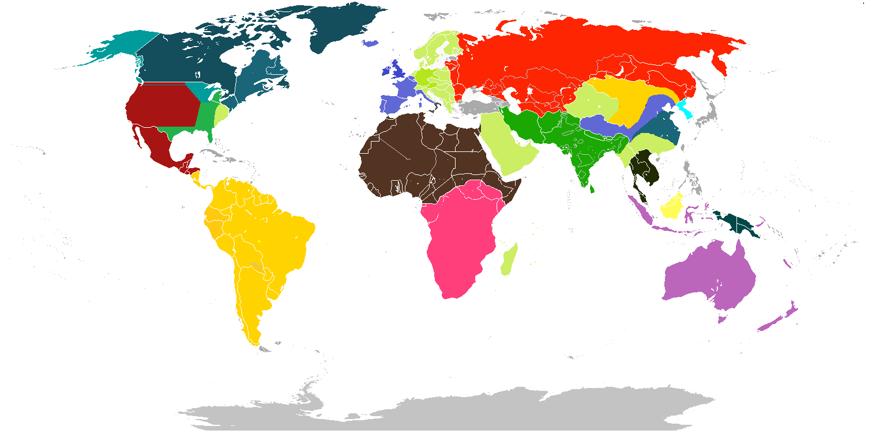
Refugee Info

Slide 2
Who is a refugee ?
A refugee is a person who is outside his or her country of nationality and can't return due to a well-founded fear of persecution because of his or her race, religion, nationality, political opinion, or membership in a particular social group.
At the end of 2013, there were 16.7 million refugees worldwide

Slide 3
Objectives of our project
Refugee Info is the desktop application which may be useful to refugees whose number is large and increasing in recent times.
It will enable refugees to freely search for their relatives and friends whose trail was lost in recent wars (especially in the Middle East).
The main objective is to make searching and contacting easier and more fun.

Slide 4
Authors:
Master : Emina Turković
Developers: Zerina Dubravac
Youssef Aly
Omer Ahmetgić
Aykut Taylan
Tester : Alija Bajramović
International University of Sarajevo ☺

