Slide 1
Introducing the New Super Energy Efficient Freezer
Notes:
Good morning, everyone. Today I'm excited to introduce to you our new super energy-efficient commercial freezer, designed to reduce energy costs and reduce our carbon footprint.

Slide 2

Energy Efficiency
Our new freezer is 50% more energy efficient than traditional freezers
Saves up to $500 on energy bills per year
Notes:
We've designed our new freezer to use less energy than traditional freezers. It's 50% more efficient and can save up to $500 on energy bills per year.

Slide 3
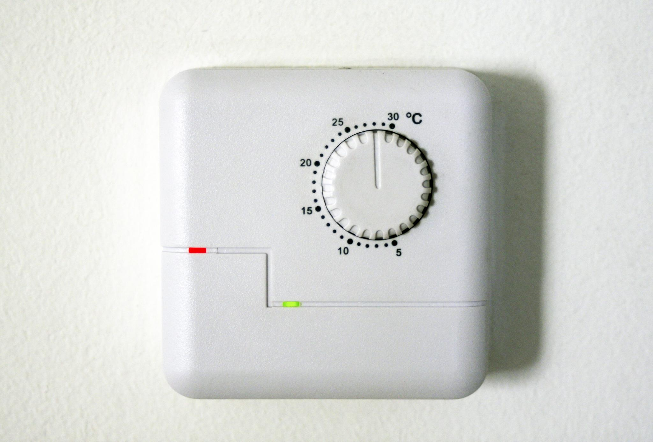
Temperature Control
Consistent temperature control to keep food fresh
Smart temperature sensors to prevent overcooling
Notes:
Our new freezer has precise temperature control to keep food at the perfect temperature. It also has smart temperature sensors that prevent overcooling and ensure that your food stays fresh for longer.

Slide 4
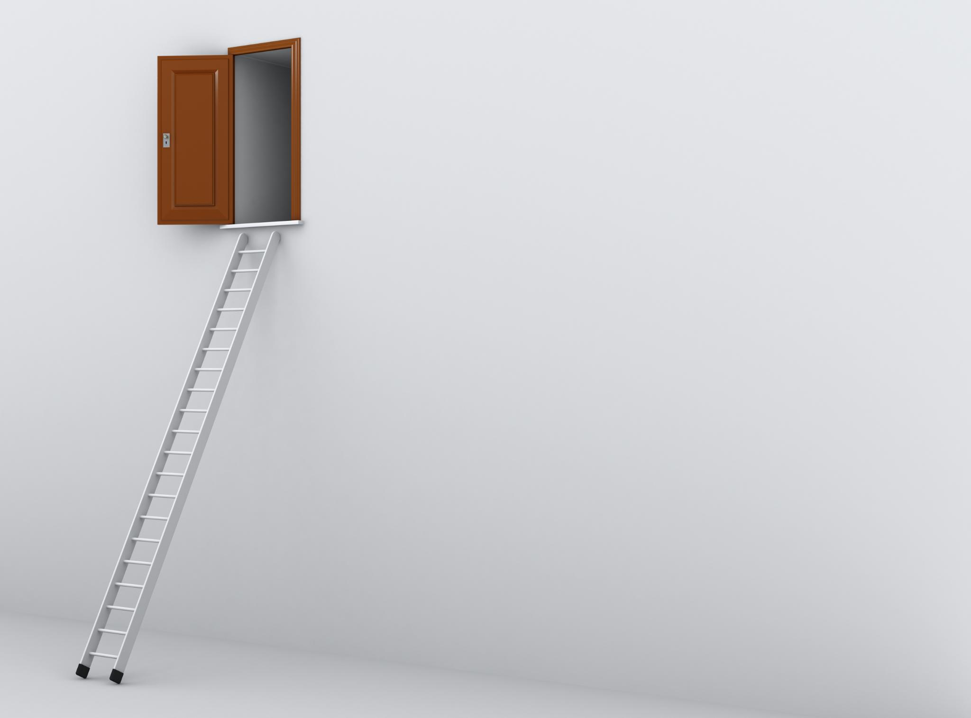
Space-Saving Design
Compact design to fit any kitchen space
Adjustable shelves for customization
Notes:
The new freezer is designed to fit in any kitchen space. Its compact design ensures that it won't take up too much space in your kitchen. Plus, it comes with adjustable shelves that allow you to customize the space to your needs.

Slide 5

Sustainability
Reduces Sara's Burgers carbon footprint
Uses R290 refrigerant with low global warming potential
Notes:
Our new freezer contributes to sustainability and reduces Sara's Burgers carbon footprint. It uses R290 refrigerant with low global warming potential, which is an environmentally friendly alternative to traditional refrigerants.

Slide 6

Cost Savings
Saves money on energy bills
Reduces food waste and spoilage
Notes:
Our new freezer is designed to save you money. It reduces energy costs and also helps reduce food waste and spoilage, which can lead to even more savings. Investing in our new freezer is a smart choice for your business.

