Slide 1
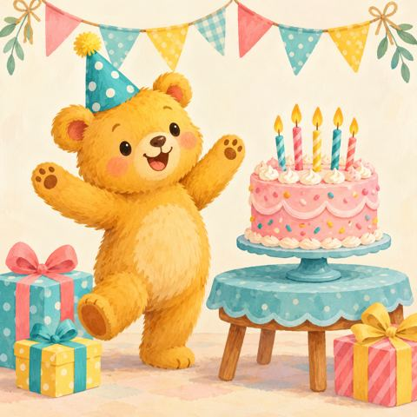
One more, one less
It’s Teddy’s birthday!
Let’s help with the party.
Find one more.
Find one less.
Year 2 Mathematics
1 / 8
Notes:
Learning intention: find one more and one less than numbers from 0 to 20, using objects and neighbouring numbers. Ask pupils to show one finger. Each change will be exactly one. The cover is a story illustration; use the separate accurate counting models on later slides.

Slide 2

One more balloon
Teddy has 5 balloons.
Add 1 more. How many now?
+
5 + 1 = 6
One more is the next number.
2 / 8
Notes:
Count the five balloons together. Ask pupils to predict the total before counting all six. Point to the separate balloon: exactly one has been added. Click once for 5 + 1 = 6. Say: One more than five is six.

Slide 3

One less cupcake
There are 6 cupcakes.
Teddy eats 1. How many are left?
×
6 − 1 = 5
One less is the number before.
3 / 8
Notes:
Count six first. The final cupcake is crossed out to show it has been eaten; count the five that remain. Click for 6 − 1 = 5. Say: One less than six is five. The crossed cupcake remains visible to show the starting quantity.

Slide 4
Birthday number neighbours
Teddy is thinking of 8.
Which number is before? Which is after?
7
8
9
One less
One more
7 comes before 8. 9 comes after 8.
4 / 8
Notes:
Read seven, eight, nine. Ask pupils to find one less than eight and one more than eight. Count back one for less and forward one for more. Click to reveal both labels. Practise orally with 4, then 12. Support with fingers or counters.

Slide 5

One more candle
There are 9 candles for the cake.
Teddy adds 1. What is one more than 9?
+
9 + 1 = 10
Say the next number.
5 / 8
Notes:
Use the nine candles in a row and the separate extra candle. Count on from nine: ten. Click to reveal 9 + 1 = 10. Make explicit that the next number after nine is ten. Do not restart the count unless pupils need support.

Slide 6

One less party present
Teddy has 10 little presents.
He gives 1 away. How many are left?
10 − 1 = 9
×
Count back one from 10.
6 / 8
Notes:
Count the two rows of five presents. The crossed final present has been given away. Ask pupils to count back one from ten. Click to reveal 10 − 1 = 9. Explain that one less than ten is nine.

Slide 7
Your birthday challenges
Write your answers on your whiteboard.
12 balloons: one more is ___
18 cupcakes: one less is ___
1 party bag: one less is ___
13 balloons 17 cupcakes 0 bags
7 / 8
Notes:
Independent check. Read each question aloud. Give thinking time before the click reveals. Answers: 13 balloons, 17 cupcakes, 0 party bags. For one less than one, physically remove the last counter and name zero. Support with counters to 20. Extend: ask pupils to explain without recounting.

Slide 8
Teddy’s party is ready!
One more: count forwards 1.
One less: count backwards 1.
One more than 19 is ___
One less than 20 is ___
20 and 19. Happy birthday, Teddy!
8 / 8
Notes:
Ask children to complete the final two statements and explain the direction of the count. Click for answers 20 and 19. Revisit any children who count in the wrong direction. Finish by asking a partner for one more or one less than a number of their choice from 1 to 19.

