Slide 1
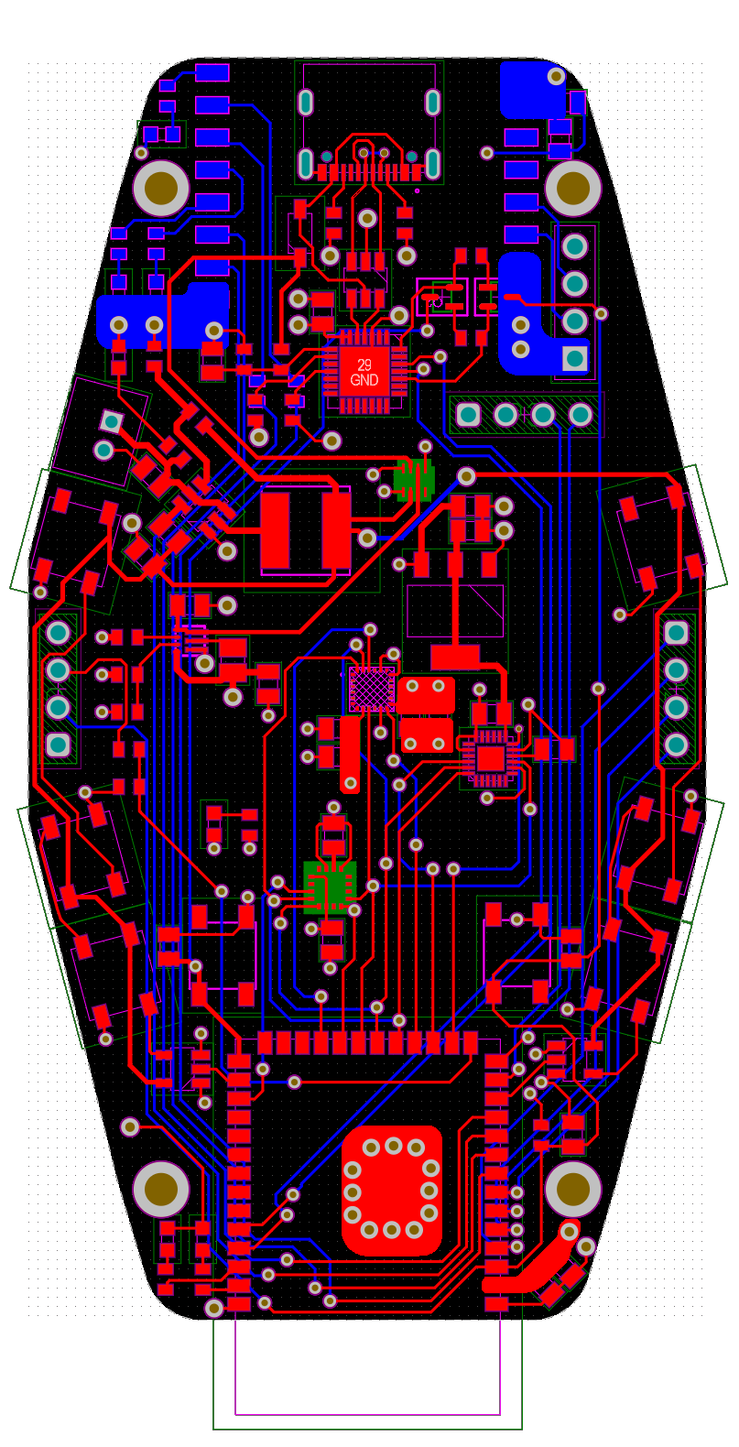
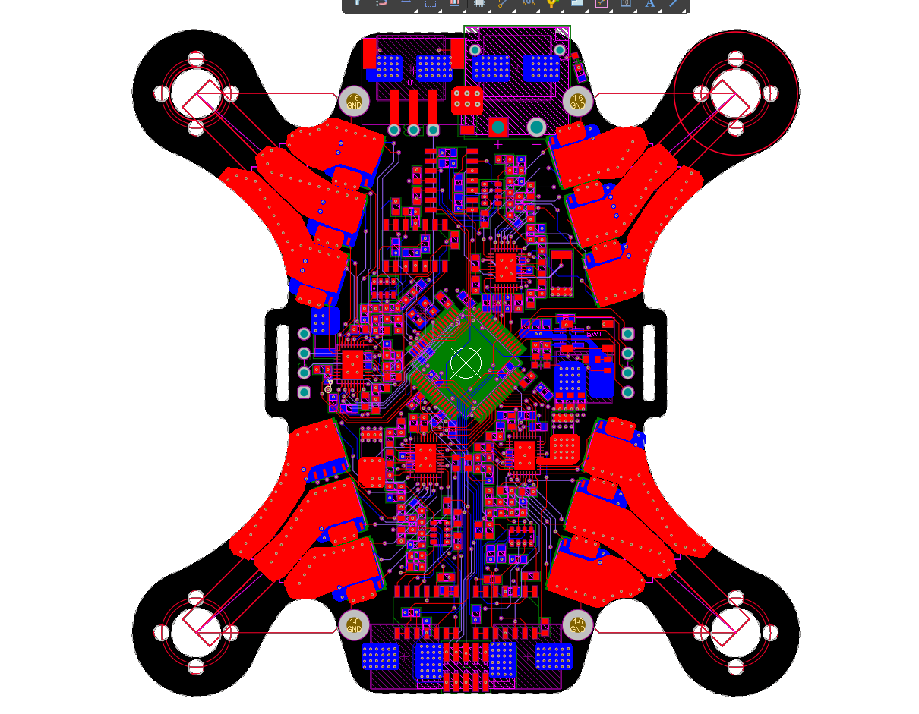

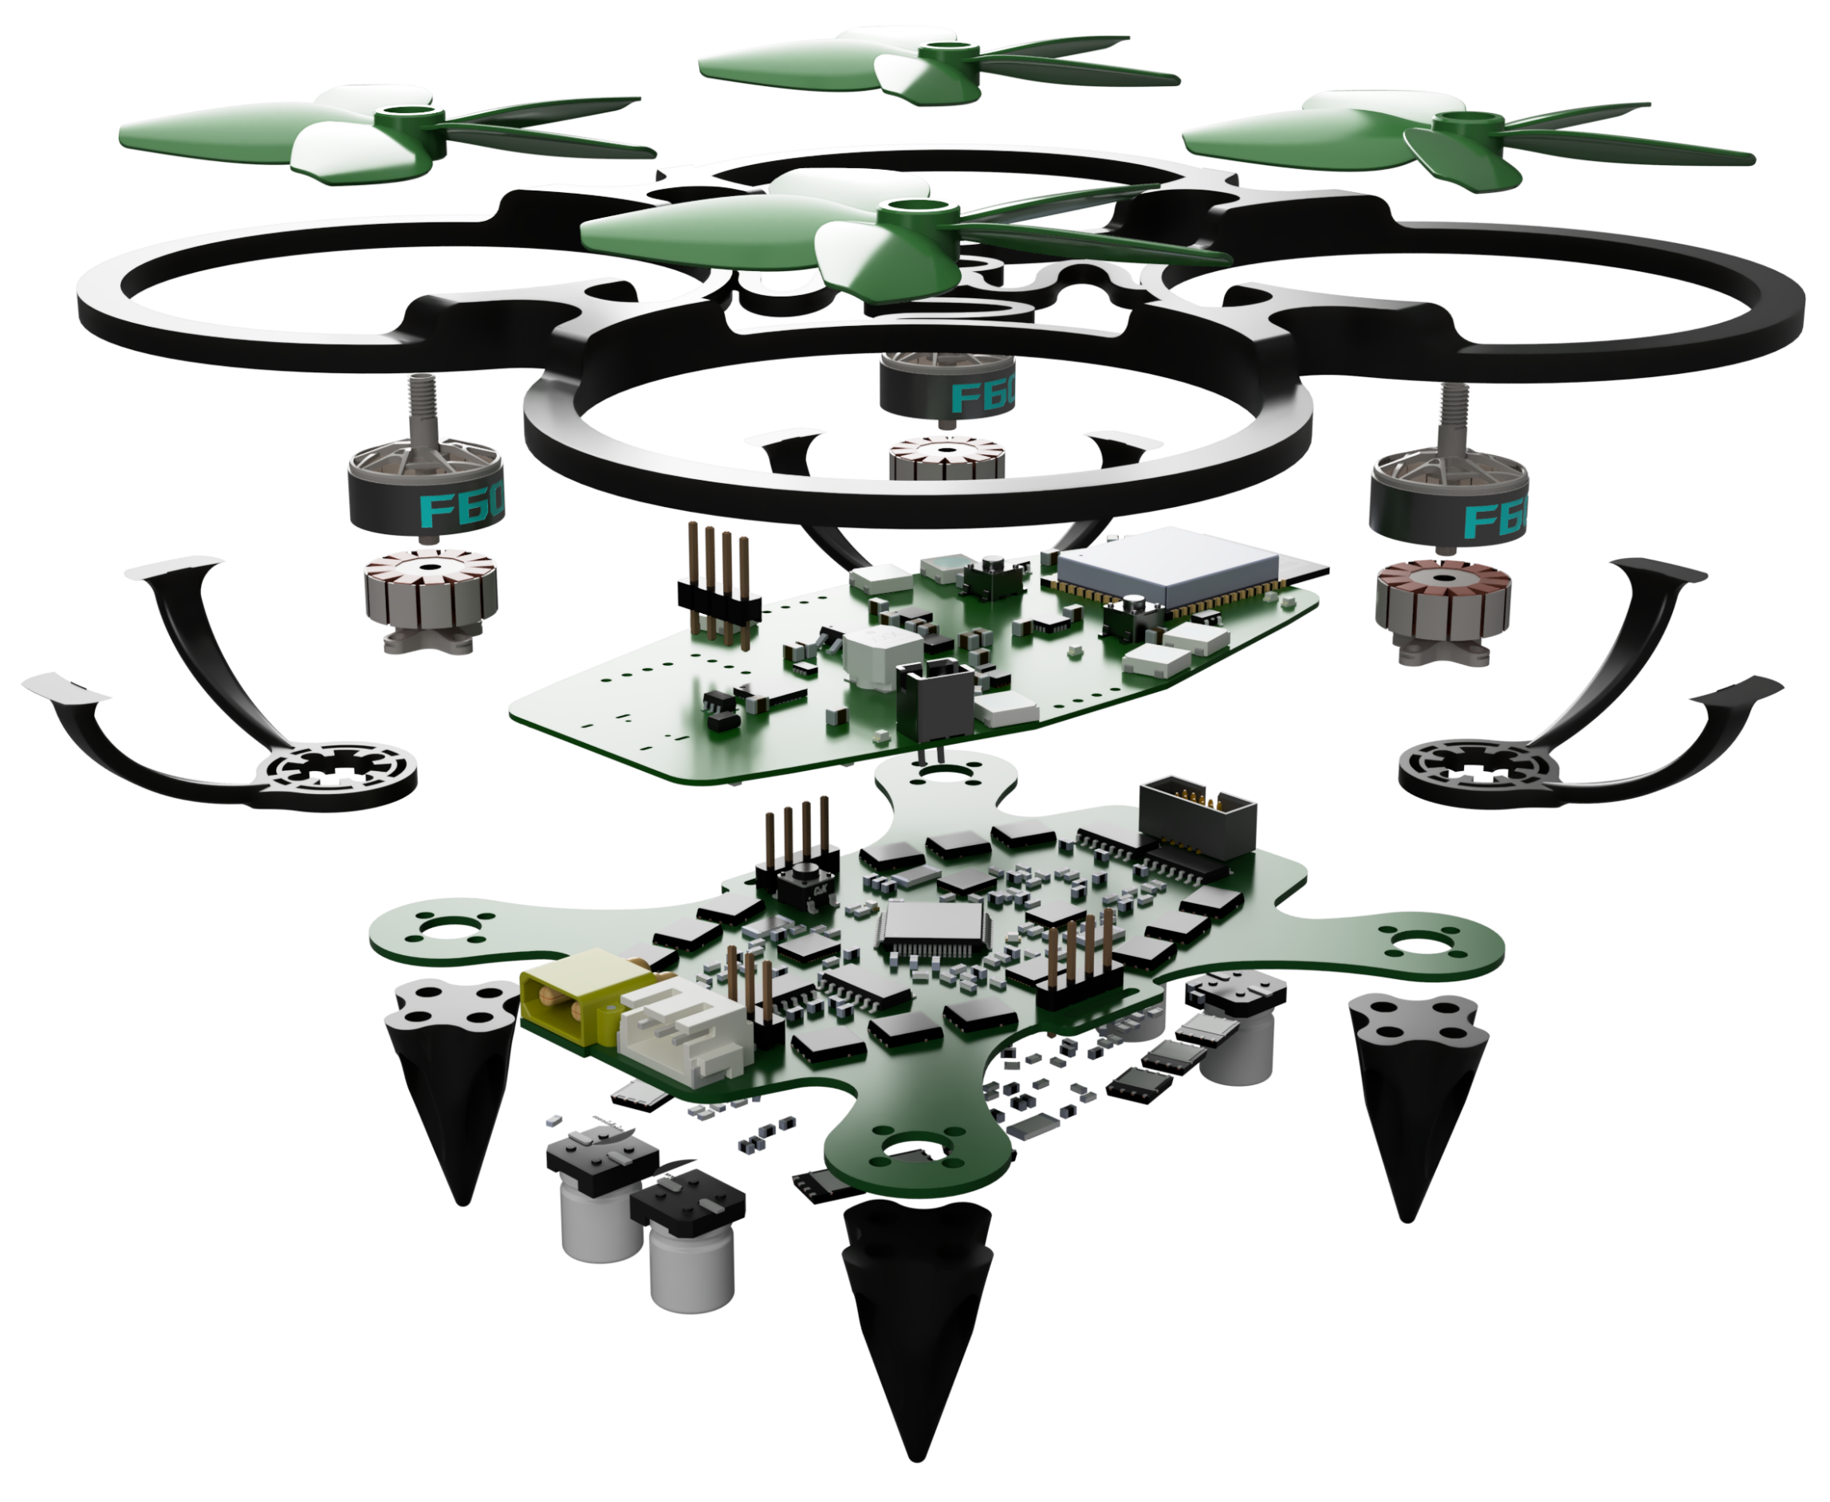
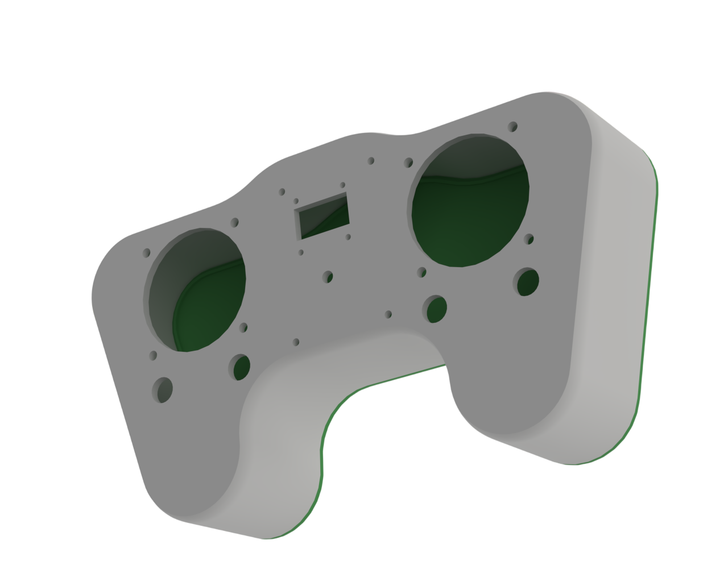
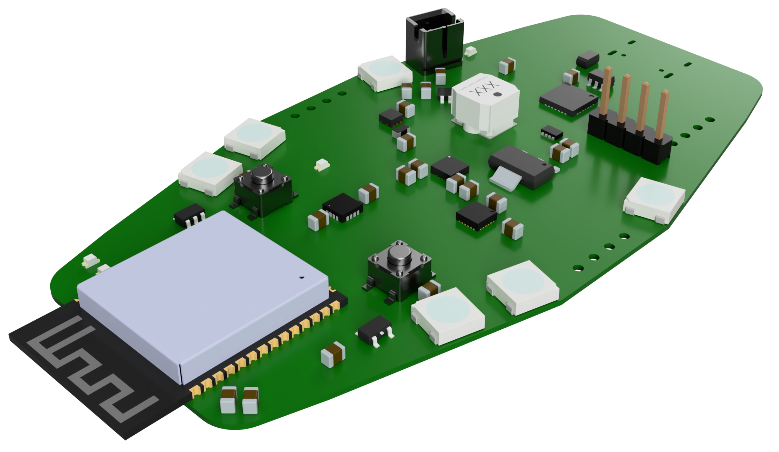
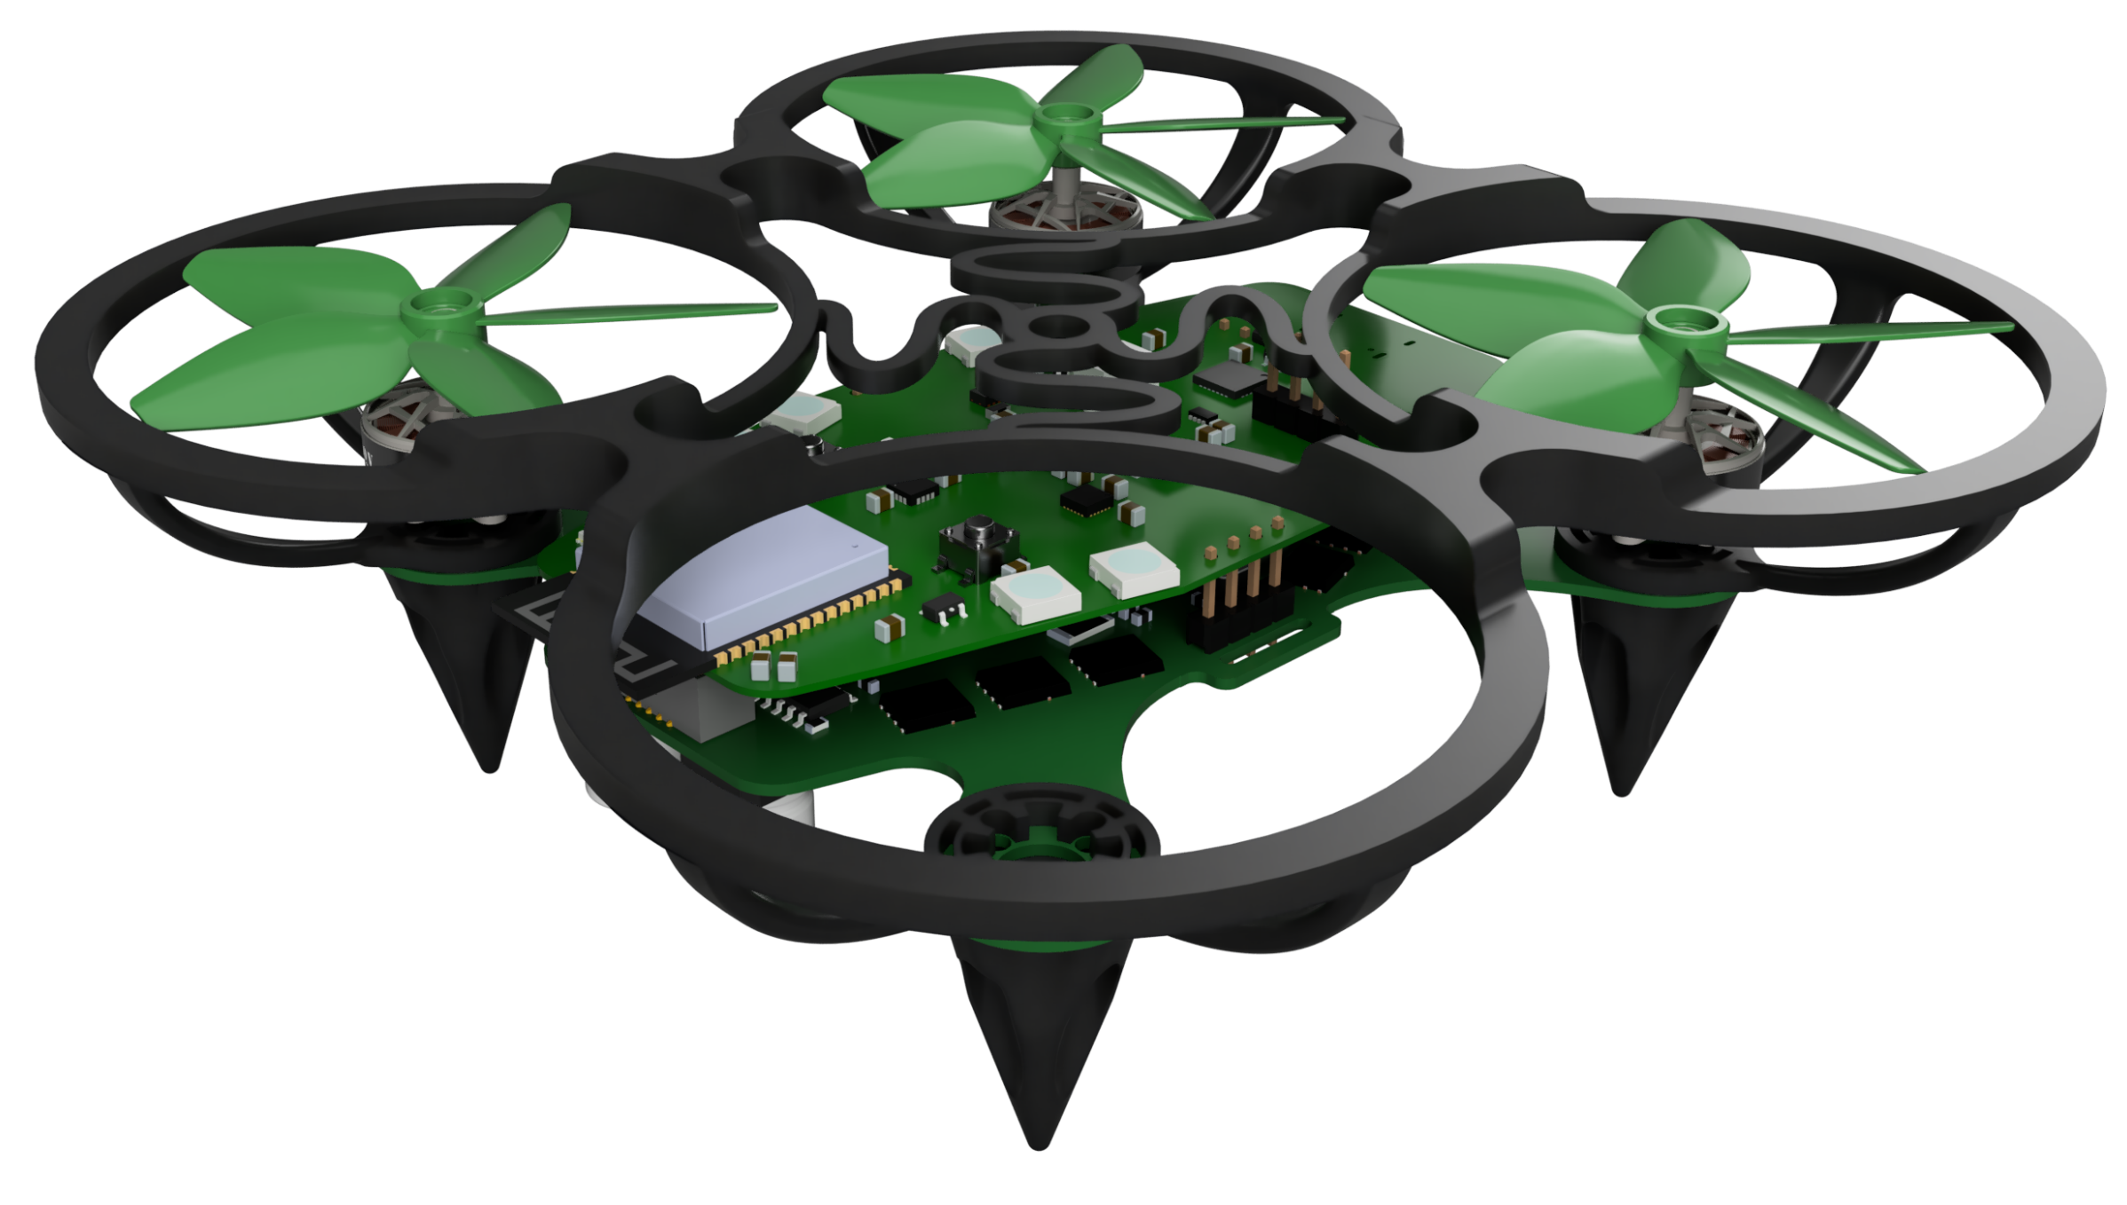
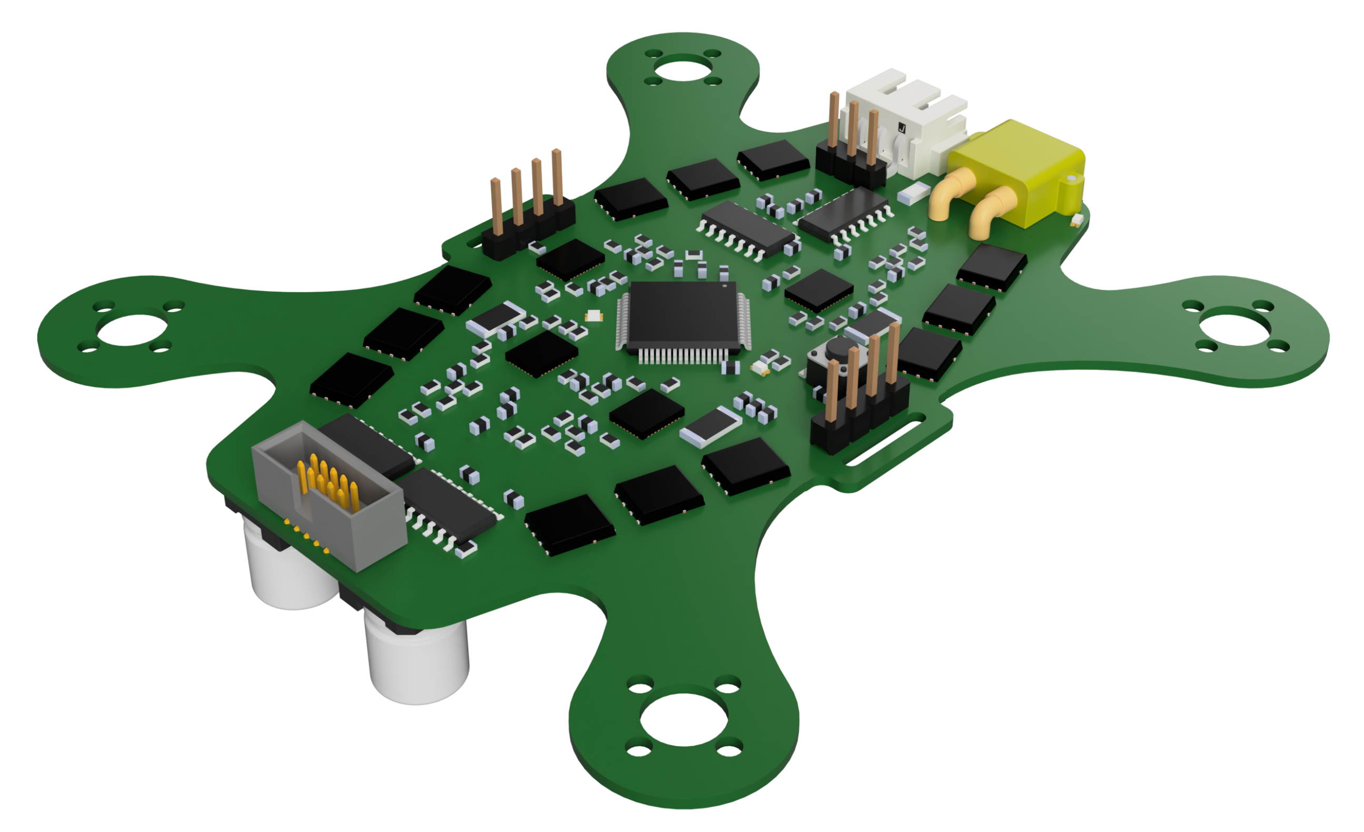
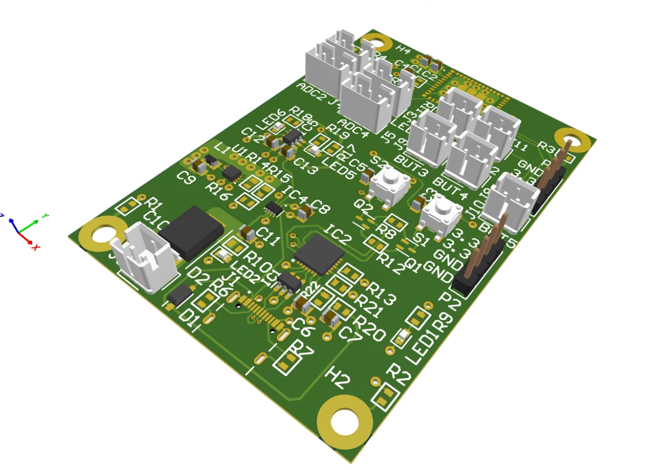
SPECIFIC DYNAMICS
HOOD RESEARCH
DEPARTMENT
January-April 2026
F-17 Humanitarian Hummingbird
Chloe Fulbrook Ethan Sam Khai Huynh Vikram Procter Caleb Garcia Minh Do
Problem Statement
Testing & Results
No sub-250g, modular, affordable microdrone exists on the market. Addresses that gap through an adaptable platform for surveying and UAV applications.
7 custom PCBs. Over 3000 lines of code. Achieves stable control for ~5min flight times. Set up for modular development and autonomous control expansions.
Flight Controls
Mechanical Design
Wirelessly communicated flight controls drive a PID loop utilizing a Mahony filter to achieve flight
Thrust to weight ratio up to 2.32 and light weight construction means incredible maneuverability.
attitude targets. Specifies motor speeds using 50Hz PWM to ESCs.
Brushless DC Motor Driver
Communications
Centered around a STM32f4 running bare-metal C firmware to control four brushless DC motors via 12 half bridges.
The controller relays two bi-axial gimbal controls, four buttons, and one arming switch to the flight control board via ESP-NOW. Implements fault disable
safety logic and
allows a range of
over 20m.
Sensorless interrupt driven trapezoidal six-step commutation allows for efficiencies over 50% better than off-the-shelf alternatives.
ENEL 400 | Electrical Engineering - Schulich School of Engineering

