Slide 1
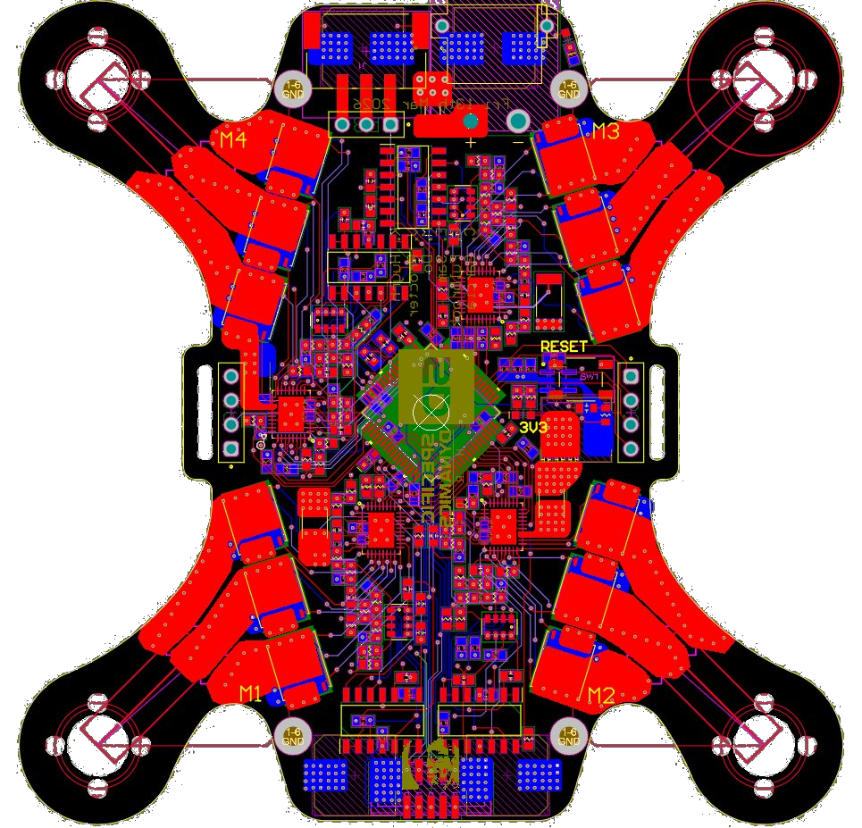

HOOD RESEARCH DEPARTMENT
SPECIFIC DYNAMICS
A Higher Purpose.
Notes:
ETHAN

Slide 2
HOOD RESEARCH DEPARTMENT
Commercial micro-drones: $300+ with closed ecosystems
Limited customization for specialized tasks
Long development timelines for purpose-built platforms
No affordable, modular, hackable sub-250 g platform exists
THE PROBLEM
Notes:
ETHAN

Slide 3
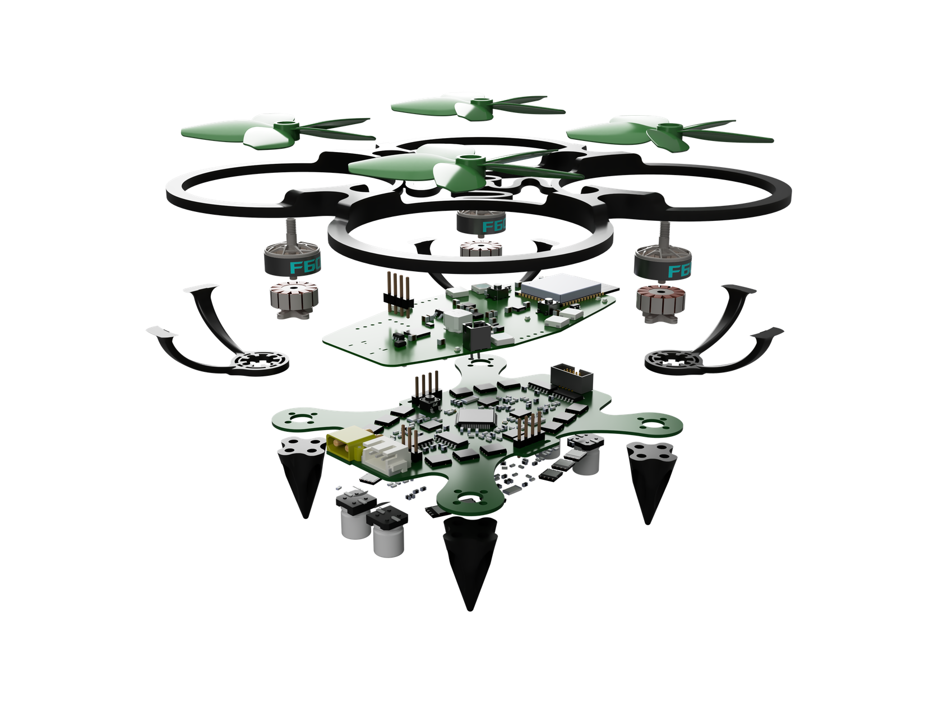
HOOD RESEARCH DEPARTMENT
F17-HUMANITARIAN HUMMINGBIRD
A 145 g microdrone platform where the printed circuit board itself serves as the structural airframe, eliminating the need for a traditional frame. The system integrates a custom brushless motor controller, PID-stabilized flight controller, and ESP-NOW wireless control link, all designed and built from scratch. The result is a compact, low-cost, and fully modular proof-of-concept platform that can be adapted for general-purpose UAV applications including aerial sensing, imaging, and small payload delivery.
Notes:
ETHAN

Slide 4
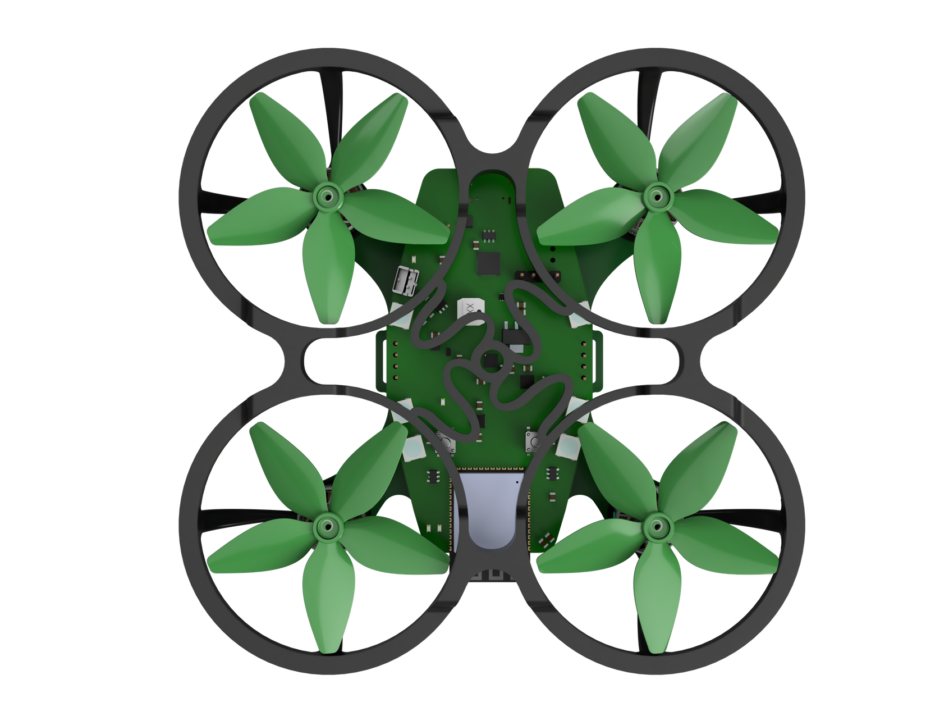
HOOD RESEARCH DEPARTMENT
LET’S SEE THIS SH!T
FLY
Notes:
ETHAN

Slide 5
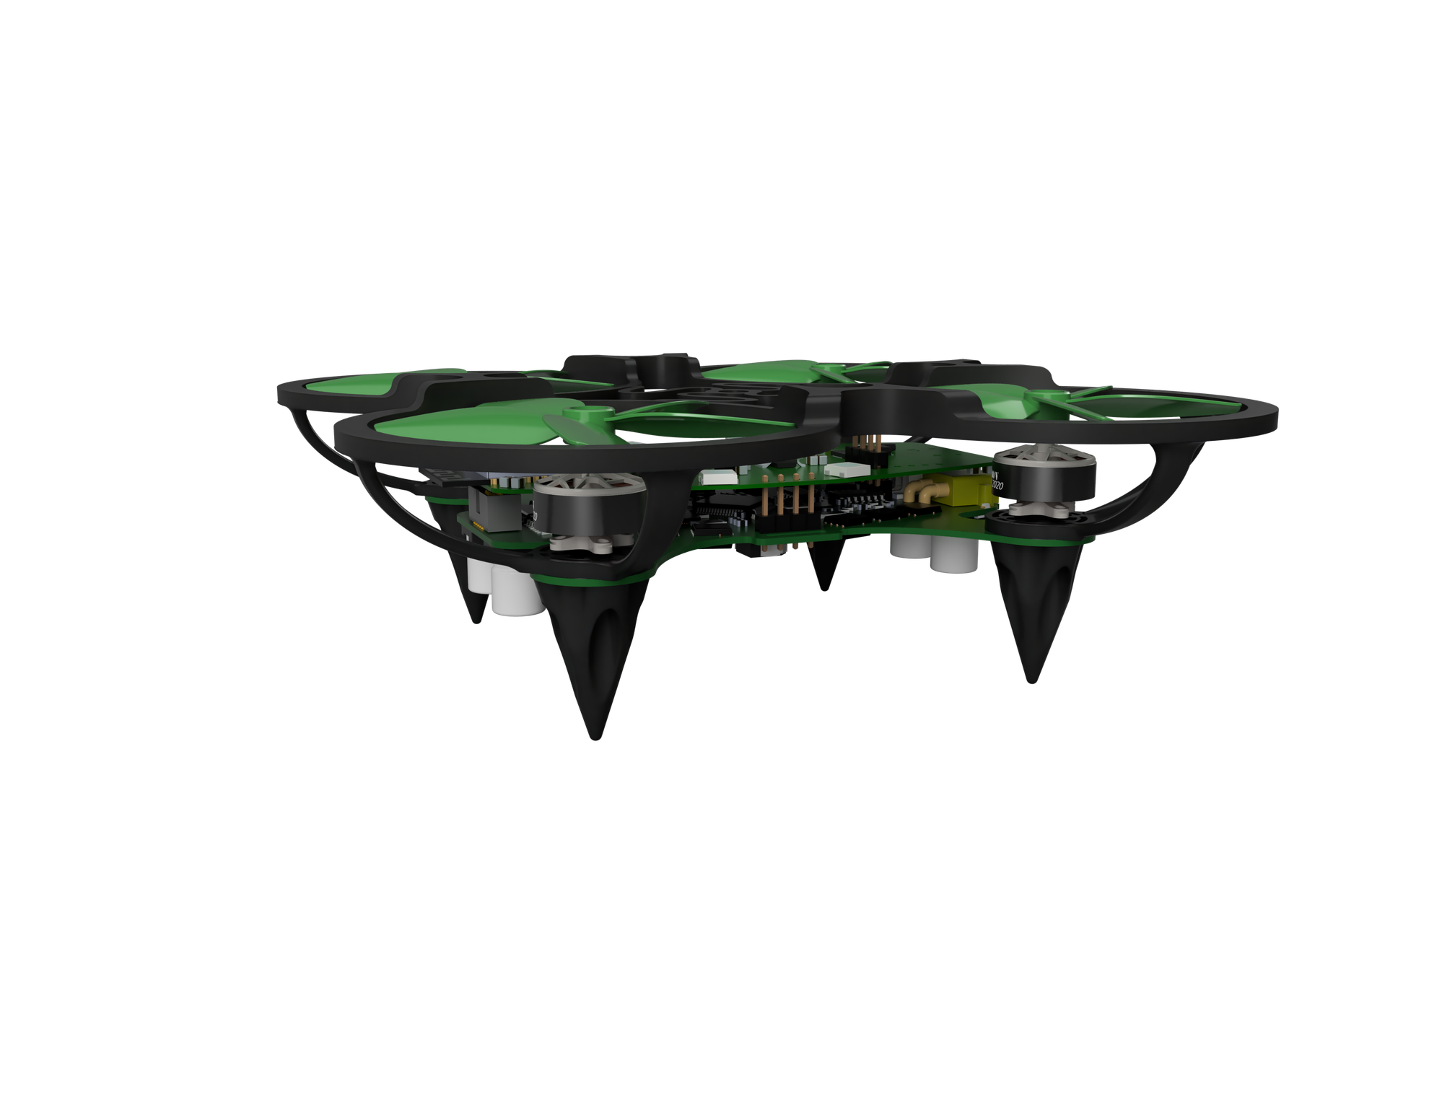
HOOD RESEARCH DEPARTMENT
SYSTEM ARCHITECTURE
Notes:
MINH

Slide 6
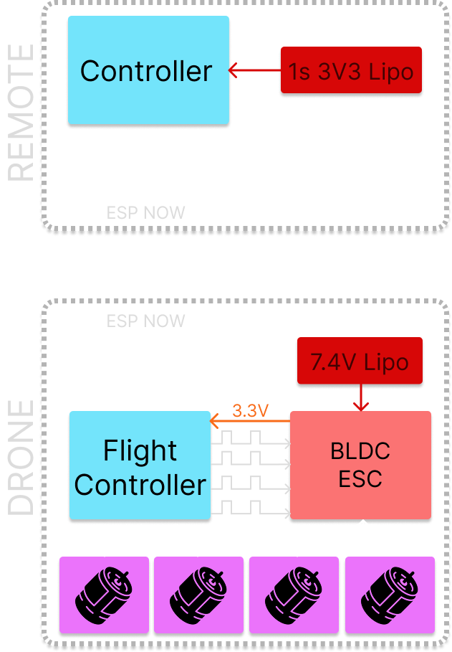
HOOD RESEARCH DEPARTMENT
HIGH-LEVEL SYSTEM OVERVIEW
Notes:
MINH

Slide 7
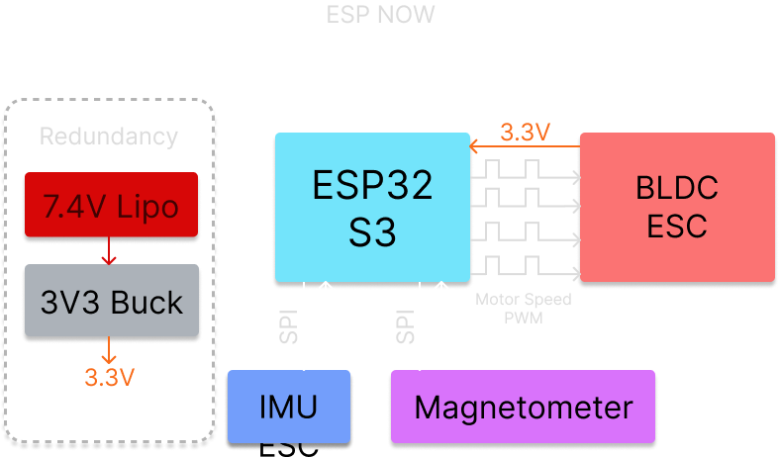
HOOD RESEARCH DEPARTMENT
AVIONICS
FLIGHT CONTROLLER
Notes:
MINH

Slide 8
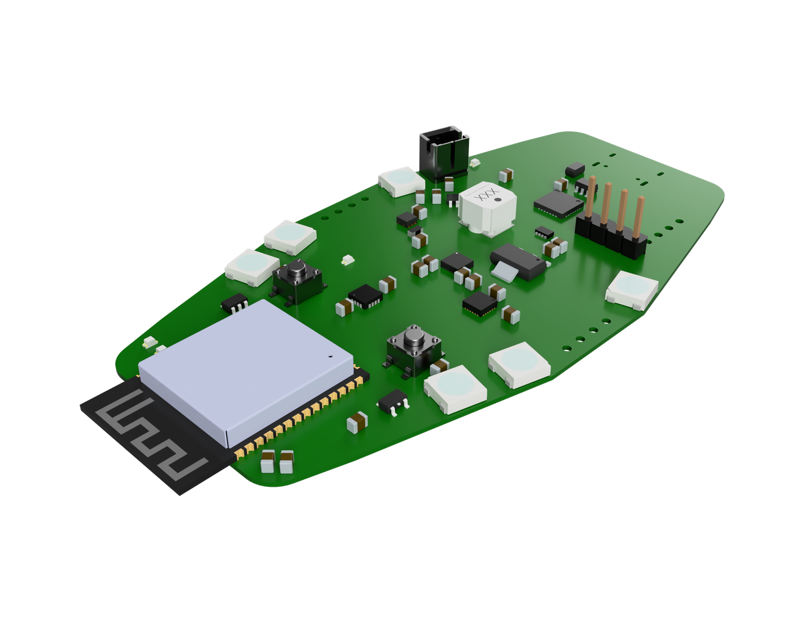
HOOD RESEARCH DEPARTMENT
PID/AVIONICS FLIGHT CONTROLLER
6 cascaded loops - outer angle + inner rate for each axis (roll, pitch, yaw)
1 kHz loop rate
9-axis sensor fusion - Mahony filter (gyro + accel + magnetometer)
Ziegler-Nichols tuned, empirically refined in flight
4-state failsafe - 1 s timeout → motors off → must re-arm
Notes:
CALEB

Slide 9
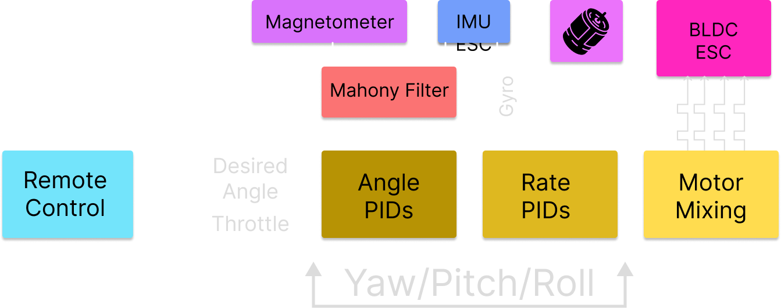
HOOD RESEARCH DEPARTMENT
AVIONICS
FLIGHT CONTROLLER
FIRMWARE
Notes:
CALEB

Slide 10
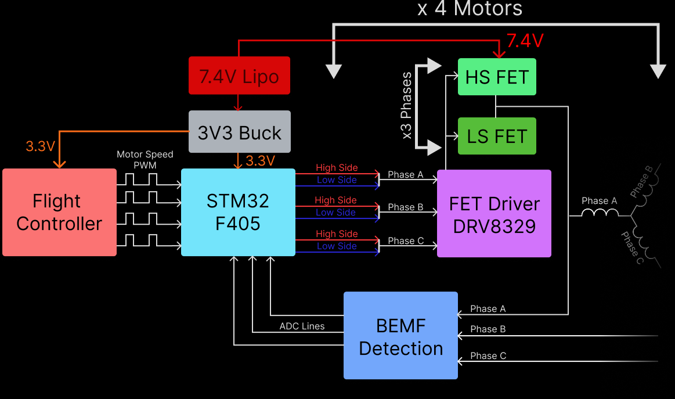
HOOD RESEARCH DEPARTMENT
ELECTRONIC SPEED CONTROLLER
Notes:
VIKRAM

Slide 11
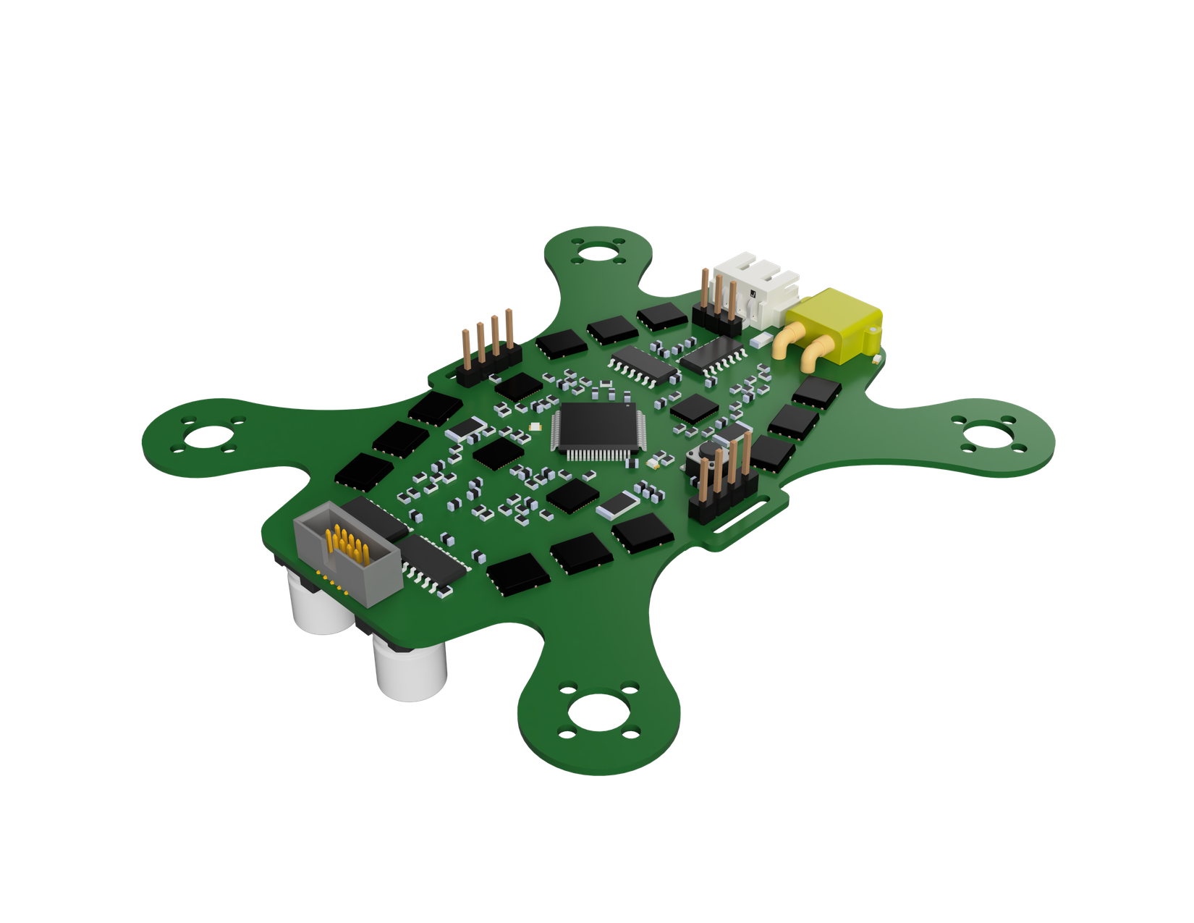
HOOD RESEARCH DEPARTMENT
ELECTRONIC SPEED CONTROLLER
Stall detection
Back EMF Commutation
Over current protection
Motor song indicator
Voltage Regulation
Notes:
VIKRAM

Slide 12
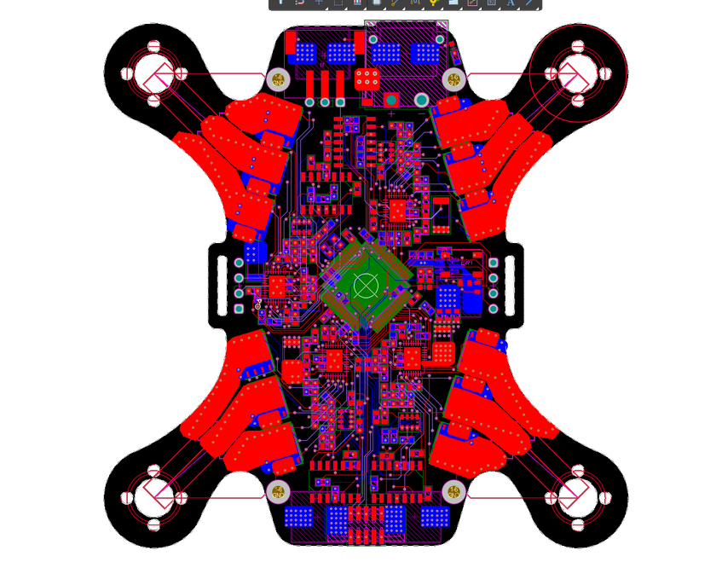
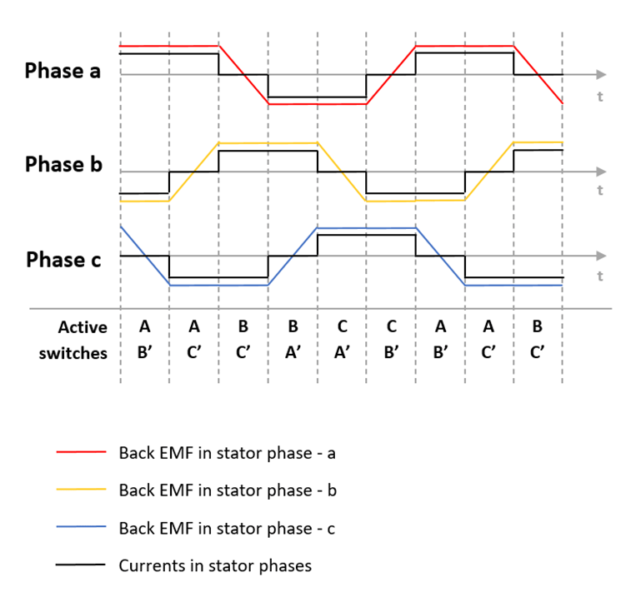
HOOD RESEARCH DEPARTMENT
TRAPEZOIDAL SIX-STEP COMUTATION
Source: MathWorks MATLAB
Notes:
KHAI

Slide 13
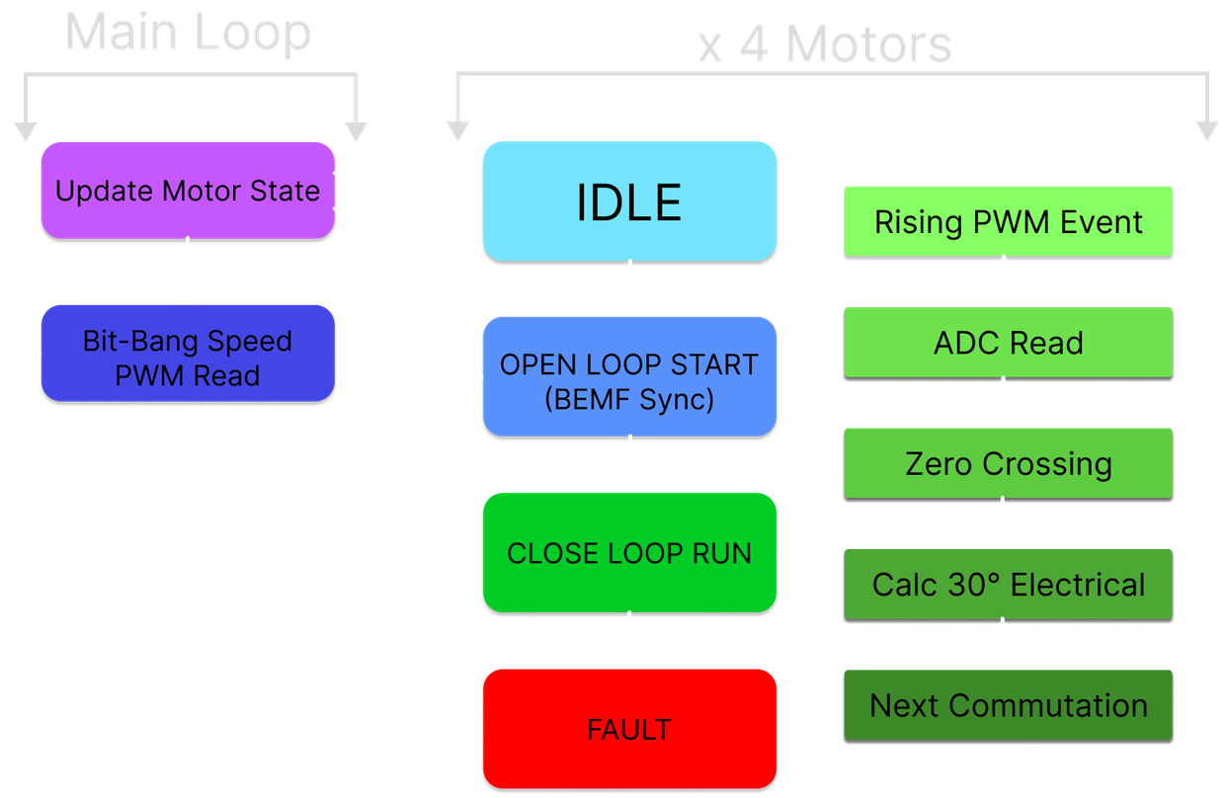
HOOD RESEARCH DEPARTMENT
ESC FIRMWARE
Each motor is generally controlled using as state machine
Main loop updates the motor state, and reads the motor speed PWM sent from the flight controller board
CLOSE LOOP RUN is the spinning state for the motor, relying on back EMF reading for commutation timing
Notes:
KHAI

Slide 14
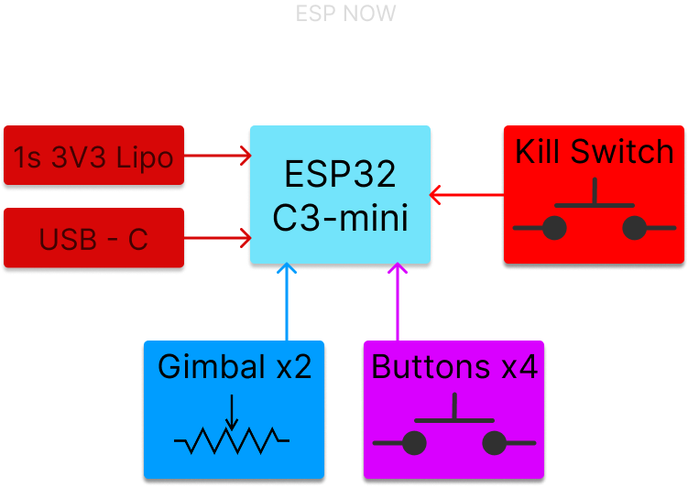
HOOD RESEARCH DEPARTMENT
REMOTE
CONTROL
Notes:
CHLOE

Slide 15
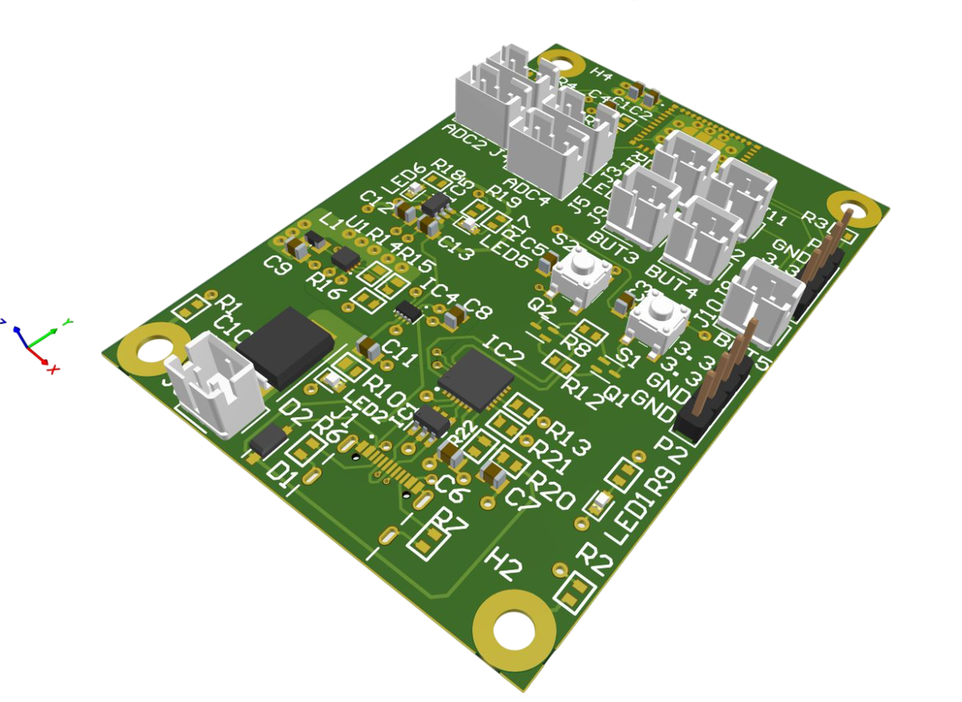
HOOD RESEARCH DEPARTMENT
REMOTE CONTROL
Battery or USB-C Power
Local battery charging and power regulation
ESP32C3-mini for ESP-NOW wireless communication
I2C LCD user interface
Notes:
CHLOE

Slide 16
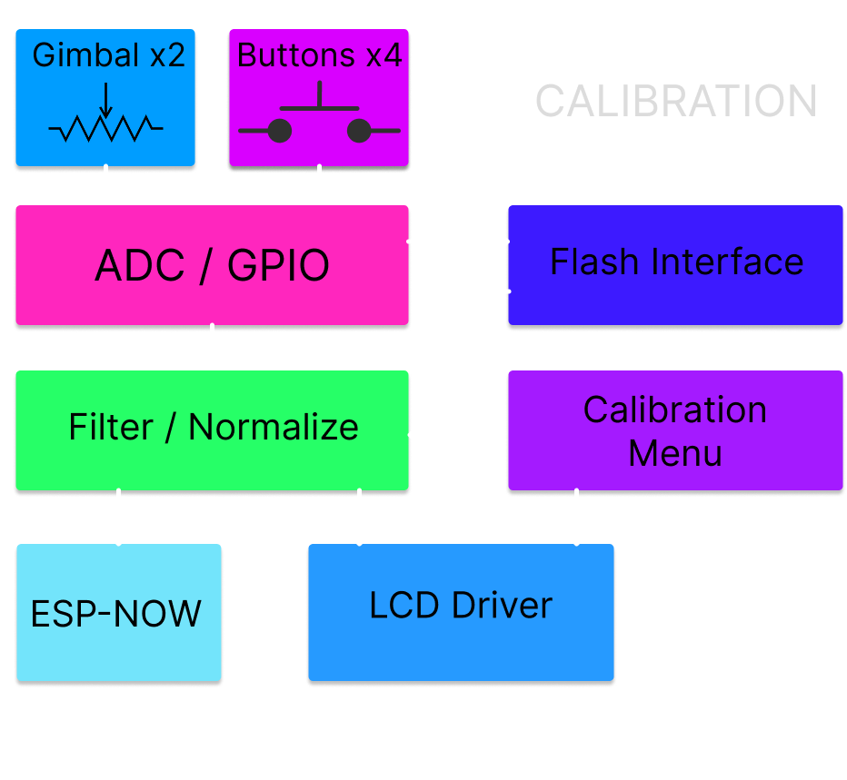
HOOD RESEARCH DEPARTMENT
REMOTE CONTROL FIRMWARE
Stored user interface calibration values
IIR gimbal ADC filtering
ESP-NOW packet queueing and acknowledgement
Notes:
CHLOE

Slide 17
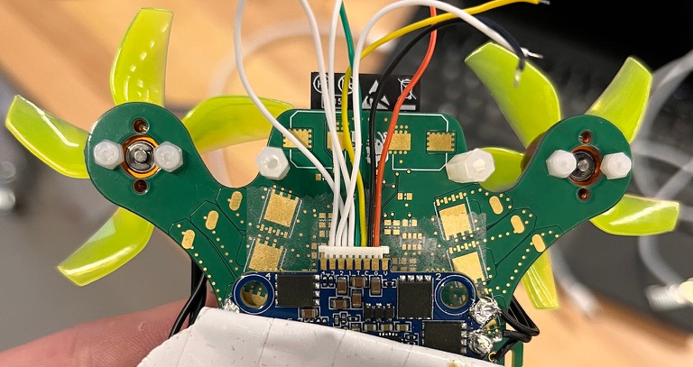
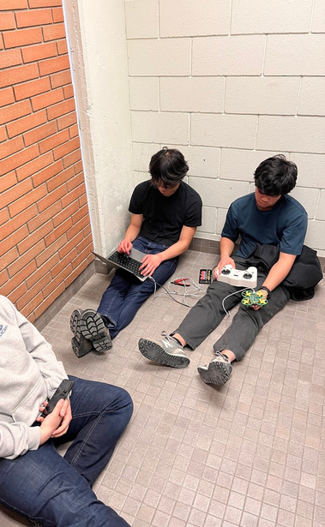
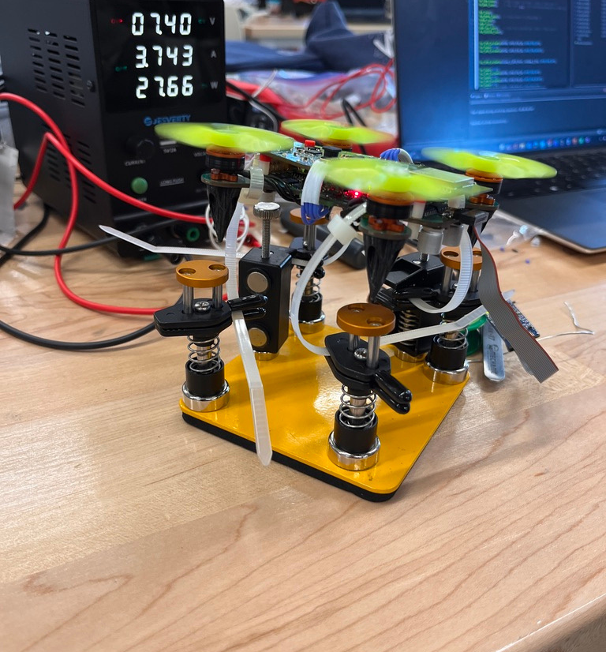
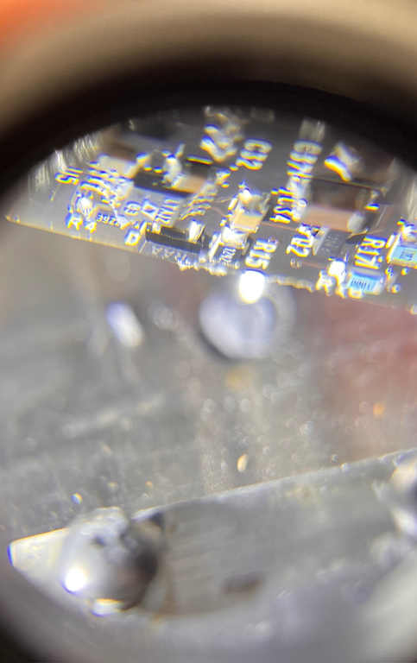
HOOD RESEARCH DEPARTMENT
TESTING AND
VALIDATION
Notes:
ETHAN

Slide 18
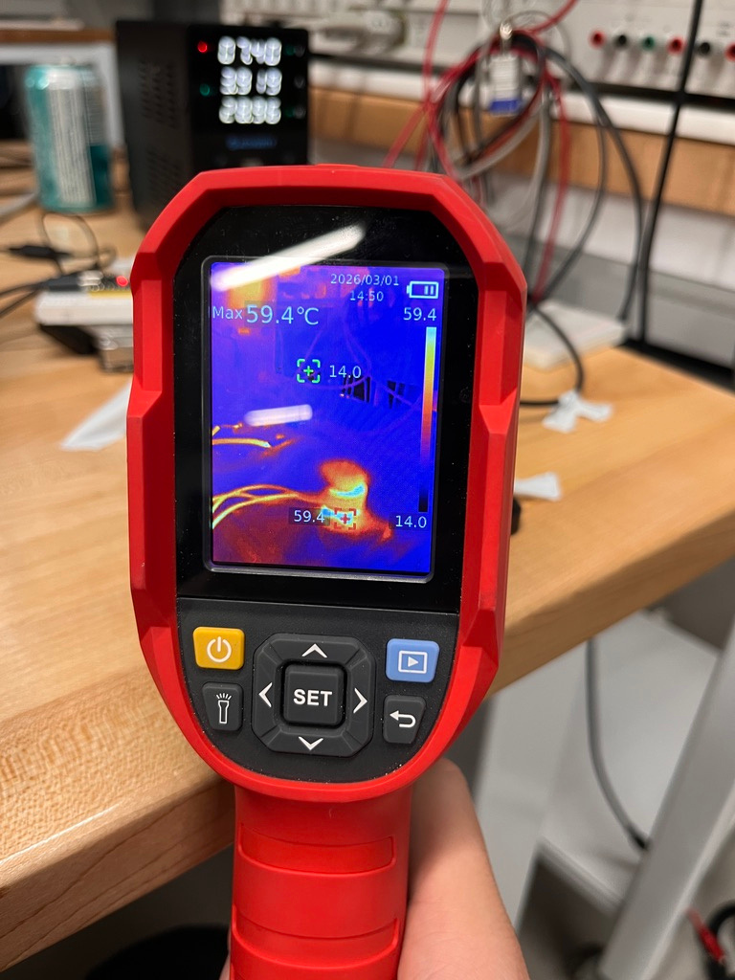
HOOD RESEARCH DEPARTMENT
TEST SUMMARY
20/24 tests passed (6 UWB tests descoped)
1 fail: max throttle current ~18 A exceeds 15 A constraint - hover current (10.4–12 A) is within spec; transient only. BEMF efficiency is near 100%
2 not attempted: bare PCB hover (safety - guards kept on) and add-on module hover (not formally tested)
Custom ESC designed, built, integrated, and flying - outperforms commercial
Drone hovers, communicates, and stabilizes as designed
The prototype passes acceptance testing
Notes:
ETHAN

Slide 19
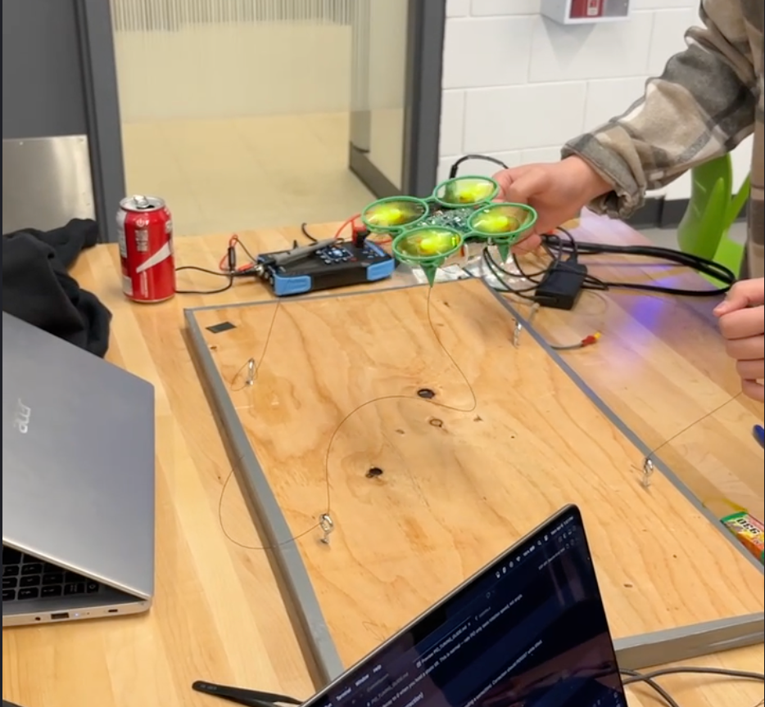
HOOD RESEARCH DEPARTMENT
TESTING AND VALIDATION
Weight: 145 g - 42% under the 250 g limit
Thrust-to-weight: 2.32:1 - exceeds 2:1 target
ESP-NOW range: 3% packet loss at 10 m, no consecutive drops
Hover endurance: 5.5 minutes - nearly 3x the 2-minute requirement
Custom ESC: all bench + flight tests passed, outperforms COTS
PID control loop: confirmed 1 kHz, stable manual hover achieved
Budget: $2,265.23 - under $2,500 cap
Notes:
ETHAN

Slide 20
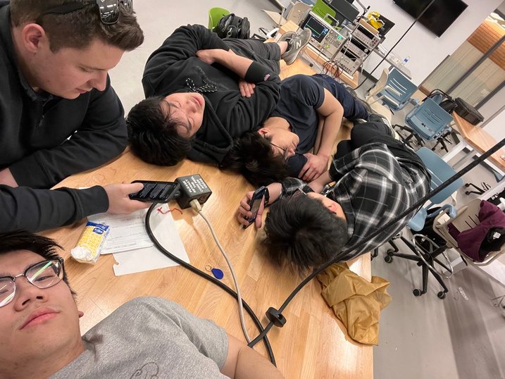
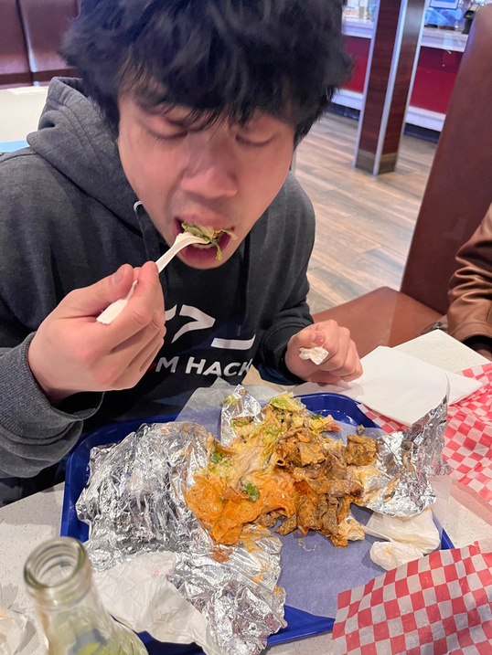
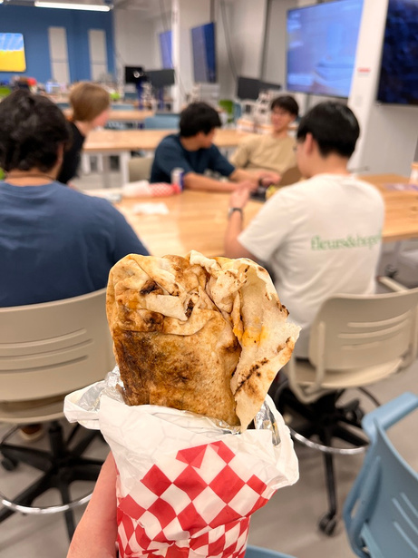
HOOD RESEARCH DEPARTMENT
PROJECT MANAGEMENT AND EXPENDITURES
Notes:
ETHAN

Slide 21
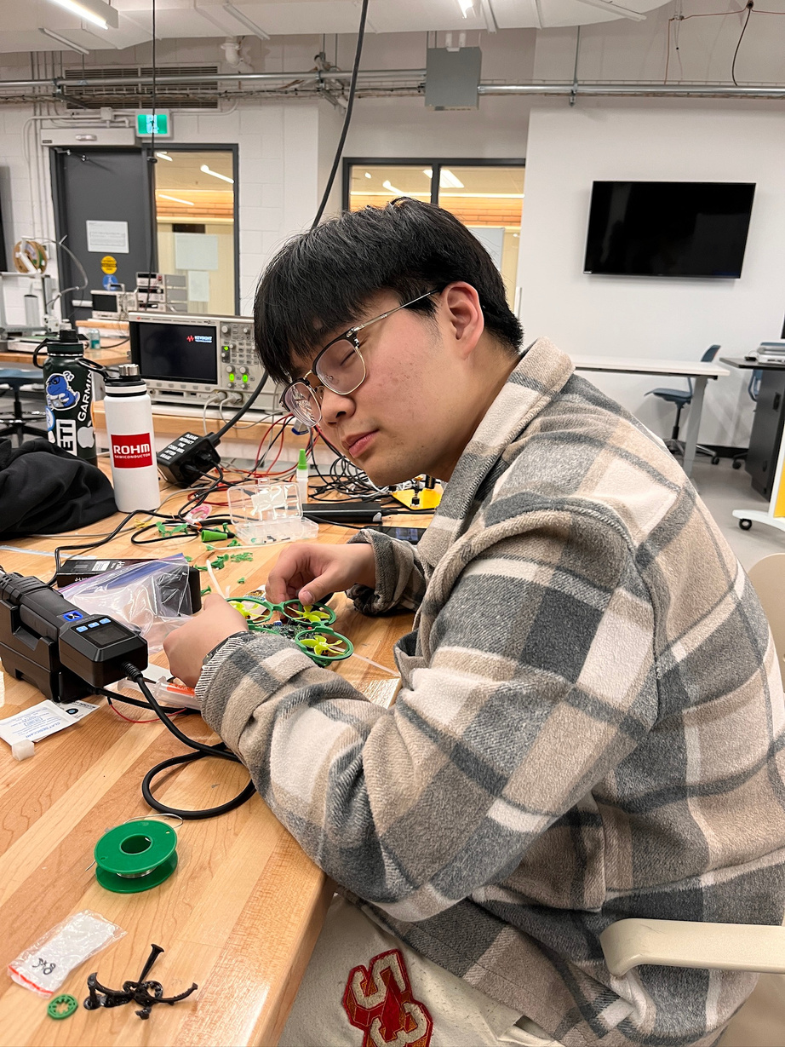
HOOD RESEARCH DEPARTMENT
HOURS AND EXPENDITURES
Total cost for R&D plus final product $2265.23
Hours - ??? (a lot)
Notes:
ETHAN

Slide 22
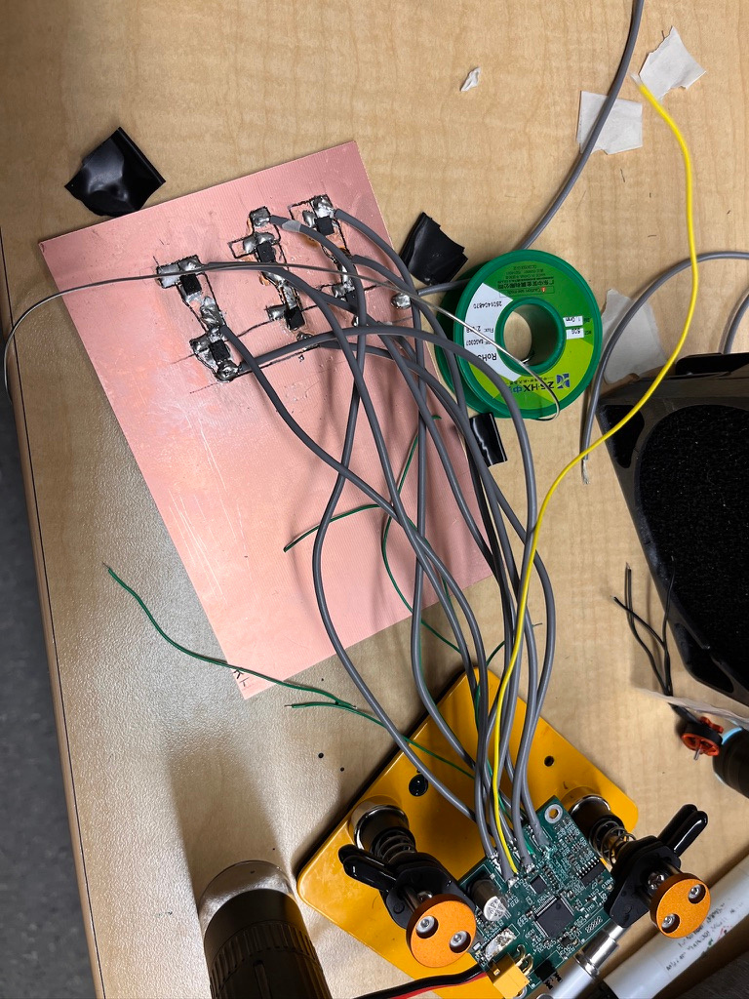
HOOD RESEARCH DEPARTMENT
DEVIATIONS AND CHANGES
ESC test board revision - MOSFET orientation error on v1
UWB descoped - planned as removable from day one
Integration bottleneck - comms code ready at MVP, couldn't test until drone hardware was built
What went faster than planned
Firmware integration - clean architecture made modules slot together easily
PID implementation - strong upfront research accelerated development
Notes:
ETHAN

Slide 23
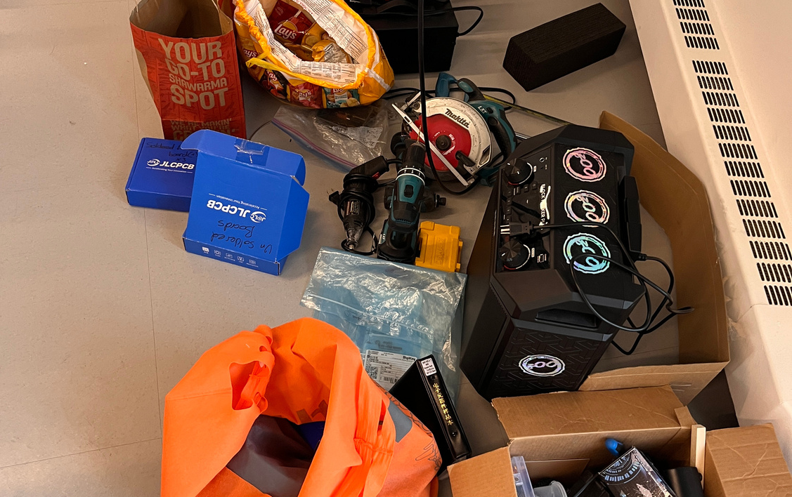
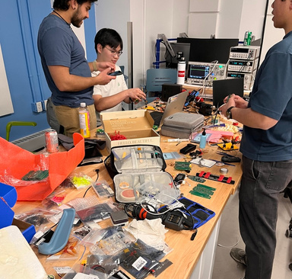

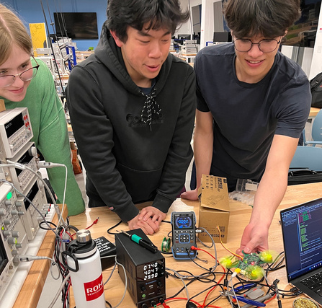
HOOD RESEARCH DEPARTMENT
LESSONS LEARNED
Notes:
ETHAN

Slide 24
HOOD RESEARCH DEPARTMENT
LESSONS LEARNED
Engineering Lessons
Plan for at least one board respin - your first PCB will have errors
Test on final hardware - dev board tuning doesn't transfer
Invest in software architecture early - clean interfaces made integration fast
Build redundancy + ORDER EXTRA - our backups had backups
Team-Work Lessons
Good Git management is crucial - 6 people, multiple branches and discipline kept us sane
BOM management across 7 boards is chaos - overlapping components, double-orders, lost parts.
Scope stretch goals as removable from day one - UWB dropped cleanly when we needed to
Documentation always takes longer than you think - plan for it, don't leave it to the last week
Notes:
ETHAN

Slide 25
HOOD RESEARCH DEPARTMENT
LESSONS LEARNED
“When I breathe in the plastic, my head hurts for some reason”
Minh Do
Notes:
ETHAN

Slide 26
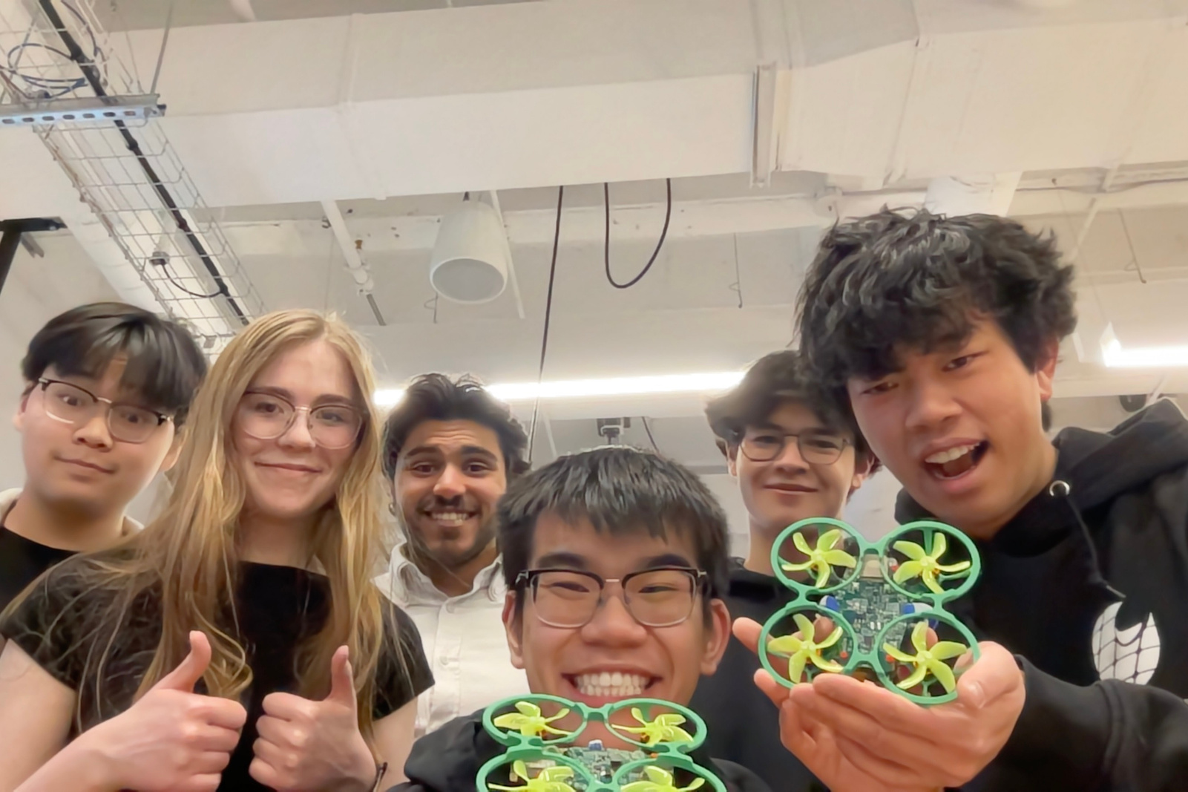
HOOD RESEARCH DEPARTMENT
WE NEED TO PUT A GROUP PIC. I LOVE MY FREINDS AND I HAD SM FUN THIS PROJECT.
Notes:
ETHAN

