Slide 1
MASTER'S STUDY PROPOSAL 碩士論文計畫書
The Invisible Ledger
Quantifying the Invisible Wedge in Indonesia's Platform Economy
隱形帳簿：量化印尼平台經濟中的隱形缺口
Christopher Ongko 王新福
Advisor: Prof. De-Rong Kong 孔德蓉
Yuan Ze University · Master of Science in Finance · 1 October 2026
Notes:
Opening: when a digital platform reports that it is growing, is the commerce on that platform actually growing? In Indonesia the answer is often no — and sometimes the two point in opposite directions.

Slide 2
THE PUZZLE
Accounts said growth. Transactions said contraction.
帳面成長，交易萎縮
+53.2%
Revenue — what the accounts record
−8.9%
Transaction value — what the platform carried
Tokopedia, 2022 → 2023. Same company, same year, both correct.
Source: GoTo annual report, e-commerce segment. Issuer-reported pair; Indonesia-aligned segment, not a literal country line.
2
Notes:
Tokopedia, Indonesia's largest domestic marketplace. Revenue +53%; value of everything bought and sold fell ~9%. Both from the company's own disclosures. The question is not which number is wrong, but how both can be right — and what happens when people use one in place of the other.

Slide 3
THE PUZZLE
Why revenue rose while transactions fell
營收為何在交易下滑時仍成長
60.6%
39.4%
Lower customer incentives
Higher gross revenue
Share of the 2022–2023 increase in Tokopedia net revenue (+53.2%)
What are customer incentives?
The platform earned more mainly by spending less to attract transactions — not by carrying more of them.
The partner incentives and end-user promotions — discounts, vouchers, shipping subsidies — that GoTo deducts from gross revenue to arrive at net revenue.
Arithmetic reconciliation of issuer-disclosed components (GoTo 2024; GoTo annual report 2023, segment note), not a causal decomposition.
3
Notes:
GoTo reports gross revenue before partner incentives and end-user promotions, then deducts them to reach net revenue. 60.6% of the net-revenue increase reconciles to lower incentives; 39.4% to higher gross revenue. (If asked: incentives fell from about Rp4.1T to Rp2.8T.) Arithmetic, not causation.

Slide 4
THE STUDY
Research question
研究問題與目標
How much economic activity remains invisible when digital platforms are measured through their reported revenue — and when does that choice change the conclusion about growth?
1
Measure
2
Reconcile
3
Compare
The transaction–revenue relationship across Indonesian platforms, 2020–2025, using W, E and D.
Large divergences to disclosed components: incentives, monetization, revenue recognition, scope.
Platform evidence against national e-commerce (BPS) and payment (Bank Indonesia) indicators.
The study does not seek one universally correct measure; it evaluates when an observable indicator is sufficient for the question being asked.
4
Notes:
Three objectives: measure the relationship over time, explain the big movements using what platforms disclose, check whether national statistics tell the same story. Not the one correct number — when one record can stand in for another.

Slide 5
THE STUDY
Three measures — and D is the test
三個衡量指標：D 是核心檢定
A platform carries 100 and keeps 10
W = V − R
90 · outside recognized revenue
How large the gap is
V = 100 (transaction value) R = 10 (revenue)
E = (V − R) / R = 1/t − 1
W = 90 E = 90 / 10 = 9
The gap relative to revenue — a transformation of the take rate, not the contribution
A large but stable gap still preserves the growth story. A moving gap does not.
D = g(R) − g(V)
Whether the relationship holds over time — the central test. A sign flip is the strongest failure.
V = transaction value; R = recognized revenue; t = R/V, the monetization rate; g(·) = annual growth.
5
Notes:
W = the gap. E = the gap relative to revenue — say plainly it is 1/t − 1, a convenient description, not the contribution. D is the test: near zero, revenue is a workable stand-in; if it moves or flips sign, revenue tells a different story from the commerce.

Slide 6
THE STUDY
What I can observe — and how directly
樣本與證據層級
Tokopedia 2022–23 · Blibli 2021–25 · Bukalapak 2020–23
11 platform-years
8 comparisons
Issuer-reported
Main sample
Grab 2021–23 · Shopee 2022–24
Ratios fixed by
company-wide figures
Constructed
2023 scale only
BPS national e-commerce · Bank Indonesia payments · 8 listed platforms outside Indonesia
Context and
external benchmark
Comparison indicators
Never pooled
Disclosing cases, not a representative sample. Lazada and TikTok Shop excluded: no matched Indonesian revenue series.
6
Notes:
Three tiers kept apart. Main sample: the three that report both measures themselves — 11 platform-years, 8 comparisons. Grab and Shopee are constructed from company-wide ratios: scale only, no movement. National, payment and external data are comparisons, never pooled.

Slide 7
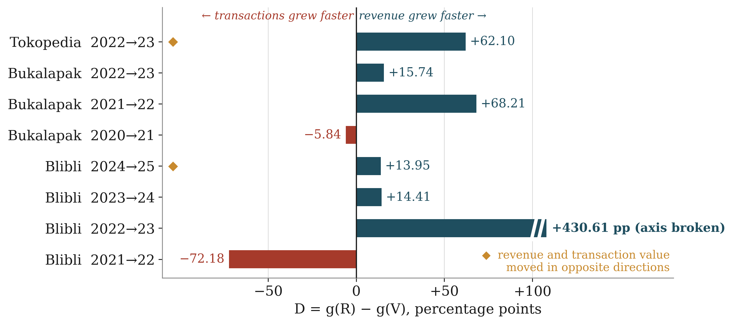
THE EVIDENCE
Revenue outgrew transactions in 6 of 8 comparisons
八次比較中有六次營收成長快於交易額
6 / 8
revenue grew faster
2
full reversals (◆)
38.92 pp
median |D|
Without Blibli 2022–23: 5 of 7, median 15.74 pp. Every Ecosystem Ratio ends below where it began.
Issuer-reported main sample: 3 platforms, 8 annual comparisons, 2020–2025. Blibli includes online travel; Bukalapak reports at Group scope.
7
Notes:
Bars right = revenue grew faster. Six of eight; two full reversals (Tokopedia 2022–23, Blibli 2024–25). Typical gap ~39 points. Blibli 2022–23 is extreme; without it, 5 of 7 and ~16 points. Every leave-one-out sample keeps a majority and at least one reversal.

Slide 8
THE EVIDENCE
The direction is common. The magnitude is not.
方向普遍，幅度不同
Median absolute divergence |g(R) − g(V)|
Direction: common
Revenue grew faster in 6 of 8 comparisons in Indonesia, and 22 of 29 abroad.
Magnitude: not
The typical gap is about five times larger in Indonesia: 38.92 vs 7.1 points.
External: eBay, Etsy, Jumia, Mercado Libre, Rakuten, Sea, Shopify, Zalando — 29 comparisons unaffected by acquisitions or scope changes, 2017–2025.
8
Notes:
Is this just how platforms work? Partly: abroad, revenue also outgrew transactions in 22 of 29. But the size differs: ~7 points abroad vs ~39 in Indonesia. Same phenomenon, around five times larger.

Slide 9
THE EVIDENCE
Nationally, growth happened outside the marketplace channel
全國電商成長主要發生在市集通路之外
Growth in value, 2023 → 2024
98.46%
of the 2023–24 increase in e-commerce value fell outside BPS's marketplace channel
BPS classifies surveyed businesses' online sales by channel: marketplaces, social media, instant messaging, own website.
BPS-Statistics Indonesia. The marketplace channel is a survey classification, not a list of firms. Single annual transition.
9
Notes:
Same pattern, measured a completely different way. Total e-commerce +17%; marketplace channel +1.45%; ~98% of the increase outside marketplaces. One year — not a trend.

Slide 10
THE EVIDENCE
Growth came from new sellers, not bigger sellers
成長來自新進賣家，而非既有賣家擴張
+17.08%
=
+15.31%
×
+1.54%
e-commerce value
number of businesses
sales per business
90.29%
Marketplace sellers keep better records
28.63%
12.25%
of the increase came from more businesses selling online
70.95% under BPS's alternative 2023 business count — entry dominates either way.
of marketplace users
of non-users
keep complete financial statements — an association, not a cause
Arithmetic split of BPS 2023–2024 e-commerce value (S = N × A). BPS publishes two 2023 business counts; both reported.
10
Notes:
Mostly more businesses selling online, not existing sellers selling more — ~90% (71% under BPS's other count). Marketplace sellers are more than twice as likely to keep complete financial statements; association, not cause.

Slide 11
WHY IT MATTERS
Marketplace records are becoming tax infrastructure
市集紀錄正成為稅務行政基礎
implementation deferred
PMK 37/2025 issued
Collection begins
Re-designation scheduled
14 Jul 2025
1 Aug 2026
1 Oct 2026
1 Jul 2026
Aug 2026
1 Nov 2026
Four marketplaces designated
Postponed; designations cancelled, amounts refunded
Collection scheduled
Tax administration is being routed through the marketplace record — while 98% of measured e-commerce growth sat outside the marketplace channel. Different categories; worth seeing side by side. Not a forecast.
PMK 37/2025: 0.5% of gross turnover withheld by designated marketplace operators. DJP: timing deferred, substance unchanged; further deferral not ruled out.
11
Notes:
PMK 37/2025: designated marketplaces withhold 0.5% of sellers' gross turnover. Postponed once — designations cancelled, refunds. Collection scheduled 1 Nov 2026. Not predicting success or failure; the pairing is only visible when you compare records instead of substituting one for another. CHECK STATUS OF 1 OCT RE-DESIGNATION ON THE MORNING OF THE ORAL.

Slide 12
WHY IT MATTERS
Two kinds of revenue growth look identical in the accounts
兩種營收成長在帳上看起來相同
From more commerce
From fewer incentives
Transactions grow; revenue follows.
Revenue grows while transactions stall or fall — Tokopedia 2022–23.
Can continue
Bounded
a platform can stop discounting only once
Reported revenue shows the same number for both. The finance question: is revenue a reliable signal of a platform's underlying growth?
Proposed extension (Prof. Kong's suggestion): which indicator, or revenue-growth component, is more informative for stock returns — exploratory, given a small, segment-affected listed sample.
12
Notes:
Finance angle: is reported revenue a reliable signal of underlying growth? Commerce-driven and incentive-driven revenue growth look identical in the accounts but differ economically. Stock-return test is a later extension; listed sample small, Tokopedia a segment inside GoTo.

Slide 13
WHAT IT CLAIMS
What the evidence does — and does not — establish
證據能說明與不能說明的範圍
Establishes | Does not by itself establish
Revenue and transaction value move apart within platforms (W, E, D) | Participant profit, taxable income, unpaid tax, or missing GDP
Disclosed components reconcile selected movements | A causal effect of incentives, monetization or accounting choices
National channels and platform records grow at very different rates | Which indicator, if any, contains measurement error
PMK 37/2025 draws on designated operators' records | Its coverage of the digital economy, or any compliance effect
Every record is correct for what it measures. The error appears only when one is used in place of another.
Descriptive, disclosure-selected evidence: 3 platforms, 11 platform-years, 8 comparisons.
13
Notes:
Be precise about boundaries: not hidden income, unpaid tax or missing GDP; reconciliations are arithmetic; no indicator is "wrong".

Slide 14
NEXT
Plan to the final defence
邁向學位考試的工作規劃
1
2
3
Proposal stage
Oct – Nov 2026
Before the final defence
Incorporate committee feedback. Finalize source definitions and figures.
Reconcile BPS and platform definitions. Split movements into volume and monetization effects. Alternative sample rules; robustness.
Complete the manuscript. Decide and, if feasible, run the stock-return extension.
The data and framework are assembled; what remains is reconciliation, robustness and the manuscript.
14
Notes:
Data and framework assembled; remaining work is reconciliation, robustness and the full manuscript.

Slide 15
The same company can look like it is growing or shrinking depending on which of its own numbers you read.
This study shows when that happens, why, and that it also appears in the national statistics — as Indonesia begins building tax collection on the more visible record.
Thank you 謝謝
Notes:
Close on the one-line takeaway. Then invite questions.

Slide 16
Backup
Scale · construction · ratio paths · BPS levels · payments · hypotheses · Tokopedia bridge

Slide 17
BACKUP
2023 scale: a large level gap
Case (US$ bn) | V | R | W | E | Evidence
Grab Indonesia | 5.381 | 0.605 | 4.776 | 7.895× | Transaction value constructed
Tokopedia | 16.331 | 0.405 | 15.926 | 39.296× | Issuer-reported pair
Shopee Indonesia | 21.520 | 2.152 | 19.368 | 9.000× | Transaction value and revenue estimated
Three platforms | 43.233 | 3.162 | 40.070 | 12.671× | Sum of three cases, not national total
≈ 2.9% of Indonesia's 2023 nominal GDP (US$1.371 trillion) — magnitude only; the wedge is transaction value, not value added.
Shopee rate varied 9–11% → W between US$39.86B and US$40.29B. Excluding any one platform leaves at least US$20.70B.
Rupiah converted at the World Bank 2023 rate, 15,236.88 IDR per US$.
17

Slide 18
BACKUP
Why Shopee is 9.000× and Grab 7.9×
Shopee Indonesia
Grab Indonesia
Transaction value: third-party estimate (Momentum Works). Revenue: that estimate × Sea's company-wide monetization rate (assumed 10%). So E = 1/0.10 − 1 = 9.000 by construction.
Indonesian revenue is disclosed; transaction value = Indonesian revenue × Group GTV / Group revenue. So Grab's Indonesian E equals its Group E (7.9×).
Both contribute 2023 levels only — no independent evidence on the ratio or its movement. The time-series result uses issuer-reported pairs alone.
18

Slide 19
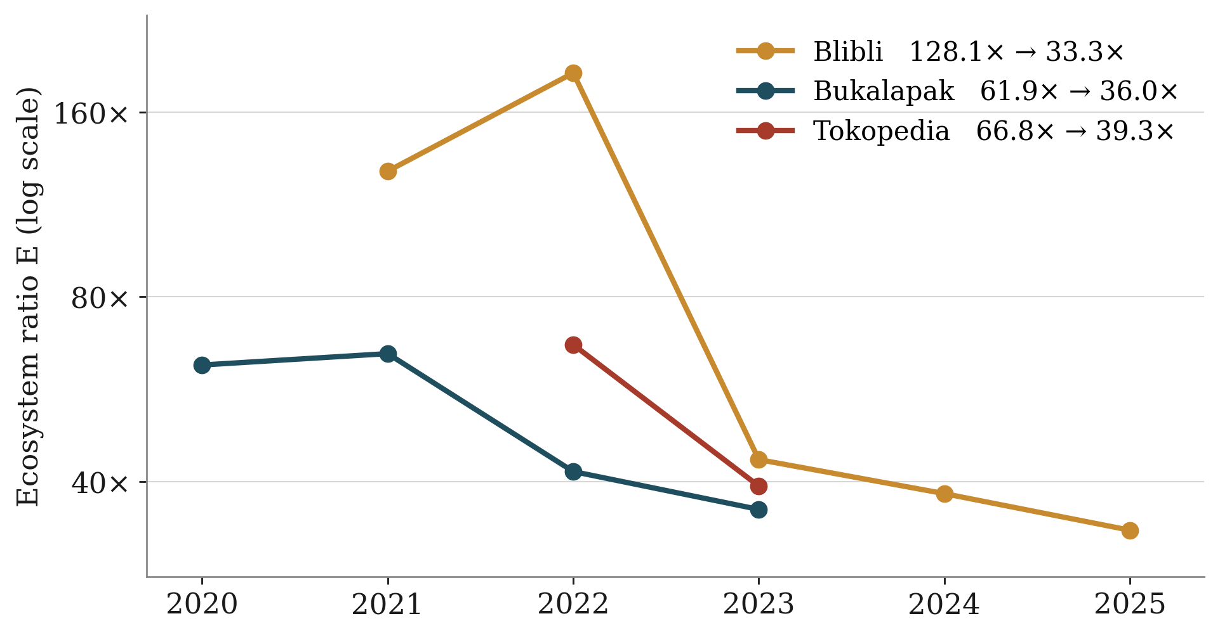
BACKUP
Ecosystem ratio over time (issuer-reported, log scale)
Years without a matched pair omitted (Tokopedia 2021; Bukalapak 2024: nine months of transactions vs twelve of revenue).
19

Slide 20
BACKUP
BPS levels are not like-for-like with platform figures
Rp200.68T
US$37.9B
BPS 2023 marketplace component ≈ US$13.2B (18.2% of e-commerce, exclusive channel split)
Tokopedia reported GTV + external Shopee GMV estimate, 2023
Different definitions and channel attribution — the study reconciles them before attributing any gap to coverage.
BPS multiple-response measure (social media 44.04%, marketplaces 32.74% of value) is not comparable with the 18.2% exclusive split.
BPS-Statistics Indonesia, Statistik E-Commerce 2023.
20

Slide 21
BACKUP
Payment measures grew far faster than e-commerce value
Growth 2023–2024. Context only: payment values reflect adoption and substitution between payment methods, not sales (Bank Indonesia).
21

Slide 22
BACKUP
Hypotheses and principal tests
Hypothesis | Principal test
H1 Within platforms, transaction value and revenue do not grow in proportion | D and E for issuer-reported pairs: level, stability, sign reversals
H2 National e-commerce growth comes mainly from more businesses | BPS value split into business count and sales per business
H3 Marketplace participation is associated with stronger recordkeeping | BPS comparison of marketplace and non-marketplace sellers
H4 Conclusions about growth change with the indicator used (central claim) | Revenue vs transaction value within platforms; marketplace channel vs all e-commerce
None of the tests is interpreted as a causal claim.
22

Slide 23
BACKUP
Tokopedia revenue bridge, 2022–2023 (Rp trillion)
 | FY2022 | FY2023 | Change
Third-party gross revenue | 8.14 | 8.99 | +0.85 (39.4%)
Customer incentives (deducted) | −4.11 | −2.81 | +1.30 (60.6%)
Third-party net revenue | 4.03 | 6.18 | +2.14 (+53.2%)
Net revenue change = gross revenue change + reduction in incentives. Incentives fell by about a third while transaction value fell 8.9%.
GoTo annual report 2023, Note 29 (segment operations). Arithmetic reconciliation only.
23

