Slide 1
The Invisible Ledger
Quantifying the Invisible Wedge in Indonesia's Platform Economy
隱形帳簿：量化印尼平台經濟中的隱形缺口
Progress update: what has changed since the proposal oral of 1 October
CHRISTOPHER ONGKO 王新福 · ADVISOR: PROF. DE-RONG KONG 孔德蓉
MASTER OF SCIENCE IN FINANCE, YUAN ZE UNIVERSITY · 9 OCTOBER 2026
Notes:
Progress update for the advisor. Same thesis as the proposal: same title, question, hypotheses and measures. This deck shows what came back from the work promised at the oral, and what it changed.

Slide 2
Since 1 October: what stayed, was added, changed
“The question and hypotheses are the ones you approved. The answers are new.”
STAYED
ADDED
CHANGED
The title, the research question, H1 and H2, word for word
The measures: the invisible wedge, the ecosystem ratio, growth divergence
The Tanah Abang opening and the three users of the numbers
BPS's own survey answers, three rounds (bought through SILASTIK)
27 foreign platforms in the comparison, up from 8
A market-value test, and tests written down before the data were opened
Primary texts of the 2023-26 rules
The thesis now answers the oral deck's own question
The wedge has a job: it explains why revenue swings
H2's meaning: about half the 2023 rise in sellers was not new
The market test came back only partly
Nothing the committee approved has moved. Everything promised at the oral has a result.
Notes:
Three columns. Stayed: nothing the committee approved has moved. Added: the data and tests promised at the oral. Changed: what the results mean, including two places where the meaning shifted from the proposal.

Slide 3
The oral deck's question, now answered
“How much commerce had actually moved online? It depends on which number you read.” (oral deck, slide 3)
THE ANSWER, IN SIX SENTENCES
In 2023 Indonesia argued about whether online selling was growing so fast it was hurting market traders, and the government shut TikTok Shop. The official figures for that year later said online sales rose 41%. I looked inside the survey behind those figures. Most sellers said their sales were flat or down, and their main complaint was a lack of customers. About half the new sellers weren't new: they were older, long-running small businesses, selling through WhatsApp and social media, that were only counted that year. On the big platforms, revenue grew mostly because they charged more, not because people bought more.
Short version: less commerce had moved online in 2023 than the numbers suggested. Platform income measured prices; the official seller count partly measured counting.
Notes:
This is the golden pitch, frozen on 8 October. Everything else in the deck backs one of its sentences.

Slide 4
How the thesis now reads
“Start where everyone is, prove it where the numbers break, end with what anyone can check.”
WIDE
NARROW: INDONESIA
WIDE AGAIN
A
A-B
B
B-C
C
The problem everywhere
Why Indonesia
The evidence
What travels
Back to everyone
Investors, statistics offices and tax offices all read the digital economy through stand-ins
Thin platform slices, sellers in chat apps, and a public fight in 2023
The wedge and H1; buying stalled; H2 and the entry test; who the sellers were
The checks travel; the Indonesian numbers do not
One lesson for each of the three users
Notes:
The five parts are the reading order; the chapters stay the proposal's. The wedge and H1 are the foundation, the 2023 seller count is the centre, the rules and other countries are the way back out.

Slide 5
What the oral deck promised, and what came back
“Every promise has a result, including the ones that did not go our way.”
Promised at the oral | Result | Status
Thicken H1 with quarterly pairs | Does not hold: the quarterly data mostly cover the calmer years after the repricing | Failed, reported
A longer foreign comparison | 27 foreign platforms; Indonesia still stands apart (p = 0.004; worst leave-one-out 0.016) | Done
Diagnose each large divergence | Grab mostly repricing; Blibli partly travel mix; GoTo cut discounts in 2024; Tokopedia 60.6% from fewer discounts | Done
Reconcile platform and BPS figures | They agree on growth where they cover the same sellers; levels cannot be fully reconciled, and the reasons are named | Done, with limits
Market test: does the market tell the two kinds of revenue growth apart? | Market value moved with buying (28 firms, p = 0.002); a different price for fee-driven revenue is not shown (p = 0.20) | Half answered
H2 caveat: “an arithmetic decomposition, not entry dynamics” | Entry test written down before the data: entry was too small; about half the 2023 rise was not first-time entry | Done, new centre
Notes:
Read across. The quarterly test failed and is reported. The market test answers only half its question. The entry test was not promised by name, but it tests the oral deck's own caveat on H2.

Slide 6
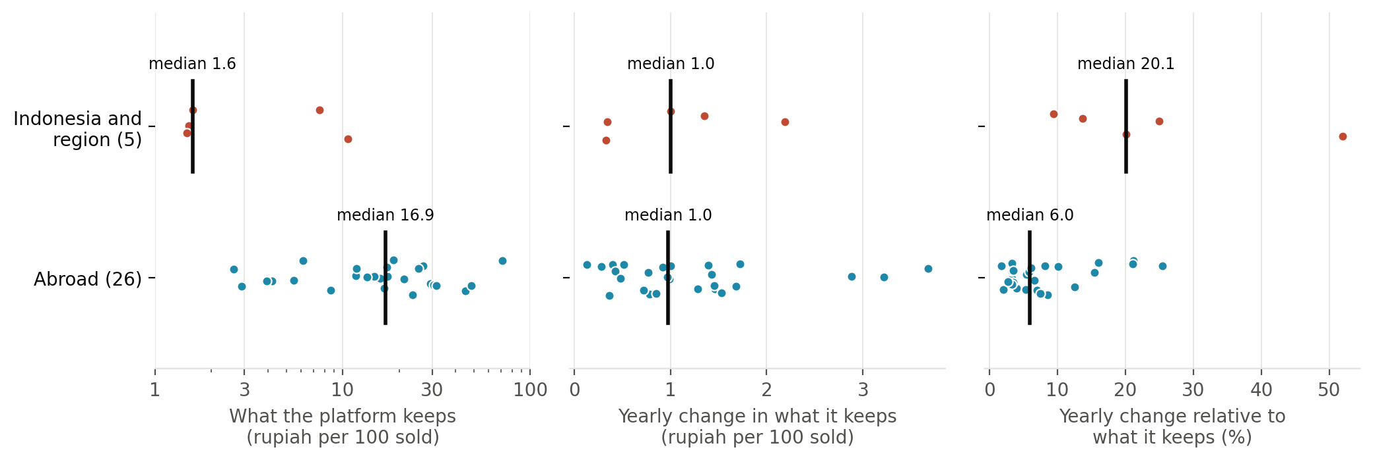
The wedge's job: same price changes, thinner slice
“Indonesian platforms did not change their prices more than platforms abroad. Their slice is ten times thinner.”
Reading it: a typical platform abroad keeps about 17 rupiah of every 100 sold; Indonesian marketplaces keep under 2. Both change what they keep by about 1 rupiah per 100 a year. On a 2-rupiah slice that is a huge change, so revenue growth swings about three times as much. H1 is still rejected; the reason is now clear.
Issuer filings, 5 Indonesian and regional vs 26 foreign platforms (firm medians); in points p = 0.65, relative p = 0.003. Exploratory, 9 Oct.
Notes:
Answers Thomas's question on the wedge. Growth divergence equals the change in the share kept divided by the share kept, so the size of the wedge next to revenue sets how far a price change moves revenue growth. Exploratory check, h1_points_vs_log.py. It also corrects our own earlier wording.

Slide 7
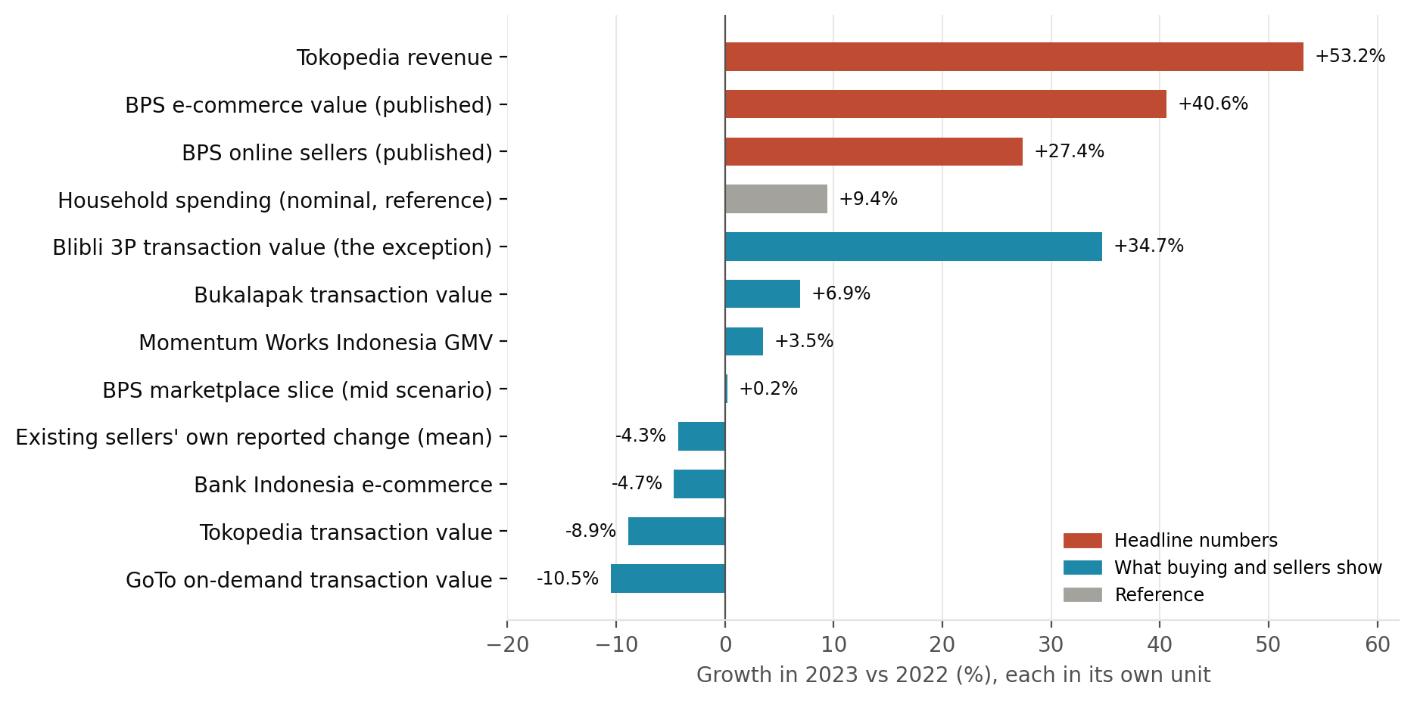
2023: the headline numbers boomed, buying did not
“Where two numbers look at the same place, they agree. They split where only one of them looks.”
WHAT IT SHOWS
Five of six Indonesia-only measures of buying grew less than household spending
Existing sellers: 24% up, 44% same, 32% down
Main complaint: not enough customers (41%, up from 35%)
Bank Indonesia −5%, BPS +41%: they agree on the marketplaces and split outside them
Company filings; Bank Indonesia; Momentum Works; BPS publications and survey microdata. Growth 2023 vs 2022, each in its own unit.
Notes:
Orange bars are the headlines; teal bars are what buying and sellers show. Bank Indonesia and BPS disagree only outside the marketplaces: BPS's own marketplace slice barely grew.

Slide 8
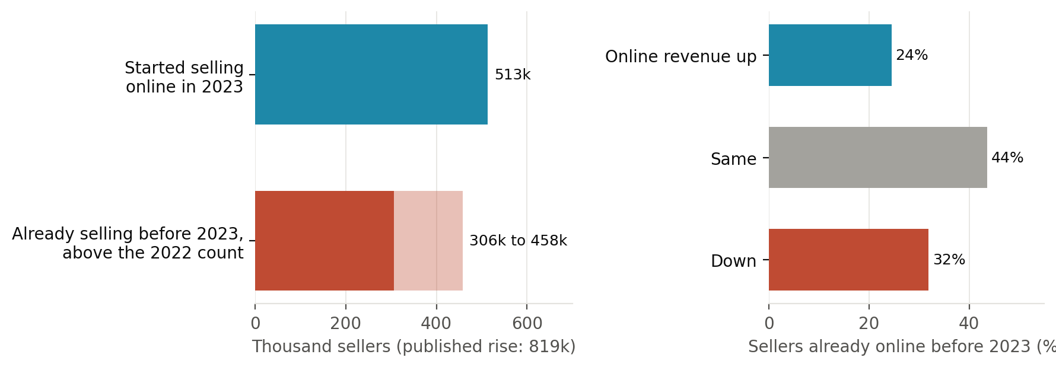
H2 holds on paper; underneath, half were not new
“If 820,000 people had started selling in 2023, they would say so. About 513,000 did.”
THE ENTRY TEST
Written down before the data: at least 1 in 5 sellers should say they started in 2023
Result: about 1 in 7
37-56% of the rise was sellers already selling before 2023
Too large for chance (4.6 standard errors); follows where the survey grew; 2024 is normal again
H2 on BPS's published numbers: holds (71% of 2022-23 growth from more businesses). The survey's own answers change what “more businesses” means.
BPS e-commerce survey microdata (2022 and 2023 rounds), weighted. Range depends on how many sellers stopped in 2023.
Notes:
The entry test was written down on 2 October and committed before the survey files were opened on 7 October. It closes the caveat on the oral deck's H2 slide: 'an arithmetic decomposition, not entry dynamics'.

Slide 9
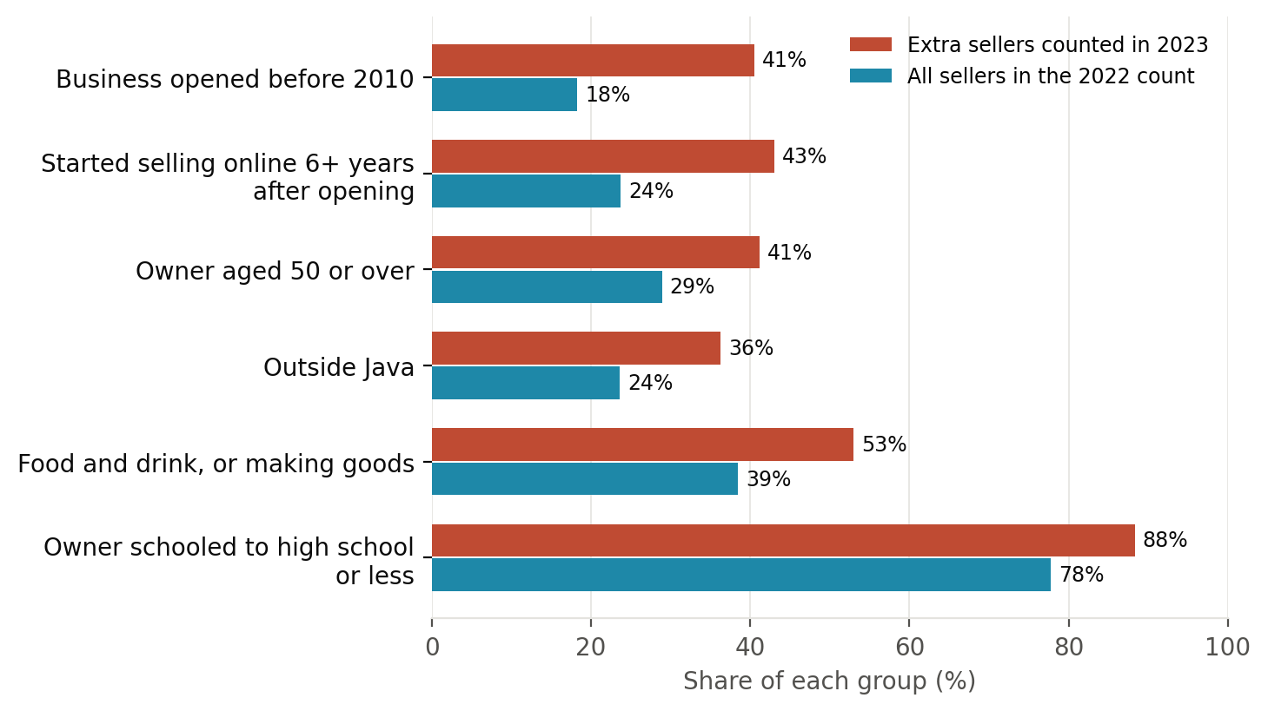
Who the extra sellers were
“Long-running small businesses, not start-ups. They had been there all along; the count reached them in 2023.”
WHAT IT MEANS
Businesses opened before 2010, often going online years later
Older owners, mostly schooled to high school or less
More often outside Java; food stalls and small workshops
Selling only through chat and social media
These are the people the original question was about: real business the numbers missed.
BPS e-commerce survey microdata (2020, 2022, 2023 rounds), weighted; about 450,000 sellers beyond normal change. Exploratory, 9 Oct.
Notes:
Exploratory: the surveys do not follow individual businesses, so each group's 2023 count is compared with its 2022 count, net of that group's normal yearly change from the 2020-22 surveys. The raw tilt to men disappears under this control.

Slide 10
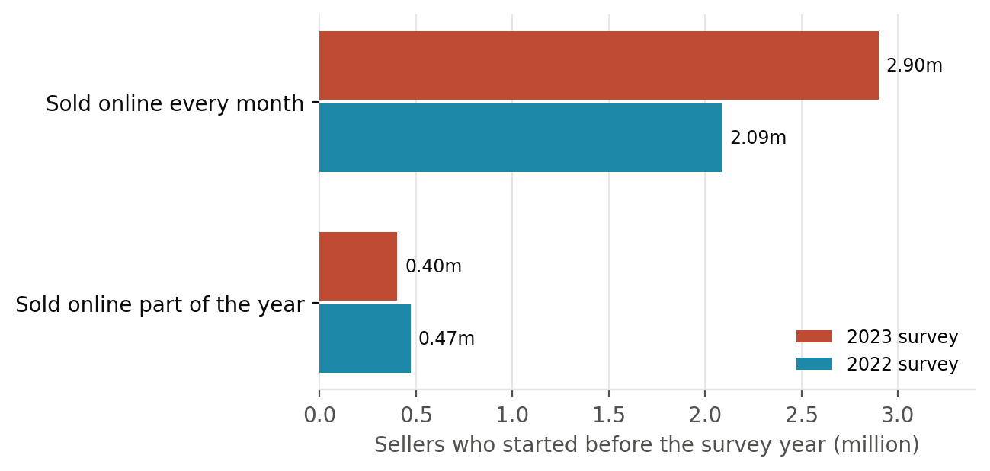
Not sellers coming back from a break
“Someone back from a break sells for part of the year. The rise is in sellers who sold every month.”
THREE ANSWERS
Months: part-year selling fell (472k to 403k); full-year selling rose (2.09m to 2.90m).
Timing: returning happens every year; it would have to spike in 2023 alone, while 2020-22 groups shrank and 2024 is normal.
Who restarts: small firms close most often when young, with young owners (McKenzie and Paffhausen 2019). These sellers are the opposite.
BPS survey microdata; the month question changed format between rounds. Recall error would inflate first-time entry, so the estimate is conservative (Neter and Waksberg 1964).
Notes:
The open alternative to wider survey reach is sellers who paused in 2022 and came back. Three answers: the month pattern, the timing, and who closes and restarts small firms. January restarts cannot be ruled out; the claim stays 'the likeliest reading'.

Slide 11

Each rule reaches only what its number sees
“A rule built on platform records reaches the sellers on the platforms. In Indonesia that is fewer than one in five.”
Commission cap
Discount rule
Marketplace tax
2026 census
Motorbike rides only (Gojek, Grab); first test 27 October
Targets discounts the platforms were already cutting
Can collect from about 1 seller in 20; puts every marketplace seller on record
Reaches the same group the 2023 count found: the next jump may be counting again
PMK 37/2025; Permendag 19/2026; Perpres 27/2026 as announced; BPS survey microdata. Abroad: OECD (2020), Directive 2021/514, BIR RR 16-2023, Decree 117/2025/ND-CP.
Notes:
No causal claims about any rule: reach is measured, effects are not. The same design is spreading: OECD model rules (2020, goods 2021), EU DAC7 (2023), Philippines withholding (2024), Viet Nam (2025).

Slide 12
Answers to the questions from the oral
“Each question now has an answer in the thesis, not just at the podium.”
Prof. Thomas: what is the point of the wedge?
Its size sets how far a price change moves revenue growth. The wedge is why growth divergence is large in Indonesia.
Prof. Thomas: the ride-hailing commission cap
Scoped to motorbike rides; its slice of the measure is shown; predictions are scored on 27 October and in mid-November.
Prof. Thomas: politics and the players
The rules chapter maps each rule to the number it acts on and how far it reaches. No causal claims.
Prof. Kong: how transaction value compares across platforms
A definition map of each platform's transaction value, in the appendix.
Prof. Kong: hard to read, too cautious
A plain story with one line from start to end; the centre is a bolder, tested claim about the official count.
Notes:
Thomas's wedge question is answered by the thin-slice result. Kong's readability point is answered by the new voice and structure; the proposal averaged 25.6 words a sentence, the story draft 15.8.

Slide 13
What we corrected along the way
“Each correction made a claim smaller and the thesis harder to knock over.”
BEFORE
NOW
“Indonesian platforms changed their prices far more”
Same price changes in rupiah; a much thinner slice
“Mostly newly counted sellers”
About half not explained by first-time entry (37-56%); returning sellers named
“Markets did not pay up for fee-driven growth”
Market value moved with buying; the multiples comparison is arithmetic, not evidence
“Two thirds of revenue growth came from the cut”
Two thirds of the movement, defined; not a share of net growth
“No one has compared platform and national figures”
UNCTAD (2024) has; our contribution is the connected Indonesian evidence
Notes:
These were found by our own checks and by the independent review. None changes a verdict.

Slide 14
Next: writing, and four dates outside our control
“The material is complete. What remains is writing it and scoring the predictions.”
27 Oct
1 Nov
Early Nov
Mid Nov
GoTo 3Q26: commission-cap predictions
Marketplace tax start (registered: slips again)
BPS 3Q26 GDP: buying vs household spending
Grab and Sea 3Q26: remaining predictions
WRITING
ONE QUESTION FOR YOU
Results chapter first, then the introduction
Same chapters as the proposal; the story runs through them
YZU template and reference check before submission
H2 still holds on the published numbers, but its 2023 meaning changes: about half the rise in sellers was not new. Is it acceptable to present the entry test as closing the limit the proposal itself named?
Notes:
The one decision needed from the advisor: is the H2 framing acceptable, with the entry test presented as closing the proposal's own stated limit?

