Slide 1
CS114 Final Project

Slide 2
An attempt to simulate the effects of water
Water is notoriously difficult to simulate graphically with any degree of accuracy
Suggested methods include simple meshes, heightmaps, and particle-based simulation (which must also be rendered as a “mesh” in programs like WebGL and such).
You can also try keeping the water still, and instead simulating how objects move as they float on the water

Slide 3
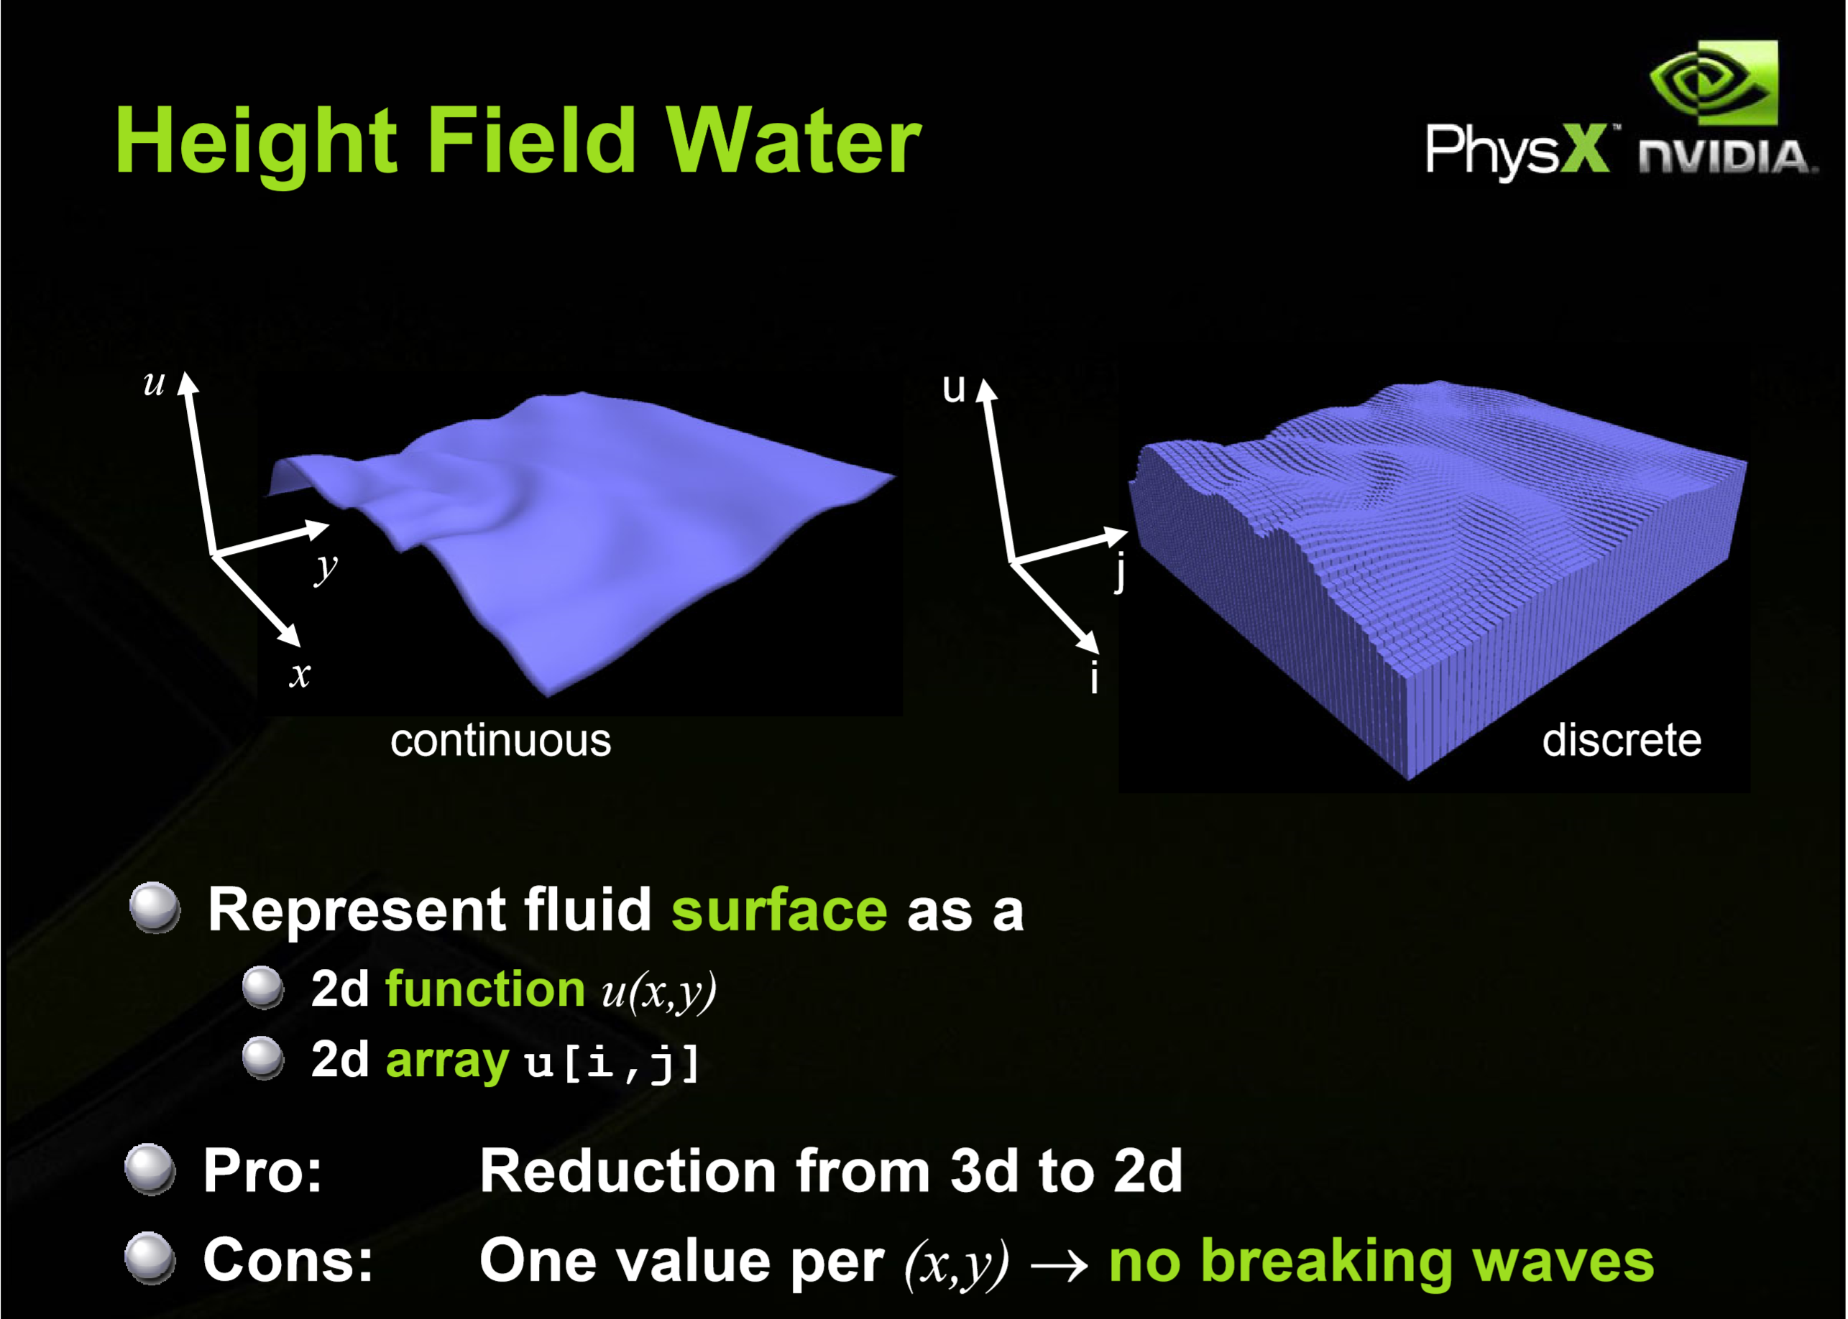

Slide 4
Visualizing the effects of water
2 main aspects: Reflection and Refraction
Reflection: What objects (if any) are hit by light bouncing off water (and are seen by an observer
Refraction: What objects an observer will see through the water as they look through it
Fresnel Equations: Determine the ratio of light that is reflected off the water to the light that “goes through” the water

Slide 5
Reflection and Refraction
Reflection: Simple equation (2.0 * N *(dot(N,L)) – L)
Refraction: Snell’s Law
But there are 2 separate components to consider
What the viewer sees
What the light actually hits (assuming the light is not from the same direction/location as the viewer).
Must also consider the refractive index.

Slide 6
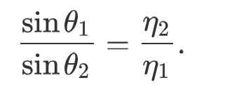
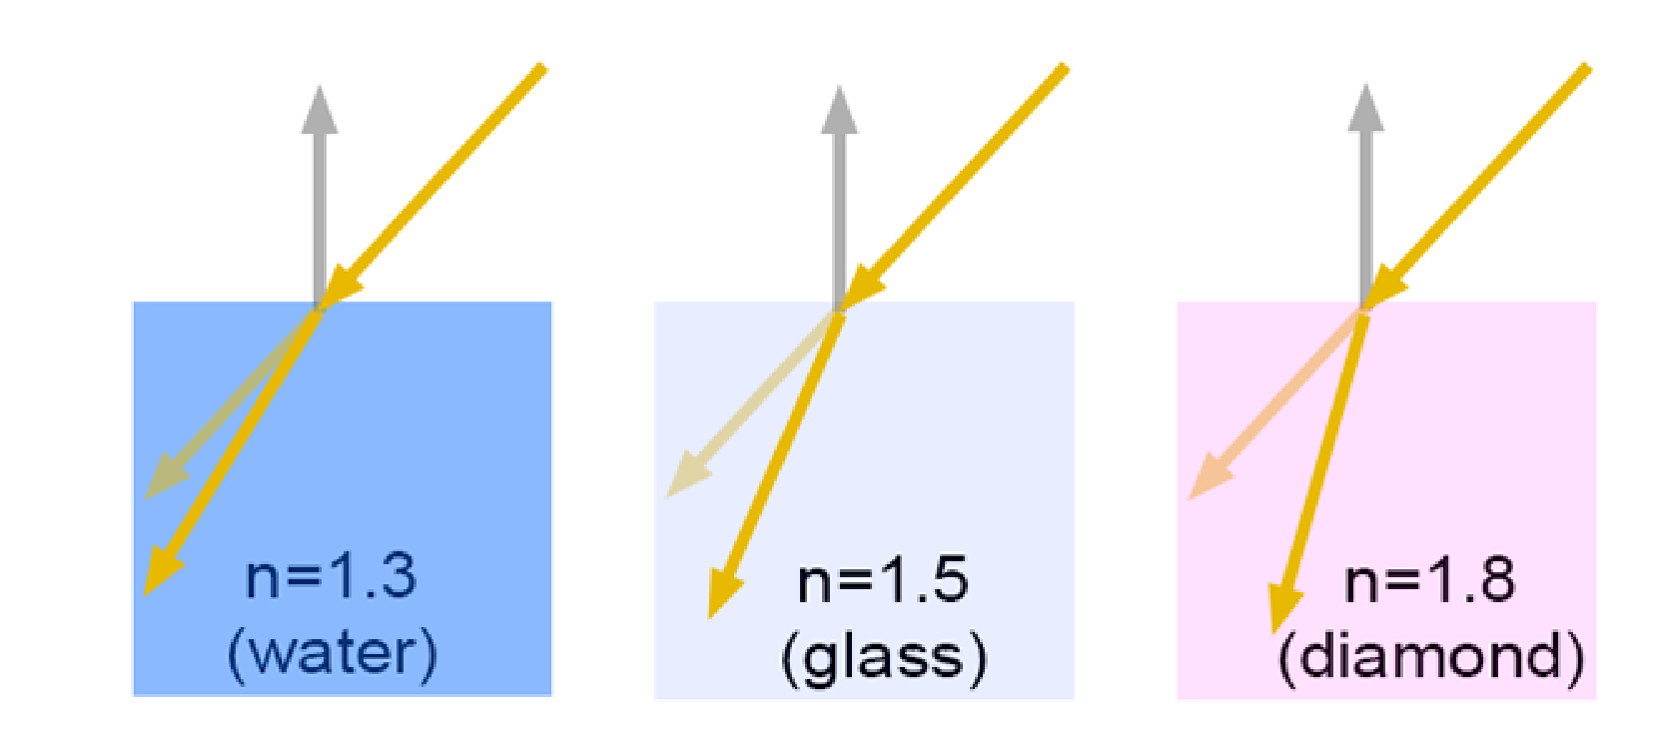
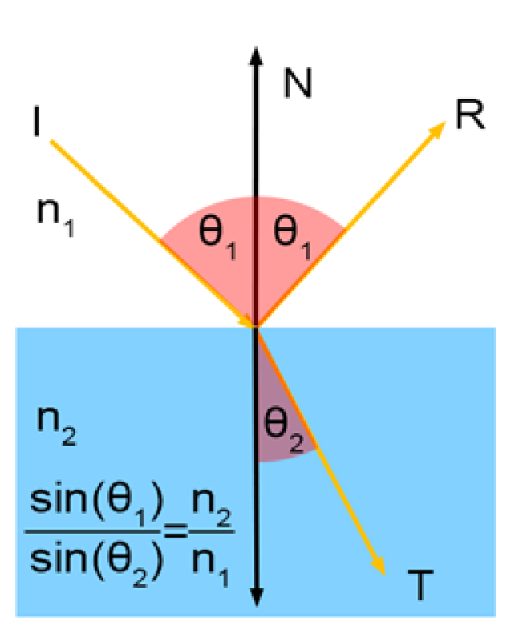
Snell’s Law

Slide 7
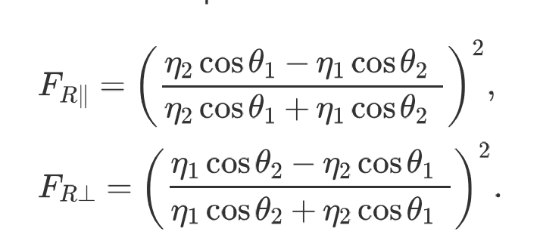
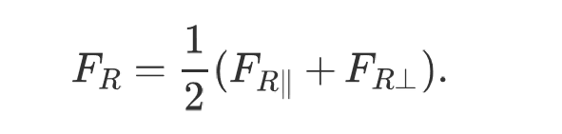
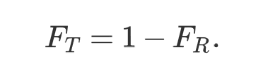
Fresnel Equations

Slide 8
Movement of water/items in water
I ultimately used a very basic sum of sines and cosines depending on time (degrees depend on a “running total” increasing with each “draw” call in WebGL).
Height of object = initial height + (sin(radianTotal) + cosine(radianTotal))
Different starting point for each of the two balls

Slide 9
Project Focus
Implement Reflection, Refraction, and Fresnel Equation ratios
Implement objects moving in the “water” and under the water (and if possible, implement movement of the “water” itself).
(Extra/Strech Goal: Implement light caustics)

Slide 10
