Slide 1
EUR/INR Currency Analysis
Technical Indicators Forecast

Slide 2
Technical Indicator Decisions
SMA_Decision | Bollinger_Band_Decision | CCI_Decision
NEUTRAL | NEUTRAL | NEUTRAL
NEUTRAL | NEUTRAL | NEUTRAL
NEUTRAL | NEUTRAL | NEUTRAL
NEUTRAL | NEUTRAL | NEUTRAL
NEUTRAL | NEUTRAL | NEUTRAL
NEUTRAL | NEUTRAL | NEUTRAL
NEUTRAL | NEUTRAL | NEUTRAL
NEUTRAL | NEUTRAL | NEUTRAL
NEUTRAL | NEUTRAL | NEUTRAL
NEUTRAL | NEUTRAL | NEUTRAL
NEUTRAL | NEUTRAL | NEUTRAL
NEUTRAL | NEUTRAL | NEUTRAL
NEUTRAL | NEUTRAL | NEUTRAL
NEUTRAL | NEUTRAL | NEUTRAL
NEUTRAL | NEUTRAL | NEUTRAL
NEUTRAL | NEUTRAL | NEUTRAL
NEUTRAL | NEUTRAL | NEUTRAL
NEUTRAL | NEUTRAL | NEUTRAL
NEUTRAL | NEUTRAL | NEUTRAL
BUY | NEUTRAL | NEUTRAL
BUY | NEUTRAL | NEUTRAL
BUY | NEUTRAL | NEUTRAL
BUY | NEUTRAL | SELL
BUY | SELL | SELL
BUY | NEUTRAL | SELL
BUY | NEUTRAL | NEUTRAL
BUY | NEUTRAL | NEUTRAL
BUY | NEUTRAL | NEUTRAL
SELL | NEUTRAL | NEUTRAL
NEUTRAL | NEUTRAL | NEUTRAL
SELL | NEUTRAL | NEUTRAL
NEUTRAL | NEUTRAL | NEUTRAL
BUY | NEUTRAL | NEUTRAL
SELL | NEUTRAL | NEUTRAL
SELL | NEUTRAL | NEUTRAL
SELL | NEUTRAL | BUY
SELL | NEUTRAL | NEUTRAL
SELL | NEUTRAL | NEUTRAL
SELL | NEUTRAL | BUY
SELL | NEUTRAL | BUY
SELL | NEUTRAL | BUY
SELL | NEUTRAL | NEUTRAL
SELL | NEUTRAL | NEUTRAL
SELL | NEUTRAL | NEUTRAL
SELL | NEUTRAL | BUY
SELL | BUY | BUY
SELL | NEUTRAL | NEUTRAL
SELL | BUY | BUY
SELL | NEUTRAL | BUY
SELL | NEUTRAL | NEUTRAL
SELL | NEUTRAL | NEUTRAL
BUY | NEUTRAL | NEUTRAL
BUY | NEUTRAL | NEUTRAL
BUY | NEUTRAL | NEUTRAL
BUY | NEUTRAL | NEUTRAL
BUY | NEUTRAL | NEUTRAL
BUY | NEUTRAL | SELL
BUY | SELL | SELL
BUY | SELL | SELL
BUY | NEUTRAL | NEUTRAL
BUY | NEUTRAL | NEUTRAL
BUY | NEUTRAL | NEUTRAL
BUY | NEUTRAL | NEUTRAL
BUY | NEUTRAL | NEUTRAL
BUY | NEUTRAL | NEUTRAL
BUY | NEUTRAL | NEUTRAL
BUY | NEUTRAL | NEUTRAL
BUY | NEUTRAL | NEUTRAL
BUY | NEUTRAL | NEUTRAL
BUY | NEUTRAL | NEUTRAL
BUY | NEUTRAL | NEUTRAL
SELL | NEUTRAL | NEUTRAL
BUY | NEUTRAL | NEUTRAL
BUY | NEUTRAL | SELL
BUY | NEUTRAL | SELL
BUY | NEUTRAL | NEUTRAL
BUY | NEUTRAL | NEUTRAL
BUY | NEUTRAL | NEUTRAL
BUY | NEUTRAL | NEUTRAL
BUY | NEUTRAL | NEUTRAL
BUY | NEUTRAL | NEUTRAL
BUY | NEUTRAL | SELL
BUY | NEUTRAL | NEUTRAL
BUY | NEUTRAL | NEUTRAL
BUY | NEUTRAL | NEUTRAL
BUY | NEUTRAL | NEUTRAL
SELL | NEUTRAL | NEUTRAL
BUY | NEUTRAL | NEUTRAL
BUY | NEUTRAL | NEUTRAL
BUY | NEUTRAL | NEUTRAL
BUY | NEUTRAL | NEUTRAL
NEUTRAL | NEUTRAL | NEUTRAL
NEUTRAL | NEUTRAL | NEUTRAL
NEUTRAL | NEUTRAL | NEUTRAL
SELL | NEUTRAL | NEUTRAL
SELL | BUY | BUY
SELL | NEUTRAL | NEUTRAL
SELL | NEUTRAL | NEUTRAL
SELL | NEUTRAL | NEUTRAL
SELL | NEUTRAL | NEUTRAL
SELL | NEUTRAL | NEUTRAL
SELL | NEUTRAL | NEUTRAL
SELL | NEUTRAL | NEUTRAL
SELL | NEUTRAL | BUY
SELL | NEUTRAL | BUY
SELL | BUY | BUY
SELL | NEUTRAL | BUY
SELL | NEUTRAL | NEUTRAL
SELL | NEUTRAL | BUY
SELL | NEUTRAL | NEUTRAL
SELL | NEUTRAL | BUY
SELL | NEUTRAL | NEUTRAL
SELL | NEUTRAL | NEUTRAL
SELL | NEUTRAL | NEUTRAL
BUY | NEUTRAL | NEUTRAL
SELL | NEUTRAL | NEUTRAL
SELL | NEUTRAL | NEUTRAL
SELL | NEUTRAL | NEUTRAL
BUY | NEUTRAL | NEUTRAL
BUY | NEUTRAL | SELL
BUY | NEUTRAL | NEUTRAL
BUY | NEUTRAL | SELL
BUY | NEUTRAL | SELL
BUY | SELL | SELL
BUY | NEUTRAL | NEUTRAL
BUY | NEUTRAL | NEUTRAL
BUY | NEUTRAL | NEUTRAL
BUY | NEUTRAL | NEUTRAL
BUY | NEUTRAL | NEUTRAL
NEUTRAL | NEUTRAL | NEUTRAL
SELL | NEUTRAL | NEUTRAL
BUY | NEUTRAL | NEUTRAL
SELL | NEUTRAL | NEUTRAL
BUY | NEUTRAL | NEUTRAL
BUY | NEUTRAL | SELL
SELL | NEUTRAL | NEUTRAL
BUY | SELL | SELL
BUY | NEUTRAL | SELL
BUY | SELL | SELL
BUY | SELL | SELL
BUY | SELL | SELL
BUY | NEUTRAL | SELL
BUY | NEUTRAL | SELL
BUY | NEUTRAL | NEUTRAL
BUY | NEUTRAL | NEUTRAL
SELL | NEUTRAL | NEUTRAL
NEUTRAL | NEUTRAL | NEUTRAL
SELL | NEUTRAL | NEUTRAL
BUY | NEUTRAL | NEUTRAL
SELL | NEUTRAL | NEUTRAL
SELL | NEUTRAL | NEUTRAL
SELL | NEUTRAL | NEUTRAL
NEUTRAL | NEUTRAL | NEUTRAL
SELL | NEUTRAL | NEUTRAL
NEUTRAL | NEUTRAL | NEUTRAL
SELL | NEUTRAL | NEUTRAL
BUY | NEUTRAL | NEUTRAL
NEUTRAL | NEUTRAL | NEUTRAL
BUY | NEUTRAL | NEUTRAL
BUY | NEUTRAL | NEUTRAL
SELL | NEUTRAL | NEUTRAL
BUY | NEUTRAL | NEUTRAL
BUY | NEUTRAL | NEUTRAL
NEUTRAL | NEUTRAL | NEUTRAL
SELL | NEUTRAL | NEUTRAL
SELL | NEUTRAL | NEUTRAL
BUY | NEUTRAL | NEUTRAL
SELL | NEUTRAL | BUY
SELL | NEUTRAL | BUY
SELL | BUY | BUY
SELL | BUY | BUY
SELL | NEUTRAL | NEUTRAL
SELL | NEUTRAL | NEUTRAL
BUY | NEUTRAL | NEUTRAL
SELL | NEUTRAL | NEUTRAL
SELL | BUY | BUY
SELL | NEUTRAL | NEUTRAL
SELL | NEUTRAL | NEUTRAL
SELL | NEUTRAL | NEUTRAL
SELL | NEUTRAL | NEUTRAL
SELL | BUY | BUY
SELL | NEUTRAL | NEUTRAL
SELL | NEUTRAL | NEUTRAL
SELL | NEUTRAL | NEUTRAL
SELL | NEUTRAL | BUY
SELL | NEUTRAL | BUY
SELL | NEUTRAL | NEUTRAL
SELL | NEUTRAL | NEUTRAL
SELL | NEUTRAL | NEUTRAL
SELL | NEUTRAL | NEUTRAL
SELL | NEUTRAL | BUY
SELL | NEUTRAL | BUY
SELL | NEUTRAL | BUY
SELL | BUY | BUY
SELL | NEUTRAL | NEUTRAL
SELL | BUY | BUY
SELL | NEUTRAL | BUY
SELL | NEUTRAL | BUY
SELL | NEUTRAL | NEUTRAL
SELL | NEUTRAL | NEUTRAL
SELL | NEUTRAL | NEUTRAL
SELL | NEUTRAL | NEUTRAL
BUY | NEUTRAL | NEUTRAL
BUY | NEUTRAL | NEUTRAL
SELL | NEUTRAL | NEUTRAL
SELL | BUY | BUY
SELL | NEUTRAL | NEUTRAL
BUY | NEUTRAL | NEUTRAL
SELL | NEUTRAL | NEUTRAL
BUY | NEUTRAL | NEUTRAL
BUY | NEUTRAL | NEUTRAL
BUY | NEUTRAL | SELL
NEUTRAL | NEUTRAL | NEUTRAL
BUY | NEUTRAL | NEUTRAL
NEUTRAL | NEUTRAL | NEUTRAL
SELL | NEUTRAL | NEUTRAL
BUY | NEUTRAL | SELL
BUY | NEUTRAL | NEUTRAL
BUY | NEUTRAL | NEUTRAL
BUY | NEUTRAL | SELL
BUY | SELL | SELL
BUY | NEUTRAL | SELL
BUY | NEUTRAL | SELL
BUY | NEUTRAL | SELL
BUY | NEUTRAL | NEUTRAL
SELL | NEUTRAL | NEUTRAL
BUY | NEUTRAL | SELL
BUY | SELL | SELL
BUY | SELL | SELL
BUY | NEUTRAL | SELL
BUY | NEUTRAL | NEUTRAL
BUY | SELL | SELL
BUY | NEUTRAL | NEUTRAL
BUY | NEUTRAL | NEUTRAL
BUY | NEUTRAL | NEUTRAL
BUY | NEUTRAL | NEUTRAL
BUY | NEUTRAL | NEUTRAL
BUY | NEUTRAL | SELL
BUY | NEUTRAL | NEUTRAL
BUY | NEUTRAL | NEUTRAL
SELL | NEUTRAL | NEUTRAL
BUY | NEUTRAL | NEUTRAL
SELL | NEUTRAL | NEUTRAL
SELL | NEUTRAL | NEUTRAL
SELL | NEUTRAL | NEUTRAL
SELL | NEUTRAL | BUY
SELL | NEUTRAL | NEUTRAL
NEUTRAL | NEUTRAL | NEUTRAL
BUY | NEUTRAL | NEUTRAL
BUY | NEUTRAL | NEUTRAL
SELL | NEUTRAL | NEUTRAL
BUY | NEUTRAL | NEUTRAL
BUY | NEUTRAL | NEUTRAL
BUY | NEUTRAL | NEUTRAL
BUY | NEUTRAL | NEUTRAL
BUY | NEUTRAL | NEUTRAL
BUY | NEUTRAL | NEUTRAL
BUY | NEUTRAL | NEUTRAL
BUY | SELL | SELL
BUY | NEUTRAL | SELL
BUY | NEUTRAL | NEUTRAL
BUY | NEUTRAL | NEUTRAL
BUY | NEUTRAL | NEUTRAL
BUY | NEUTRAL | NEUTRAL
BUY | NEUTRAL | NEUTRAL
SELL | NEUTRAL | NEUTRAL
NEUTRAL | NEUTRAL | NEUTRAL
SELL | NEUTRAL | NEUTRAL
BUY | NEUTRAL | NEUTRAL
BUY | NEUTRAL | NEUTRAL
SELL | NEUTRAL | BUY
SELL | NEUTRAL | NEUTRAL
SELL | NEUTRAL | NEUTRAL
SELL | NEUTRAL | NEUTRAL
SELL | NEUTRAL | NEUTRAL
SELL | BUY | BUY
SELL | NEUTRAL | NEUTRAL
SELL | NEUTRAL | NEUTRAL
SELL | NEUTRAL | NEUTRAL
SELL | NEUTRAL | NEUTRAL
SELL | NEUTRAL | BUY
SELL | NEUTRAL | NEUTRAL
SELL | NEUTRAL | NEUTRAL
SELL | NEUTRAL | BUY
SELL | NEUTRAL | NEUTRAL
SELL | BUY | BUY
SELL | NEUTRAL | BUY
SELL | NEUTRAL | BUY
SELL | NEUTRAL | NEUTRAL
SELL | NEUTRAL | NEUTRAL
SELL | NEUTRAL | BUY
SELL | NEUTRAL | NEUTRAL
SELL | NEUTRAL | BUY
SELL | NEUTRAL | NEUTRAL

Slide 3
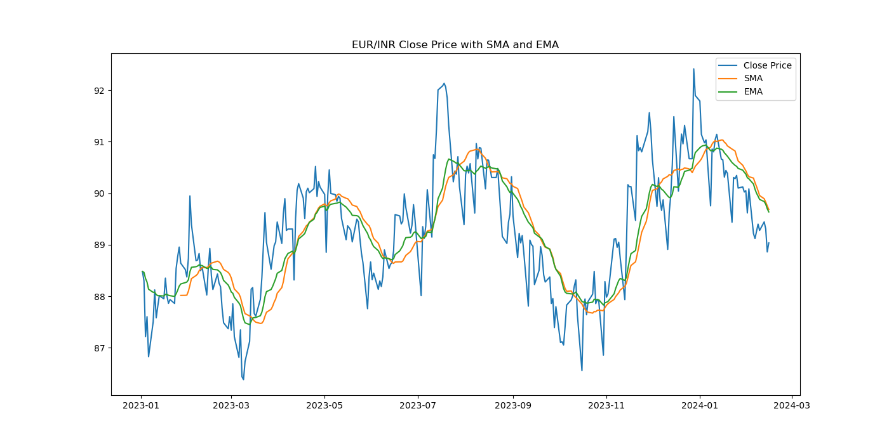
Moving Average-SMA & EMA

Slide 4
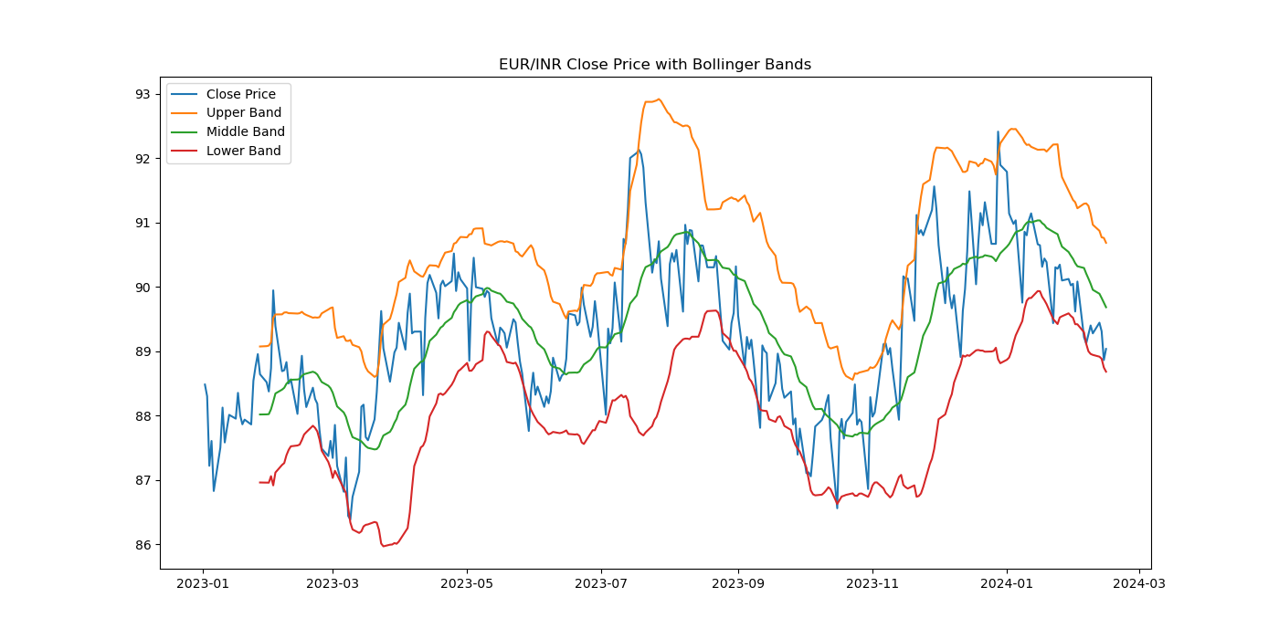
Bollinger Band

Slide 5
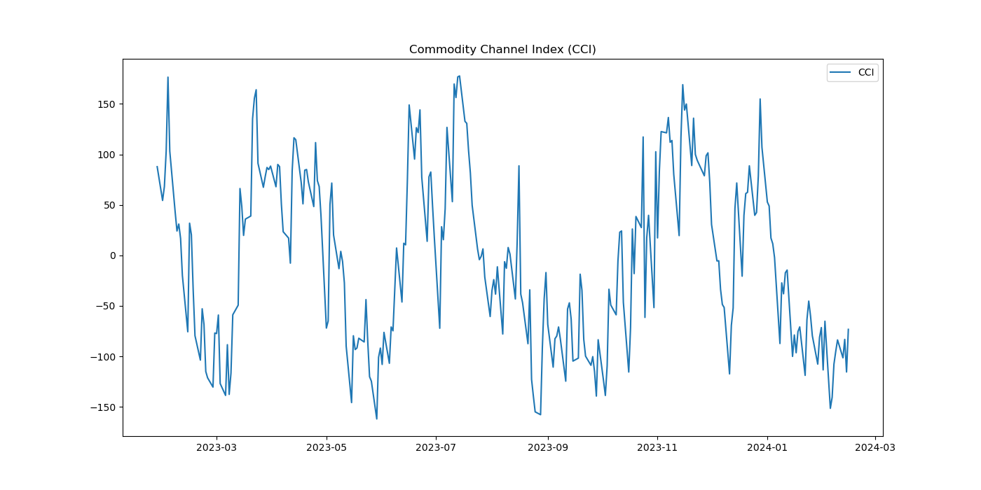
CCI (Commodity Channel Index)

