Slide 1
Walker Abstraction Use-Cases
Shachaf Cohen
2023

Slide 2
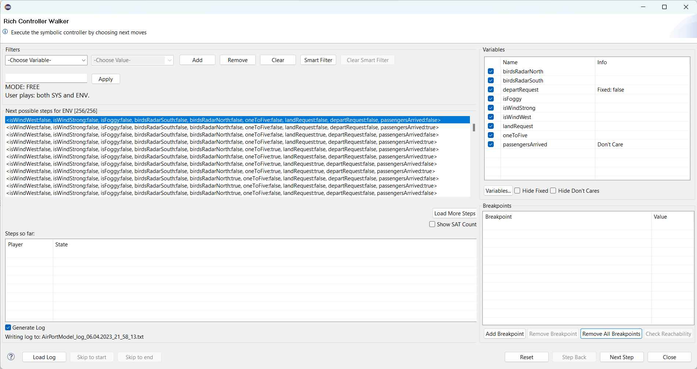
Main Walker Screen
Variables Panel
Filters Panel
Steps Panel
Log Panel
Breakpoints Panel

Slide 3
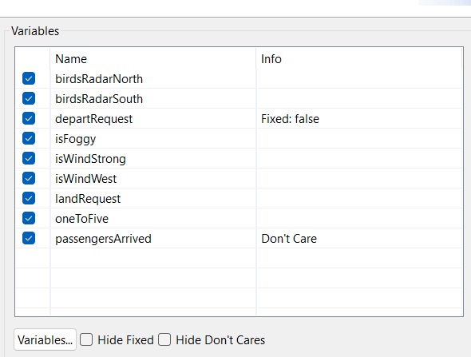
The Variables Panel
Tick to hide / unhide
Shows only the current turn variables
Additional Information
Fixed variables – all the possible assignments have the same value for these variables
Don’t Care variables – can be assigned any value regardless of the values of the other variables
Drag & Drop rows to reorder variables
Open the extended variables panel

Slide 4
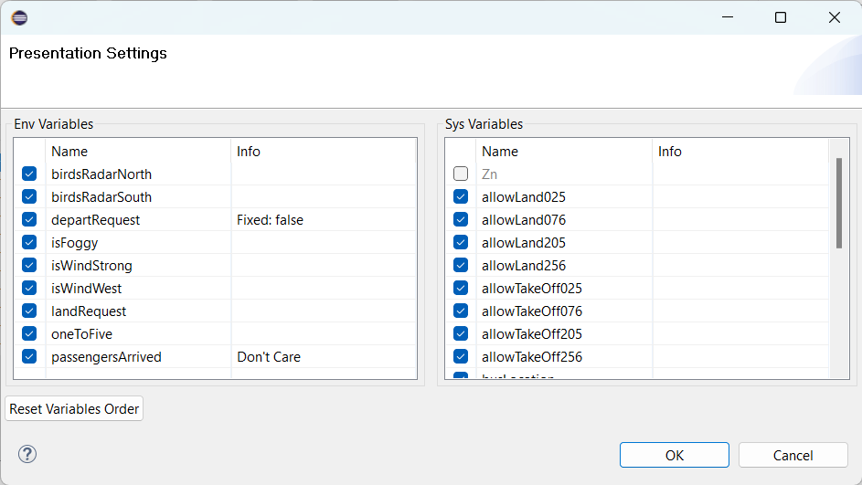
The Extended Variables Panel
Shows both player variables
Reset reordered variables

Slide 5
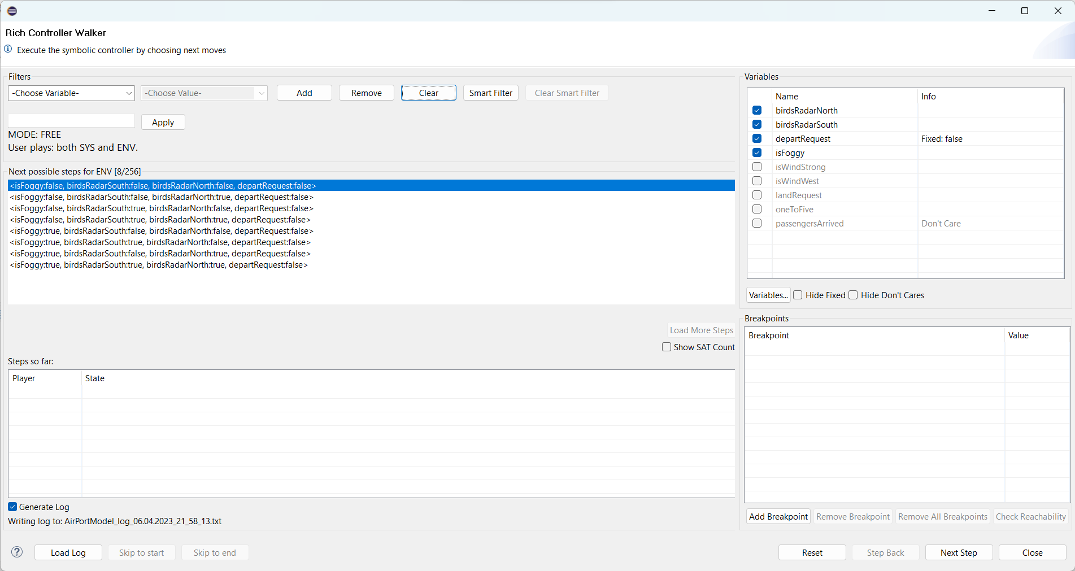
Hiding Variables
8 displayed results out of 256 total
Hidden variables are grayed-out

Slide 6
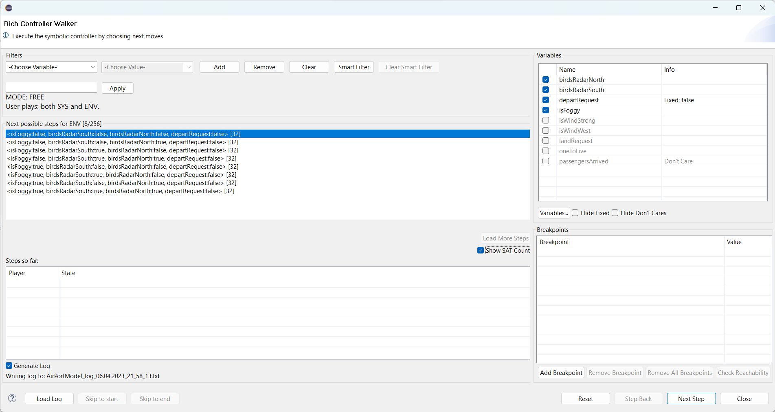
Hiding Variables – SAT Count
Tick to show how many options are abstracted by each displayed option
Note: may be slower

Slide 7
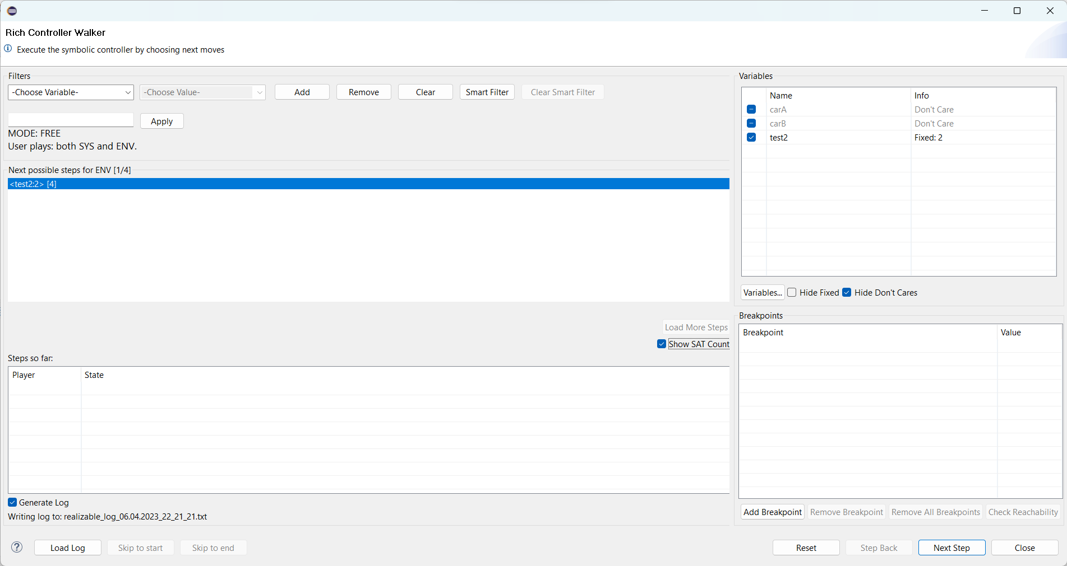
Hide Fixed / Don’t Cares
Can’t unhide variables hidden as fixed/don’t cares

Slide 8
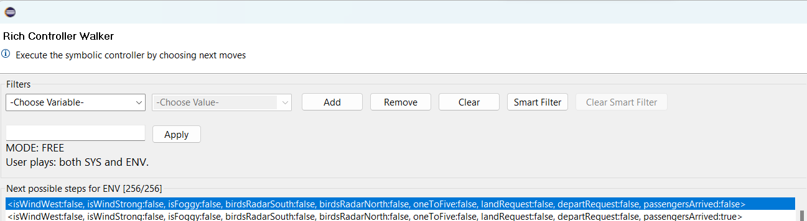
Smart Filters
Used to find out patterns while debugging the specification
Find variable assignments that “determine” all other variables:
Make them either fixed or don’t-care
Open Smart Filters Dialog

Slide 9
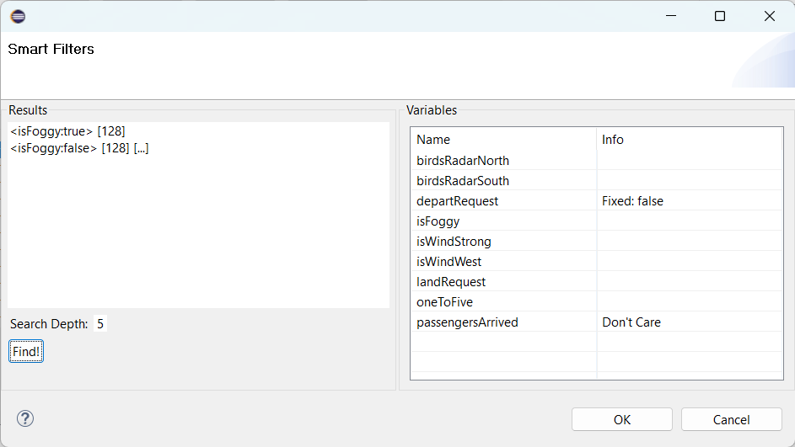
Smart Filters dialog
Number of options abstracted by each assignment
Variables Panel
Filter Results
Drag & Drop rows to reorder variables

Slide 10
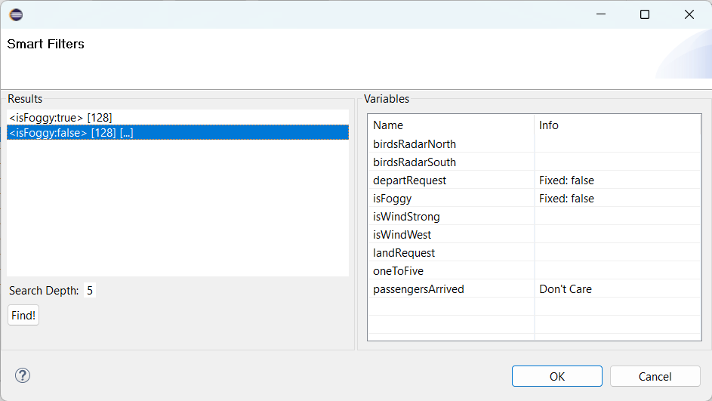
Incomplete Assignments
The […] mark incomplete assignments
Not all variables are determined

Slide 11
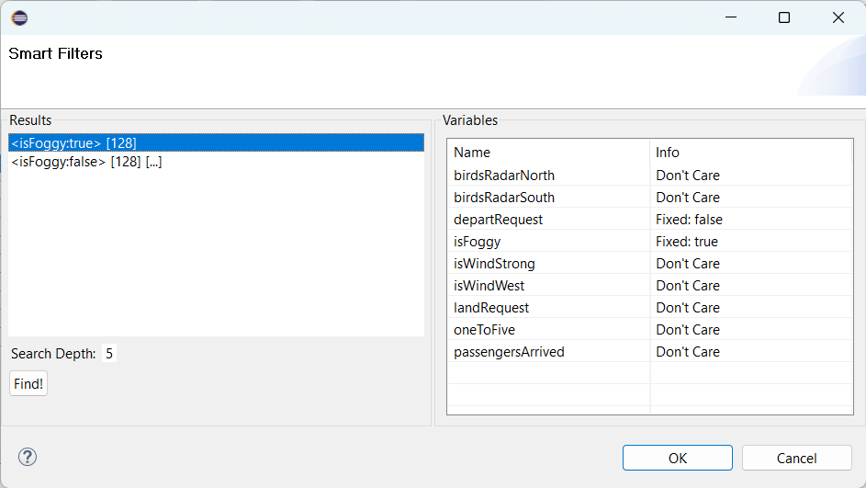
Complete Assignments
All the variables are either fixed or don’t care

Slide 12
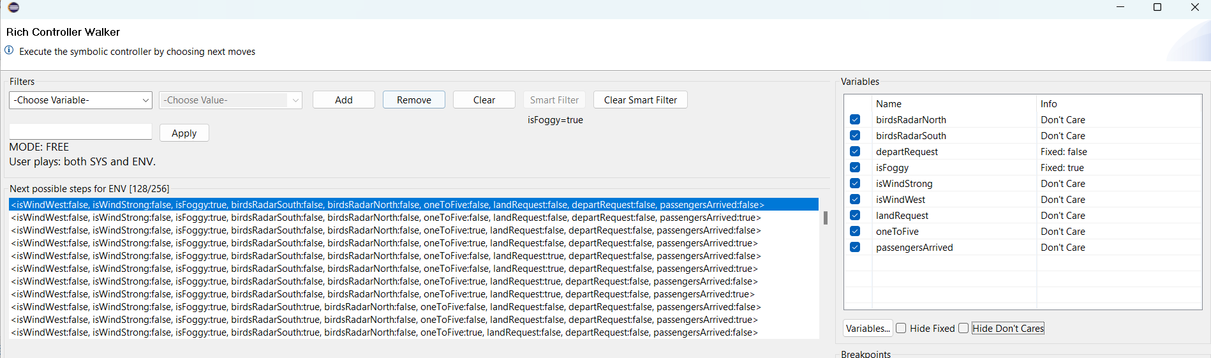
Accepting the Filter
The filter is applied to the variables and the results

Slide 13
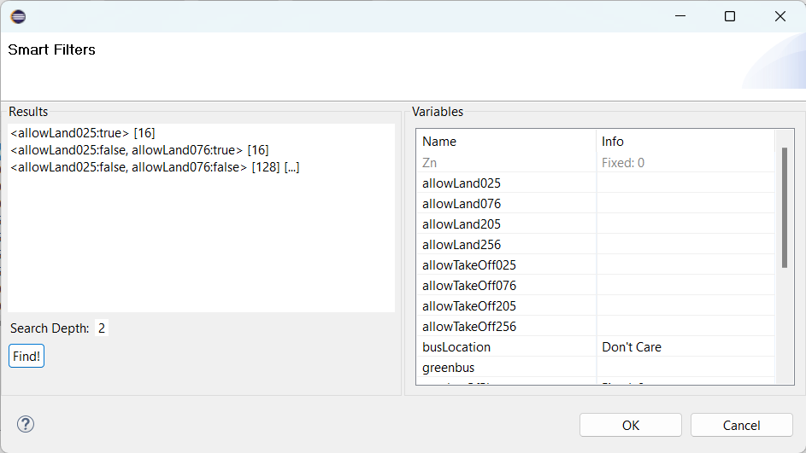
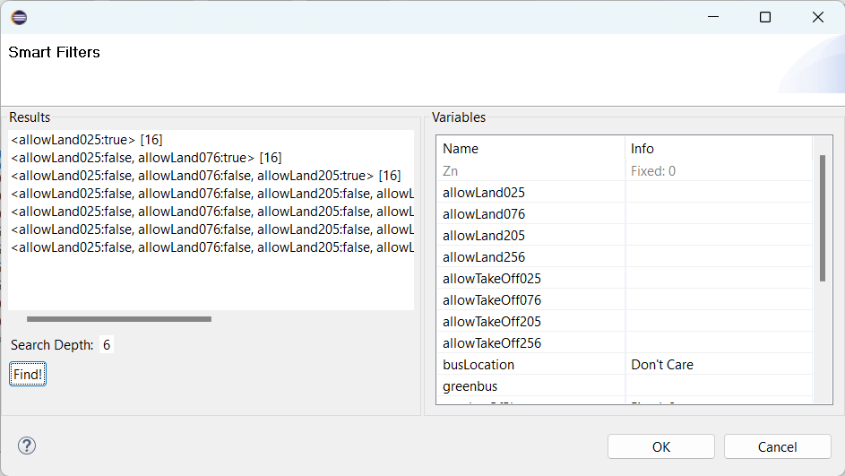
Smart Filter Depth
Depth=2
Depth=6, Note the longer results

