Slide 1
Generative Adversarial Nets
Prepared by Group E

Slide 2
Contents
Introduction
Related Work
Adversarial Networks
Theoretical Results and Key Concepts
Experiments & Results
Advantages and Disadvantages
Improvements & Applications
References & Questions

Slide 3
Introduction
Basics:
Discriminative algorithms try and classify input data - they predict the likely label of an object given its set of features.
Generative algorithms do the ‘opposite’ - they predict the likelihood of the features given the label of the object.
GANs:
A GAN (Generative Adversarial Network) is a type of deep neural network architecture which pits a discriminative network against a generative one - this is the model proposed by the paper.
The generator generates new data samples and the discriminator evaluates its authenticity, it decides whether or not the new sample belongs to the actual training data set or not.
Counterfeiter Analogy:
The role of the generator may be thought of as that of a team of counterfeiters: trying to produce fake currency, which can pass through the system without detection, while the role of the discriminator is that of the police: trying to determine which currency is real and which is fake.
As the counterfeiters techniques becomes more complex so do the methods of detection employed by the police - it is this ‘competition’ that drives both sides to improve their methods until the fake currency is indistinguishable from the real currency.

Slide 4
Related Work
Recently:
Before GANs, most successes in deep learning have involved discriminative models such as in image classification due to relatively ‘well-behaved’ nature of the training processes.
Generative models have had less success due to a number of difficulties, for example intractable computations that arise in maximum likelihood estimation.
Other Approaches:
Restricted Boltzmann Machines (RBMs) - a type of Recurrent Neural Network.
Deep Boltzmann Machines (DBMs) - a type of Markov Random Field.
Deep Belief Networks (DBNs) - a type of deep neural network which can learn to reconstruct its inputs probabilistically.
Variational Auto-encoders (VAEs) - can be used to generate many kinds of complicated data.
However, these different approaches all encounter some difficulties at some point in the process. A summary of these difficulties is given in the table on the next slide [1].
The model proposed by the paper side-steps a number of these difficulties.

Slide 5
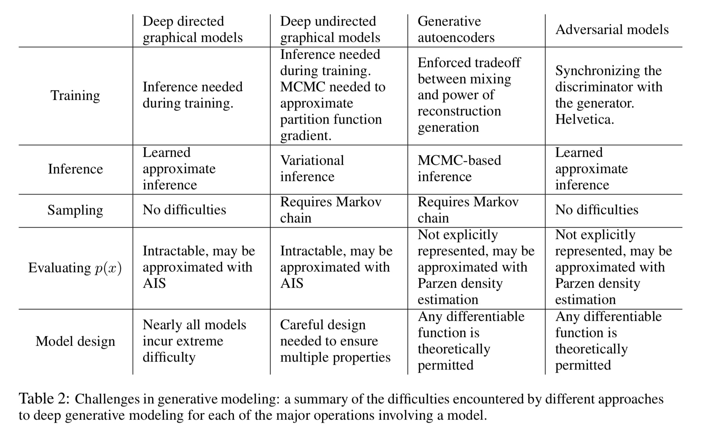
Table taken from [1]

Slide 6
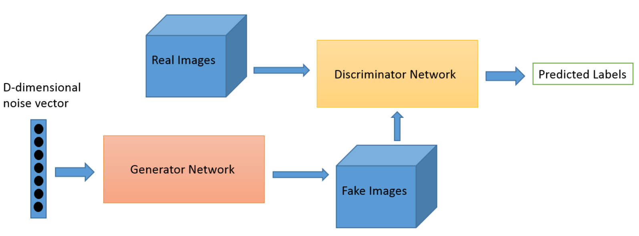
Adversarial Networks
Based on game theory where a generator (G) network competes against an adversary, the Discriminator (D) network
(Diagram from: https://deeplearning4j.org/generative-adversarial-network)
Generator, G, takes random numbers and produces an output.
The generated output is fed to the discriminator, D, together with output from the actual dataset
D generates probability estimates from the real and generated images predicting authenticity (1) and fake (0)
There is a double feedback loop where
the discriminator is in a feedback loop with the real images and
the generator is in a feedback loop with the discriminator.

Slide 7
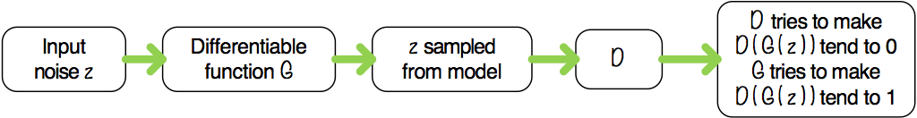
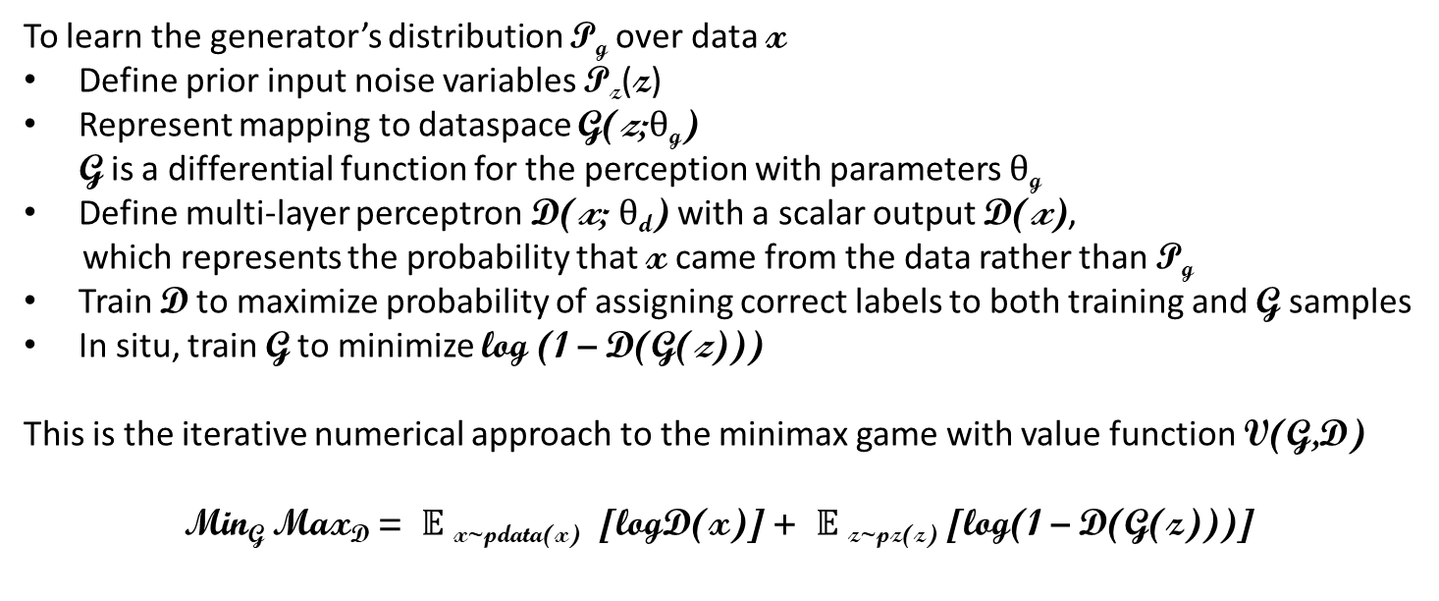
Adversarial Networks

Slide 8
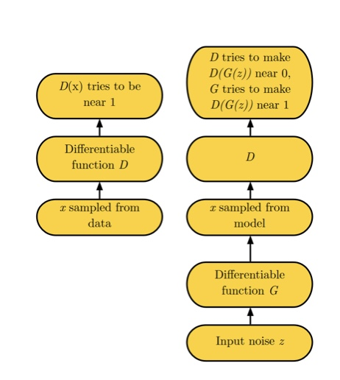
Adversarial Networks
The computation is carried out in two loops.
The cost of optimising D in the inner loop is expensive and given finite data sets it would tend to overfit.
The workaround when G changes slowly is to alternate between
k steps of optimising for D and
one step of optimising for G thus maintaining D close its optimal solution
The min max argument above, provides insufficient gradient for G to be a good learner.
Early learning in G is poor
Samples are rejected with high confidence by D as they are different from the training examples.
As log (1 – D(G(z))) values approach its limit the resulting curve starts to level out and become horizontal (or saturates).
An alternative is to train G to maximise D(G(z)). This results in stronger gradients in the earlier stages

Slide 9
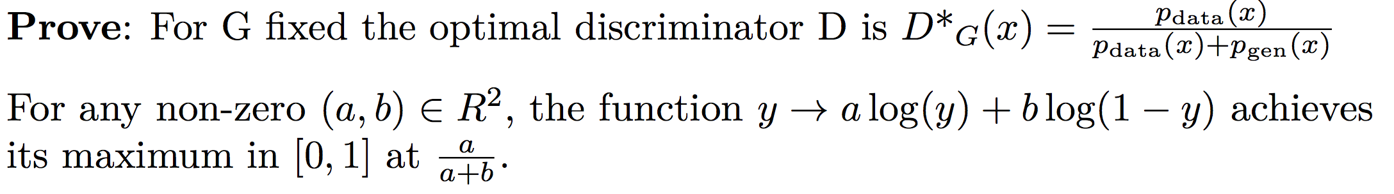
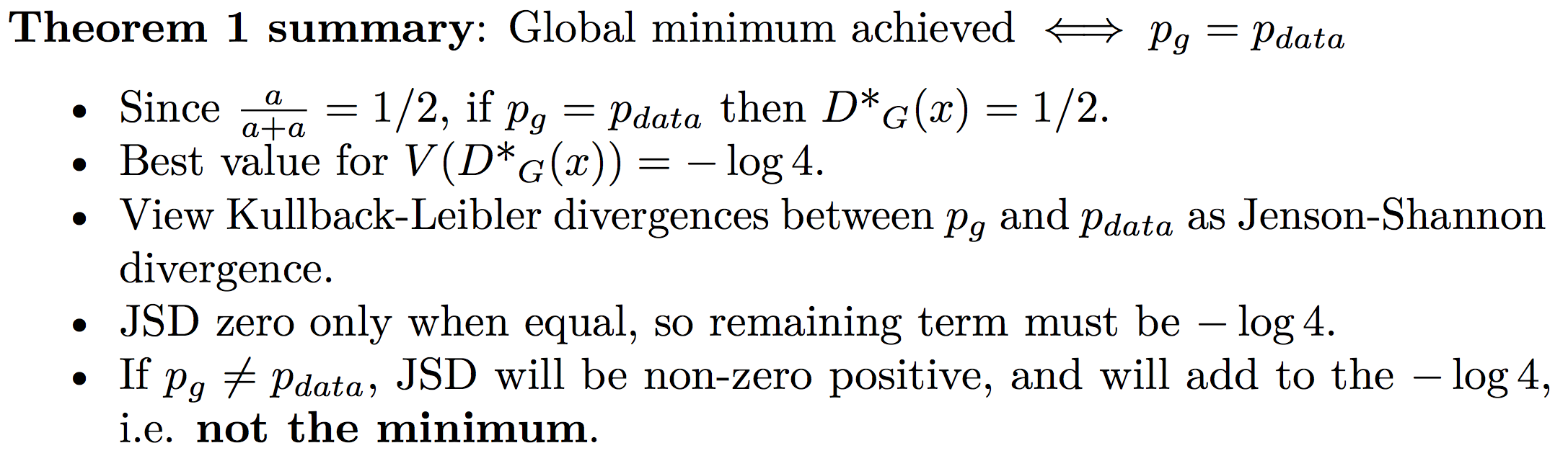
Proof: Global optimum for Pg = Pdata
- Demonstration: https://www.desmos.com/calculator/odj1obavmt

Slide 10
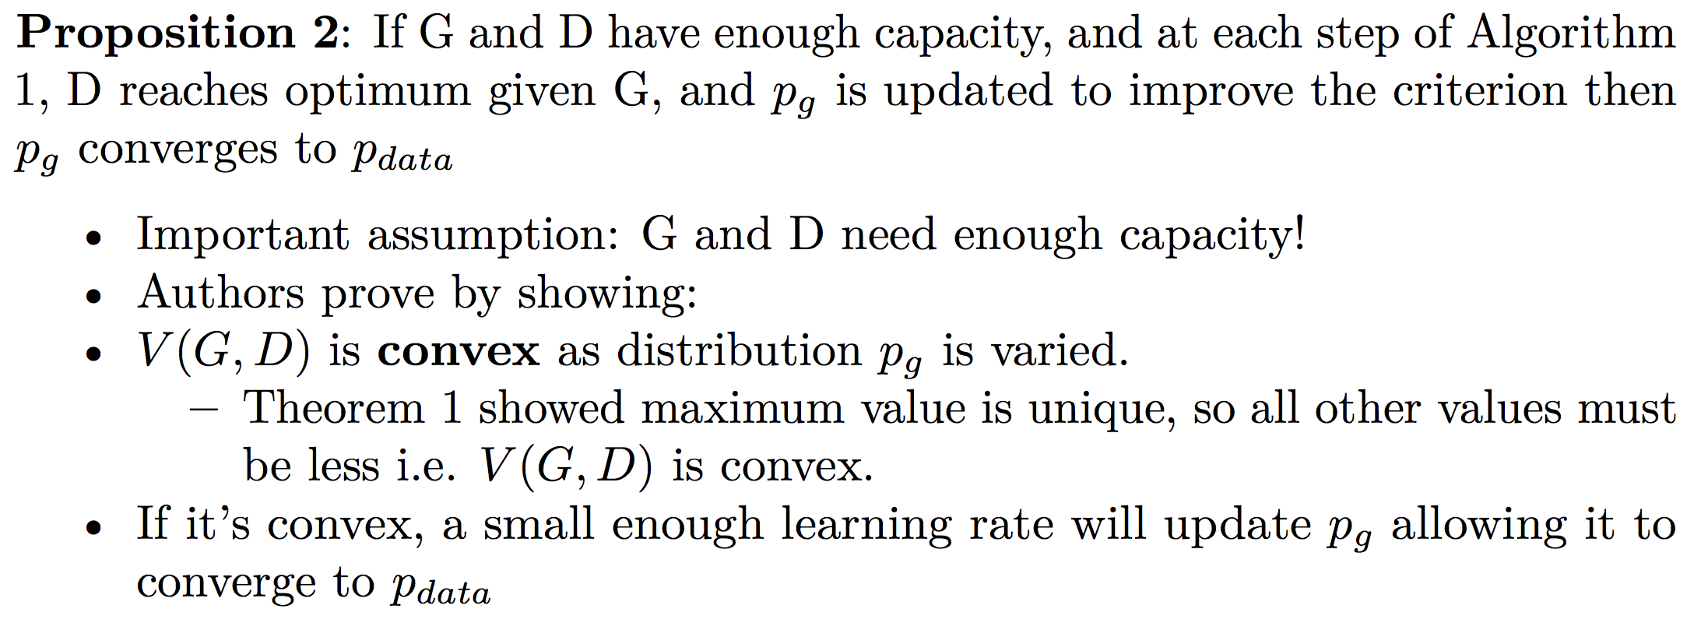
Proof: Convergence of gradient-based learning
​
​
​
​
​
​
​
​

Slide 11
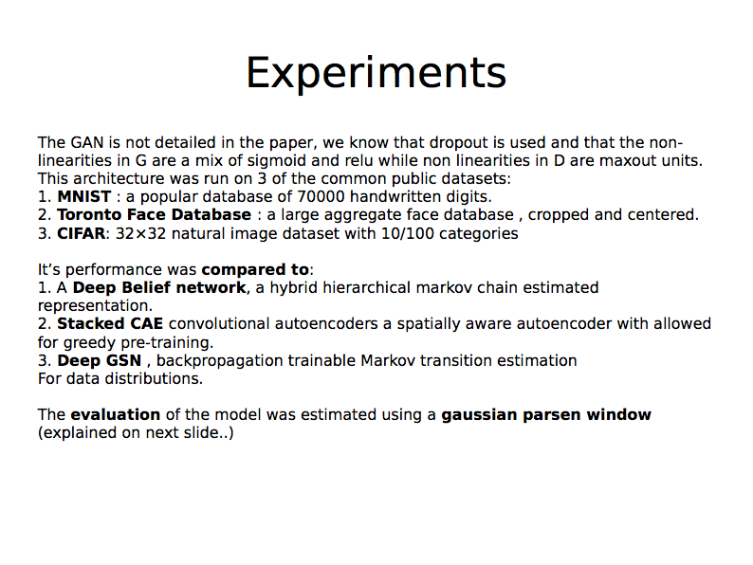

Slide 12
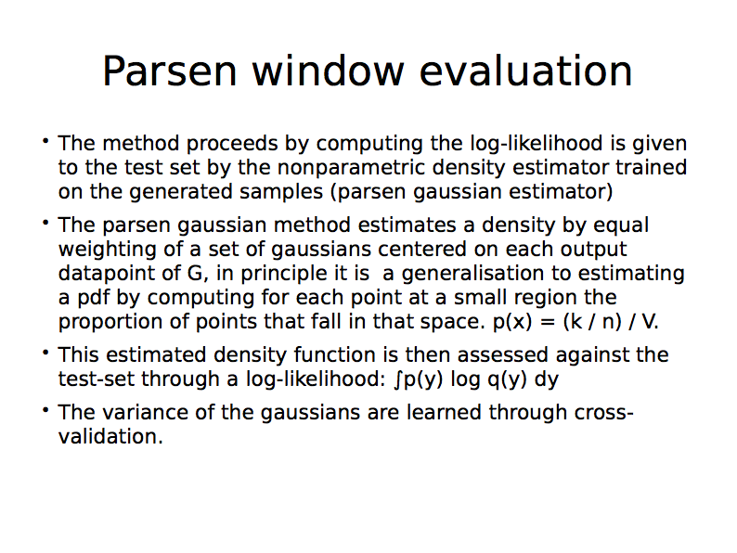

Slide 13
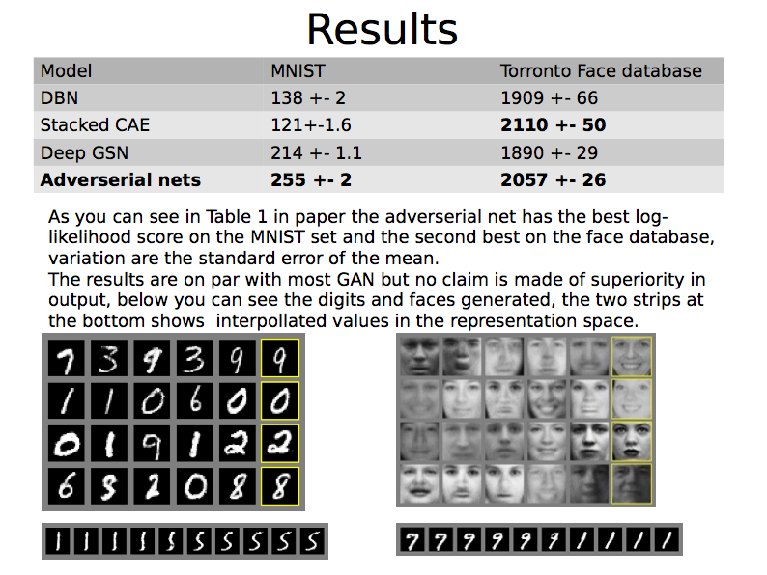

Slide 14
Pros and Cons of GAN
Advantages
Disadvantages
Back-propagation used to obtain the gradients, no Markov chains required
No inference is needed during training
The generator is updated by gradients and not input data so doesn’t copy the components of input
Requires synchronization of Discriminator with Generator as there is no explicit representation of p_{g}(x) [Helvetica Scenario]
GANs are not very optimized at differentiating perspectives

Slide 15
Further Improvements
Conditional Generative Model of GAN
Both generator and discriminator are conditioned on some data c (class label or data from some other modality). C is fed to both the generator and discriminator as additional input layer such that c and input are combined in a joint hidden representation.
Semi Supervised Learning with GAN
A technique in which both labelled and unlabelled data are used to train a classifier. The discriminator is transformed into a multi-class classifier.
Deep Convolutional GAN (DCGAN)
The generator of the DCGAN uses the transposed convolution technique (reverse of convolution) to perform up-sampling of 2D image size. Whereas the generator of the simple GAN was a simple fully connected network.
Efficiency Improvements during training GAN
GAN can be improved by having better methods to synchronize G and D or by finding a better distribution to sample z from during training.
Notes:
Conditional version of Generative Adversarial Nets (GAN) where both generator and discriminator are conditioned on some data c (class label or data from some other modality). C is fed to both the generator and discriminator as additional input layer such that c and input are combined in a joint hidden representation.
Semi-supervised learning is a technique in which both labelled and unlabelled data are used to train a classifier. The discriminator is transformed into a multi-class classifier.
DCGAN The generator of the DCGAN uses the transposed convolution technique (reverse of convolution) to perform up-sampling of 2D image size. Whereas the generator of the simple GAN was a simple fully connected network.
Training efficiency of GAN can be improved by having better methods to synchronize G and D or by finding a better distribution to sample z from during training.

Slide 16
Applications
Image translation and style transfer
CycleGAN - Image from an input domain D_{i} is transformed into an image of target domain D_{t} without necessarily having a one-to-one mapping between images from input to target domain in the training set.
Image super resolution
SRGAN
Data augmentation
A Network can be trained using simulated data generated by GAN to avoid human labelling

Slide 17
References
[1] Goodfellow, I. J.; Pouget-Abadie, J.; Mirza, M.; Xu, B.; Warde-Farley; D., Ozair, S.; Courville, A.; Bengio, Y.; “Generative Adversarial Nets”, <http://www.eecs.qmul.ac.uk/~sgg/_ECS795P_/papers/WK07-08_Goodfellow_GAN_NIPS2014.pdf>.
[2] “GAN: A Beginner’s Guide to Generative Adversarial Networks”, <https://deeplearning4j.org/generative-adversarial-network>.
[3] Goodfellow, I.; Bengio Y.; Courville, A.; “Deep Learning”, Chapter 20, <http://www.deeplearningbook.org/contents/generative_models.html>.
[4] Goodfellow, I; “NIPS 2016 Tutorial: Generative Adversarial Networks”, <https://arxiv.org/pdf/1701.00160.pdf>
[5] Shaikh, F; “Introductory Guide to GANs and their promise!”, <https://www.analyticsvidhya.com/blog/2017/06/introductory-generative-adversarial-networks-gans/>

Slide 18
Questions?

Slide 19
Contributions
Marium Fayyaz – Advantages/Disadvantages, Improvements, Applications.
John Flynn – Theoretical Results & Key Concepts.
Houssem El Fekih – Experimentation, Results.
Conal Walster – Introduction, Related Work, Slide editing & amalgamation.
Ahad Fakim – Adversarial Networks/Algorithm.

