Slide 1

Cybersecurity
Author: Osipenko D.V.
595 group

Slide 2
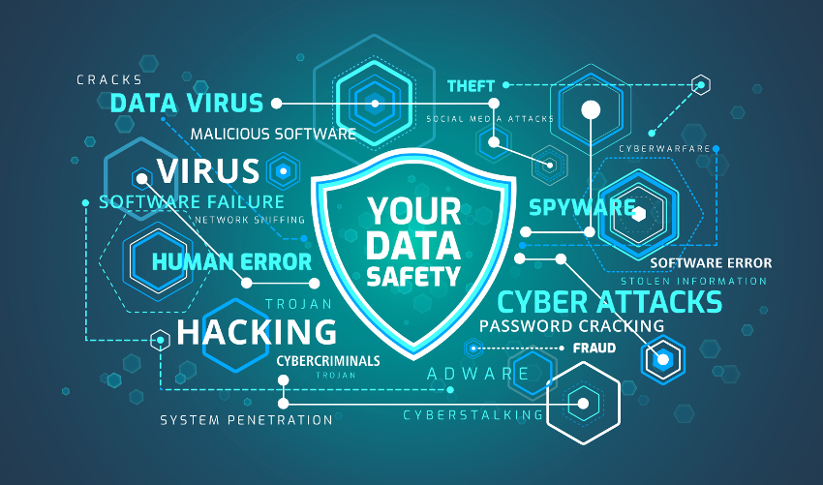
Cybersecurity is …
the practice of ensuring the integrity, confidentiality, and availability (ICA) of information.
comprised of an evolving set of tools, risk management approaches, technologies, training, and best practices designed to protect networks, devices, programs, and data from attacks or unauthorized access.

Slide 3
2020 …
By March, most people that could do so were now working from home. That created a number of cybersecurity challenges that had to be addressed as a priority. This was an issue because many homeworkers were now lacking the corporate protection they had when working in the office.
Almost half of respondents had either not heard of or did not know what ransomware is. Furthermore, one-quarter of public sector workers had either not heard of or did not know what phishing is. Also, 11% admitted they had clicked on a link in an unsolicited email at work.
The research revealed an obvious vulnerability and one that organizations needed to address quickly with training.

Slide 4
One of the best solutions was security education

