Slide 1
Wave generator programs
Higher-Order- Spectral-Method
(HOSM)
Boussinesq
Shallow Water Model
Measurement
Wave reconstruction
SWD-file
The
spectral_wave_data
interface
API
CFD, BEM, HPC, SPH…
programs
Statistical-tools
Visualization tools
Scripts
Application programs

Slide 2
SpectralWaveData.cpp
spectral_wave_data.py
SpectralWaveData.h
spectral_wave_data.h
spectral_wave_data_c.f90
ISO_C_BINDINGS
spectral_wave_data.f90
Shape
Impl.
1
Shape
Impl.
2
Shape
Impl.
3
Shape
Impl.
…

Slide 3
Examples of Ocean Wave Generators
Higher-Order-Spectral-Method (HOSM)
Boussinesq
Shallow Water Model
Measurement
Wave Reconstruction
SWD-file
The
spectral_wave_data
interface
MIT license
API
CFD, BEM, HPC, SPH…
programs
Statistical-tools
Visualization tools
Scripts
Application programs

Slide 4
Application Program
Generic Interface
Impl.
A
Impl.
B
Impl.
C
Impl.
…
SWD-file

Slide 5





$$z$$
$$x=λ_{max}$$
$$x$$
$${(x_{sf},z_{sf})}_{i}$$
sea floor
$$n_{sf}=6$$

Slide 6



$$y$$
$$γ_{j}$$
$$x$$

Slide 7
__animation__.pvd
swd2vtk.inp
swd2vtk
my_output_dir
VTK-files

Slide 8
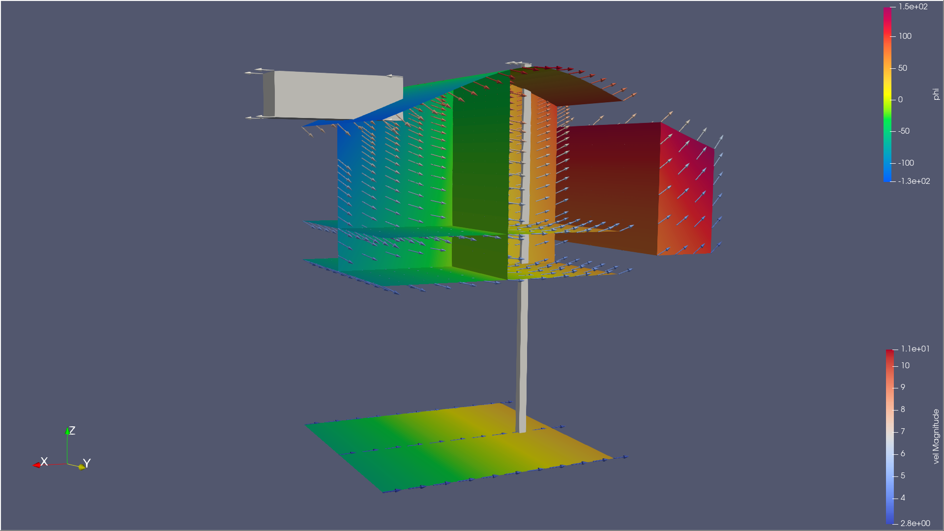
Reference Box
Free surface
Vertical cuts
Vol-3d
Horizontal cuts
Reference Box
Sea floor

