Slide 1
DIGITAL TRACK · TRACK A · PROJECT UDYAM DIGITAL
Udyam Express
From 'what do I need?' to 'it's live' in one phone session, for India's small businesses
Team Hopeful · NSUT
Anshul Dhoptey · Shiyon Tom Sherin
Notes:
Cover. Team Hopeful, NSUT. Our answer to Project Udyam Digital: Udyam Express.

Slide 2
Only 7 in 100 SMB leads go live, and 73% of the 17.6-day wait happens before anyone installs anything
Accel Business SMB funnel, one quarter (Apr–Jun 2026), 5,000 leads
Where 5,000 leads go
Where they die (leads lost, top reasons)
The owner’s experience
Step | Lost | Top reasons
Lead → contact | 1,594 | Unreachable 805 · not interested 470 · wrong number 319
Contact → needs | 1,432 | No time for a visit 531 · visit never scheduled 296
Needs → quote | 1,113 | Price 414 · competitor 207 · too complex 206 · too slow 179
Quote → KYC | 273 | Missing GST/Udyam 94 · paperwork 79 · signatory 53
KYC → live | 220 | Install > 21 days 98 · cancelled 53 · not feasible 41
17.6
3.0
days to go live
status chases
12.8 before install
per customer
₹15k
−25
cost to acquire
NPS
per activation
activated base
Field visits, a PDF quote and paper KYC: a journey built for corporates, sold to a kirana owner.
Step pass rate: 68% · 58% · 44% · 68% · 63%
SO WHAT
Owners want these products; the journey loses 93 in 100 of them. Udyam Express lifts conversion to 13.8% and cuts CAC to ₹7.1k (Base case).
Source: smb_leads.csv (5,000 leads, synthetic case data); team analysis. Stage days = mean for the 368 activated customers. NPS = % promoters (9–10) minus % detractors (0–6).
Notes:
The funnel matches the case appendix. The biggest single leak is needs-to-quote (44% pass). Visits cost 827 leads at the contact stage. 12.8 of the 17.6 days pass before installation even starts: contact 2.0, needs 3.0, quote 4.1, KYC 3.8, install 4.8 days.

Slide 3
Root cause: a GSTIN wall, a confusing quote and silent installs, and micro customers lose money on every sale
Four leaks explain most of the loss, and every one of them is a digital-journey problem
S1 · No GSTIN, no sale: KYC is a wall
S3 · The quote leaks 1,113 leads
≈3.8× higher odds of activating with a GSTIN, other factors held equal
47.5% of firms under ₹40 lakh turnover have no GSTIN; many sit below the GST threshold, yet KYC asks for one
Only 44% pass from needs to quote, the steepest step
Regional-language leads pass the quote at 39.9% vs 45.4%
S5 · Every status chase raises churn
S6/S7 · Micro loses money; compliance has holes
+0.33 log-odds of churn per chase, segment held equal (p = 0.014)
NPS falls from −3 (1 call) to −63 (5 calls)
Segment | Share | CAC | ARPU/mo | LTV/CAC
Micro | 54% | ₹20,007 | ₹2,505 | 0.9×
Prof. offices | 25% | ₹10,695 | ₹6,796 | 6.1×
Multi-site + mfg | 21% | ₹15.5k | ₹19.9–31.2k | 15–21×
22 customers activated on a cancelled or suspended GSTIN
15% of bundles break a catalogue rule
₹53k field-sales CAC on micro
SO WHAT
Fix the journey and micro flips from value-destroying (0.9×) to 4.5× LTV/CAC, while the compliance holes close.
Source: smb_leads.csv, mock_gstin_registry.csv, product_catalogue.csv; team analysis. GSTIN odds ratio from logistic regression controlling for segment, source, tier, turnover, language (≈3.7–3.9×). LTV at an assumed 40% contribution margin, 36-month cap.
Notes:
S1: conversion 9.6% vs 2.0%, KYC pass 80.6% vs 24.7%. S3: needs-to-quote drop reasons. S5: churn rises with chase calls; buckets have 34/84/137/70/43 customers. S6: micro economics. S7: 22 activations on cancelled or suspended GSTINs; cancelled GSTINs even activate at 10.8%, so status is never checked.

Slide 4
Udyam Express takes an owner from 'what do I need?' to 'it's live' in one phone session
Four digital steps remove the drop reasons behind 2,800+ lost leads; people step in only where a visit pays
1 Advisor
2 Quote & checkout
3 Smart KYC
4 Tracker
WhatsApp / app, 10 languages
One monthly price
Minutes, not days
Install slot + live status
5 questions, no visit
Eligible bundles only
OTP-verified number
Add-ons switch on/off
Instant, plain language
UPI Autopay
GSTIN + Udyam lookup
OCR + tamper checks, e-sign
Lawful GST-free path
Push updates at each step
5G FWA if fibre fails
No need to call
Removes: no-time-for-visit 531, visit not scheduled 296, unreachable 805
Removes: too complex 206, too slow 179, price shock 414
Removes: missing docs 94, paperwork 79, mismatch 47, signatory 53
Removes: install > 21 days 98, cancellations 53; 3 chases → ≤ 1
Who first (Q1)
Starter bundles (catalogue-priced)
People where they pay (Q4)
# | Segment | Mode
0 | Existing Accel customers (38% of leads, convert 1.5×) | Cross-sell
1 | Professional offices + micro (79%) | Fully digital
2 | Multi-site + manufacturers (21%) | Assisted
Bundle | ₹ / month | GSTIN?
Dukaan Entry (AirFiber + postpaid) | 1,198–1,498 | No
Dukaan Starter (fibre, POS, Wi-Fi) | 2,296–3,096 | No
Clinic & Office Pro | 4,016–5,191 | No
Factory Connect / Multi-site | 14k–41k | Yes
Field sales: off micro (₹53k CAC); multi-site and factories, from a propensity-ranked call list
Partners → Udyam Mitra: install and assisted sign-up; paid on every activation in their pin code
Inside sales: KYC exceptions and hand-offs
SO WHAT
Digital for the 79%, a visit only where it pays: the same journey serves self-serve owners, partners and field reps.
Source: product_catalogue.csv (catalogue price ranges, eligibility rules checked); smb_leads.csv. Drop counts are leads lost to the reasons each step removes.
Notes:
Each step is mapped to the drop reasons it removes. Micro median telecom spend is ₹900/month, hence the ₹1,198 entry pack. WhatsApp API and SMS need a GSTIN, so they become available once a GSTIN is verified.

Slide 5
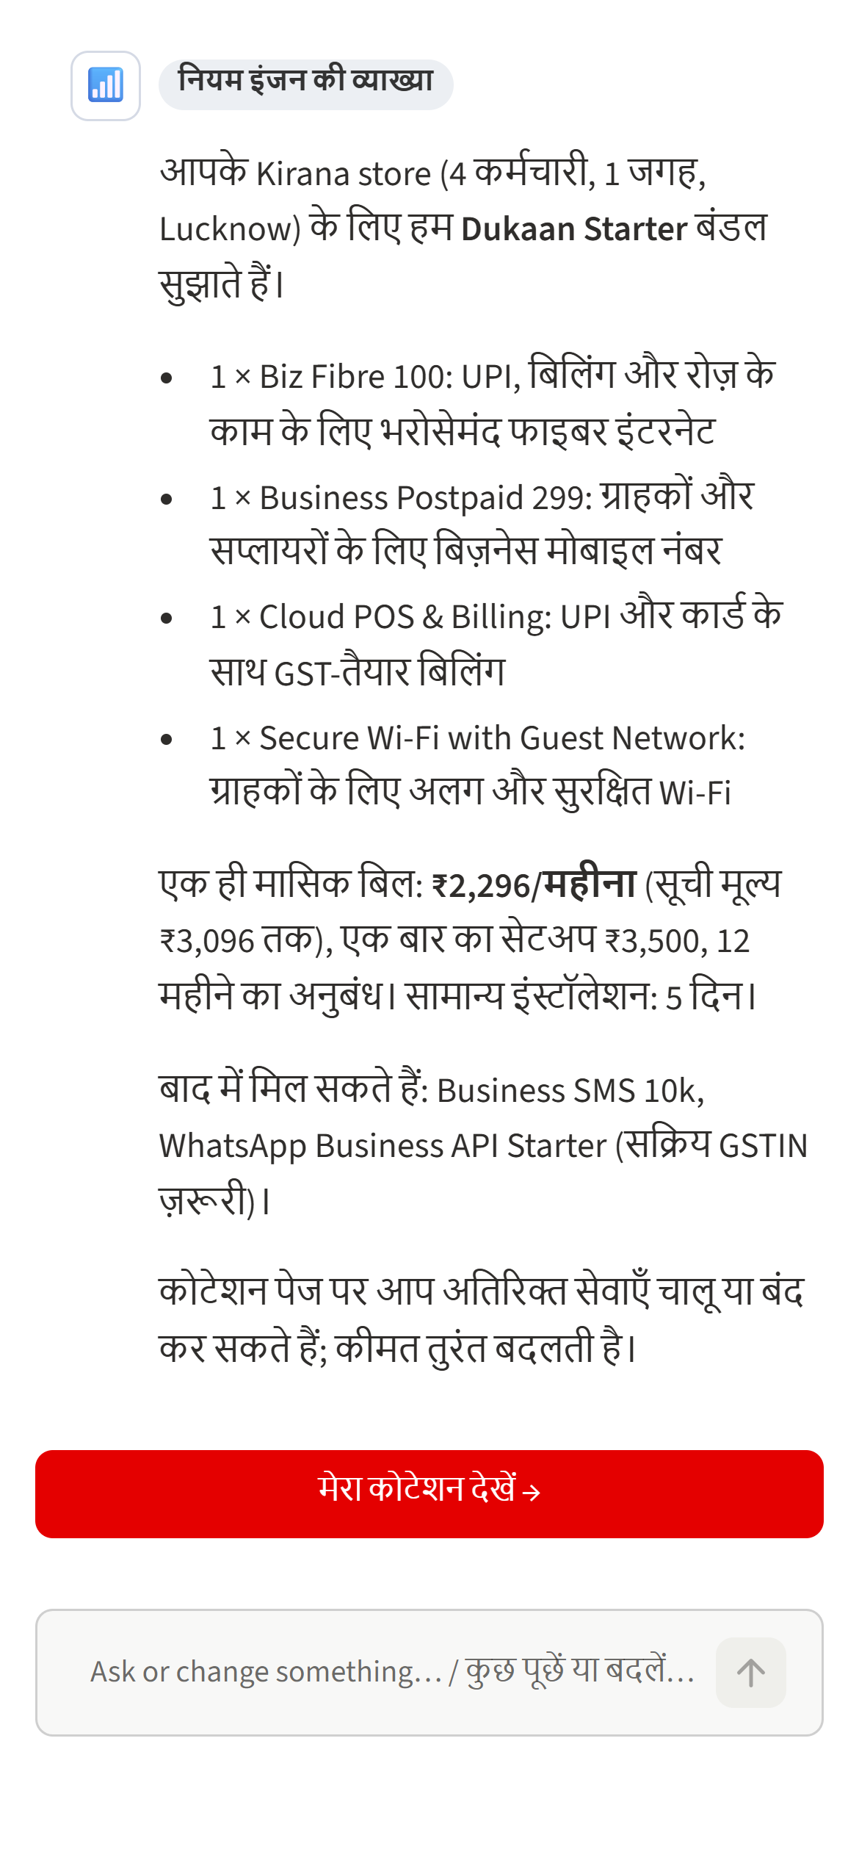
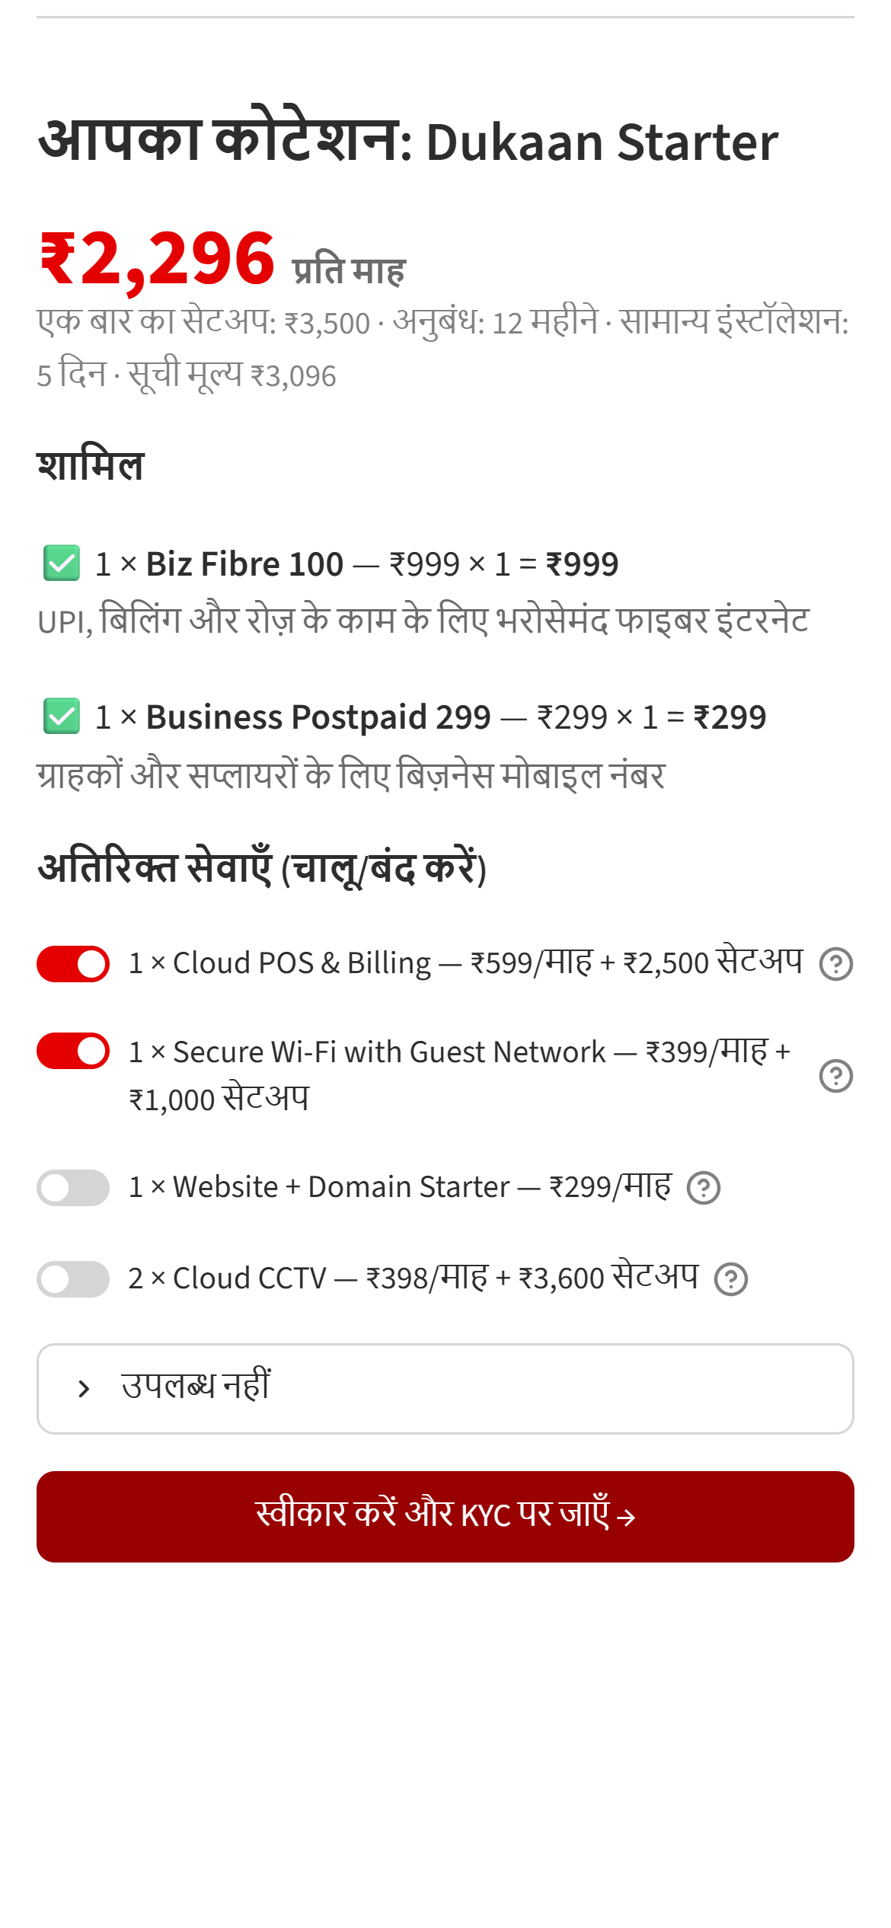
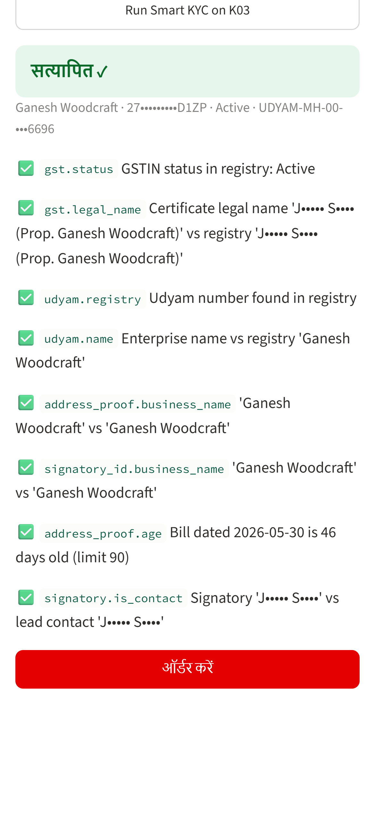
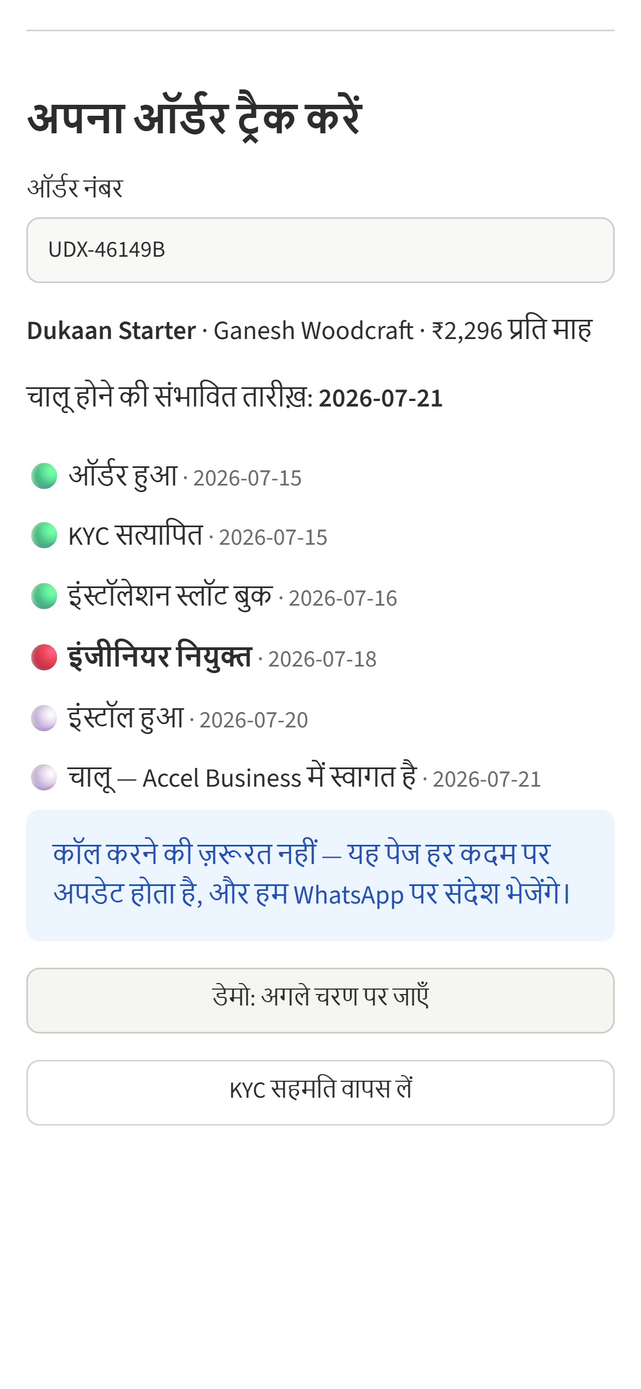
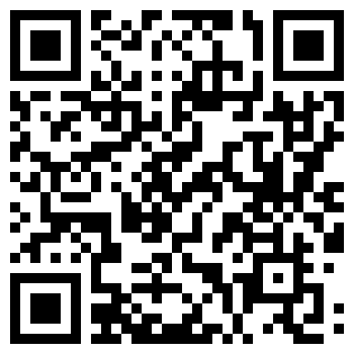
Prototype: the advisor recommends only bundles an owner can legally buy, and Smart KYC flags all 8 problem files
Built on the case pack: mock GSTIN and Udyam APIs backed by the registries; every price from the catalogue
The journey on a phone, in Hindi
Architecture: GenAI explains, the rules engine decides
Channels
Orchestrator
Services
Data
WhatsApp · RCS · web · partner app
LLM advisor + catalogue rules engine
GSTIN · Udyam · OCR · e-sign · quote · install
Consent store · masked logs · order DB
Smart KYC on 12 specimens (Q3)
DPDP by design
Verdict | Applicants
Pass | K03 · K08 · K09 · K12
Auto-fixed | K02 skewed scan · K05 Udyam from registry
Re-capture | K04 blurred · K11 bill 257 days old
Reject / hold | K01 cancelled GSTIN · K06 GSTIN altered · K07 name altered · K10 wrong signatory
Consent screen before KYC; purpose stated
Only the fields each step needs
GSTIN, Udyam and phone masked in logs and UI
Documents deleted after verification, except what DoT rules require
Full DPDP duties live by 13 May 2027
1 Advisor
2 Quote
3 Smart KYC
4 Tracker
Prototype screens · Hindi demo: kirana store, Lucknow, no GSTIN
15/15 advisor tests passed · 12/12 KYC verdicts match
Code: github.com/Spectre-anshul/Airtel-Sync-2026
SO WHAT
No quote can break a catalogue or KYC rule: the LLM talks, the rules engine prices, and every check is logged.
Source: team prototype; KYC results on the 12 specimen applicants (K01–K12), checked against mock registries with today = 15 Jul 2026. Screens captured from the running prototype; 15 advisor test scenarios in app/tests/test_advisor_scenarios.py.
Notes:
Screens are from the running prototype: the Hindi demo recommends Dukaan Starter at ₹2,296/month (setup ₹3,500, 12-month contract). The KYC screen runs specimen K03. The repo link and QR code open github.com/Spectre-anshul/Airtel-Sync-2026. Validation order: OCR, GSTIN checksum, registry status, Udyam lookup, cross-document name match, address age ≤ 90 days, signatory authority.

Slide 6
Others sell a product online; Accel sets up the whole business, verified and live, in under a week
Capability comparison for India’s SMB connectivity buyer (indicative, from public sources)
Capability matrix ● strong ◐ partial ○ absent
Where players sit
Capability | Accel today | Jio Business | Vi Business | Tata Tele | Local ISP | Fintech / SaaS | Udyam Express
One bundle, one bill | ○ | ◐ | ◐ | ◐ | ○ | ○ | ●
Self-serve needs discovery | ○ | ◐ | ◐ | ◐ | ○ | ● | ●
Vernacular journey | ○ | ◐ | ◐ | ◐ | ● | ◐ | ●
Instant registry KYC | ○ | ? | ? | ? | ○ | ◐ | ●
Order tracker | ○ | ◐ | ◐ | ◐ | ○ | n/a | ●
Trust / anti-fraud layer | ◐ | ◐ | ◐ | ◐ | ○ | ◐ | ●
Physical install reach | ● | ● | ◐ | ◐ | ● | ○ | ●
Fintech/SaaS
Udyam Express
Speed to live →
Jio
Local ISP
Vi
Tata Tele
Accel today
Breadth of bundle →
Threats and our answer
Price-led bundles (Jio): answer with a ₹1,198 entry pack and add-ons, not discounts (621 leads lost on price)
Fintechs own the Udyam moment: partner with them as distribution in Phase 3
? = not publicly verifiable. Fintech/SaaS = PhonePe Business, Zoho, Razorpay. PhonePe launched digital Udyam Assist registration with SIDBI in Sep 2025.
SO WHAT
Accel can win on breadth, trust and speed, backed by network fraud signals, install reach and pin-code partners that online rivals lack.
Source: TelecomTalk (Jio Business Broadband Max 801, 13 Mar 2026; Vi Business MSME MoU, 5 Aug 2026); PhonePe press release (digital Udyam Assist registration with SIDBI, 10 Sep 2025); Airtel press release (IQ Gateway, 5 Oct 2026); team assessment. Ratings are indicative.
Notes:
Ratings are indicative and based on public sources. Instant registry KYC for Jio, Vi and Tata Tele could not be verified publicly, so it is marked with a question mark.

Slide 7
Base case: 87% more activations, 53% lower CAC and +₹14.6 cr retained ARR from the same leads
One quarter of 5,000 leads; each drop reason is recovered at a judged rate, then haircut by a scenario factor (0.3 / 0.5 / 1.0)
13.8%
₹7,143
≤ 7 days
−28%
+₹14.6 cr
lead → live
CAC
target to go live
churn, every segment
retained ARR / yr
from 7.4%
from ₹15,053
from 17.6 (single site)
15.2% → 11.6% blended
₹19.3 → 33.8 cr
CAC bridge: what is earned vs assumed
Activations by scenario
CAC payback (months): today vs Base
₹15,053
−₹5,197
₹9,856
−₹2,713
₹7,143
Today
Funnel effect
Funnel only
Digital cost mix
Base case
CAC: ₹15.1k · ₹8.3k · ₹7.1k · ₹5.2k
Conversion: 7.4% · 10.8% · 13.8% · 24.1%
SO WHAT
Even the Conservative case pays: 47% more activations at 45% lower CAC. Micro alone moves from 0.9× to 4.5× LTV/CAC.
Source: Udyam_Digital_Model.xlsx (Scorecard, Sensitivity); smb_leads.csv. Assumptions: 40% contribution margin; ₹30 advisor and ₹50 KYC cost per lead; partner commission 1.5× MRR as today; churn ×0.72 from a segment-controlled logit (chases 3 → 2). ARR = 4 quarterly cohorts × 12, net of 6-month churn.
Notes:
CAC bridge: ₹15,053 today. Applying today’s per-stage cost ladders to the Base funnel gives ₹9,856 (−35%, earned by conversion). Removing visits for micro and professional offices, adding ₹30 advisor and ₹50 KYC cost per lead, gives ₹7,143. Recovery rates are judgement-based and will be measured against holdout cities in the pilot.

Slide 8
Pilot in 4 cities against 4 holdouts, scale to all 22 cities in 12 months, and be DPDP-complete before May 2027
A gated rollout: each phase starts only when the previous gate’s numbers are met
Roadmap (months)
M0
M3
M6
M9
M12
M15
M18
0 Harden prototype
Gate: 15/15 scenarios, KYC 12/12
1 Pilot (Wave 0 + 1)
Gate: conversion ≥ 1.5× holdout, CAC ≤ ₹9k
2 Scale to 22 cities, 10 languages
Gate: KPI targets met city by city
3 Assisted + embedded (UPI, accounting apps)
DPDP full duties by May 2027
Five metrics, 12-month targets (Q5)
Governance
Top risks → mitigation
Metric | Today | Target
Lead → live | 7.4% | ≥ 13%
Days to go live | 17.6 | ≤ 7
CAC per activation | ₹15,053 | ≤ ₹7,500
6-month churn | 15.2% | −25% / segment
Status chases (guardrail) | 3.0 | ≤ 1
Monthly steering: Head of SMB (chair), CDO, CISO/DPO, Channel, Finance; owns gates and price floors
Owners: product → KPIs; DPO → consent; Channel → partner policy
Wrong AI price → catalogue-only pricing, tests every release
Forged KYC → registry + checksum, humans on Red
Partner backlash → pin-code commission
Tier-2 installs → feasibility check, 5G FWA fallback
SO WHAT
The ask: 4 pilot cities, GSTIN and Udyam API access, and sign-off on the partner policy. Every phase is gated on measured results.
Source: team plan; DPDP Rules 2025 timeline (consent managers from 13 Nov 2026; full obligations 13 May 2027). Pilot cities: Delhi and Bengaluru (Tier 1); Lucknow and Vadodara (lowest-converting Tier 2).
Notes:
Wave 0 (existing Accel customers) launches first inside the pilot because they convert about twice as well. Holdout cities measure the true recovery rates that the model assumes.

Slide 9
Appendix A1 · Twelve signals planted in the leads data, and what each changes
# | Signal | Evidence | Design response
S1 | GSTIN is the KYC wall | 9.6% vs 2.0% conversion; quote → KYC 80.6% vs 24.7%; odds ≈ 3.7–3.9× | Registry lookup + GST-free path
S2 | Wait is before install | 12.8 of 17.6 days before installation | Digital contact, quote, KYC
S3 | Quote is the leak | 1,113 drops; 44% pass | Instant single price + toggles
S4 | Visits kill deals | 827 drops: no time 531, not scheduled 296 | No-visit advisor
S5 | Chases predict churn | 5.9% → 27.9% churn (1 → 5 calls); p = 0.014 | Tracker
S6 | Micro loses money | CAC ₹20,007, ARPU ₹2,505, LTV/CAC 0.9×; field micro CAC ₹53,026 | Digital only, entry pack
S7 | Compliance holes | 22 live on cancelled/suspended GSTIN; 21 GSTIN-only sales without one; 15% break rules | Rules engine + live status
S8 | Installed base converts ~2× | Prof. offices 15.3% vs 8.4%; multi-site 15.4% vs 8.3% | Wave 0 cross-sell
S9 | Micro price shock | Median spend ₹900/month vs ₹2,300+ starter | ₹1,198 entry pack
S10 | Leaky digital capture | WhatsApp leads 2.8%; 30.7% unreachable, 12.0% wrong numbers | OTP / silent auth
S11 | Vernacular gap | Regional 6.2% vs 8.0%; quote 39.9% vs 45.4% | 10-language journey
S12 | Tier-2 install; costly partners | KYC → live 51.8% vs 72.7%; partner cost = ₹900 + 1.5× MRR | FWA fallback; Udyam Mitra
Source: smb_leads.csv, registries, product_catalogue.csv; team analysis, independently recomputed. Effects are raw gaps unless noted.

Slide 10
Appendix A2 · How the impact model works, and every recovery assumption
Method
Drop reason | Leads | Recovery
Unreachable after 3 attempts | 805 | 30%
Owner had no time for a visit | 531 | 50%
Not interested on first call | 470 | 10%
Price too high | 414 | 20%
Locked in with provider | 325 | 0%
Wrong or invalid number | 319 | 0%
Visit not scheduled by sales | 296 | 70%
Only wanted a mobile plan | 280 | 0%
Competitor cheaper | 207 | 15%
Quote too complex | 206 | 70%
Drop reason | Leads | Recovery
Quote took too long | 179 | 85%
Decided to wait | 107 | 10%
Installation > 21 days | 98 | 50%
Missing GST/Udyam doc | 94 | 60%
Paperwork too long | 79 | 70%
Signatory not available | 53 | 60%
Cancelled before install | 53 | 30%
Document mismatch | 47 | 50%
Site not feasible for fibre | 41 | 60%
First payment failed | 28 | 60%
Map each of 20 drop reasons to the step that removes it
Set a recovery rate at full effect
Multiply by a scenario factor: 0.3 / 0.5 / 1.0
Rebuild each segment funnel: pass = (passed + recovered) ÷ entering
Conversion = product of the 5 pass rates
CAC = lead cost + ₹30 advisor + ₹50 KYC + partner commission; assisted segments keep field and partner costs
Churn × 0.72 (chases 3 → 2), from a segment-controlled logit
LTV at 40% margin, 36-month cap (sensitivity 30–50%)
Source: Udyam_Digital_Model.xlsx (Assumptions, Uplift Model). Recovery rates are team judgement at full effect; the Base case applies 50% of each. "Only wanted a mobile plan" and wrong numbers are not counted as recovered.

Slide 11
Appendix A3 · Smart KYC answer key: 12 specimen applicants
ID | Business | Verdict | What the checks found | Action
K01 | Vindhya Tours & Travels | Reject | GSTIN cancelled in registry; Udyam number blank (lead has no Udyam) | GST-free path; human review
K02 | Harmony Dental Care | Pass (fixed) | Skewed scan; matches registry after deskew | Auto-deskew
K03 | Ganesh Woodcraft | Pass | Consistent with both registries | None needed
K04 | Saffron Dental Care LLP | Re-capture | GST certificate too blurred to read | New photo or GSTIN lookup
K05 | Balaji Realty LLP | Pass (fixed) | Udyam certificate missing; found in registry. "Owner" for an LLP | Auto-fill; confirm partner by e-sign
K06 | Saffron Unisex Salon | Reject | GSTIN fails checksum; 8189 vs registry 5189 | Tamper flag; human review
K07 | Neelgiri Physio Clinic | Reject | Legal name "Shri" vs registry "Neelgiri" | Tamper flag; human review
K08 | Green Leaf Legal Associates | Pass | OCR O/0 confusion fixed by GSTIN position rule | None needed
K09 | Kaveri Insurance Advisors | Pass | Consistent; bill 5 days old | None needed
K10 | Kaveri Stays LLP | Hold | Signatory Nisha Arora ≠ owner Fatima Menon on lead | Partner authorisation + e-sign
K11 | Trinity Bake House Pvt Ltd | Re-capture | Bill 257 days old (> 90); "Owner" for a Pvt Ltd | New bill; director authorisation
K12 | Star Electronics | Pass | Consistent; bill 9 days old | None needed
Source: kyc_documents K01–K12, mock_gstin_registry.csv, mock_udyam_registry.csv; today = 15 Jul 2026. Udyam certificate dates and "major activity" are deliberately not matched: they differ from the registry on all 11 certificates.

Slide 12
Appendix A4 · Sensitivity: the case holds across scenario factors and margins
Lead → live conversion by scenario factor
LTV/CAC by assumed contribution margin (Base)
Margin | Micro | Prof. offices | Multi-site | Manufacturers
30% | 3.4× | 12.7× | 19.2× | 15.8×
40% (used) | 4.5× | 16.9× | 25.6× | 21.0×
50% | 5.6× | 21.1× | 32.0× | 26.3×
Propensity model: who to call first (AUC 0.71)
Top 30% of leads hold 53% of activations; the bottom 30% hold 8%
Top-decile conversion 13.4% vs 1.4% in the bottom decile
Used for the field-sales call list in Wave 2
Source: Udyam_Digital_Model.xlsx (Sensitivity). Scenario factor = share of each full-effect recovery rate achieved. LTV/CAC at Base funnel and cost.

Slide 13
Appendix A5 · Sources and data notes
Fact used | Source (checked 8 Nov 2026)
All funnel, KYC, catalogue and economics figures | Airtel SYNC case pack: smb_leads.csv, registries, product_catalogue.csv, kyc_documents (synthetic); Udyam_Digital_Model.xlsx
Udyam + Udyam Assist: over 7.9 crore enterprises (May 2026) | IANS, 14 May 2026
Active GST taxpayers 1.67 crore (30 Jun 2026); 76.9% proprietorships | GSTN, "9 Years of GST" report
DPDP Rules: consent managers 13 Nov 2026; full obligations 13 May 2027 | Legal500 and law-firm notes on DPDP Rules 2025
IQ Gateway with IQ Verify fraud scoring (5 Oct 2026) | Airtel press release
Jio Business Broadband Max 801 bundle (fibre + JioMeet / JioAttendance / JioGate) | TelecomTalk, 13 Mar 2026
Vi Business ReadyForNext: ~2.5 lakh MSMEs engaged | TelecomTalk, 5 Aug 2026
PhonePe launched digital Udyam Assist registration with SIDBI | PhonePe press release, 10 Sep 2025
15% of 30 mn formalised small businesses sell online | Bain & Meta, Win with Conversations, May 2024
Data notes: Accel Telecom is fictional and all case data is synthetic. Contribution margin (40%) and per-lead tool costs are team assumptions, tested in A4.

