Slide 1
HighV
Computer Vision

Slide 2
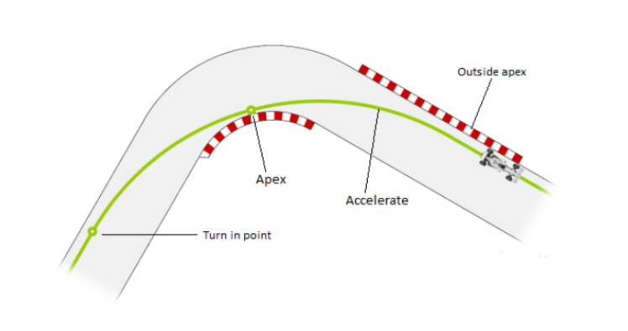
Motivation: Velocity-Position Trade-off
Classical lane following control restricts velocity
Intended velocity can be achieved by sacrificing the lane following

Slide 3
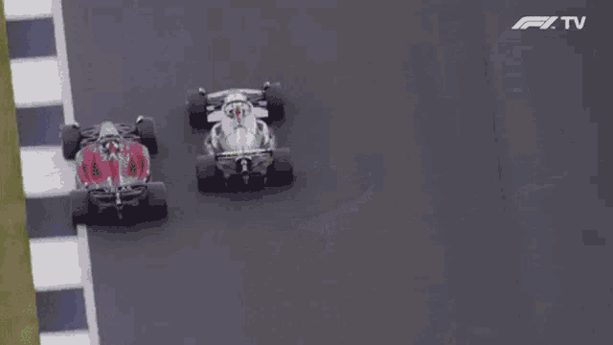
Idea
The main idea of the project is to make the system that will:
Make a test run on the highway
Analyze data from test run
Find turns with apex
Calculate optimal velocities

Slide 4
Methods

Slide 5
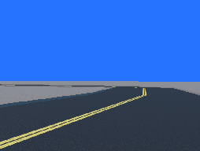
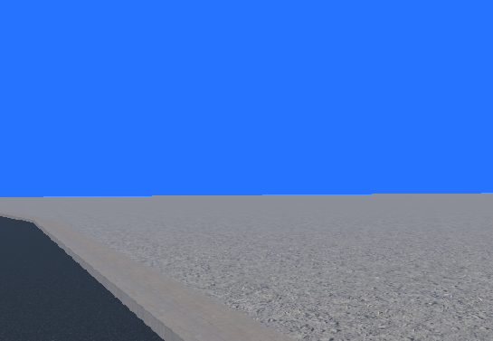
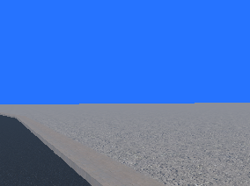
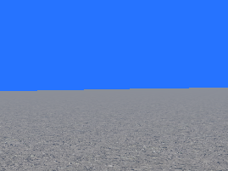
Multicamera
Problem! No road
Solution: few cameras

Slide 6
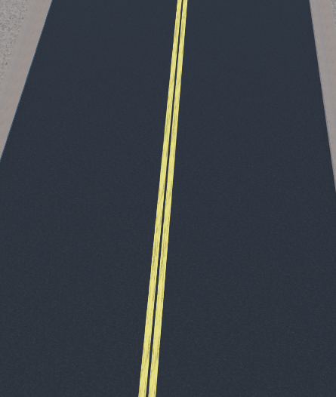
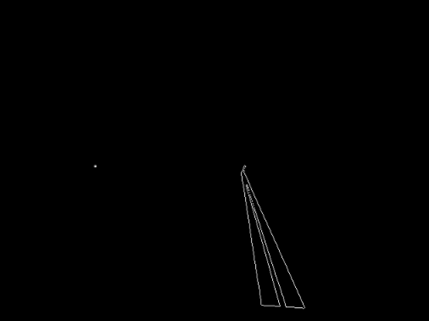
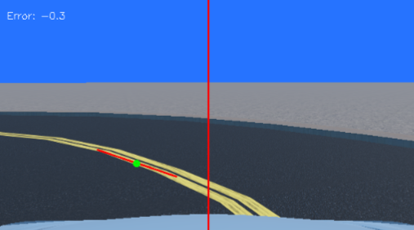
Image Processing
Original image
Canny
Hough

Slide 7
PD Controller Sensor Measurement
The purpose is to find the error between central red line and green dot.
The error can be either positive either negative.
The error shows the way to rotate and the intensity of rotation

Slide 8
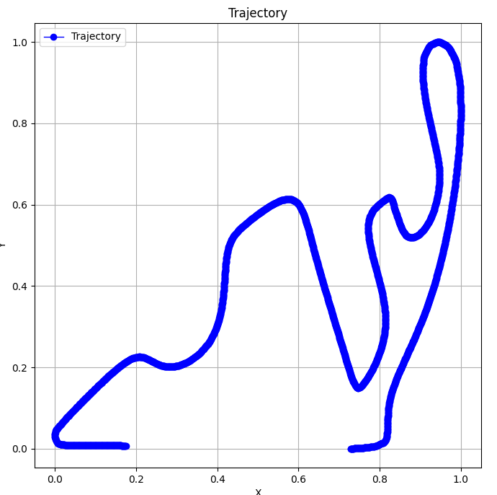
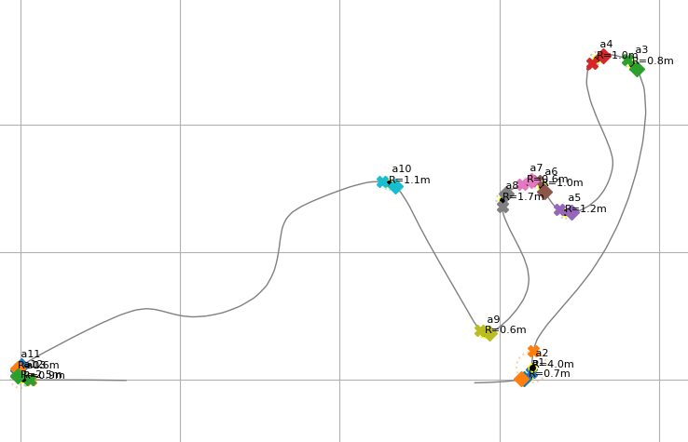
Post Processing
How to find turns?

Slide 9
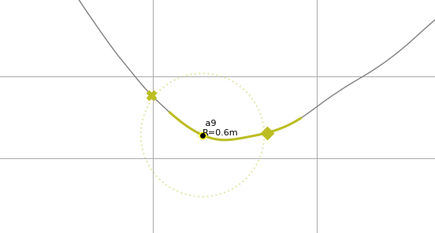
Post Processing
Calculating curvature
Finding apex point
Finding points of entry and exit

Slide 10
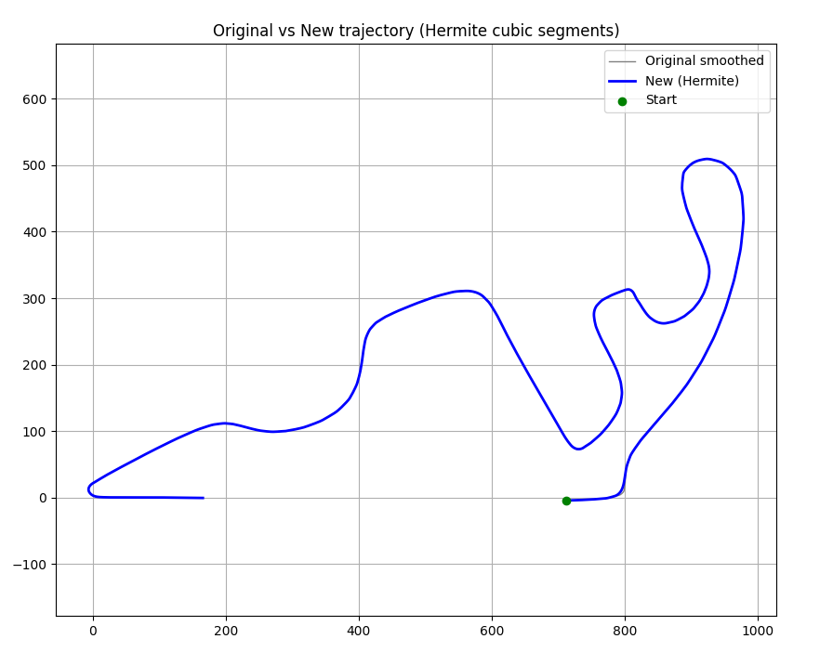
Post Processing

Slide 11
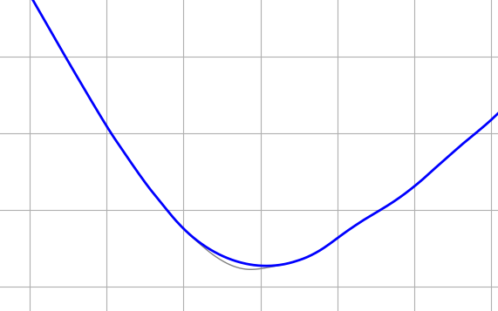
Post Processing
New trajectory

Slide 12
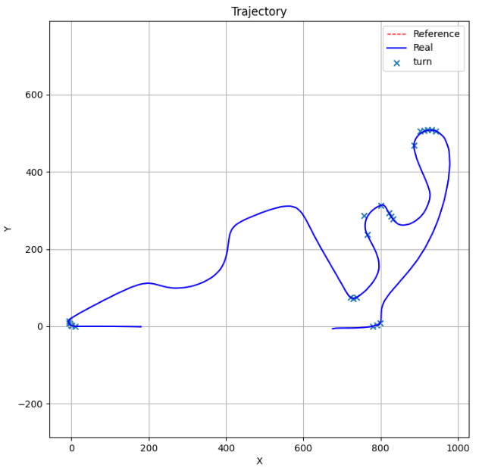
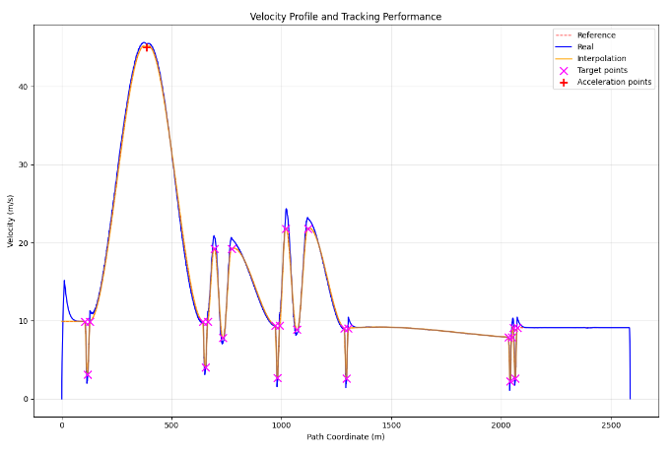
Velocity profile

Slide 13
Our Team

Slide 14
Roles and Contribution
Vladimir Toporkov:
Role: CV + Control
  Post-processing pipeline
  Vehicle cameras setup
Ilya Grigorev:
Role: CV + Control
  Camera hierarchy control logic
  PID-controller design and tests
Salavat Faizullin:
Role: CV
  Test map implementation
  Lane detection methods exploration and documentation

Slide 15
Results

Slide 16
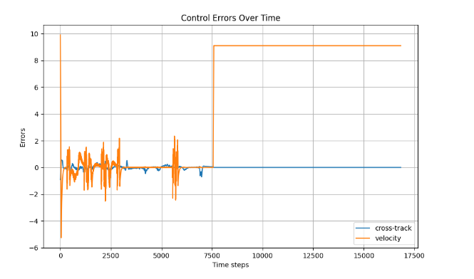
Results
Maximum velocity and acceleration in turns calculated.
Logic for moving along old and new trajectory implemented

Slide 17
Demo

