Slide 1





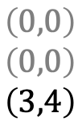









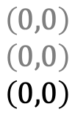











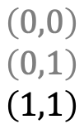







Schedule:
$$τ_{1}$$
$$τ_{2}$$
$$τ_{i}$$
$$0$$
$$1$$
$$2$$
$$3$$
$$4$$
$$5$$
$$6$$
$$t$$
State Trajectory $\vec{x}$:
$$τ_{1}$$
$$\left(0,0\right)$$
$$\left(0,0\right)$$
$$\left(0,0\right)$$
$$\left(0,0\right)$$
$$\left(0,0\right)$$
$$\left(3,4\right)$$
$$\left(1,2\right)$$
$$\left(2,3\right)$$
$$\left(2,3\right)$$
$$\left(0,1\right)$$
$$\left(1,2\right)$$
$$\left(2,2\right)$$
$$\left(0,0\right)$$
$$\left(0,1\right)$$
$$\left(1,1\right)$$
$$\left(0,0\right)$$
$$\left(0,0\right)$$
$$\left(0,0\right)$$
$$\left(0,0\right)$$
$$\left(0,0\right)$$
$$\left(3,4\right)$$
$$τ_{2}$$
$$τ_{i}$$
$$\vec{x}\left(0\right)$$
$$\vec{x}\left(1\right)$$
$$\vec{x}\left(2\right)$$
$$\vec{x}\left(3\right)$$
$$\vec{x}\left(4\right)$$
$$\vec{x}\left(5\right)$$
$$\vec{x}\left(6\right)$$
Characteristic functions for task $τ_{i}$:
$$r_{i}\left(\vec{x},t\right)$$
$$1$$
$$0$$
$$q_{i}\left(\vec{x},t\right)$$
$$s_{i}\left(\vec{x},t\right)$$

Slide 2


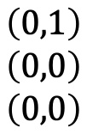










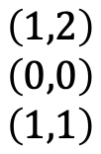

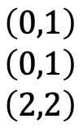


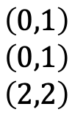







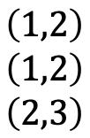

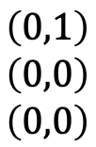


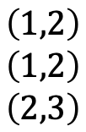


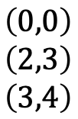




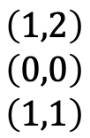
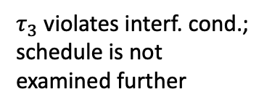


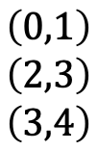







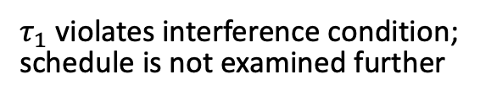
Scenario A:
$τ_{1}$ violates interference condition;
schedule is not examined further
$$τ_{1}$$
$$J_{1}$$
$$τ_{2}$$
$$J_{2}$$
$$τ_{3}$$
$$J_{3}$$
$$0$$
$$1$$
$$2$$
$$3$$
$$4$$
$$5$$
$$6$$
$$7$$
$$8$$
$$t$$
$$τ_{1}$$
$$\left(1,2\right)$$
$$\left(0,0\right)$$
$$\left(3,4\right)$$
$$\left(0,1\right)$$
$$\left(2,3\right)$$
$$\left(2,3\right)$$
$$\left(0,0\right)$$
$$\left(1,2\right)$$
$$\left(1,2\right)$$
$$\left(1,2\right)$$
$$\left(0,1\right)$$
$$\left(0,1\right)$$
$$\left(0,1\right)$$
$$\left(2,3\right)$$
$$\left(3,4\right)$$
$$\left(1,2\right)$$
$$\left(1,2\right)$$
$$\left(2,3\right)$$
$$\left(0,1\right)$$
$$\left(0,1\right)$$
$$\left(2,2\right)$$
$$\left(1,2\right)$$
$$\left(0,0\right)$$
$$\left(1,1\right)$$
$$\left(0,1\right)$$
$$\left(0,0\right)$$
$$\left(0,0\right)$$
$$τ_{2}$$
$$τ_{3}$$
States pruned for $t≥1$
Scenario B: (transformed)
$τ_{3}$ violates interf. cond.;
schedule is not examined further
$$τ_{1}$$
$$J_{1}$$
$$τ_{2}$$
$$J_{2}$$
$$τ_{3}$$
$$J_{3}$$
$$0$$
$$1$$
$$2$$
$$3$$
$$4$$
$$t$$
$$τ_{1}$$
$$\left(0,0\right)$$
$$\left(2,3\right)$$
$$\left(3,4\right)$$
$$\left(1,2\right)$$
$$\left(1,2\right)$$
$$\left(2,3\right)$$
$$\left(0,1\right)$$
$$\left(0,1\right)$$
$$\left(2,2\right)$$
$$\left(1,2\right)$$
$$\left(0,0\right)$$
$$\left(1,1\right)$$
$$\left(0,1\right)$$
$$\left(0,0\right)$$
$$\left(0,0\right)$$
$$τ_{2}$$
$$τ_{3}$$
States pruned for $t≥4$

Slide 3



























Scenario A:
$τ_{1}$ violates interference condition;
schedule is not examined further
$$τ_{1}$$
$$J_{1}$$
$$τ_{2}$$
$$J_{2}$$
$$τ_{3}$$
$$J_{3}$$
$$0$$
$$1$$
$$2$$
$$3$$
$$4$$
$$5$$
$$6$$
$$t$$
$$τ_{1}$$
$$\left(1,2,0\right)$$
$$\left(0,0,0\right)$$
$$\left(3,4,0\right)$$
$$\left(0,1,0\right)$$
$$\left(2,3,0\right)$$
$$\left(2,3,0\right)$$
$$\left(0,0,0\right)$$
$$\left(1,2,0\right)$$
$$\left(1,2,0\right)$$
$$\left(1,2,0\right)$$
$$\left(0,1,0\right)$$
$$\left(0,1,0\right)$$
$$\left(0,1,0\right)$$
$$\left(2,3,0\right)$$
$$\left(3,4,0\right)$$
$$\left(1,2,0\right)$$
$$\left(1,2,1\right)$$
$$\left(2,3,0\right)$$
$$\left(0,1,1\right)$$
$$\left(0,1,1\right)$$
$$\left(2,2,0\right)$$
$$τ_{2}$$
…
$$τ_{3}$$
States pruned for $t≥1$
State Notation:
$${x=\left(c_{i},p_{i},h_{i}\right)}_{i=1}^{n}$$
Scenario B:
$$τ_{1}$$
$$J_{1}$$
$$τ_{2}$$
$$J_{2}$$
$$τ_{3}$$
$$J_{3}$$
$$0$$
$$1$$
$$2$$
$$t$$
$$τ_{1}$$
$$\left(0,0,0\right)$$
$$\left(2,3,0\right)$$
$$\left(3,4,0\right)$$
$$\left(1,2,0\right)$$
$$\left(1,2,1\right)$$
$$\left(2,3,0\right)$$
$$\left(0,1,1\right)$$
$$\left(0,1,1\right)$$
$$\left(2,2,0\right)$$
$$τ_{2}$$
…
$$τ_{3}$$

Slide 4

















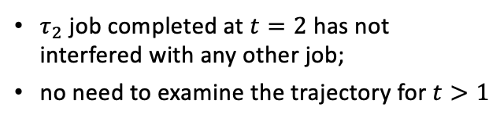








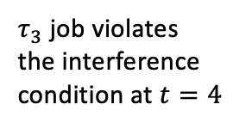
















$τ_{2}$ job completed at $t=2$ has not interfered with any other job;
no need to examine the trajectory for $t>1$
GEDF Schedule A:
$$τ_{1}$$
$$J_{1}$$
$$τ_{2}$$
$$J_{2}$$
$$τ_{3}$$
$$J_{3}$$
$$0$$
$$1$$
$$2$$
$$3$$
$$4$$
$$5$$
$$t$$
$$τ_{1}$$
$$\left(0,0,0\right)$$
$$\left(2,3,0\right)$$
$$\left(0,0,0\right)$$
$$\left(0,0,0\right)$$
$$\left(1,2,0\right)$$
$$\left(3,5,0\right)$$
$$\left(0,0,0\right)$$
$$\left(0,1,0\right)$$
$$\left(2,4,0\right)$$
$$\left(1,2,0\right)$$
$$\left(2,3,0\right)$$
$$\left(1,3,0\right)$$
$$\left(0,1,1\right)$$
$$\left(1,2,1\right)$$
$$\left(1,2,0\right)$$
$$\left(0,0,0\right)$$
$$\left(0,1,0\right)$$
$$\left(0,1,0\right)$$
$$τ_{2}$$
…
$$τ_{3}$$
State Notation:
$${x=\left(c_{i},p_{i},h_{i}\right)}_{i=1}^{n}$$
GEDF Schedule B:
$τ_{3}$ job violates the interference condition at $t=4$
$$τ_{1}$$
$$J_{1}$$
$$τ_{2}$$
$$J_{2}$$
$$τ_{3}$$
$$J_{3}$$
$$0$$
$$1$$
$$2$$
$$3$$
$$4$$
$$t$$
$$τ_{1}$$
$$\left(0,0,0\right)$$
$$\left(0,0,0\right)$$
$$\left(3,5,0\right)$$
$$\left(0,0,0\right)$$
$$\left(0,0,0\right)$$
$$\left(2,4,0\right)$$
$$\left(1,2,0\right)$$
$$\left(2,3,0\right)$$
$$\left(1,3,0\right)$$
$$\left(0,1,1\right)$$
$$\left(1,2,1\right)$$
$$\left(1,2,0\right)$$
$$\left(0,0,0\right)$$
$$\left(0,1,1\right)$$
$$\left(0,1,0\right)$$
$$τ_{2}$$
…
$$τ_{3}$$

Slide 5



















































Jobs Arrival
$$τ_{\text{LIDAR}}=\left(20,50\right)$$
$$J_{1}^{1}$$
$$J_{1}^{2}$$
$$J_{1}^{3}$$
$$J_{1}^{4}$$
$$J_{1}^{5}$$
$$τ_{\text{IMU}}=\left(3,10\right)$$
$$J_{2}^{1}$$
$$J_{2}^{2}$$
$$J_{2}^{3}$$
$$J_{2}^{4}$$
$$J_{2}^{5}$$
$$J_{2}^{6}$$
$$J_{2}^{7}$$
$$J_{2}^{8}$$
$$J_{2}^{9}$$
$$J_{2}^{10}$$
$$J_{2}^{11}$$
$$J_{2}^{12}$$
$$J_{2}^{13}$$
$$J_{2}^{14}$$
$$J_{2}^{15}$$
$$J_{2}^{16}$$
$$J_{2}^{17}$$
$$J_{2}^{18}$$
$$J_{2}^{19}$$
$$J_{2}^{20}$$
$$J_{2}^{21}$$
$$J_{2}^{22}$$
$$τ_{\text{CAMERA}}=\left(40,200\right)$$
$$J_{3}^{1}$$
$$J_{3}^{2}$$
$$0$$
$$20$$
$$40$$
$$60$$
$$80$$
$$100$$
$$120$$
$$140$$
$$160$$
$$180$$
$$200$$
$$t$$
Exec. Scenario A: No opt.
$$τ_{\text{LIDAR}}=\left(20,50\right)$$
$$τ_{\text{IMU}}=\left(3,10\right)$$
$$τ_{\text{CAMERA}}=\left(40,200\right)$$
$$0$$
$$20$$
$$40$$
$$60$$
$$80$$
$$100$$
$$120$$
$$140$$
$$160$$
$$180$$
$$200$$
$$t$$

Slide 6















































Jobs Release
$$τ_{\text{LIDAR}}=\left(20,50\right)$$
$$R_{1}^{1}$$
$$R_{1}^{2}$$
$$R_{1}^{3}$$
$$τ_{\text{IMU}}=\left(5,10\right)$$
$$R_{2}^{1}$$
$$R_{2}^{2}$$
$$R_{2}^{2}$$
$$R_{2}^{4}$$
$$R_{2}^{5}$$
$$R_{2}^{6}$$
$$R_{2}^{7}$$
$$R_{2}^{8}$$
$$R_{2}^{9}$$
$$R_{2}^{10}$$
$$R_{2}^{11}$$
$$0$$
$$10$$
$$20$$
$$30$$
$$40$$
$$50$$
$$60$$
$$70$$
$$80$$
$$90$$
$$100$$
$$t$$
Release Handling Scenario
$$τ_{\text{LIDAR}}=\left(20,50\right)$$
$$R_{1}^{1}$$
$$R_{1}^{2}$$
$$R_{1}^{3}$$
$$τ_{\text{IMU}}=\left(5,10\right)$$
$$R_{2}^{1}$$
$$R_{2}^{4}$$
$$R_{2}^{5}$$
$$R_{2}^{6}$$
$$R_{2}^{9}$$
$$R_{2}^{10}$$
$$0$$
$$10$$
$$20$$
$$30$$
$$40$$
$$50$$
$$60$$
$$70$$
$$80$$
$$90$$
$$100$$
$$t$$
$$t^{cur}$$
$$0$$
$$0$$
$$0$$
$$20$$
$$50$$
$$0$$
$$25$$
$$50$$
$$30$$
$$30$$
$$50$$
$$30$$
$$35$$
$$50$$
$$40$$
$$40$$
$$50$$
$$40$$
$$45$$
$$50$$
$$50$$
$$50$$
$$50$$
$$50$$
$$70$$
$$100$$
$$50$$
$$75$$
$$100$$
$$80$$
$$80$$
$$100$$
$$80$$
$$85$$
$$100$$
$$90$$
$$90$$
$$100$$
$$90$$
$$95$$
$$100$$
$$100$$
$$100$$
$$100$$
$$100$$
$$t_{LiDAR}^{next}$$
$$t_{IMU}^{next}$$

Slide 7
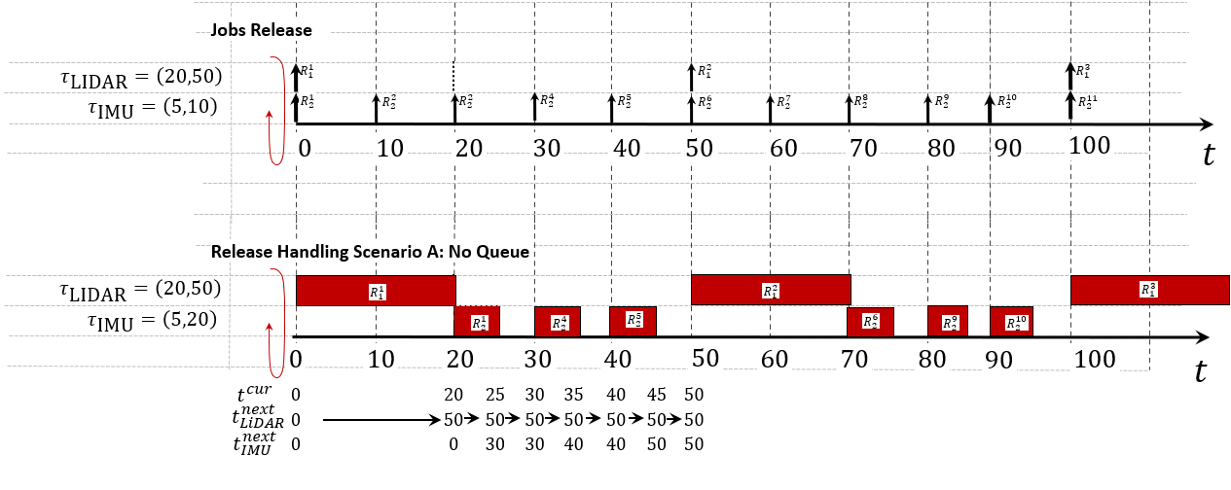
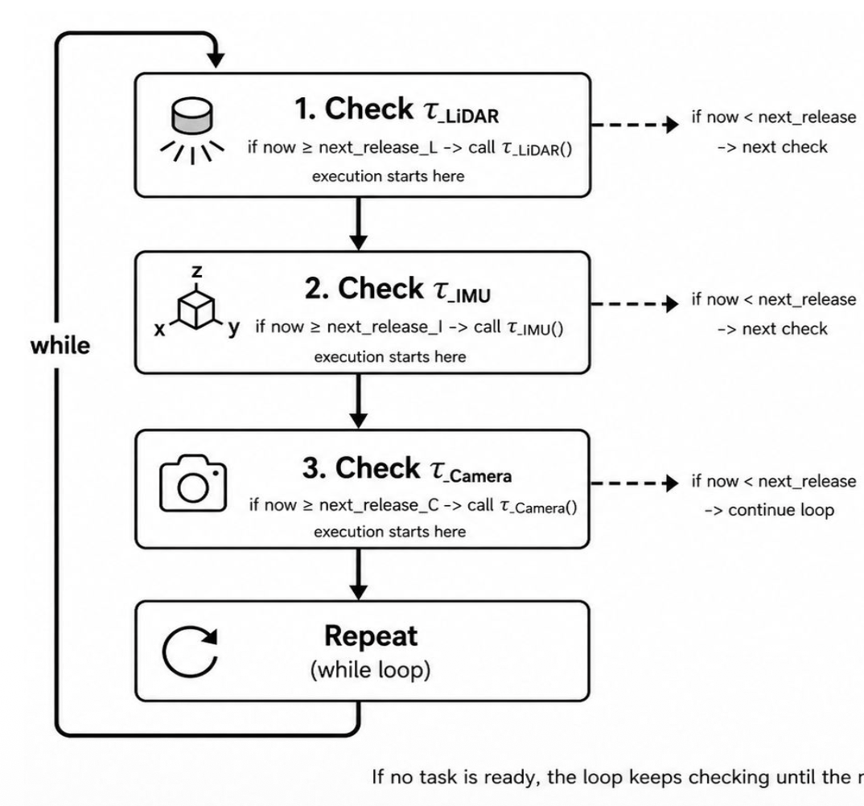












1. Check ${\text{τ}}_{LiDAR}$
ELSE
$${t^{curr}≥t}_{LiDAR}^{next}$$
TRUE
Execute tau_LiDAR()
$t^{curr}=t^{curr}$+ 0
$$t^{prev}=t^{curr}$$
$$t^{finish}=t^{prev}+C_{LiDAR}$$
$R_{time}$ = $t^{finish} −t_{LiDAR}^{next}$
$$R_{time}>D_{LiDAR}$$
TRUE
$$D_{LiDAR}^{miss}+=1$$
2. Check ${\text{τ}}_{IMU}$
ELSE
$$t_{LiDAR}^{next}+=T_{LiDAR}$$
$${t^{curr}≥t}_{IMU}^{next}$$
TRUE
$$t^{curr}=t^{curr}+C_{LiDAR}$$
Execute tau_IMU()
While $t^{finish}≥t_{LiDAR}^{next}$
$$t^{prev}=t^{curr}$$
$$t^{curr}=t^{curr}+C_{IMU}$$
${SKIP}_{LiDAR}$+= 1
$R_{time}$ = $t^{curr} −t_{IMU}^{next}$
$$R_{time}>D_{IMU}$$
TRUE
$$t_{LiDAR}^{next}+=T_{LiDAR}$$
$$D_{IMU}^{miss}+=1$$
ELSE
$$t_{IMU}^{next}+=T_{IMU}$$
ELSE
$t^{curr}=t^{curr}$+ 0
While $t^{curr}≥t_{IMU}^{next}$
$$t^{curr}=t^{curr}+C_{IMU}$$
${SKIP}_{IMU}$+= 1
$$t_{IMU}^{next}+=T_{IMU}$$

Slide 8




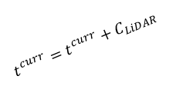





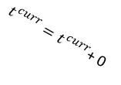









1. Check ${\text{τ}}_{LiDAR}$
ELSE
$${t^{curr}≥t}_{LiDAR}^{next}$$
TRUE
Execute tau_LiDAR()
$t^{curr}=t^{curr}$+ 0
$$t^{prev}=t^{curr}$$
$$t^{finish}=t^{prev}+C_{LiDAR}$$
$R_{time}$ = $t^{finish} −t_{LiDAR}^{next}$
$$R_{time}>D_{LiDAR}$$
TRUE
$$D_{LiDAR}^{miss}+=1$$
2. Check ${\text{τ}}_{IMU}$
ELSE
$$t_{LiDAR}^{next}+=T_{LiDAR}$$
$${t^{curr}≥t}_{IMU}^{next}$$
TRUE
$$t^{curr}=t^{curr}+C_{LiDAR}$$
Execute tau_IMU()
While $t^{finish}≥t_{LiDAR}^{next}$
$$t^{prev}=t^{curr}$$
$$t^{finish}=t^{prev}+C_{IMU}$$
${SKIP}_{LiDAR}$+= 1
$R_{time}$ = $t^{finish} −t_{IMU}^{next}$
$$R_{time}>D_{IMU}$$
TRUE
$$t_{LiDAR}^{next}+=T_{LiDAR}$$
$$D_{IMU}^{miss}+=1$$
ELSE
$$t_{IMU}^{next}+=T_{IMU}$$
ELSE
$t^{curr}=t^{curr}$+ 0
While $t^{curr}≥t_{IMU}^{next}$
$$t^{curr}=t^{curr}+C_{IMU}$$
${SKIP}_{IMU}$+= 1
$$t_{IMU}^{next}+=T_{IMU}$$

Slide 9















Jobs Arrival
$$τ_{\text{LIDAR}}=\left(20,50\right)$$
$$J_{1}^{1}$$
$$J_{1}^{2}$$
$$J_{1}^{3}$$
$$J_{1}^{4}$$
$$J_{1}^{5}$$
$$τ_{\text{IMU}}=\left(3,10\right)$$
$$J_{2}^{1}$$
$$J_{2}^{2}$$
$$J_{2}^{3}$$
$$J_{2}^{4}$$
$$J_{2}^{5}$$
$$J_{2}^{6}$$
$$J_{2}^{7}$$
$$J_{2}^{8}$$
$$J_{2}^{9}$$
$$J_{2}^{10}$$
$$J_{2}^{11}$$
$$J_{2}^{12}$$
$$J_{2}^{13}$$
$$J_{2}^{14}$$
$$J_{2}^{15}$$
$$J_{2}^{16}$$
$$J_{2}^{17}$$
$$J_{2}^{18}$$
$$J_{2}^{19}$$
$$J_{2}^{20}$$
$$J_{2}^{21}$$
$$J_{2}^{22}$$
$$τ_{\text{CAMERA}}=\left(40,200\right)$$
$$J_{3}^{1}$$
$$J_{3}^{2}$$
$$0$$
$$20$$
$$40$$
$$60$$
$$80$$
$$100$$
$$120$$
$$140$$
$$160$$
$$180$$
$$200$$
$$t$$
Exec. Scenario A: No opt.
$$τ_{\text{LIDAR}}=\left(20,50\right)$$
$$τ_{\text{IMU}}=\left(3,10\right)$$
$$τ_{\text{CAMERA}}=\left(40,200\right)$$
$$0$$
$$20$$
$$40$$
$$60$$
$$80$$
$$100$$
$$120$$
$$140$$
$$160$$
$$180$$
$$200$$
$$t$$
Exec. Scenario B: With Opt.
$$τ_{\text{LIDAR}}=\left(20,100\right)$$
$$τ_{\text{IMU}}=\left(1,5\right)$$
$$τ_{\text{CAMERA}}=\left(40,200\right)$$
$$0$$
$$20$$
$$40$$
$$60$$
$$80$$
$$100$$
$$120$$
$$140$$
$$160$$
$$180$$
$$200$$
$$t$$

Slide 10































Scenario A: No optimizations
$$τ_{\text{LIDAR}}=\left(20,100\right)$$
$$τ_{\text{IMU}}=\left(1,5\right)$$
$$τ_{\text{CAMERA}}=\left(40,200\right)$$
$$0$$
$$20$$
$$40$$
$$60$$
$$80$$
$$100$$
$$120$$
$$140$$
$$160$$
$$180$$
$$200$$
$$t$$
Scenario B: With optimizations
$$τ_{\text{LIDAR}}=\left(20,100\right)$$
$$J_{1}$$
$$τ_{\text{IMU}}=\left(1,5\right)$$
$$J_{2}$$
$$τ_{\text{CAMERA}}=\left(40,200\right)$$
$$J_{3}$$
$$0$$
$$1$$
$$2$$
$$3$$
$$4$$
$$5$$
$$6$$
$$7$$
$$8$$
$$t$$

