Slide 1





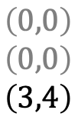









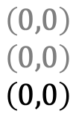











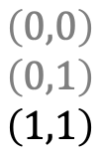







Schedule:
$$τ_{1}$$
$$τ_{2}$$
$$τ_{i}$$
$$0$$
$$1$$
$$2$$
$$3$$
$$4$$
$$5$$
$$6$$
$$t$$
State Trajectory $\vec{x}$:
$$τ_{1}$$
$$\left(0,0\right)$$
$$\left(0,0\right)$$
$$\left(0,0\right)$$
$$\left(0,0\right)$$
$$\left(0,0\right)$$
$$\left(3,4\right)$$
$$\left(1,2\right)$$
$$\left(2,3\right)$$
$$\left(2,3\right)$$
$$\left(0,1\right)$$
$$\left(1,2\right)$$
$$\left(2,2\right)$$
$$\left(0,0\right)$$
$$\left(0,1\right)$$
$$\left(1,1\right)$$
$$\left(0,0\right)$$
$$\left(0,0\right)$$
$$\left(0,0\right)$$
$$\left(0,0\right)$$
$$\left(0,0\right)$$
$$\left(3,4\right)$$
$$τ_{2}$$
$$τ_{i}$$
$$\vec{x}\left(0\right)$$
$$\vec{x}\left(1\right)$$
$$\vec{x}\left(2\right)$$
$$\vec{x}\left(3\right)$$
$$\vec{x}\left(4\right)$$
$$\vec{x}\left(5\right)$$
$$\vec{x}\left(6\right)$$
Characteristic functions for task $τ_{i}$:
$$r_{i}\left(\vec{x},t\right)$$
$$1$$
$$0$$
$$q_{i}\left(\vec{x},t\right)$$
$$s_{i}\left(\vec{x},t\right)$$

Slide 2


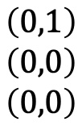










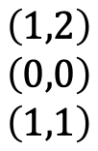

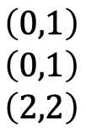


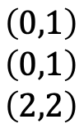







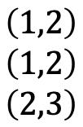

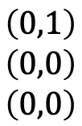


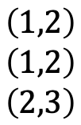


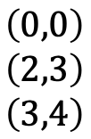




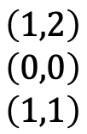
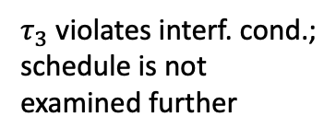


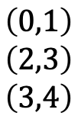







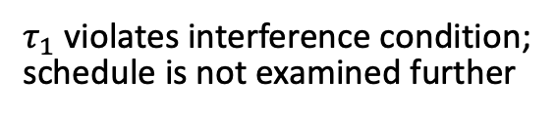
Scenario A:
$τ_{1}$ violates interference condition;
schedule is not examined further
$$τ_{1}$$
$$J_{1}$$
$$τ_{2}$$
$$J_{2}$$
$$τ_{3}$$
$$J_{3}$$
$$0$$
$$1$$
$$2$$
$$3$$
$$4$$
$$5$$
$$6$$
$$7$$
$$8$$
$$t$$
$$τ_{1}$$
$$\left(1,2\right)$$
$$\left(0,0\right)$$
$$\left(3,4\right)$$
$$\left(0,1\right)$$
$$\left(2,3\right)$$
$$\left(2,3\right)$$
$$\left(0,0\right)$$
$$\left(1,2\right)$$
$$\left(1,2\right)$$
$$\left(1,2\right)$$
$$\left(0,1\right)$$
$$\left(0,1\right)$$
$$\left(0,1\right)$$
$$\left(2,3\right)$$
$$\left(3,4\right)$$
$$\left(1,2\right)$$
$$\left(1,2\right)$$
$$\left(2,3\right)$$
$$\left(0,1\right)$$
$$\left(0,1\right)$$
$$\left(2,2\right)$$
$$\left(1,2\right)$$
$$\left(0,0\right)$$
$$\left(1,1\right)$$
$$\left(0,1\right)$$
$$\left(0,0\right)$$
$$\left(0,0\right)$$
$$τ_{2}$$
$$τ_{3}$$
States pruned for $t≥1$
Scenario B: (transformed)
$τ_{3}$ violates interf. cond.;
schedule is not examined further
$$τ_{1}$$
$$J_{1}$$
$$τ_{2}$$
$$J_{2}$$
$$τ_{3}$$
$$J_{3}$$
$$0$$
$$1$$
$$2$$
$$3$$
$$4$$
$$t$$
$$τ_{1}$$
$$\left(0,0\right)$$
$$\left(2,3\right)$$
$$\left(3,4\right)$$
$$\left(1,2\right)$$
$$\left(1,2\right)$$
$$\left(2,3\right)$$
$$\left(0,1\right)$$
$$\left(0,1\right)$$
$$\left(2,2\right)$$
$$\left(1,2\right)$$
$$\left(0,0\right)$$
$$\left(1,1\right)$$
$$\left(0,1\right)$$
$$\left(0,0\right)$$
$$\left(0,0\right)$$
$$τ_{2}$$
$$τ_{3}$$
States pruned for $t≥4$

Slide 3



























Scenario A:
$τ_{1}$ violates interference condition;
schedule is not examined further
$$τ_{1}$$
$$J_{1}$$
$$τ_{2}$$
$$J_{2}$$
$$τ_{3}$$
$$J_{3}$$
$$0$$
$$1$$
$$2$$
$$3$$
$$4$$
$$5$$
$$6$$
$$t$$
$$τ_{1}$$
$$\left(1,2,0\right)$$
$$\left(0,0,0\right)$$
$$\left(3,4,0\right)$$
$$\left(0,1,0\right)$$
$$\left(2,3,0\right)$$
$$\left(2,3,0\right)$$
$$\left(0,0,0\right)$$
$$\left(1,2,0\right)$$
$$\left(1,2,0\right)$$
$$\left(1,2,0\right)$$
$$\left(0,1,0\right)$$
$$\left(0,1,0\right)$$
$$\left(0,1,0\right)$$
$$\left(2,3,0\right)$$
$$\left(3,4,0\right)$$
$$\left(1,2,0\right)$$
$$\left(1,2,1\right)$$
$$\left(2,3,0\right)$$
$$\left(0,1,1\right)$$
$$\left(0,1,1\right)$$
$$\left(2,2,0\right)$$
$$τ_{2}$$
…
$$τ_{3}$$
States pruned for $t≥1$
State Notation:
$${x=\left(c_{i},p_{i},h_{i}\right)}_{i=1}^{n}$$
Scenario B:
$$τ_{1}$$
$$J_{1}$$
$$τ_{2}$$
$$J_{2}$$
$$τ_{3}$$
$$J_{3}$$
$$0$$
$$1$$
$$2$$
$$t$$
$$τ_{1}$$
$$\left(0,0,0\right)$$
$$\left(2,3,0\right)$$
$$\left(3,4,0\right)$$
$$\left(1,2,0\right)$$
$$\left(1,2,1\right)$$
$$\left(2,3,0\right)$$
$$\left(0,1,1\right)$$
$$\left(0,1,1\right)$$
$$\left(2,2,0\right)$$
$$τ_{2}$$
…
$$τ_{3}$$

Slide 4

















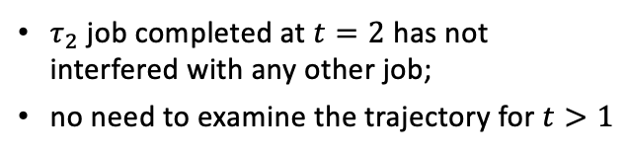








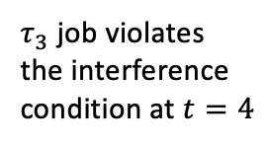
















$τ_{2}$ job completed at $t=2$ has not interfered with any other job;
no need to examine the trajectory for $t>1$
GEDF Schedule A:
$$τ_{1}$$
$$J_{1}$$
$$τ_{2}$$
$$J_{2}$$
$$τ_{3}$$
$$J_{3}$$
$$0$$
$$1$$
$$2$$
$$3$$
$$4$$
$$5$$
$$t$$
$$τ_{1}$$
$$\left(0,0,0\right)$$
$$\left(2,3,0\right)$$
$$\left(0,0,0\right)$$
$$\left(0,0,0\right)$$
$$\left(1,2,0\right)$$
$$\left(3,5,0\right)$$
$$\left(0,0,0\right)$$
$$\left(0,1,0\right)$$
$$\left(2,4,0\right)$$
$$\left(1,2,0\right)$$
$$\left(2,3,0\right)$$
$$\left(1,3,0\right)$$
$$\left(0,1,1\right)$$
$$\left(1,2,1\right)$$
$$\left(1,2,0\right)$$
$$\left(0,0,0\right)$$
$$\left(0,1,0\right)$$
$$\left(0,1,0\right)$$
$$τ_{2}$$
…
$$τ_{3}$$
State Notation:
$${x=\left(c_{i},p_{i},h_{i}\right)}_{i=1}^{n}$$
GEDF Schedule B:
$τ_{3}$ job violates the interference condition at $t=4$
$$τ_{1}$$
$$J_{1}$$
$$τ_{2}$$
$$J_{2}$$
$$τ_{3}$$
$$J_{3}$$
$$0$$
$$1$$
$$2$$
$$3$$
$$4$$
$$t$$
$$τ_{1}$$
$$\left(0,0,0\right)$$
$$\left(0,0,0\right)$$
$$\left(3,5,0\right)$$
$$\left(0,0,0\right)$$
$$\left(0,0,0\right)$$
$$\left(2,4,0\right)$$
$$\left(1,2,0\right)$$
$$\left(2,3,0\right)$$
$$\left(1,3,0\right)$$
$$\left(0,1,1\right)$$
$$\left(1,2,1\right)$$
$$\left(1,2,0\right)$$
$$\left(0,0,0\right)$$
$$\left(0,1,1\right)$$
$$\left(0,1,0\right)$$
$$τ_{2}$$
…
$$τ_{3}$$

Slide 5



















































Jobs Arrival
$$τ_{\text{LIDAR}}=\left(20,50\right)$$
$$J_{1}^{1}$$
$$J_{1}^{2}$$
$$J_{1}^{3}$$
$$J_{1}^{4}$$
$$J_{1}^{5}$$
$$τ_{\text{IMU}}=\left(3,10\right)$$
$$J_{2}^{1}$$
$$J_{2}^{2}$$
$$J_{2}^{3}$$
$$J_{2}^{4}$$
$$J_{2}^{5}$$
$$J_{2}^{6}$$
$$J_{2}^{7}$$
$$J_{2}^{8}$$
$$J_{2}^{9}$$
$$J_{2}^{10}$$
$$J_{2}^{11}$$
$$J_{2}^{12}$$
$$J_{2}^{13}$$
$$J_{2}^{14}$$
$$J_{2}^{15}$$
$$J_{2}^{16}$$
$$J_{2}^{17}$$
$$J_{2}^{18}$$
$$J_{2}^{19}$$
$$J_{2}^{20}$$
$$J_{2}^{21}$$
$$J_{2}^{22}$$
$$τ_{\text{CAMERA}}=\left(40,200\right)$$
$$J_{3}^{1}$$
$$J_{3}^{2}$$
$$0$$
$$20$$
$$40$$
$$60$$
$$80$$
$$100$$
$$120$$
$$140$$
$$160$$
$$180$$
$$200$$
$$t$$
Exec. Scenario A: No opt.
$$τ_{\text{LIDAR}}=\left(20,50\right)$$
$$τ_{\text{IMU}}=\left(3,10\right)$$
$$τ_{\text{CAMERA}}=\left(40,200\right)$$
$$0$$
$$20$$
$$40$$
$$60$$
$$80$$
$$100$$
$$120$$
$$140$$
$$160$$
$$180$$
$$200$$
$$t$$

Slide 6















































Jobs Release
$$τ_{\text{LIDAR}}=\left(20,50\right)$$
$$R_{1}^{1}$$
$$R_{1}^{2}$$
$$R_{1}^{3}$$
$$τ_{\text{IMU}}=\left(10,20\right)$$
$$R_{2}^{1}$$
$$R_{2}^{2}$$
$$R_{2}^{3}$$
$$R_{2}^{4}$$
$$R_{2}^{5}$$
$$R_{2}^{6}$$
$$0$$
$$10$$
$$20$$
$$30$$
$$40$$
$$50$$
$$60$$
$$70$$
$$80$$
$$90$$
$$100$$
$$t$$
Release Handling Scenario
$$τ_{\text{LIDAR}}=\left(20,50\right)$$
$$R_{1}^{1}$$
$$R_{1}^{2}$$
$$R_{1}^{3}$$
$$τ_{\text{IMU}}=\left(10,20\right)$$
$$R_{2}^{1}$$
$$R_{2}^{4}$$
$$R_{2}^{5}$$
$$R_{2}^{6}$$
$$R_{2}^{9}$$
$$R_{2}^{10}$$
$$0$$
$$10$$
$$20$$
$$30$$
$$40$$
$$50$$
$$60$$
$$70$$
$$80$$
$$90$$
$$100$$
$$t$$
$$t^{cur}$$
$$0$$
$$0$$
$$0$$
$$20$$
$$50$$
$$0$$
$$25$$
$$50$$
$$30$$
$$30$$
$$50$$
$$30$$
$$35$$
$$50$$
$$40$$
$$40$$
$$50$$
$$40$$
$$45$$
$$50$$
$$50$$
$$50$$
$$50$$
$$50$$
$$70$$
$$100$$
$$50$$
$$75$$
$$100$$
$$80$$
$$80$$
$$100$$
$$80$$
$$85$$
$$100$$
$$90$$
$$90$$
$$100$$
$$90$$
$$95$$
$$100$$
$$100$$
$$100$$
$$100$$
$$100$$
$$t_{LiDAR}^{next}$$
$$t_{IMU}^{next}$$

Slide 7






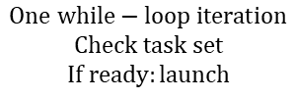













































$$τ_{\text{i}}=\left(C_{\text{i}},T_{\text{i}}=D_{\text{i}}\right)$$
Jobs Release
$$\text{Superloop} \text{polling} \text{order}:τ_{\text{1}}→τ_{\text{2}}$$
$$τ_{\text{1}}=\left(20,50\right)$$
$$R_{1}^{1}$$
$$R_{1}^{2}$$
$$R_{1}^{3}$$
$$τ_{\text{2}}=\left(10,20\right)$$
$$R_{2}^{1}$$
$$R_{2}^{2}$$
$$R_{2}^{3}$$
$$R_{2}^{4}$$
$$R_{2}^{5}$$
$$R_{2}^{6}$$
$$0$$
$$10$$
$$20$$
$$30$$
$$40$$
$$50$$
$$60$$
$$70$$
$$80$$
$$90$$
$$100$$
$$t$$
Release Handling Scenario
Busy polling
Busy polling
$$τ_{\text{1}}=\left(20,50\right)$$
$$J_{1}^{1}$$
$$J_{1}^{2}$$
$$J_{1}^{3}$$
$$τ_{\text{2}}=\left(10,20\right)$$
$$J_{2}^{1}$$
$$J_{2}^{3}$$
$$J_{2}^{4}$$
$$J_{2}^{5}$$
$$0$$
$$10$$
$$20$$
$$30$$
$$40$$
$$50$$
$$60$$
$$70$$
$$80$$
$$90$$
$$100$$
$$t$$
No readiness check task executing
$$1 iteration$$
$$1 iteration$$
$$t^{cur}$$
$$0$$
$$0$$
$$0$$
$$−$$
$$20$$
$$50$$
$$0$$
$$30$$
$$50$$
$$40$$
$$40$$
$$50$$
$$40$$
$$50$$
$$50$$
$$60$$
$$−$$
$$70$$
$$100$$
$$60$$
$$80$$
$$100$$
$$80$$
$$90$$
$$100$$
$$100$$
$$t_{1}^{next}$$
$$−$$
$$−$$
$$t_{2}^{next}$$
$$−$$
$$−$$
$miss?→ t^{cur}$ >${ R}_{i}^{k}+ D^{i}$
$$−$$
$20$ <${ R}_{1}^{1}+50$
$30$ >${ R}_{2}^{1}+20$
$50$ <${ R}_{2}^{3}+20$
$$−$$
$70$ <${ R}_{1}^{2}+50$
$80$ =${ R}_{2}^{4}+20$
$90$ <${ R}_{2}^{5}+20$
$skip?→ t^{cur}$ >${ t}_{i}^{next}$
$$−$$
$20$ <${ R}_{1}^{2}$
$30$ >${ R}_{2}^{2}$
$50$ <${ R}_{2}^{4}$
$$−$$
$70$ <${ R}_{1}^{3}$
$80$ = $R_{2}^{5}$
$90$ < $R_{2}^{6}$
$30$ <${ R}_{2}^{3}$
$$One while−loop iteration$$
$$Check task set$$
$$If ready:launch$$
$$\text{Busy} \text{polling}\text{: }$$
$$\text{repeated} \text{while} \text{loop} \text{iterations}$$
$$1 iteration −$$
$$One while−loop iteration$$
$$D^{i} miss$$
$$Job release$$
$Job$ execution
$$readiness check:instant$$
$$(−) \text{No} \text{scheduler} \text{check} \text{while} \text{a} \text{job} \text{is} \text{executing}$$

Slide 8








































Jobs Release
$$\text{Superloop} \text{polling} \text{order}:τ_{\text{1}}→τ_{\text{2}}$$
$$τ_{\text{1}}=\left(20,50\right)$$
$$R_{1}^{1}$$
$$R_{1}^{2}$$
$$R_{1}^{3}$$
$$τ_{\text{2}}=\left(10,20\right)$$
$$R_{2}^{1}$$
$$R_{2}^{2}$$
$$R_{2}^{3}$$
$$R_{2}^{4}$$
$$R_{2}^{5}$$
$$R_{2}^{6}$$
$$0$$
$$10$$
$$20$$
$$30$$
$$40$$
$$50$$
$$60$$
$$70$$
$$80$$
$$90$$
$$100$$
$$t$$
Release Handling Scenario
Busy polling
Busy polling
$$τ_{\text{1}}=\left(20,50\right)$$
$$J_{1}^{1}$$
$$J_{1}^{2}$$
$$J_{1}^{3}$$
$$τ_{\text{2}}=\left(10,20\right)$$
$$J_{2}^{1}$$
$$J_{2}^{3}$$
$$J_{2}^{4}$$
$$J_{2}^{5}$$
$$0$$
$$10$$
$$20$$
$$30$$
$$40$$
$$50$$
$$60$$
$$70$$
$$80$$
$$90$$
$$100$$
$$t$$
$$1 iteration$$
$$1 iteration$$
$$t^{cur}$$
$$0$$
$$0$$
$$0$$
$$−$$
$$20$$
$$50$$
$$0$$
$$30$$
$$50$$
$$40$$
$$40$$
$$50$$
$$40$$
$$50$$
$$50$$
$$60$$
$$−$$
$$70$$
$$100$$
$$60$$
$$80$$
$$100$$
$$80$$
$$90$$
$$100$$
$$100$$
$$t_{1}^{next}$$
$$−$$
$$−$$
$$t_{2}^{next}$$
$$−$$
$$−$$
$miss?→ t^{cur}$ >${ R}_{i}^{k}+ D^{i}$
$$−$$
$20$ <${ R}_{1}^{1}+50$
$30$ >${ R}_{2}^{1}+20$
$50$ <${ R}_{2}^{3}+20$
$$−$$
$70$ <${ R}_{1}^{2}+50$
$80$ =${ R}_{2}^{4}+20$
$90$ <${ R}_{2}^{5}+20$
$skip?→ t^{cur}$ >${ t}_{i}^{next}$
$$−$$
$20$ <${ R}_{1}^{2}$
$30$ >${ R}_{2}^{2}$
$50$ <${ R}_{2}^{4}$
$$−$$
$70$ <${ R}_{1}^{3}$
$80$ = $R_{2}^{5}$
$90$ < $R_{2}^{6}$
$30$ <${ R}_{2}^{3}$
$$init$$

Slide 9
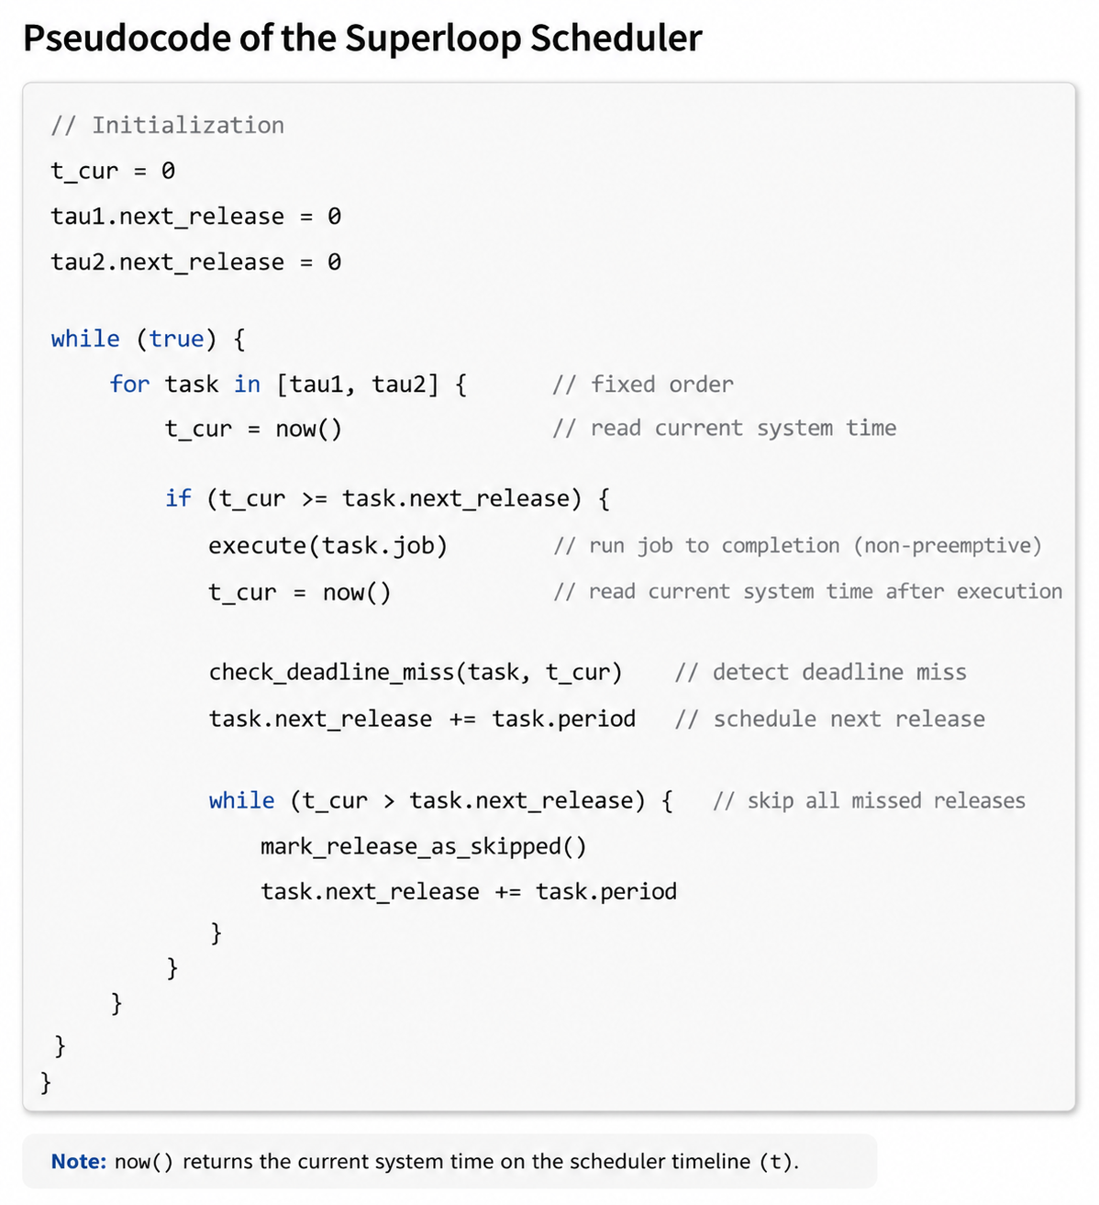


























Superloop Scheduler: Key Principles
Job Releases
Simplified pseudocode of the superloop
$$τ_{\text{1}}=\left(20,50\right)$$
$$R_{1}^{1}$$
$$R_{1}^{2}$$
$$τ_{\text{2}}=\left(10,20\right)$$
$$R_{2}^{1}$$
$$R_{2}^{2}$$
$$R_{2}^{3}$$
$$0$$
$$10$$
$$20$$
$$30$$
$$40$$
$$t$$
Execution scenario
Busy polling
$$τ_{\text{1}}=\left(20,50\right)$$
$$J_{1}^{1}$$
$$τ_{\text{2}}=\left(10,20\right)$$
$$J_{2}^{1}$$
$$J_{2}^{3}$$
$$0$$
$$10$$
$$20$$
$$30$$
$$40$$
$$t$$
$$1 iteration$$
$$t^{cur}$$
$$0$$
$$0$$
$$0$$
$$20$$
$$50$$
$$0$$
$$30$$
$$50$$
$$40$$
$$40$$
$$50$$
$$40$$
$$50$$
$$50$$
$$60$$
$$t_{1}^{next}$$
$$t_{2}^{next}$$
$miss?→ t^{cur}$ >${ R}_{i}^{k}+ D^{i}$
$$−$$
$20$ <${ R}_{1}^{1}+50$
$30$ >${ R}_{2}^{1}+20$
$$−$$
$50$ <${ R}_{2}^{3}+20$
$$D^{i} miss$$
$$Job release$$
$Job$ execution
$skip?→ t^{cur}$ >${ t}_{i}^{next}$
$$−$$
$20$ <${ R}_{1}^{2}$
$30$ >${ R}_{2}^{2}$
$$−$$
$50$ <${ R}_{2}^{4}$
$$\text{Busy} \text{polling}\text{: }$$
$$\text{repeated} \text{while} \text{loop} \text{iterations}$$
$$One while−loop iteration$$
$$Check task set$$
$$If ready:launch$$
$30$ <${ R}_{2}^{3}$

Slide 10
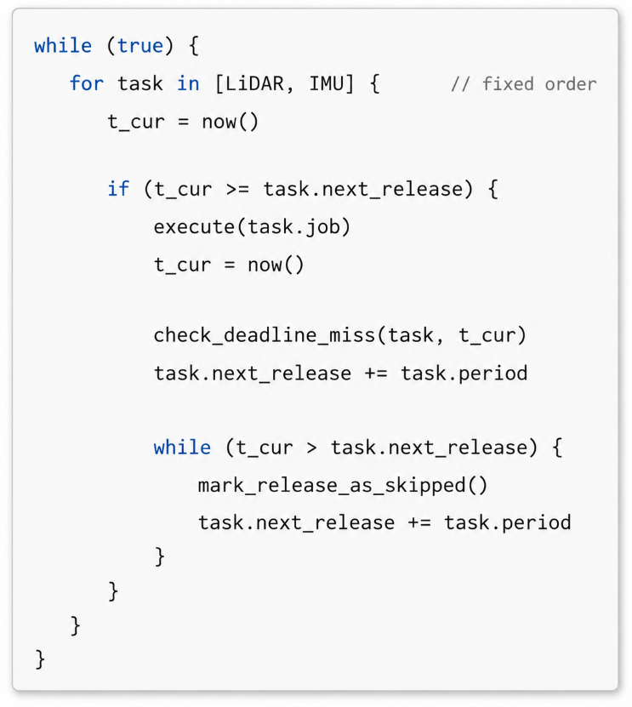
Simplified pseudocode of the illustrated superloop

Slide 11



















Job Releases
Superloop Scheduler: Key Principles
$$τ_{\text{1}}=\left(20,50\right)$$
$$τ_{\text{2}}=\left(10,20\right)$$
Initial values
$$τ_{\text{1}}→τ_{\text{2}}$$
$$t^{cur}$$
$$0$$
$$t_{1}^{next}$$
$$0$$
$$t_{2}^{next}$$
$$0$$
Computations
$$t^{cur}$$
$$0$$
$$20$$
$$30$$
$$t_{1}^{next}$$
$$50$$
$$50$$
$$50$$
$$t_{2}^{next}$$
$$20$$
$$20$$
$$40$$
Scheduler Computations
Resulted Schedule
$$τ_{\text{1}}$$
$$J_{1}^{1}$$
$$τ_{\text{2}}$$
$$J_{2}^{1}$$

Slide 12



























$$τ_{\text{i}}=\left(C_{\text{i}},T_{\text{i}}=D_{\text{i}}\right)$$
Jobs Release
$$chunked EDF$$
$$τ_{\text{1}}=\left(20,50\right)$$
$$R_{1}^{1}$$
$$R_{1}^{3}$$
$$τ_{\text{2}}=\left(10,20\right)$$
$$R_{2}^{1}$$
$$R_{2}^{2}$$
$$R_{2}^{5}$$
$$0$$
$$5$$
$$10$$
$$15$$
$$20$$
$$25$$
$$30$$
$$35$$
$$40$$
$$45$$
$$50$$
$$t$$
Release Handling Scenario
$$τ_{\text{1}}=\left(20,50\right)$$
$$J_{1}^{1}$$
$$J_{1}^{1}$$
$$τ_{\text{2}}=\left(10,20\right)$$
$$J_{2}^{1}$$
$$J_{2}^{2}$$
$$J_{2}^{3}$$
$$0$$
$$5$$
$$10$$
$$15$$
$$20$$
$$25$$
$$30$$
$$35$$
$$40$$
$$45$$
$$50$$
$$t$$
$$Job release$$
$$Preemption$$
$$1 Chunk$$

Slide 13
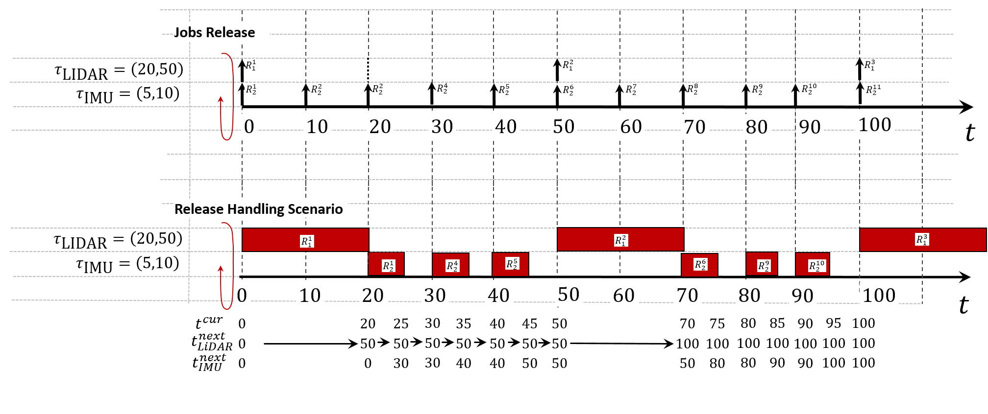
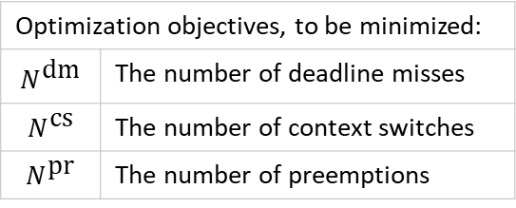
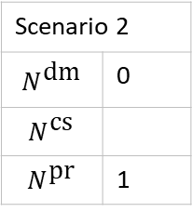
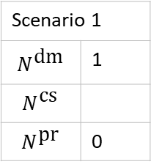
Optimization objectives, to be minimized:
$$N^{\text{dm}}$$ | The number of deadline misses
$$N^{\text{cs}}$$ | The number of context switches
$$N^{\text{pr}}$$ | The number of preemptions
Scenario 1
$$N^{\text{dm}}$$ | 1
$$N^{\text{cs}}$$
$$N^{\text{pr}}$$ | 0
Scenario 2
$$N^{\text{dm}}$$ | 0
$$N^{\text{cs}}$$
$$N^{\text{pr}}$$ | 1

Slide 14
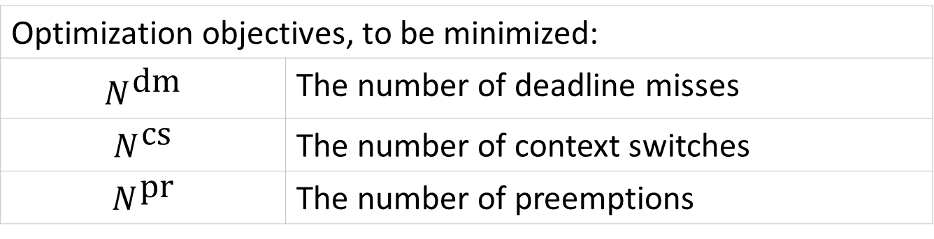
Optimization objectives, to be minimized:
$$N^{\text{dm}}$$ | The number of deadline misses
$$N^{\text{cs}}$$ | The number of context switches
$$N^{\text{pr}}$$ | The number of preemptions
STM32 scheduling overheads: to be investigated
Overhead | Cost, cycles
Context switch
Preemption

Slide 15















Jobs Arrival
$$τ_{\text{LIDAR}}=\left(20,50\right)$$
$$J_{1}^{1}$$
$$J_{1}^{2}$$
$$J_{1}^{3}$$
$$J_{1}^{4}$$
$$J_{1}^{5}$$
$$τ_{\text{IMU}}=\left(3,10\right)$$
$$J_{2}^{1}$$
$$J_{2}^{2}$$
$$J_{2}^{3}$$
$$J_{2}^{4}$$
$$J_{2}^{5}$$
$$J_{2}^{6}$$
$$J_{2}^{7}$$
$$J_{2}^{8}$$
$$J_{2}^{9}$$
$$J_{2}^{10}$$
$$J_{2}^{11}$$
$$J_{2}^{12}$$
$$J_{2}^{13}$$
$$J_{2}^{14}$$
$$J_{2}^{15}$$
$$J_{2}^{16}$$
$$J_{2}^{17}$$
$$J_{2}^{18}$$
$$J_{2}^{19}$$
$$J_{2}^{20}$$
$$J_{2}^{21}$$
$$J_{2}^{22}$$
$$τ_{\text{CAMERA}}=\left(40,200\right)$$
$$J_{3}^{1}$$
$$J_{3}^{2}$$
$$0$$
$$20$$
$$40$$
$$60$$
$$80$$
$$100$$
$$120$$
$$140$$
$$160$$
$$180$$
$$200$$
$$t$$
Exec. Scenario A: No opt.
$$τ_{\text{LIDAR}}=\left(20,50\right)$$
$$τ_{\text{IMU}}=\left(3,10\right)$$
$$τ_{\text{CAMERA}}=\left(40,200\right)$$
$$0$$
$$20$$
$$40$$
$$60$$
$$80$$
$$100$$
$$120$$
$$140$$
$$160$$
$$180$$
$$200$$
$$t$$
Exec. Scenario B: With Opt.
$$τ_{\text{LIDAR}}=\left(20,100\right)$$
$$τ_{\text{IMU}}=\left(1,5\right)$$
$$τ_{\text{CAMERA}}=\left(40,200\right)$$
$$0$$
$$20$$
$$40$$
$$60$$
$$80$$
$$100$$
$$120$$
$$140$$
$$160$$
$$180$$
$$200$$
$$t$$

Slide 16































Scenario A: No optimizations
$$τ_{\text{LIDAR}}=\left(20,100\right)$$
$$τ_{\text{IMU}}=\left(1,5\right)$$
$$τ_{\text{CAMERA}}=\left(40,200\right)$$
$$0$$
$$20$$
$$40$$
$$60$$
$$80$$
$$100$$
$$120$$
$$140$$
$$160$$
$$180$$
$$200$$
$$t$$
Scenario B: With optimizations
$$τ_{\text{LIDAR}}=\left(20,100\right)$$
$$J_{1}$$
$$τ_{\text{IMU}}=\left(1,5\right)$$
$$J_{2}$$
$$τ_{\text{CAMERA}}=\left(40,200\right)$$
$$J_{3}$$
$$0$$
$$1$$
$$2$$
$$3$$
$$4$$
$$5$$
$$6$$
$$7$$
$$8$$
$$t$$

