Slide 1

Your agent still
needs a manager
You repeat the context. Reconnect the accounts.
Remind it what "done" means.
01
Notes:
Offload is a workspace for agents that need to keep working after the first reply. The problem is the supervision around the model. We keep supplying the same context, renewing account access, and explaining what counts as finished. The product goal is fewer interruptions for recurring work. This pitch describes the product plan; it does not claim that every integration is finished.

Slide 2
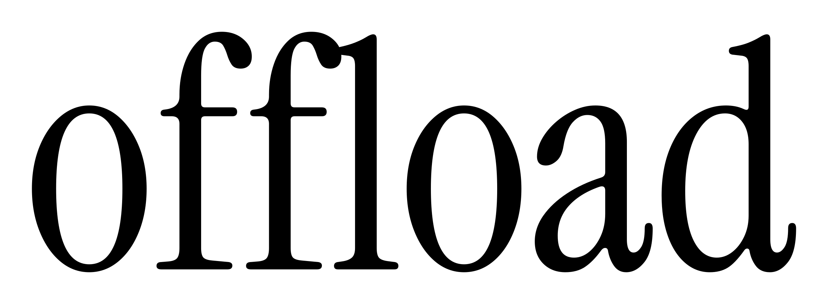
Keep the context.
Keep going.
Connect your tools. Keep the task's
place when access needs renewing.
Choose what it can see and hear.
Review suggestions for work you repeat.
Correct it once. Save the rule
for the next run.
Offload puts account access, work history and task memory in one workspace.
02
Notes:
Account access should refresh where the provider permits it, and preserve a checkpoint when the person must sign in again. The user chooses work sessions and recording. Everyone present must agree to recording. The task panel should show the evidence behind each suggestion. Sleep reviews stored notes and proposed routines. It does not retrain the underlying model. MongoDB is intended to store context, rules and task checkpoints. These are the intended behaviors; account integrations still need implementation.

Slide 3
Give it
the night
"Have the update ready by 8.
Use at most 10,000 tokens."
Slow mode gives a task time to check
its work. Memory review keeps useful
rules for the next run.
Jev is planned to score context and completion evidence.
Product plan. Account authorization, Jev and overnight execution still need integration.
03
Notes:
Slow mode is an overnight task with a deadline and token budget. Time alone does not make a model cheaper. We need to measure token use, output quality and the number of human corrections before claiming savings. The current UI saves an overnight queue. The worker still needs integration. Jev, from TypeSafe AI, is a planned decision model for selecting context and evaluating individual completion criteria against evidence. A Noul result is the probability of yes for a specified question; a general confidence score is not proof that an entire task is complete. Jev is not connected. Sources: https://docs.typesafe.ai/introduction and https://docs.typesafe.ai/primitives/noul .

