Slide 1

AI Live Meeting Summarizer
Real-time Transcription & AI-Powered Summarization
INFOSYS AI VIRTUAL INTERNSHIP
DEDEEPYA NARNE

Slide 2
Project Objective
To develop a real-time Meeting Summarizer that leverages speech-to-text (STT) models and open-source LLMs to generate structured summaries from live recordings, delivered as a fully integrated Streamlit application.

Slide 3
Key Features & Outcomes
Live Audio Capture: Convert live audio to text in real-time using offline STT models like Vosk or Whisper.
Speaker Identification: Identify and segment the audio by speaker using diarization models like pyannote.audio.
LLM Summarization: Integrate transformer-based summarization using LLMs from Groq API or Hugging Face (T5, BART).
Structured Summaries: Deliver summaries only after the 'Stop' button is pressed and the complete transcript is available.
Interactive UI: Build an interactive UI using Streamlit with real-time control (Start/Stop) and result rendering.
One-Click Export: Export summaries as Markdown/PDF and send them via email with a single click.

Slide 4
System Architecture Pipeline
2. Real-time STT
4. Summarization
Audio chunks transcribed in real-time using Vosk/Whisper and displayed on the UI.
The diarized transcript is sent to an LLM (Groq/T5) to generate a structured summary.
1. Audio Capture
3. Diarization
Live audio captured from microphone via PyAudio/SoundDevice in a separate thread.
On 'Stop', the full .wav file is processed by pyannote.audio to tag all speakers.

Slide 5






Core Modules (Part 1)
Audio & STT
Speaker Diarization
LLM Summarization
Implement threaded audio capture from the microphone and connect the STT engine (Vosk/Whisper) to transcribe in real time.
Integrate pyannote.audio to process the final audio file, tag different speakers, and format the transcript.
Design prompt templates and an API wrapper for summarizer models (Groq LLaMA, T5, BART) to handle diarized text.

Slide 6






Core Modules (Part 2)
Streamlit Frontend
Backend Pipeline
Finalization & Export
Design the real-time UI with Start/Stop buttons, a live transcription log, and a final summary/diarization viewer.
Use multi-threading and queuing to manage capture, transcription, and async summarization to prevent UI blocking.
Implement export (PDF/MD), email (smtplib), structured logging, final testing, and project documentation.

Slide 7

1 : Speech To Text
Tasks & Deliverables
Define the technical architecture (multi-threaded pipeline) and set up the Python environment. Compare Vosk and Whisper models.
Implement threaded audio capture from the microphone and connect the STT engine to transcribe in real time.
Deliverable: Python module for real-time STT.
Metric: Word Error Rate (WER) < 15%.

Slide 8
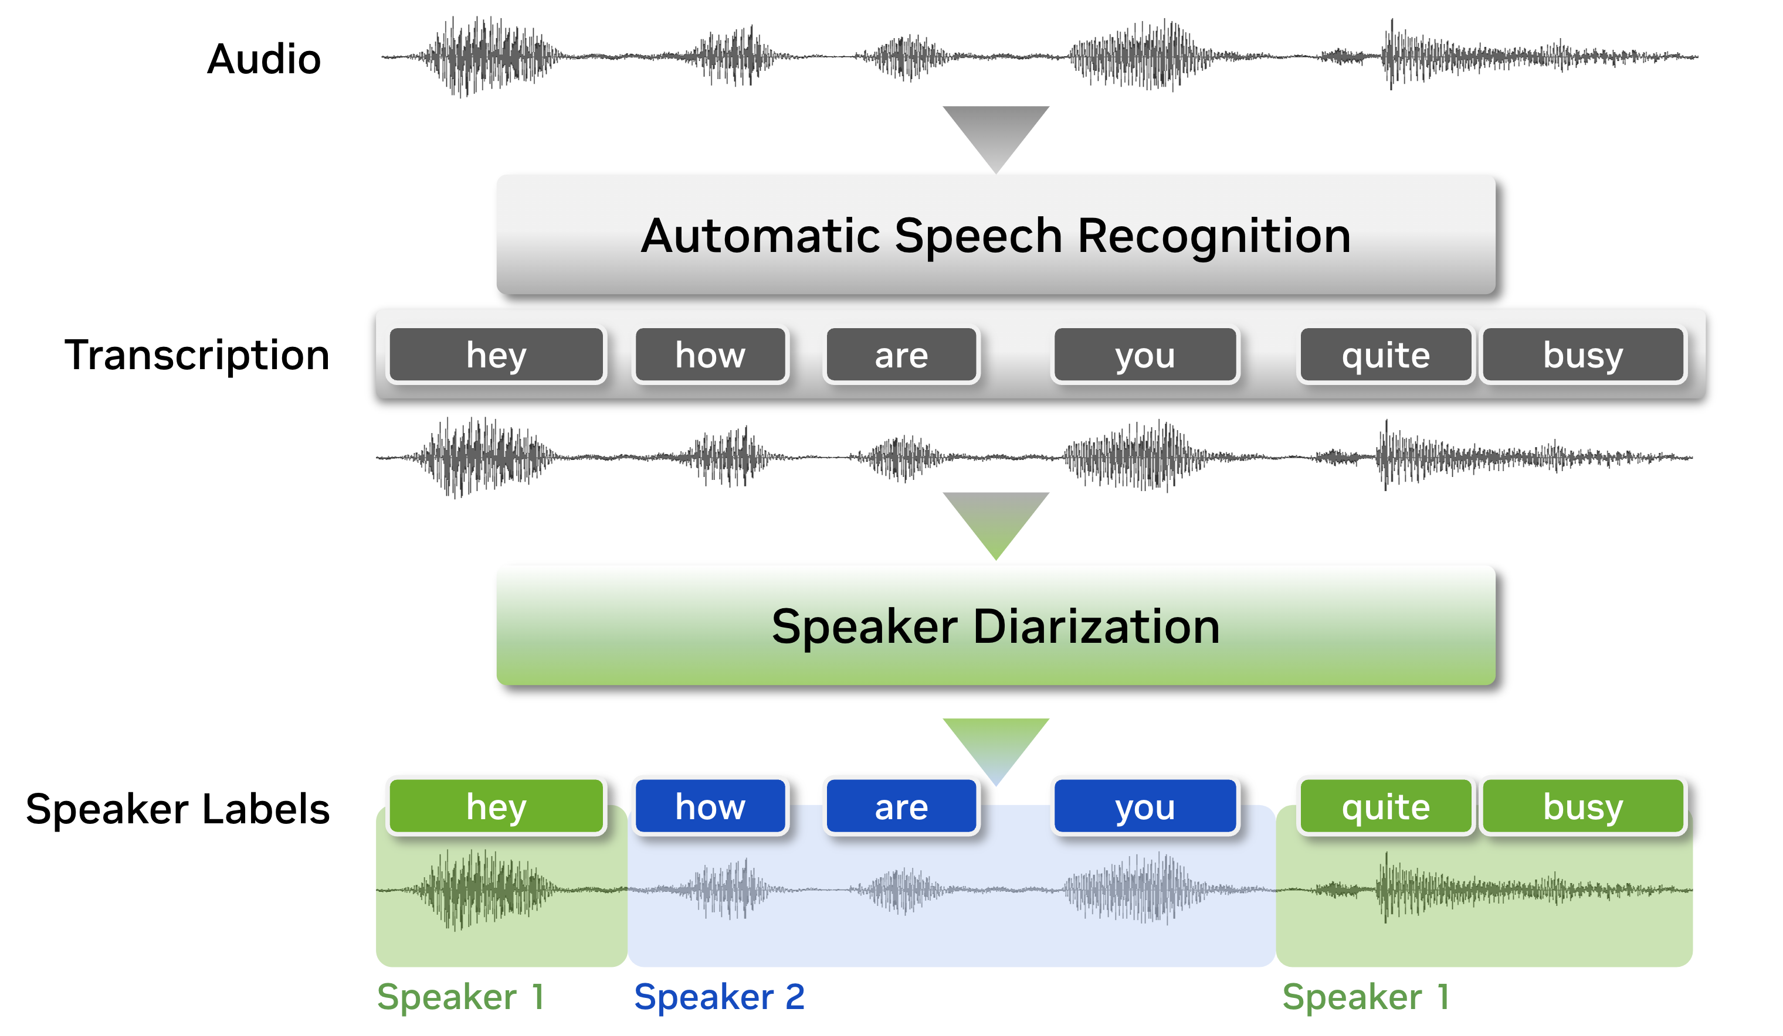
2 : Speaker Diarization
Tasks & Deliverables
Integrate pyannote.audio to tag speakers in the .wav file after recording ends. Convert segments into a readable diarized transcript.
Choose the summarizer model (Groq, T5, BART) and design prompts to handle the speaker-tagged text.
Deliverables: Diarized transcript function & Summarizer module.
Metrics: Diarization Error Rate (DER) < 20%, ROUGE > 0.4.

Slide 9
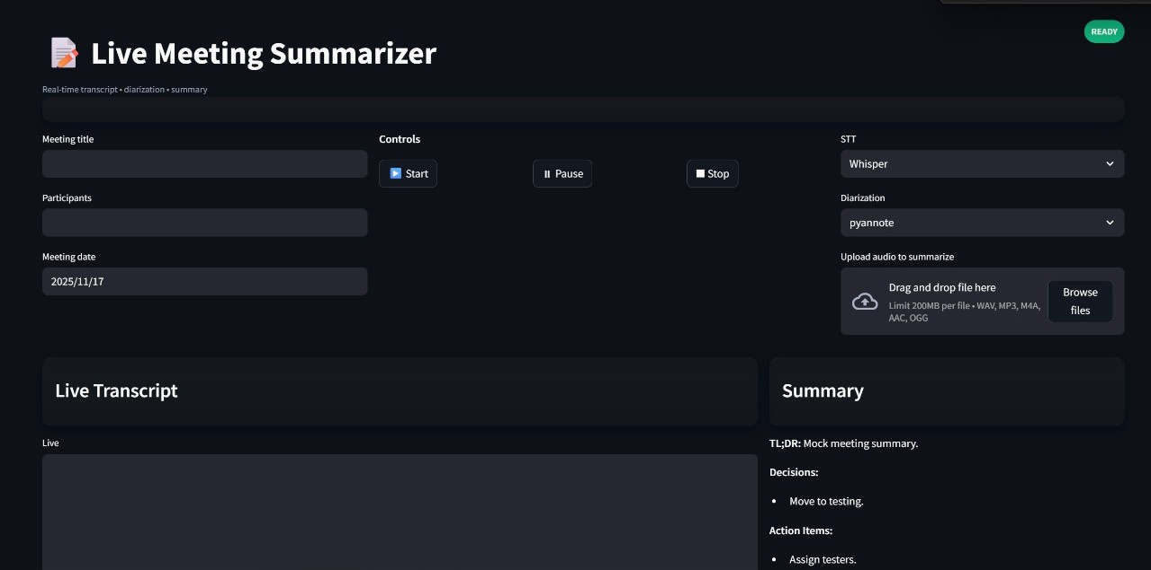
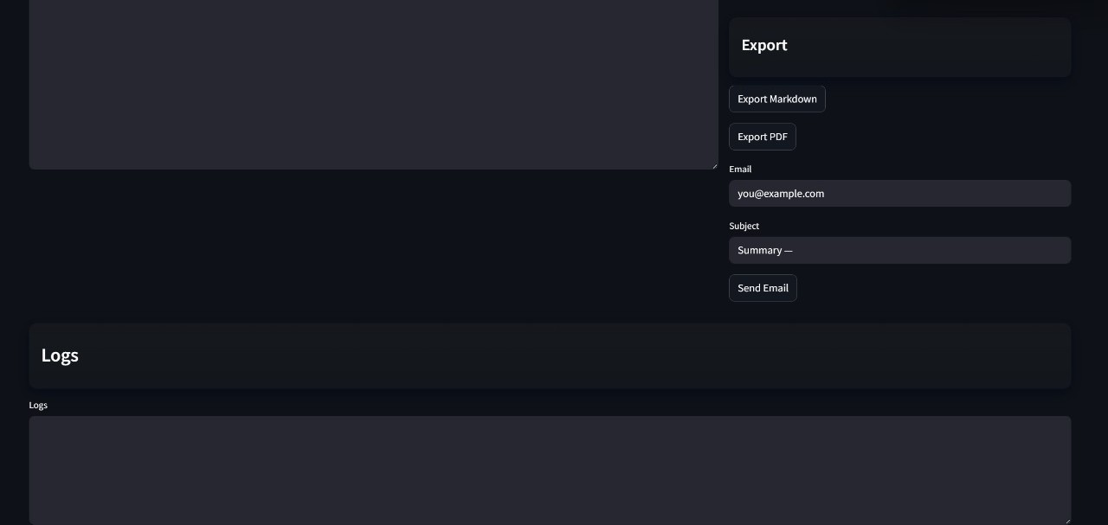
3 : Frontend Development
Tasks & Deliverables
Build the backend queue for the full pipeline (transcript → diarization → summary) to ensure summarization only triggers after 'Stop'.
Design the Streamlit UI with real-time components: Start/Stop buttons, transcription log, summary viewer, and status bar.
Deliverable: Fully functional Streamlit application.
Metric: Smooth end-to-end functionality with no UI blocking.

Slide 10
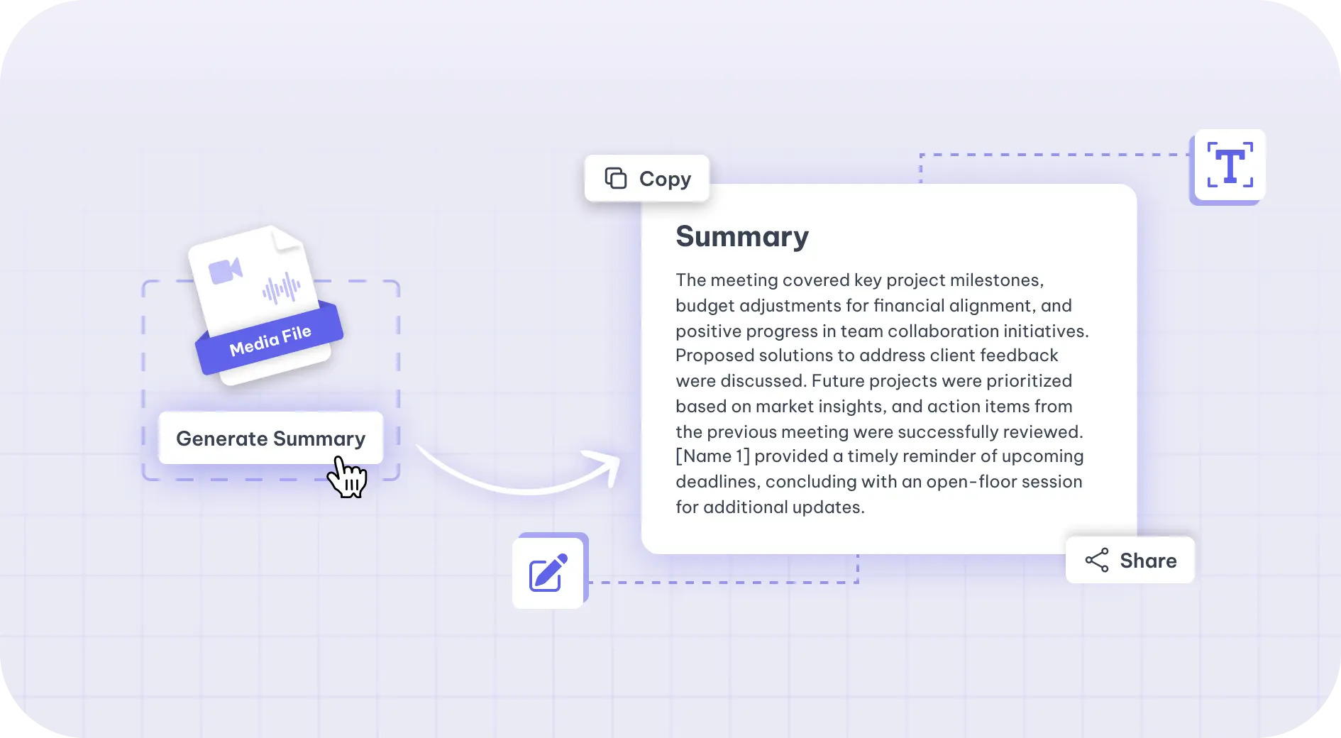
4 : Additional Features
Tasks & Deliverables
Add download options (Export as .md and .pdf) and integrate the email system (smtplib) for one-click sharing.
Implement structured logging for each session and finalize all documentation (architecture, APIs, UI).
Prepare a final demo script and package the entire solution for a GitHub release.
Deliverables: Documented codebase, GitHub repo, final deck.
Metric: Fully functional export and email features.

Slide 11
Key Evaluation Metrics
Milestone | Focus Area | Metric / Tool | Target / Goal
Speech to Text | STT System | WER (jiwer) | < 15%
Speaker Diarization | Diarization | DER | < 20%
Speaker Diarization | Summarization | ROUGE Score | > 0.4
Frontend Development | UI Integration | Responsiveness | No lag / errors
Additional Features | Full System | Full Pipeline Flow | Working Export/Email

Slide 12
Questions?
Thank you for your attention.

