Slide 1


INFOSYS AI VIRTUAL INTERNSHIP
AI MEETING SUMMARIZER
Dhanashree Borkar

Slide 2

PROBLEM STATEMENT
Meetings generate hours of discussions, but most key points are lost or manually noted.
Key Points:
Manual note-taking is time-consuming and inaccurate.
2. Online meetings lack structured summaries.
3. Organizations need automated meeting documentation.

Slide 3


OBJECTIVES
Build an AI-powered system that records speech, identifies speakers, transcribes the conversation, and generates concise summaries automatically.
Real-time Speech-to-Text conversion
AI-based meeting summarization
Export summary via email or file

Slide 4
TOOLS AND TECHNOLOGIES
Category | Tools / Libraries
Programming | Python
Speaker Diarization | Pyannote
STT Engine | OpenAI Whisper, Vosk
Speaker Diarization | Pyannote
Summarization | Groq API, Hugging Face
Backend Integration | Custom Python pipeline
Environment | Virtualenv (.venv)

Slide 5
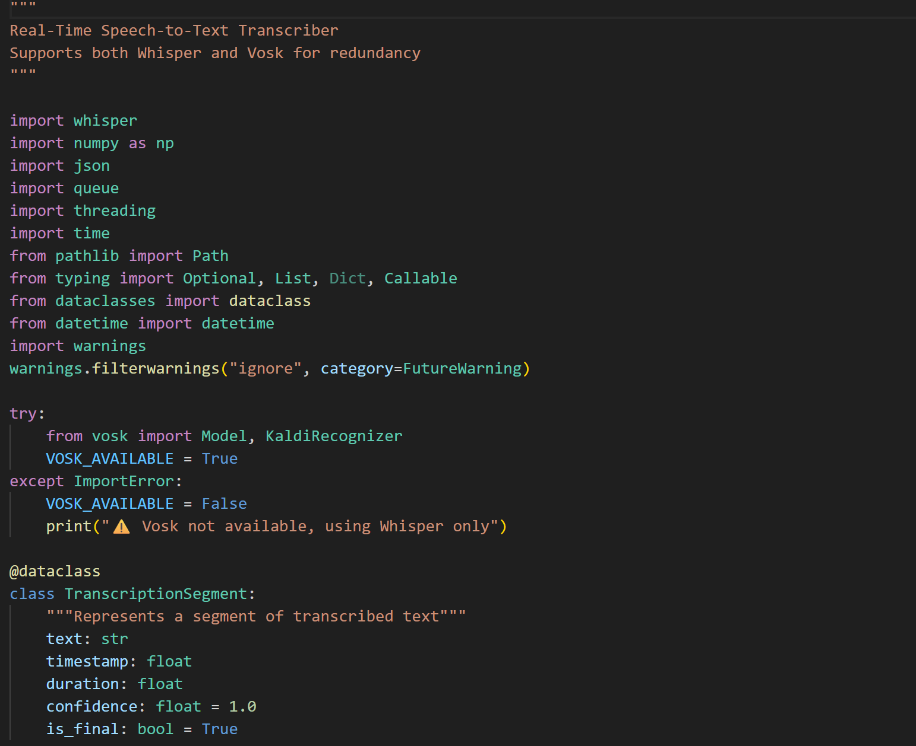
REAL-TIME STT
audio_capture.py → captures live audio
realtime_stt.py → streams audio into Whisper model
Features:
Live transcription at 16 kHz sample rate
Supports different Whisper model sizes (tiny, base, etc.)
SPEAKER DIARIZATION
speaker_identifier.py
pyannote.audio integration
Function:
Detects speaker changes
Tags transcript segments with speaker labels
Fallback to simple detector if token unavailable

Slide 6
INTEGRATION AND UI
Module: pipeline.py
Combine STT → Diarization → Summarization and Handles recording flow & post-processingManage error fallback and logs
Result: One-click meeting processing
Module: streamlit_app.py
Modern, interactive web UI, Start/Stop recording buttons with Real-time transcript updates. Auto-generated summary displayed
-Option to export or email.

Slide 7
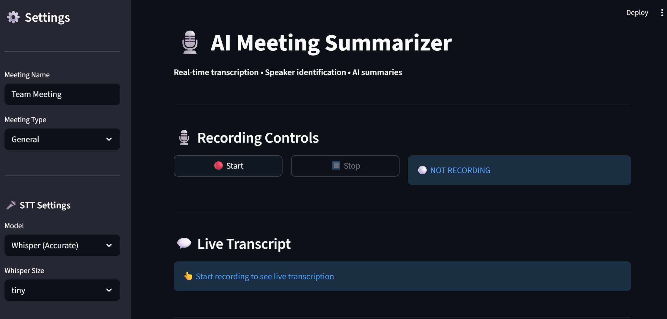
RESULT : DASHBOARD

Slide 8
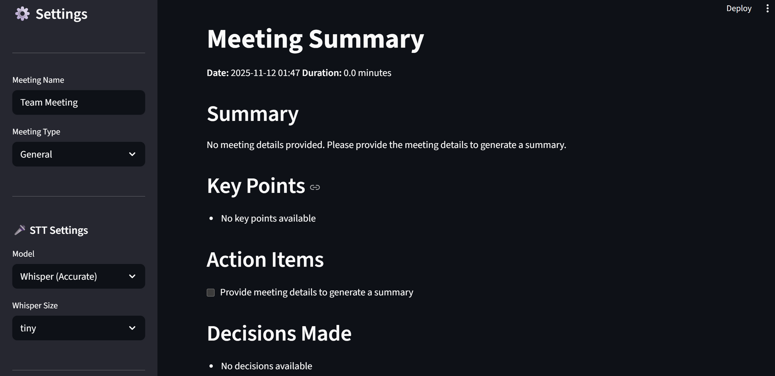
RESULT : DASHBOARD

Slide 9


FUTURE SCOPE
Integrate with Google Meet / Zoom APIs
Add multilingual support
Include sentiment analysis
Create mobile-friendly web app
The AI Meeting Summarizer bridges the gap between communication and documentation saving time and improving meeting productivity.

Slide 10
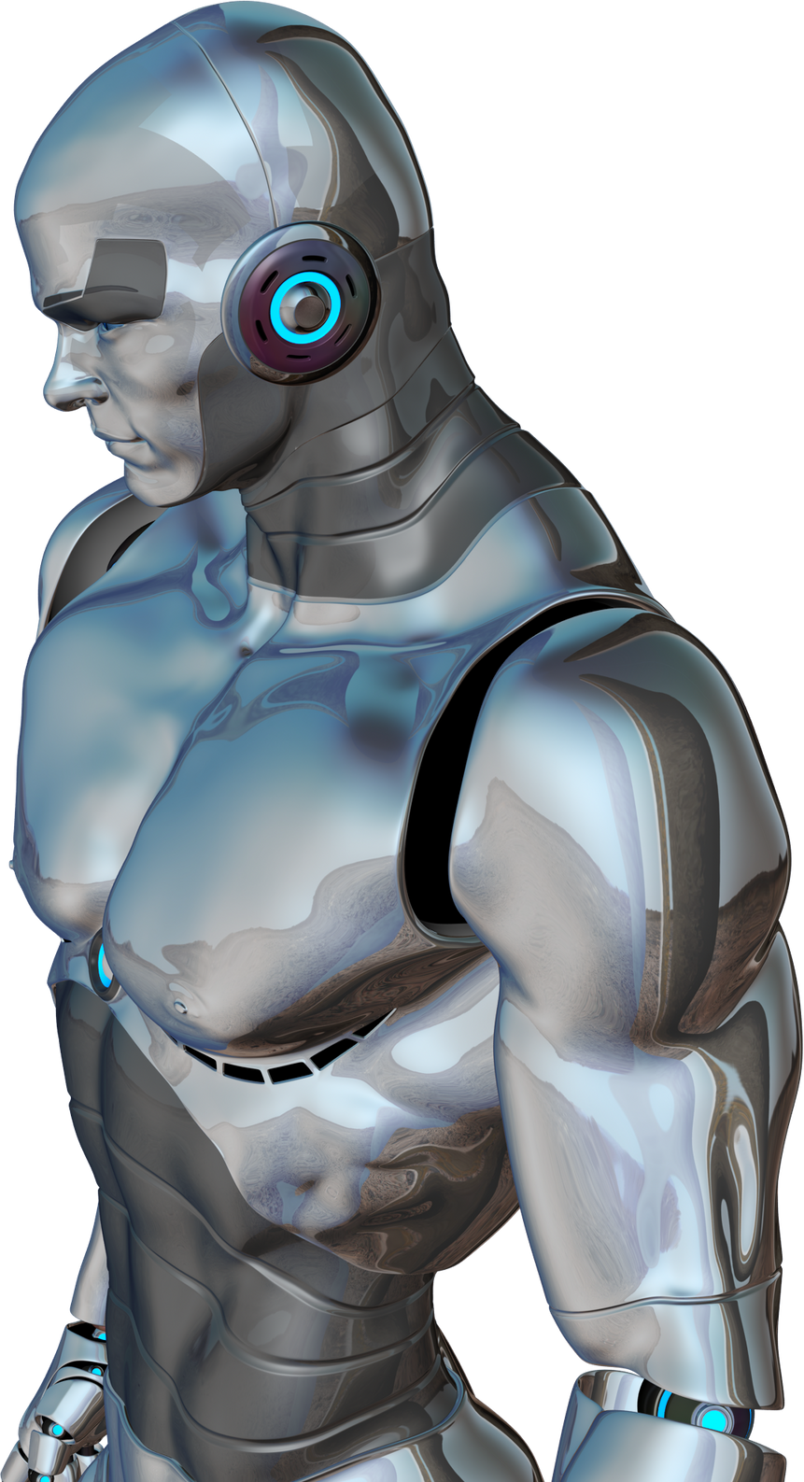
TESTING & RESULTS
STT Accuracy: We expect transcription accuracy to be approximately 95% (Whisper Base model), corresponding to a Word Error Rate (WER) of less than 15.
Speaker Diarization: We anticipate approx. 85% correct speaker labeling, with the Diarization Error Rate (DER) targeted to be less than 20%.
Summarization Quality: The final summary must be logically coherent and structured, preserving speaker context, and achieving a ROUGE score of greater than 0.4%.

Slide 11
THANK YOU!

