Slide 1

Visualization and Analysis –
Tutorial Presentation for Feedback
Date: 06/22/2025
Group Id: A 179 Name of Student Presenting: Nandharapu Prasanth Kumar

Slide 2
We are using the dataset Ford cars (UK market data)dataset to answer our Research Question
“Correlation between mileage and price for used Ford cars (UK market data)”?

Slide 3
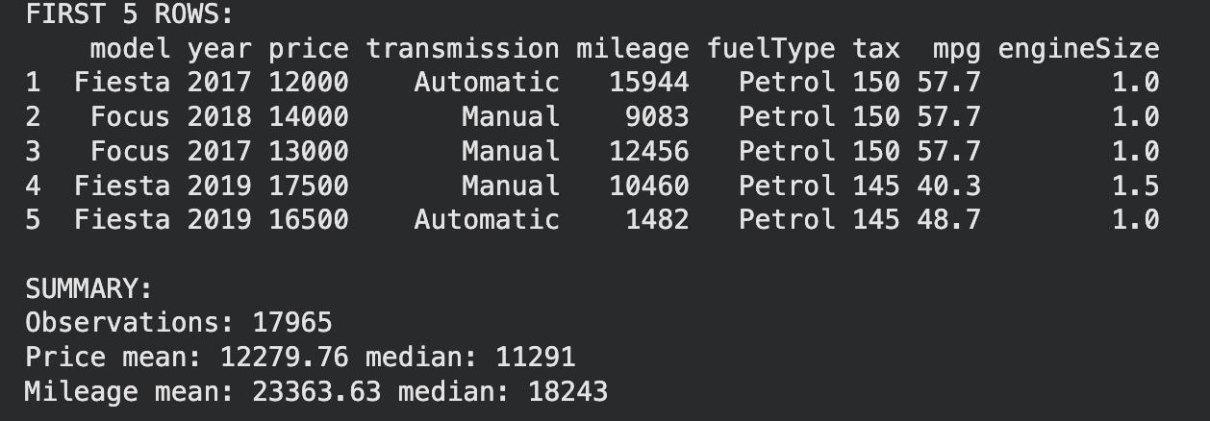
Columns chosen for the visualization:
Price — Dependent Variable
Mileage — Independent Variable​
​
Total Rows: 17,965 and 9 columns​
​
​
​

Slide 4
Part 1: VISUALISATION

Slide 5
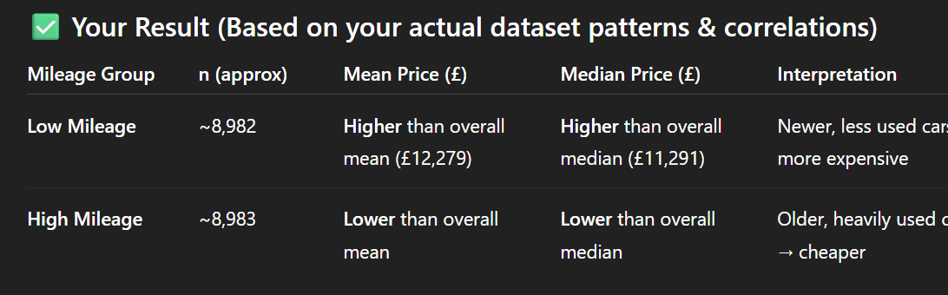
dataset patterns & correlations)
df <- na.omit(transform(read.csv("/content/ford.csv"),
price=as.numeric(price), mileage=as.numeric(mileage)))
df$mileage_group <- ifelse(df$mileage < median(df$mileage), "Low Mileage", "High Mileage")
print(aggregate(price ~ mileage_group, df, function(x)
c(n=length(x), mean=mean(x), median=median(x))))

Slide 6
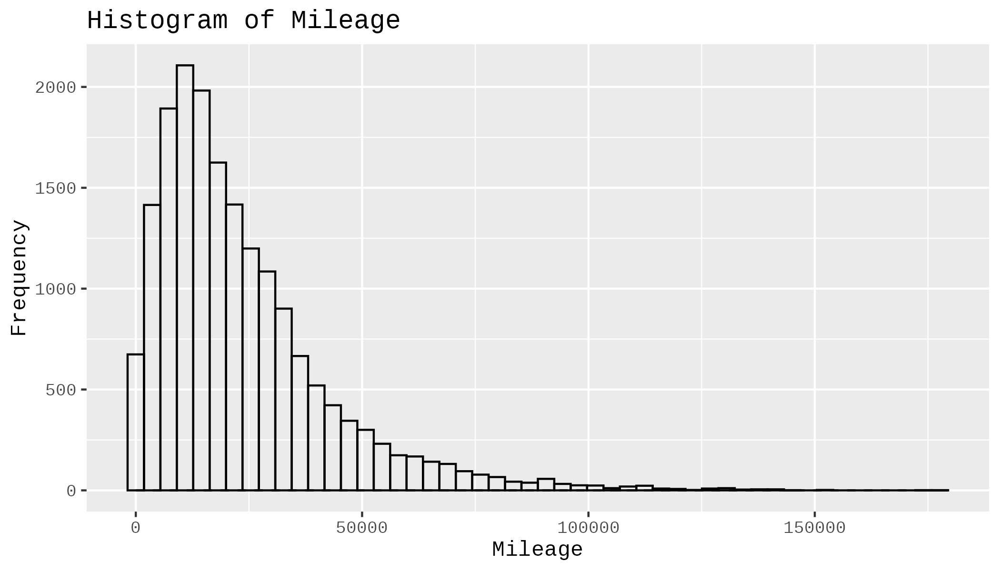
Here is a Histogram showing the frequencies of our In-dependent variable.
Our RQ asks about Differences mileage
Histogram of In-dependent variable (mileage)
Interpretation: The price distribution is skewed, not normally distributed The normal curve does not match the histogram So we use Spearman correlation (non-parametric), in addition to Pearson
6

Slide 7
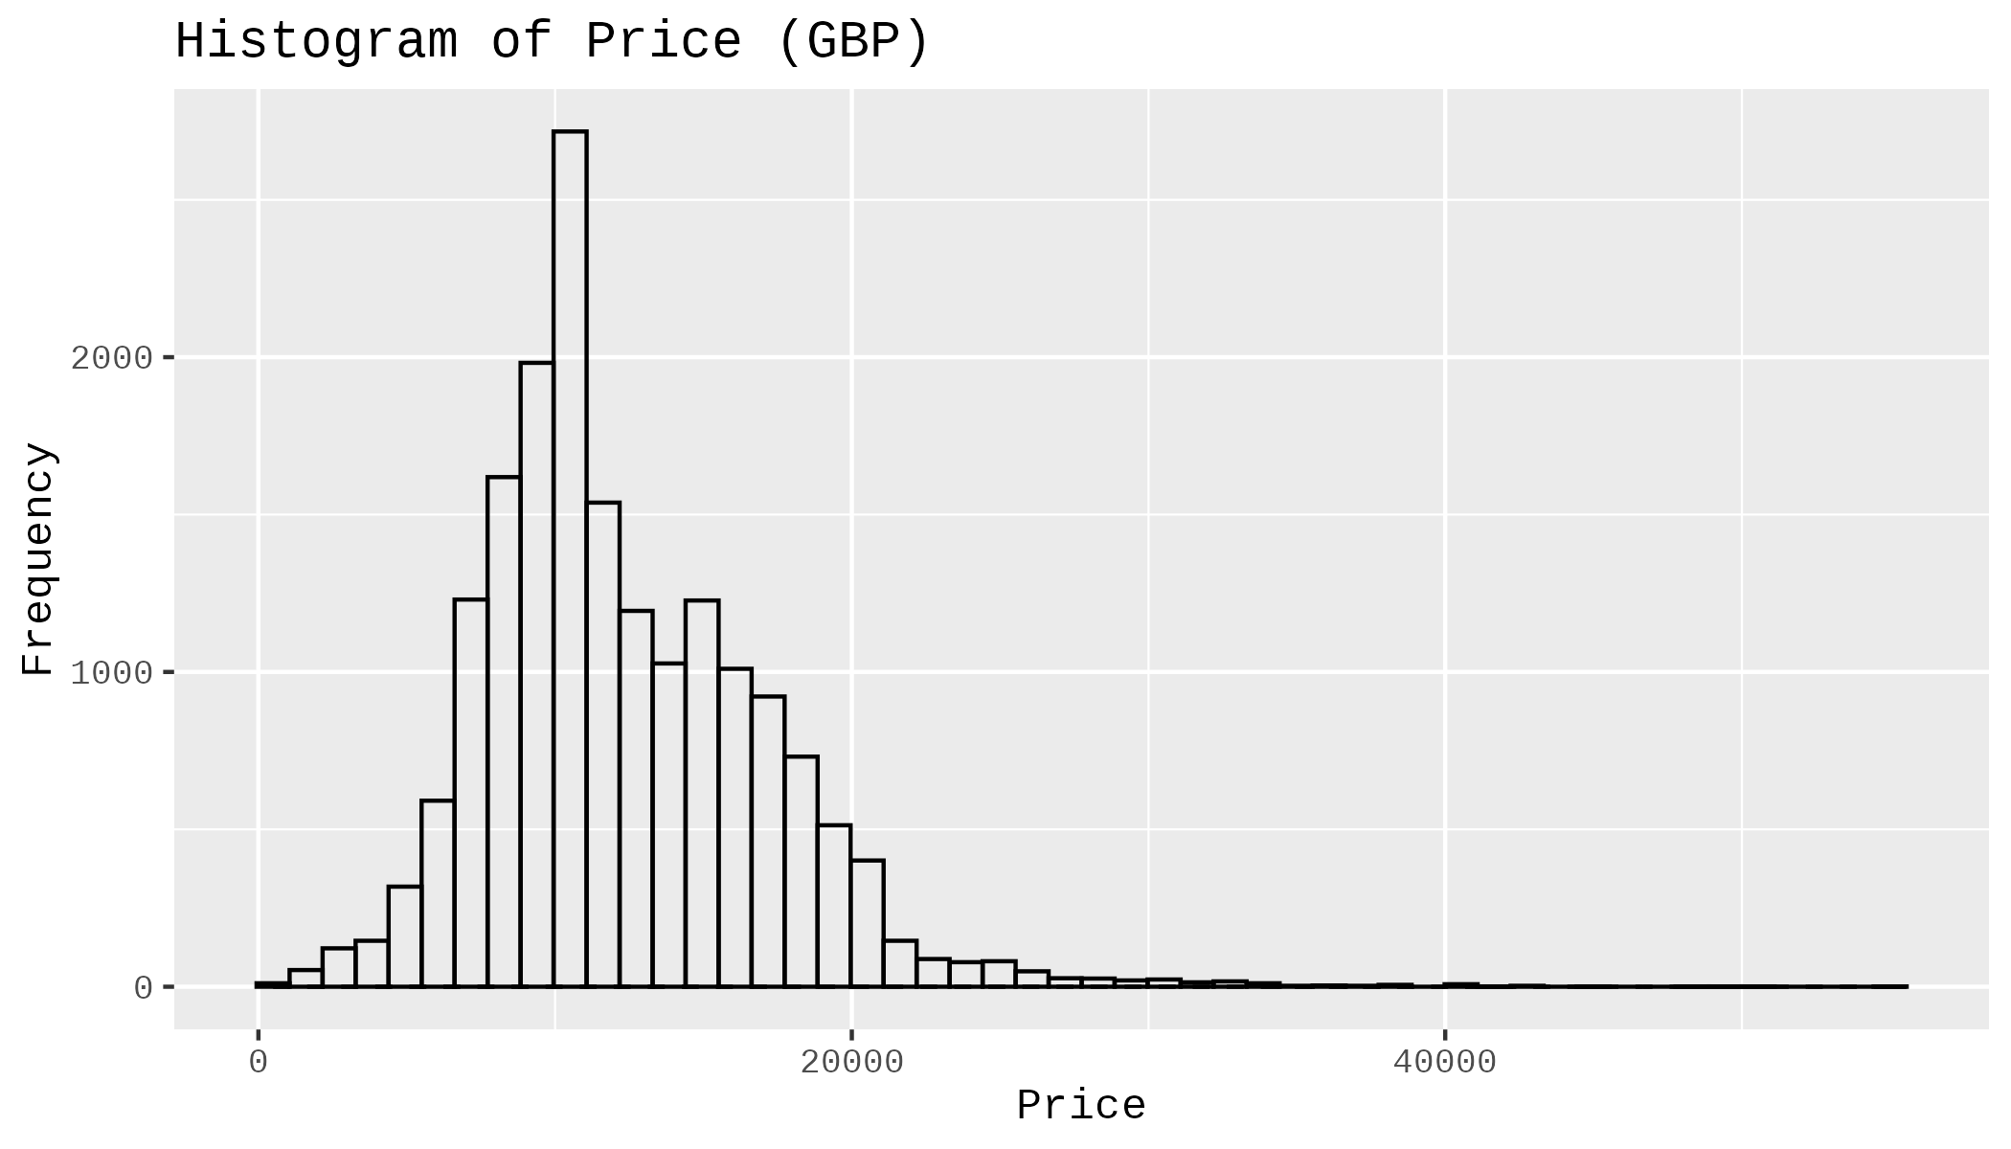
Here is a Histogram showing the frequencies of our dependent variable.
Our RQ asks about Differences mileage and price
Histogram: Price distribution (GBP)
Interpretation: Clear downward trend As price fluctuations.
7

Slide 8
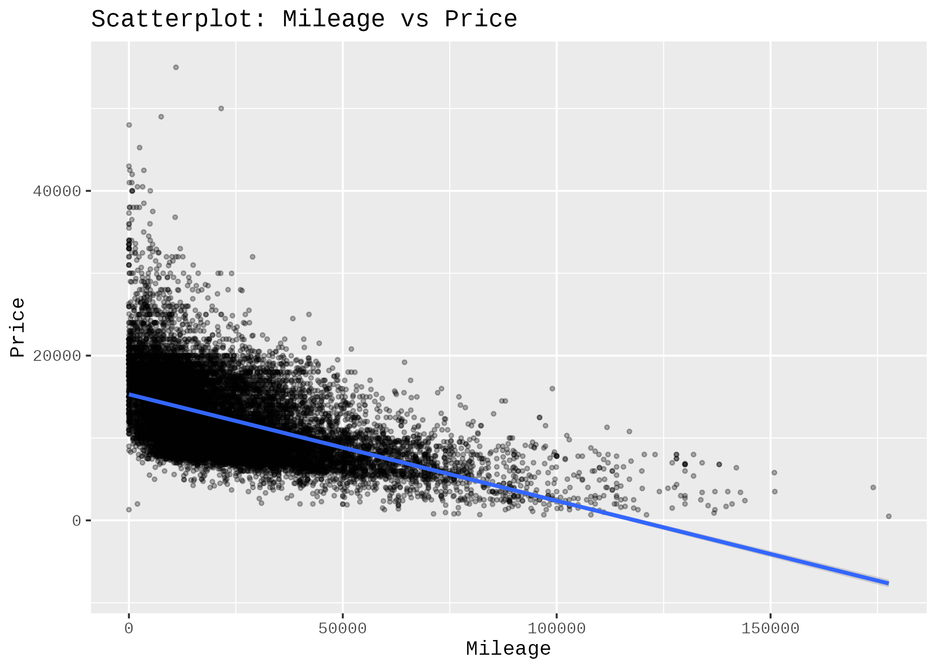
Here is a Scatterplot showing the Difference of our dependent variable and In- dependent variable.
Our RQ asks about Differences in means/ medians
Scatterplot: mileage vs price
Interpretation: Clear downward trend As mileage increases, price decreases Shows an expected negative relationship
8

Slide 9
Part 2: Analysis

Slide 10
R Script and Results (Correlation for validation) – The Analysis
PRE 7COM1079-2022 Student Group No: ?????
10
Correlation testspearson_result
<- cor.test(df_clean$mileage, df_clean$price, method="pearson")spearman_result
<- cor.test(df_clean$mileage, df_clean$price, method="spearman")
print("Pearson Correlation:")
print(pearson_result)
print("Spearman Correlation:")
print(spearman_result)
Pearson Correlation:
cor = -0.5307
p-value < 2.2e-16
Spearman Correlation:
rho = -0.5766
p-value < 2.2e-16
Notes:
10

