Slide 1

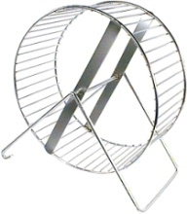
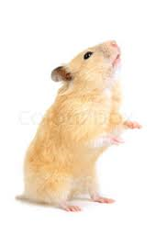
The Hamster Wheel and the How and Why of Agile Data Science
©Ron Neely
January 18, 2016

Slide 2

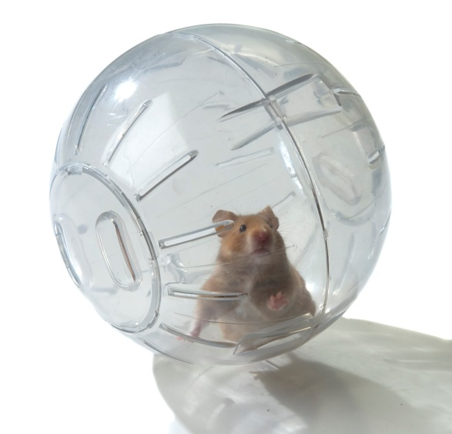
The Question?
Doing vast amounts of homework with my pets led me to wonder:
How do
Cats
Hamsters
Hamster Wheels
relate to Data Science?
Or, was I doing too much
homework?

Slide 3

Found Answer on My Favorite Tee
Curiosity = Desire To Know the Unknown

Slide 4
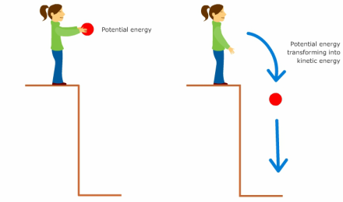
Curiosity = Potential Energy
Unknown
Known
http://physics20project.weebly.com/unit-4-work-and-energy.html (c) 2007-2010 Univ. Walkato www.sciencelearn.org.nz

Slide 5
Data Science Projects -> How to Know Unknown
UnKnown
http://physics20project.weebly.com/unit-4-work-and-energy.html (c) 2007-2010 Univ. Walkato www.sciencelearn.org.nz

Slide 6

3 Components of a Data Science Project
Data
Analysis
Communication

Slide 7
3 Components of a Data Science Project
Facts
- Real World
Info
- Gathered Facts
Data
Analysis
Communication

Slide 8
3 Components of a Data Science Project
Data
Cleaned
Digested
Models
Math
Simulation
Prediction
Machine Learning
Visualizations
Data
Analysis
Communication

Slide 9
3 Components of a Data Science Project
Data
Analysis
Communication
Verification = Client Agreement + Reality Check
- Reports
- Presentations
- User Interfaces

Slide 10
Most Important for Working Data Scientists
Data
Analysis
Communication
Verification = Client Agreement + Reality Check

Slide 11

Agile Approach to Verification
Iterate
Analysis
Data
Iterate
Communication
Verification = Client Agreement + Reality Check

Slide 12
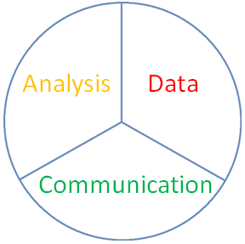
The Data Science Project Wheel
Why? - because we (i.e. the client) wants to know
How? - iterate Data, Analysis, & Communication
Unknown
Known

Slide 13
The Data Science Project Wheel
Keep going until
Unknown
Known

Slide 14
The Data Science Project Wheel
Keep going until
Unknown
Known

Slide 15
The Data Science Project Wheel
the client knows what they want
UnKnown

Slide 16
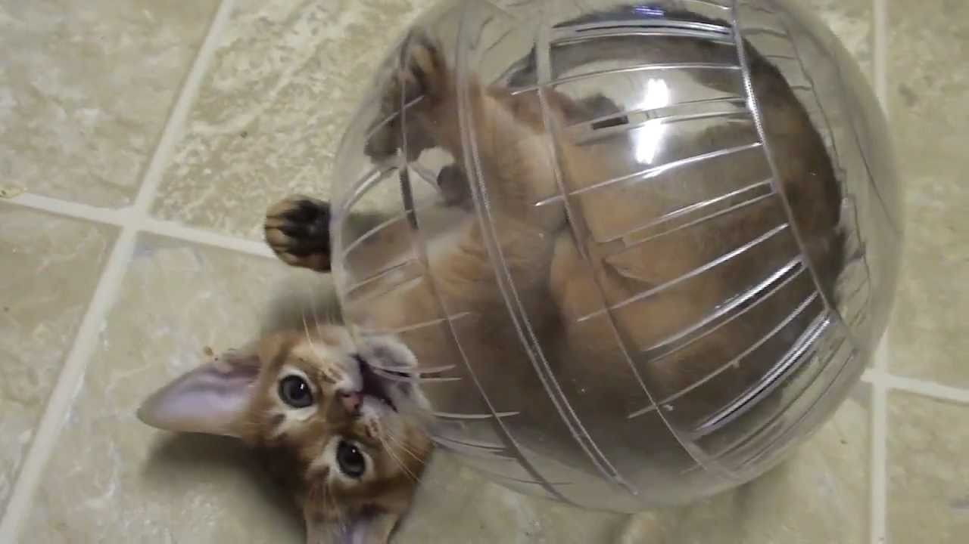
Or Until the Cat is Curious Again
Thank You ☺

