Slide 1
Hidden Markov Map Matching Through Noise and Sparseness
Paul Newson and John Krumm. 2009. “Hidden markov map matching through noise and sparseness”. In Proceedings of the 17th ACM SIGSPATIAL international conference on advances in geographic information systems, 336–343.

Slide 2
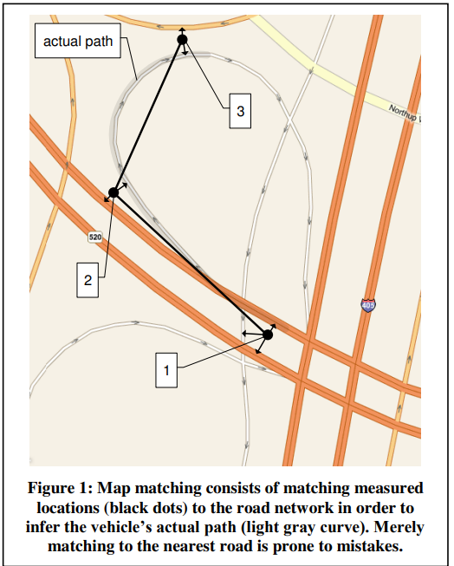
MAP Matching
Problem:

Slide 3
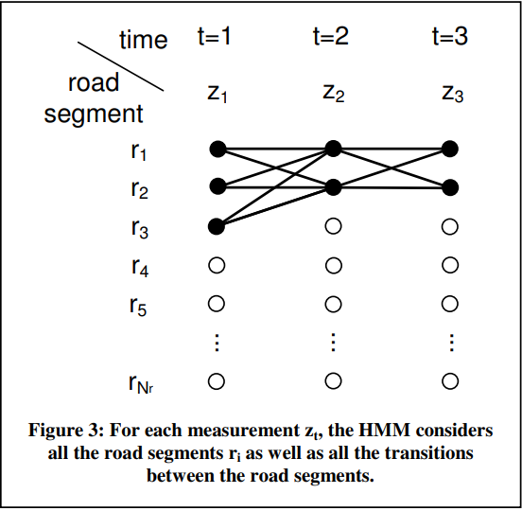
HMM MAP MATCHING:
In our map matching algorithm, the states of the HMM are the Indivdual road segments, and the state measurements are the noisy vehicle location measurements. The goal is to match each location measurement with the proper road segment.
More formally, the discrete states of the HMM are the 𝑁_{𝑟} road segments, 𝑟_{𝑖} , 𝑖 = {1 … 𝑁_{𝑟} }.
For each 2D latitude/longitude location measurement 𝑧_{𝑡 .}

Slide 4
HMM MAP MATCHING:
Figure 3 shows an illustration of the HMM for the map matching illustrated in Figure 1. Here, each vertical slice represents a point in time corresponding to a location measurement 𝑧_{𝑡} for the three times 𝑡 = 1, 2, 3.
we do not consider matching to road Segments that are quite distant from the measurement. In our algorithm, we set to zero any measurement probability from a road segment that is more than 200 meters away from 𝑧_{𝑡}.

Slide 5
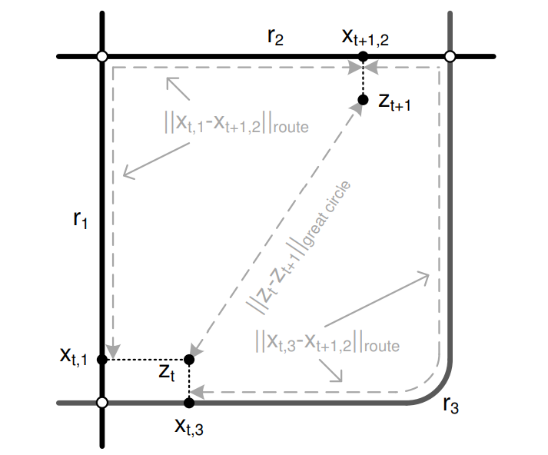
Figure 4: This shows an example of our notation. There are three road segments, r₁, r₂, and r₃,
and two measured points ,𝑧_{𝑡} and 𝑧_{𝑡+1}.
The first measured point, 𝑧_{𝑡}, has candidate road matches at 𝑥_{𝑡,1} and 𝑥_{𝑡,3}. Each match candidate results in a route to 𝑥_{𝑡+1,2} , which is a match candidate for the second measured point, 𝑧_{𝑡+1} .
These two routes have their own lengths, as does the great circle path between the two measured points.
The great circle distance on the surface of the earth between the measured point and the candidate match is ‖ 𝑧_{𝑡} − 𝑥_{𝑡,𝑖} ‖_{𝑔𝑟𝑒𝑎𝑡 𝑐𝑖𝑟𝑐𝑙e}.
HMM MAP MATCHING:
Figure 4

Slide 6
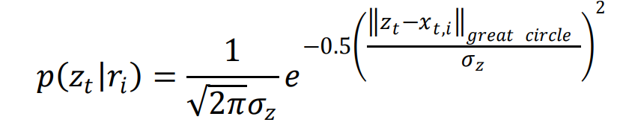
Measurement Probabilities:
This gives the likelihood that the measurement 𝑧_{𝑡} would be observed if the vehicle were actually on road segment 𝑟_{𝑖}. (also called emission probabilities)
For the correct match, this difference is due to GPS noise. Based on previous work we can model GPS noise as zero-mean Gaussian.
Here 𝜎_{𝑧} is the standard deviation of GPS measurements [Parameter Estimation unit].
the initial state probabilities 𝜋_{𝑖} = 𝑝(𝑧₁|𝑟_{𝑖}) , 𝑖 = 1 … 𝑁_{𝑟.} Assuming no measurements have been taken, we start at the first measurement.
Notes:
https://blog.csdn.net/deephub/article/details/121807552

Slide 7
Transition Probabilities:
Each measurement 𝑧_{𝑡} has a list of possible road matches, as does the next measurement 𝑧_{𝑡+1} . Transition probabilities give the probability of a vehicle moving between the candidate road matches at these two times.
Practically, we favor transitions whose driving distance is about the same as the great circle distance between the measurements.
- Our intuition, confirmed by experiment, is that these two distances will be about the same for correct matches. This is because the relatively short distance traveled on the road(s) between a pair of correct matches will be about the same as the distance between the measured GPS points.

Slide 8
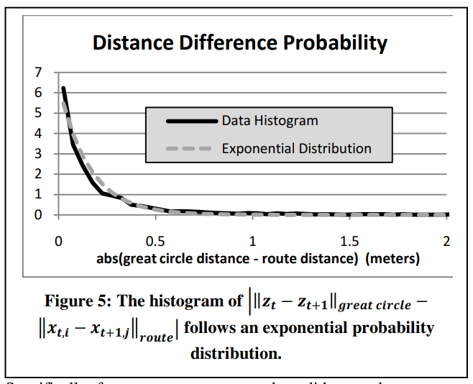


Transition Probabilities:
We computed a histogram of the absolute values of the differences between the great circle distances and the route distances from the correct matches, shown in Figure 5. This histogram fits well to an exponential probability distribution given by Equation ( 2 ):
where 𝑖∗ and 𝑗∗ indicate the ground truth road segments of the route.
We estimate the value of 𝛽 in [Parameter Estimation unit].
Notes:
https://zh.wikipedia.org/zh-tw/%E6%8C%87%E6%95%B0%E5%88%86%E5%B8%83

Slide 9
Optimal Path:
With measurement probabilities from Equation (Measurement Probabilities) and transition probabilities from Equation (Transition Probabilities), we used the Viterbi algorithm to compute the best path through the HMM lattice.
The Viterbi algorithm uses dynamic programming to quickly find the path through the lattice that maximizes the product of the measurement probabilities and transition probabilities.
This gave us an inference of the correct road segment for each location measurement.
Notes:
https://ckmarkoh.github.io/blog/2014/04/06/natural-language-processing-viterbi-algorithm/

Slide 10
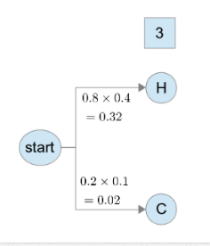
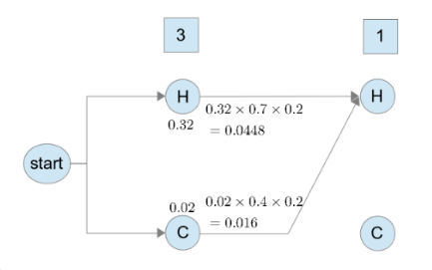
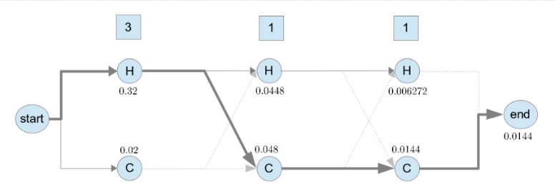
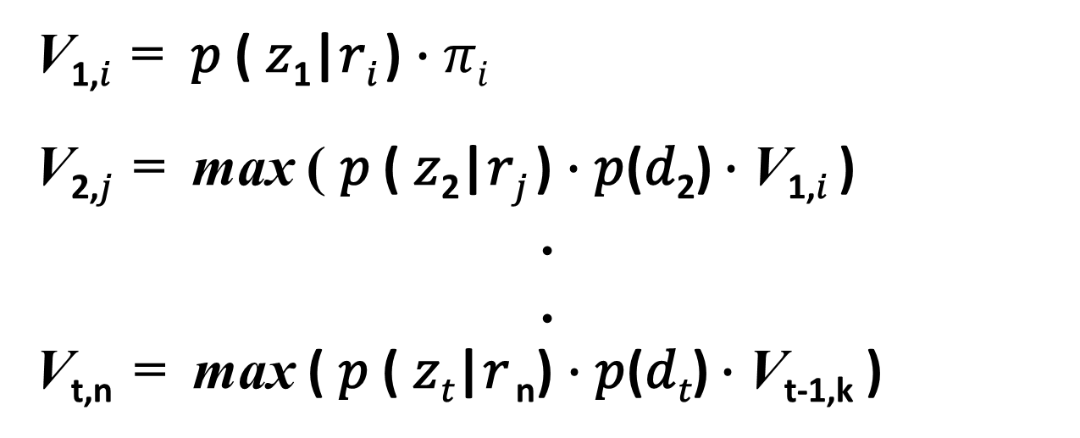
V_{1,𝑖} = 𝑝 ( 𝑧₁|𝑟_{𝑖} )$∙$ 𝜋_{𝑖}
V_{2,𝑗} = max ( 𝑝 ( 𝑧₂|𝑟_{𝑗} ) $∙$𝑝(𝑑₂) $∙$V_{1,𝑖} )
.
.
V_{t,n} = max ( 𝑝 ( 𝑧_{𝑡}|𝑟 _{n}) $∙$𝑝(𝑑_{𝑡}) $∙$V_{t-1,k} )
Viterbi algorithm :
Notes:
https://ckmarkoh.github.io/blog/2014/04/06/natural-language-processing-viterbi-algorithm/

Slide 11
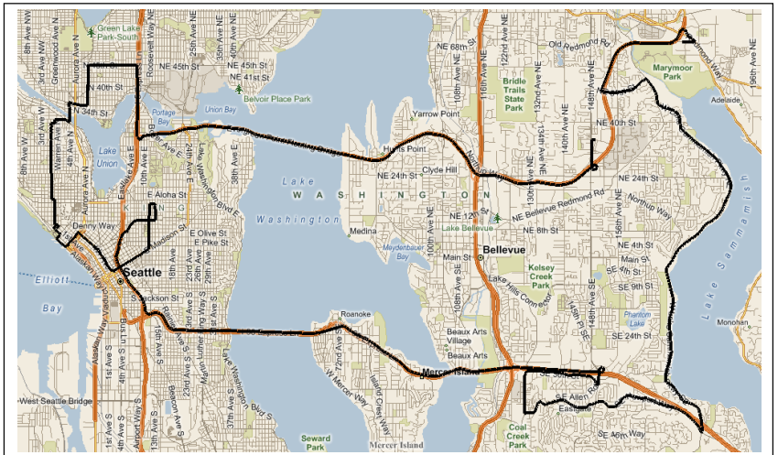
GROUND TRUTH DATA:
The data for our test route was collected by driving a known, planned route in a vehicle containing a commercially available consumer grade GPS device with a logging featur that records the current latitude and longitude once per second.
A map of the route is shown in Figure 2. This route is about 80 kilometers long, and it took about 2 hours to drive. It Resulted in 7531 time stamped latitude/longitudepairs.
Figure 2

Slide 12
Degraded Data:
We simulate degraded versions of the GPS data by removing points and adding Gaussian random noise.
We simulated sampling periods of (2, 5, 10, 20, 30, 45, 60, 90, 120, 180, 240, 300, 360, 420, 480, 540, and 600 seconds) in addition to the original 1 - second data from our logger.
We simulated random Gaussian noise with standard deviations of (10, 15, 20, 30, 40, 50, 75, and 100 meters).

Slide 13
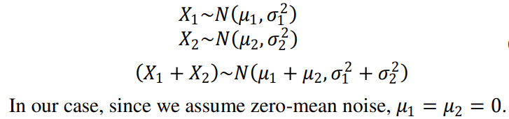
Degraded Data:
Note that to simulate a particular noise level, we had to account for the fact that there is already some random noise in the original data.
Fortunately, Gaussian noise is additive in the sense of the equations below, so we could simulate any amount of additional noise with knowledge of the original 𝜎_{𝑧} from the sensor.

Slide 14

Parameter Estimation:
Our HMM needs two probability-related parameters. One is 𝜎_{𝑧} , which is the standard deviation of Gaussian GPS noise. We estimate this starting with our 𝑧_{𝑡} measurements.
The standard deviation of these values is our estimate of the GPS noise, 𝜎_{𝑧} . We estimated 𝜎_{𝑧} using the median absolute deviation (MAD), which is a robust estimator of standard deviation:
For our test data, this value was 𝜎_{𝑧} = 4.07 meters, which is a reasonable value for GPS noise.

Slide 15
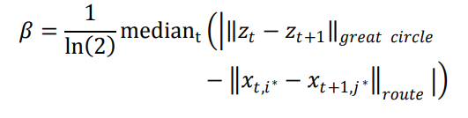
Parameter Estimation:
The other probability parameter we need is 𝛽 from the exponential distribution in Equation (Transition Probabilities). This describes the difference between route distances and great circle distances.
A larger value of 𝜎_{𝑧} ,represents less trust in the location measurements.
A larger value of 𝛽, represents more tolerance of non-direct routes.
Notes:
https://zhtw.eferrit.com/%E6%8C%87%E6%95%B8%E5%88%86%E4%BD%88medians/

Slide 16
RESULTS:
There are various conditions that induce a break in the HMM lattice where all the transition probabilities from one time step to the next are zero. We detail these conditions below, after which we give a simple method to work around these breaks, effectively removing unmatchable data. The conditions that lead to a break are:
Route Localization: to avoid an unreasonable amount of computation, we set to zero the measurement probability of any road segment more than 200 meters away from the GPS point.
Low Probability Routes: we terminate the search for a route when ‖𝑥_{𝑡,𝑖} − 𝑥_{𝑡 1,𝑗} ‖_{𝑟𝑜𝑢𝑡𝑒} > ‖𝑧_{𝑡} − 𝑧_{𝑡+1}‖_{𝑔𝑟𝑒𝑎𝑡 𝑐𝑖𝑟𝑐𝑙𝑒 ,} the transition probability 𝑝(𝑑_{𝑡}) becomes very small.
GPS Outliers: Speed > 180 km/h and set its probability to zero.

Slide 17
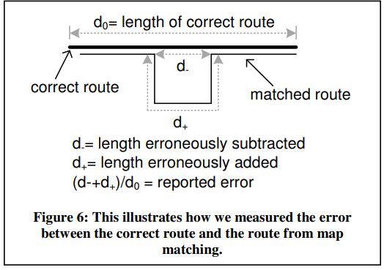
RESULTS:
Giving 7531 time stamped latitude/longitude pairs. After removing points ,there were 4605 remaining. The result of running our algorithm is a road segment match for each point.
we sum the lengths of incorrect road added to and subtracted from the correct route. We divide this sum by the length of the correct route to compute the fraction of incorrect route, which is the error value we report. This is shown in Figure 6.

Slide 18
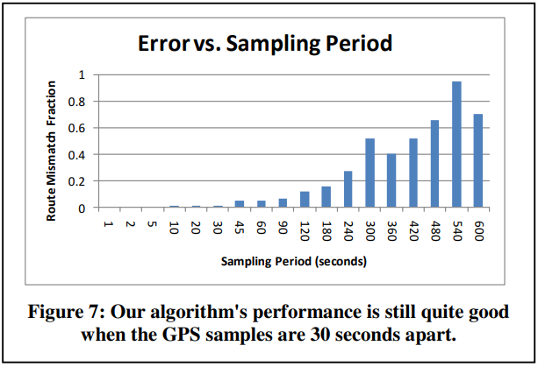
RESULTS:
Figure 7, Shows how our results degrade with subsampling. We note that the error is only 0.11% even when the sampling period grows to 30 seconds.

Slide 19
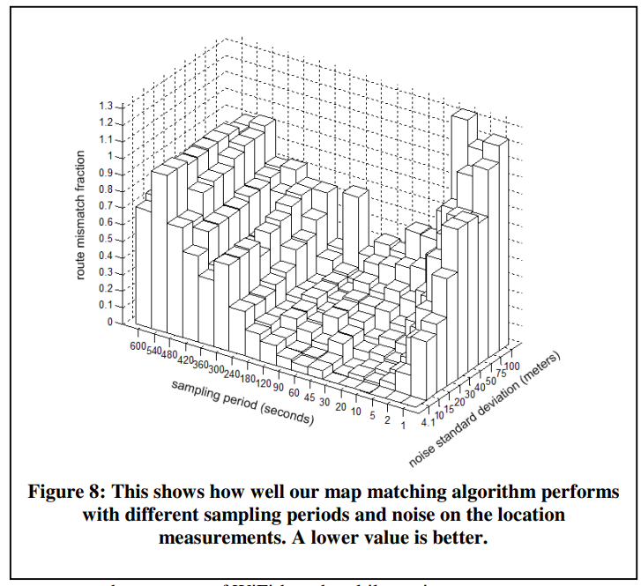
RESULTS:
Surprisingly, it is more sensitive to noise with a 1 second sampling period than at longer periods. This is likely because frequent, noisy points tend to pull the route rather violently in different directions.
At longer sampling periods, shows robustness to measurement noise as high as 50 meters standard deviation, because the accuracy of WiFi-based multilateration.

Slide 20
We have presented a new algorithm based on the HMM that explicitly accounts for measurement noise and the feasible routes through the road network. We tested the algorithm on an 80 kilometer drive. Compared to manually matching the data, our algorithm performed perfectly.
We also tested how the accuracy of our algorithm degrades when the location sampling rate decreases and when the measurement noise increases. Significantly, we found that even with 30 seconds between measured locations, the accuracy of our algorithm was barely degraded.
Finally, we made our test data, ground truth data, and road network publicly available for other researchers to develop, test, and compare their own map matching algorithms.
RESULTS:

