Slide 1

A deep neural network model with GCN and 3D convolutional network for short-term metro passenger flow forecasting
Xuanrong Zhang, Cheng Wang, Jianwei Chen, Ding Chen
College of Computer Science and Technology, Huaqiao University, Xiamen, China
© 2023 The Authors. IET Intelligent Transport Systems published by John Wiley & Sons Ltd on behalf of The Institution of Engineering and Technology.

Slide 2
Introduction:
The purpose of this study is to use historical smart card data to predict the passenger flow of urban rail transit networks.
Passenger data for each metro station is usually aggregated using a specific time interval to form a batch of time sequence.
we propose a model called (ARConv-GCN) based on graph convolutional neural network (GCN) and 3D convolutional neural network combining with residual structure and attention mechanism(ARConv) for urban rail transit systematic short-term passenger flow forecasting.

Slide 3
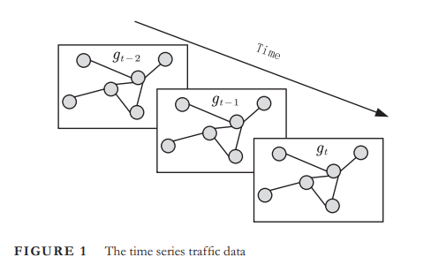
Definition:
Define the urban rail transit network as a graph G = (V , E, A) as shown in Figure 1, where V is the set of nodes and E denotes the set of edges.
|V | = n is the number of stations
|E| = e is the number of connection between stations.
A ∈ R^{n*n} is an adjacency matrix which indicate a link between two stations exist or not.

Slide 4

Definition:
We treat the passenger flow volume as the attribute feature and the feature matrix F = (${\text{X}}_{\text{N}\text{,}\text{T}}^{\text{r}}$ , ${\text{X}}_{\text{N}\text{,}\text{T}}^{\text{d}}$ , ${\text{X}}_{\text{N}\text{,}\text{T}}^{\text{w}}$) is composed of recent passenger flow patterns, daily passenger flow patterns and weekly passenger flow patterns.
The recent passenger flow patterns represent the passenger flow of the most recent previous periods of the forecast period,
the daily passenger flow patterns represent the passenger flow of the same period of the previous day.
the weekly passenger flow patterns represent the passenger flow of the same period of the previous week.

Slide 5
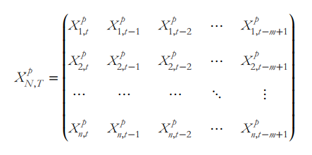

Definition:
where p represents the overall of three passenger patterns, including recent, daily, and weekly patterns.
m denotes the past several time steps used to predict.
${\text{X}}_{\text{j}\text{,}\text{k}}^{\text{p}}$ indicates the passenger flow vector of the j station in the k time interval in the p passenger flow patterns and each time interval will generate a feature matrix as input to our model.

Slide 6
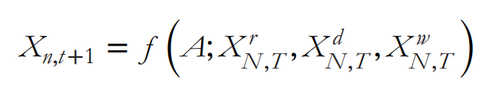
Definition:
Therefore, the problem can be defined according to Equation, whereby f is the mapping function to be learn to using the proposed deep learning architecture.

Slide 7
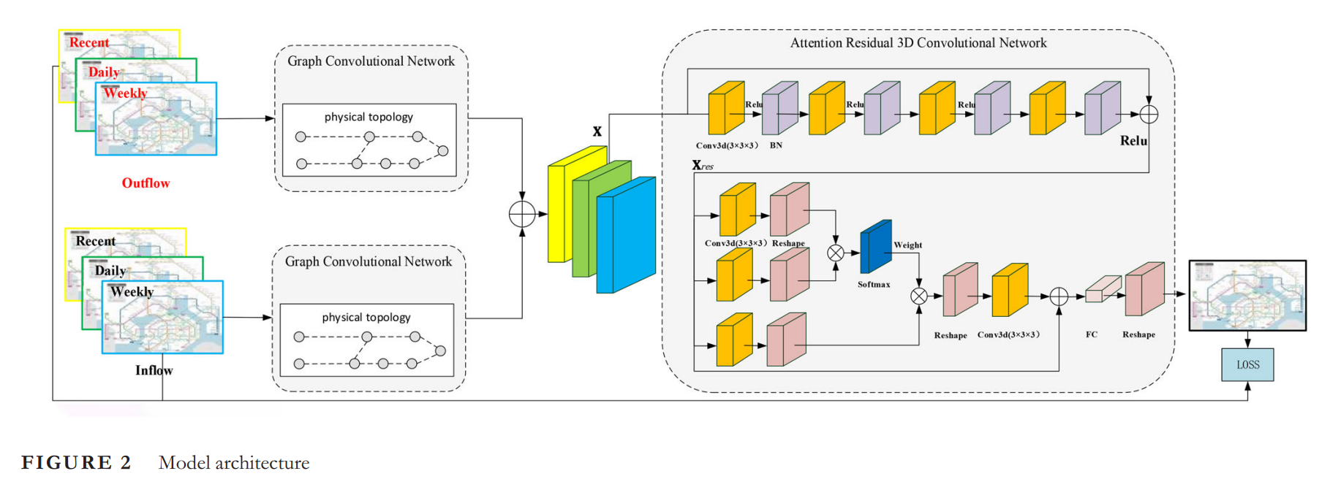
Architecture:

Slide 8
Graph convolution network:
In this section, we apply GCN to capture the topological relationships between stations in an urban rail transit network.
By determining the relationship between the nodes or links based on physical topologies, GCN can encode the topological structure of rail transit, thereby capturing the spatial dependence of passenger flow.
Since the inflow and outflow are closely related to the passenger flow of recent, daily, and weekly periods, we have aggregated the historical passenger flows into three patterns to input into the GCN: the recent pattern, the daily pattern, and the weekly pattern with the same time steps.

Slide 9
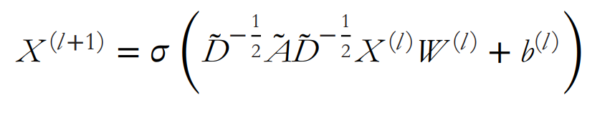
GCN:
Where A ∈ R^{n∗n} is the adjacency matrix based on a predefined physical topologies.
Ã = A + I and I is the identity matrix.
D̃ ∈ R^{n∗n} is the normalized node degree matrix of Ã .
X^{l} ∈ R^{n∗m} is the feature matrix of the l layer and m represents is the number of features of each of the node.
W^{l} ∈ R^{n∗m} is the weight matrix of the l layer.
𝜎 is the ReLU function
b is the bias vector.

Slide 10
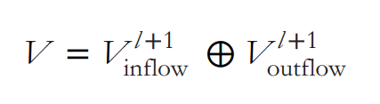
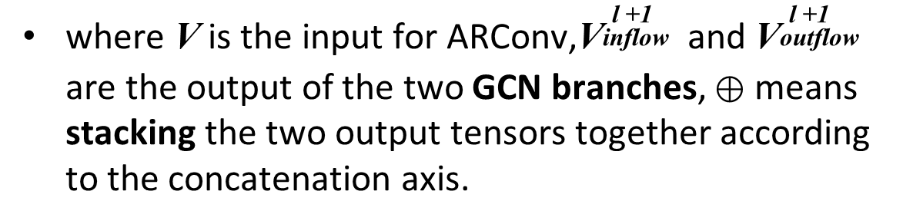
Concatenation:
Their results are concatenated together before being input into attention residual 3D convolutional network (ARConv) to deeply integrate inflow and outflow information as shown in Figure 2 and the following Equation
where V is the input for ARConv,${\text{V}}_{\text{inflow} }^{ \text{l}\text{ +}\text{1}}$ and ${\text{V}}_{\text{outf}\text{low} }^{ \text{l}\text{ +}\text{1}}$ are the output of the two GCN branches, ⊕ means stacking the two output tensors together according to the concatenation axis.

Slide 11
3D convolutional network:
With the passage of time, the passenger flow conditions of different time periods will affect each other, and there is a correlation in the time dimension.
the model needs to learn the temporal and spatial characteristics of rail passenger flow at the same time.
Therefore, we apply 3D convolutions network to model the spatiotemporal features,by aggregating the inflow and outflow information output by the GCN layer.

Slide 12
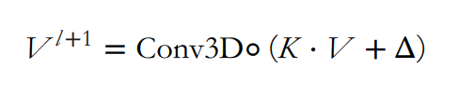
3D Convolution:
where V is the input.
K is the 3D filters.
Δ is the bias.
Conv3D◦ means the convolution operation including 3D convolution and 3D pooling.
V ^{l+1} is the high-level output feature.

Slide 13
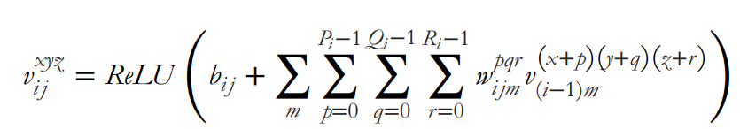
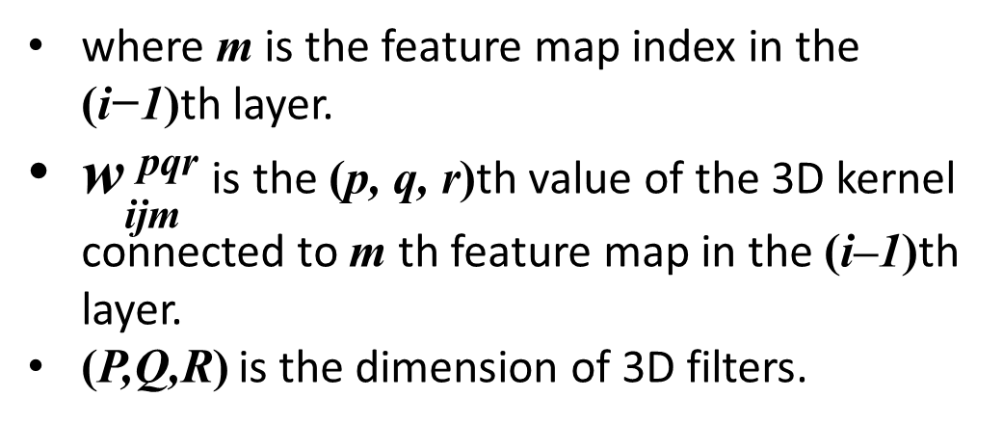
3D Convolution:
The values 𝑣 at position (x,y,z) in the j th feature map of i layer can be obtained by following equation .
where m is the feature map index in the (i−1)th layer.
${\text{w}}_{\text{ijm}}^{ \text{pqr}}$ is the (p, q, r)th value of the 3D kernel connected to m th feature map in the (i–1)th layer.
(P,Q,R) is the dimension of 3D filters.
Notes:
https://www.dbs.ifi.lmu.de/~yu_k/icml2010_3dcnn.pdf

Slide 14
Residual structure:
Information loss seems inevitable due to convolution and pooling mechanisms in 3D convolutions network . So we use residual module and attention mechanism to improve this phenomenon.
In order to solve the degradation problem caused by the increase of network depth, we use four normalization layers, four convolutional layers, and skip the connections of these layers through identity mapping.
The residual module takes the shallow features extracted by the 3D CNN module as input, and then Richer deep spatio-temporal feature information is extracted through convolutional layers and normalization layers.

Slide 15
Attention mechanism:
Since three patterns of historical passenger flow information have been inputted, they each have a different role in passenger flow prediction.
We used an attention mechanism to calculate a context vector that can express the global trend of passenger flow status on the track in order to learn the importance of passenger flow information at each moment.
From Figure 2, we can see that there is one addition operation and three convolution branches in the attention mechanism structure.
There are two different paths in the convolution branch, we use two convolution branches constitute the traffic flow attention weight extraction part, we use another convolution branch for traffic flow feature extraction part.

Slide 16
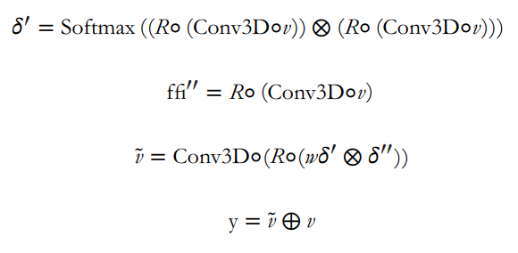
Attention mechanism:
where Conv3D◦ means the 3D convolution operation.
R◦ means the reshape operation.
⊕ means the matrix addition operation .
⊗ means the matrix multiplication operation.

Slide 17

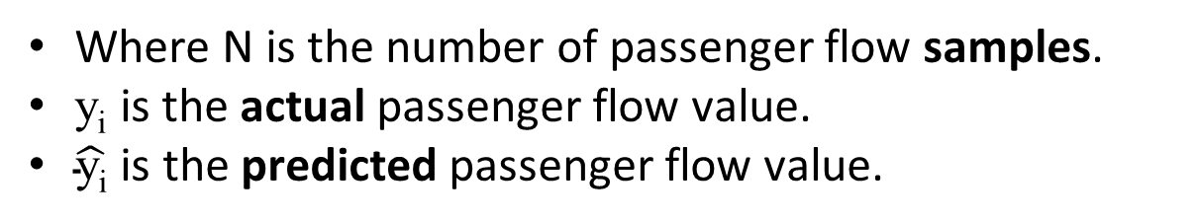
Loss function:
The loss function is MSE, which is the average squared difference between the predicted data and the actual data and the calculation formula as shown in Equation
Where N is the number of passenger flow samples.
y_{i} is the actual passenger flow value.
$\hat{\text{y}\text{i}}$ is the predicted passenger flow value.

Slide 18
Case Analysis:
Two datasets from Beijing Metro and Xiamen Metro are used in the experiments.
The first dataset is MetroBJ, which is collected from February 29, 2016, to April 3, 2016 with 17 lines and 276 stations.
The second dataset is MetroXM,which is collected from December 1, 2019, to January 3, 2020 with 2 lines and 52 stations.
These data is extracted from about 98 million pieces of AFC data in 25 working days for 5 consecutive weeks. (Automatic Fare Collection Systems)

Slide 19
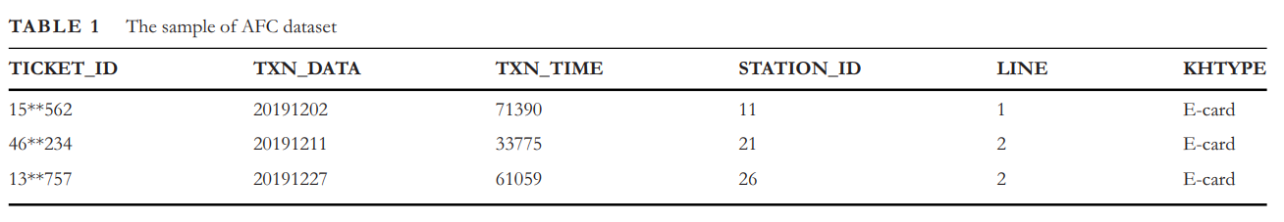
Research object
and data description:
The AFC data mainly includes {
card number(TICKET_ID),
travel date(TXN_DATA) ,
card-swiping time(TXN_TIME) ,
the id of stations(STATION_ID) ,
the id of lines (LINE) ,
the type of card(KHTYPE)
} as shown in Table 1.
These AFC records are aggregated at 10 min time intervals to form the passenger inflow data and outflow data separately

Slide 20
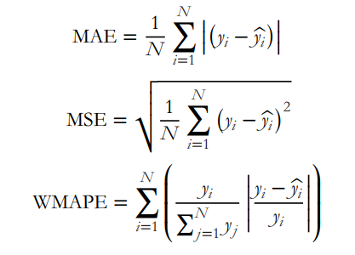
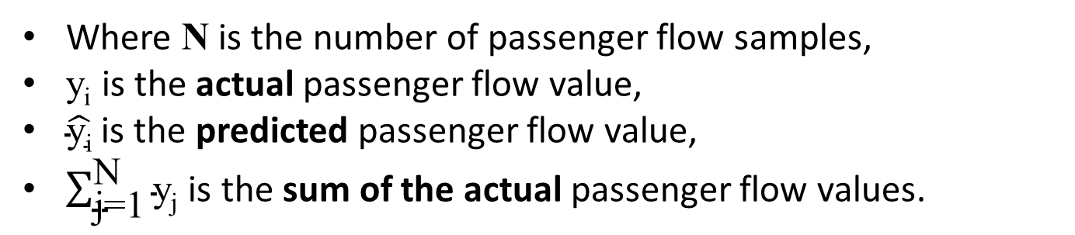
Evaluation method and criteria:
We use root mean squared error (RMSE), mean average error (MAE) and weighted mean absolute percentage error(WMAPE) as the evaluation metrics as shown in Equations.
R
Where N is the number of passenger flow samples,
y_{i} is the actual passenger flow value,
$\hat{\text{y}\text{i}}$ is the predicted passenger flow value,
$\sum_{\text{j}\text{=}\text{1}}^{\text{N}}{\text{y}\text{j}}$ is the sum of the actual passenger flow values.

Slide 21
Baseline:
HA: Historical average model, which is used to predict the future passenger flow using the average value of historical passenger flow data [49].
ARIMA: Autoregressive integrated moving average model. The lag order, the degree of difference, and the order of the moving average, are set as 2, 1, 0 after fine-tuning [50].

Slide 22
Baseline:
LSTM: Long short term memory neural network. The LSTM model we use consists of one fully connected layer and two hidden layers [14]. The optimizer is Adam with a learning rate of 0.001. The batch size is 32. The inputs are inflow series in the last 20 time steps while outputs are the next time step time series.
CNN: We apply two CNN layers and a fully connected layers [17], The two hidden layers have 32 and 64 filters with 3×3 size kernel. The optimizer is Adam with a learning rate of 0.001. Our inputs and outputs are the same as that of the LSTM model.

Slide 23
Baseline:
DCRNN: A deep-learning architecture integrates graph convolution into a gated recurrent unit, we directly use the original network structure [25].
GCCN: A deep-learning architecture with multidimensional flows graph matrices, we directly use the original network structure [51].
STGCN: A deep-learning architecture use graph convolution and 1D convolution to capture spatial dependencies and temporal correlations respectively, we directly use the original network structure [26].

Slide 24
Baseline:
Conv-GCN: A deep-learning architecture with GCN and 3D CNN for passenger flow forecasting, we directly use the original network structure [48].
Conv-LSTM: It has one fully connected layer and two hidden layers with 32 and 64 filters [19] and the kernel size is 3×3. The optimizer is Adam with a learning rate of 0.001.
3D CNN: We use the 3D CNN model and the filter number we set is 16, kernel size is 3 [48].
ARConv-GCN-A: ARConv-GCN without attention mechanism.
ARConv-GCN-R: ARConv-GCN without residual module.
ARConv-GCN-AR: ARConv-GCN without attention mechanism and residual module.

Slide 25
Experimental settings:
laptop { Intel Core i7- 10875H (16M Cache, up to 5.1 GHz),
16 GB of memory,
NVIDIA GeForce GTX 2060 }.
We used Keras and TensorFlow to implement our model.
We trained our model using the Adam optimizer with a learning rate of 0.001. The training epoch was set to 200 and the batch size was set to 64 to train the model.

Slide 26
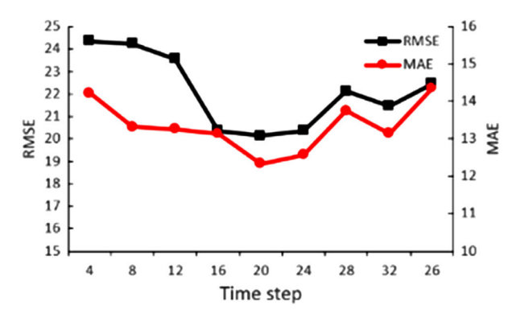
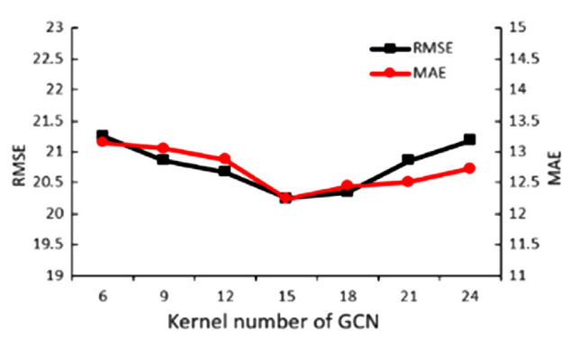
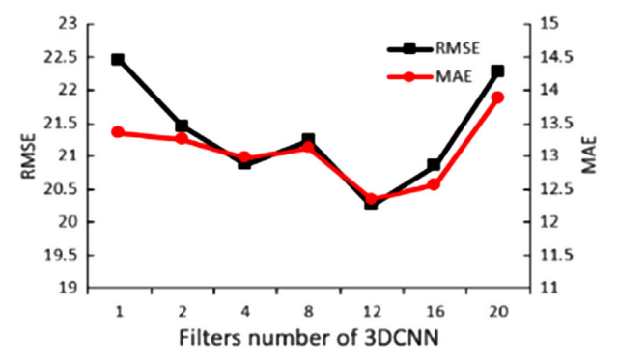
Experimental settings:
In total, there are three important hyperparameters in our model: time steps, the number of kernels in the GCN, and the number of filters in the 3DCNN. After many experimental tests and parameter adjustments, as shown in Figure 3, they were set to 20, 15, and 12, respectively

Slide 27
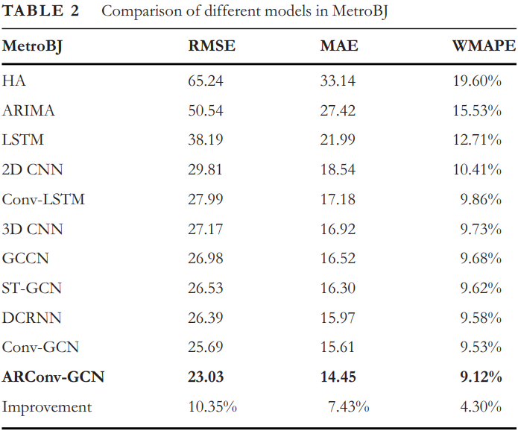
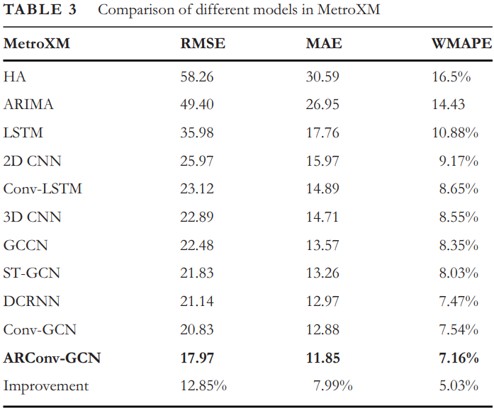
Experimental results:

Slide 28
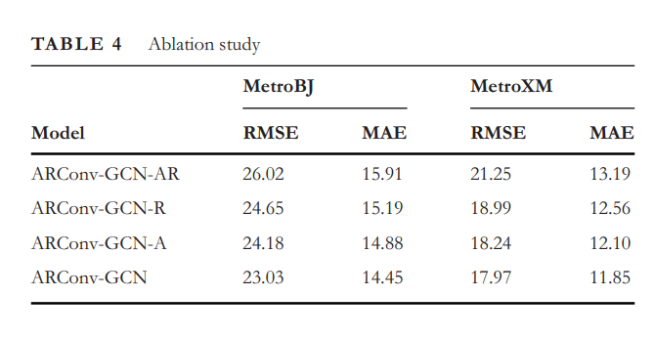

Slide 29
Analysis of experimental results:
In deep learning models, LSTMs may not be able to model spatial correlations, and CNNs may not be able to capture temporal dynamics.
In most cases, complex deep learning architectures such as ConvLSTM, STGCN, DCRNN, and GCNN have produced more favourable results than a single model. This is mainly due to the utilization of temporal and spatial features in these models.
ARConv-GCN achieves the most accurate prediction in comparison to both traditional and deep learning models.
In order to verify the influence of different components on ARConv-GCN, we conducted an ablation study as shown in Table 4, which proved that our improvement on 3DCNN is effective.

Slide 30
END

