Slide 1
Luka Škodnik, Robert Jutreša
June 2023
Question Answering Pipeline for Closed Domain Questions
Research work for Data Science Project competition

Slide 2
Presentation overview
Problem Description​​ | Question-Answering system for the NLB Group.​​
Motivation | Process optimization and ESG.
Implemented Solution | Datasets, models and pipelines.
Presentation of Results​​ | Metric scores and Qualitative Analysis for models and pipelines.​​
Demo | Quick demonstration of β application
Discussion​​ | Usability and possible improvements.​​
Questions ​​ | For any additional information, the project repository is available on GitHub.​​

Slide 3
Introduction

Slide 4
Problem Description
Extract from the Data Science Project Competition Website
In56ight, in collaboration with the NLB banking group, is exploring the idea of developing a chatbot that would be trained on data from annual reports and would be capable of answering different questions regarding the banking group performance.

Slide 5
Motivation
Thousands of employees check NLB policy documents daily.
Saving as little as 15 minutes per employee is a big deal.
Quickly extract relevant information from various reports.
ESG - A very important world-wide topic for companies
Environmental, Social and Governance
Efficiency
Customer and employee relations
Leadership

Slide 6
Implemented Solution

Slide 7
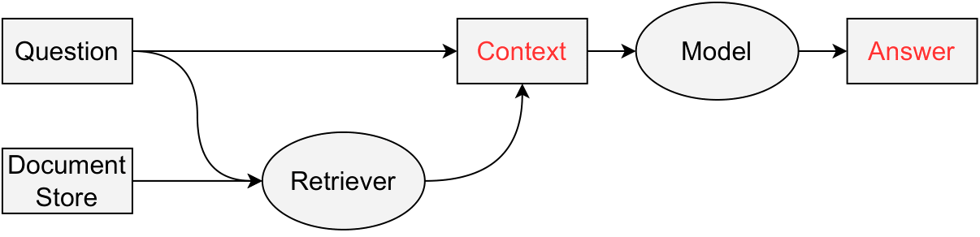
Solution
Question Answering
Dataset
Generation (2020, 2022)
Large Language Models
Filtering
Extractive vs. Generative
SQuAD Data Formatting
Context Retrieval
Variant Selection
DPR
Expert Data
Fine-tuning (full, half)
DPR Data Formatting
Combining Generated Data
Fine-tuning

Slide 8
Results

Slide 9
Results: Metrics
​ | Bert​ Precision​ | Bert​ Recall​ | Bert​ F1​ | Bleu​ | SQuAD​ Exact​ | SQuAD​ F1​
Distilbert​ | 86.98​ | 86.94​ | 86.93​ | 0​ | 4.76​ | 11.58​
RoBERTa​ | 88.15​ | 87.33​ | 87.63​ | 4.61​ | 4.76​ | 21.53​
T5-Small​ | 88.78​ | 87.44​ | 88.04​ | 13.48​ | /​ | /​
T5-Base​ | 86.11​ | 88.20​ | 87.06​ | 24.60​ | /​ | /​
​ | ​ | ​ | ​ | ​ | ​ | ​
Distilbert​ | 87.41​ | 87.19​ | 87.25​ | 0​ | 4.76​ | 16.87​
RoBERTa​ | 88.78​ | 87.75​ | 88.21​ | 5.1​ | 14.29​ | 27.57​
T5-Small​ | 86.92​ | 85.23​ | 86.03​ | 0.88​ | /​ | /​
T5-Base​ | 85.45​ | 87.42​ | 86.38​ | 18.75​ | /​ | /​
DPR not fine-tuned
DPR fine-tuned
Extract from Table 4 of the report: Pipeline performance using fine-tuned models (expert data only)

Slide 10
Results: Qualitative analysis
​ | Correctness​ |  |  | ​ | Sensibility​ |  |  | ​ | "None"​
​ | 1​ | 2​ | 3​ | Avg[%]​ | 1​ | 2​ | 3​ | Avg[%]​ | ​
Distilbert​ | 13​ | 1​ | 7​ | 57​ | 7​ | 5​ | 9​ | 70​ | 0​
RoBERTa​ | 13​ | 1​ | 7​ | 57​ | 7​ | 5​ | 9​ | 70​ | 0​
T5-Small​ | 13​ | 1​ | 7​ | 57​ | 7​ | 6​ | 8​ | 68.3​ | 0​
T5-Base​ | 13​ | 1​ | 7​ | 57​ | 7​ | 5​ | 9​ | 70​ | 0​
​ | ​ | ​ | ​ | ​ | ​ | ​ | ​ | ​ | ​
Distilbert​ | 17​ | 3​ | 1​ | 41.3​ | 8​ | 6​ | 7​ | 65​ | 0​
RoBERTa​ | 18​ | 3​ | 0​ | 38​ | 11​ | 4​ | 6​ | 58.7​ | 0​
T5-Small​ | 16​ | 5​ | 0​ | 41.3​ | 12​ | 3​ | 6​ | 57​ | 7​
T5-Base​ | 17​ | 3​ | 1​ | 41.3​ | 14​ | 1​ | 6​ | 54​ | 0​
2020/22
Expert
Table 5 of the report: Qualitative analysis using defined metrics

Slide 11
Results: Qualitative analysis
Question: How much did the bank reduce the use of paper in 2022 compared to the previous year?
Ground truth answer: 19%
Retrieved context: In 2022, another step to achieving this goal has been made as paper usage (prints) was reduced by 17% compared to 2021. Thus, we saved 866 trees. Paper usage in NLB was lower by 26%, which is the highest reduction group – wide. All banking subsidiaries experienced rediction as well ranging from 8% to 19%, respectively.
Our answer(s): 17%
ChatGPT answer: Based on the given context, the bank reduced the use of paper by 17% compared to the previous year (2021). However, the exact amount of paper usage in 2021 or any specific quantity of paper used is not mentioned.

Slide 12
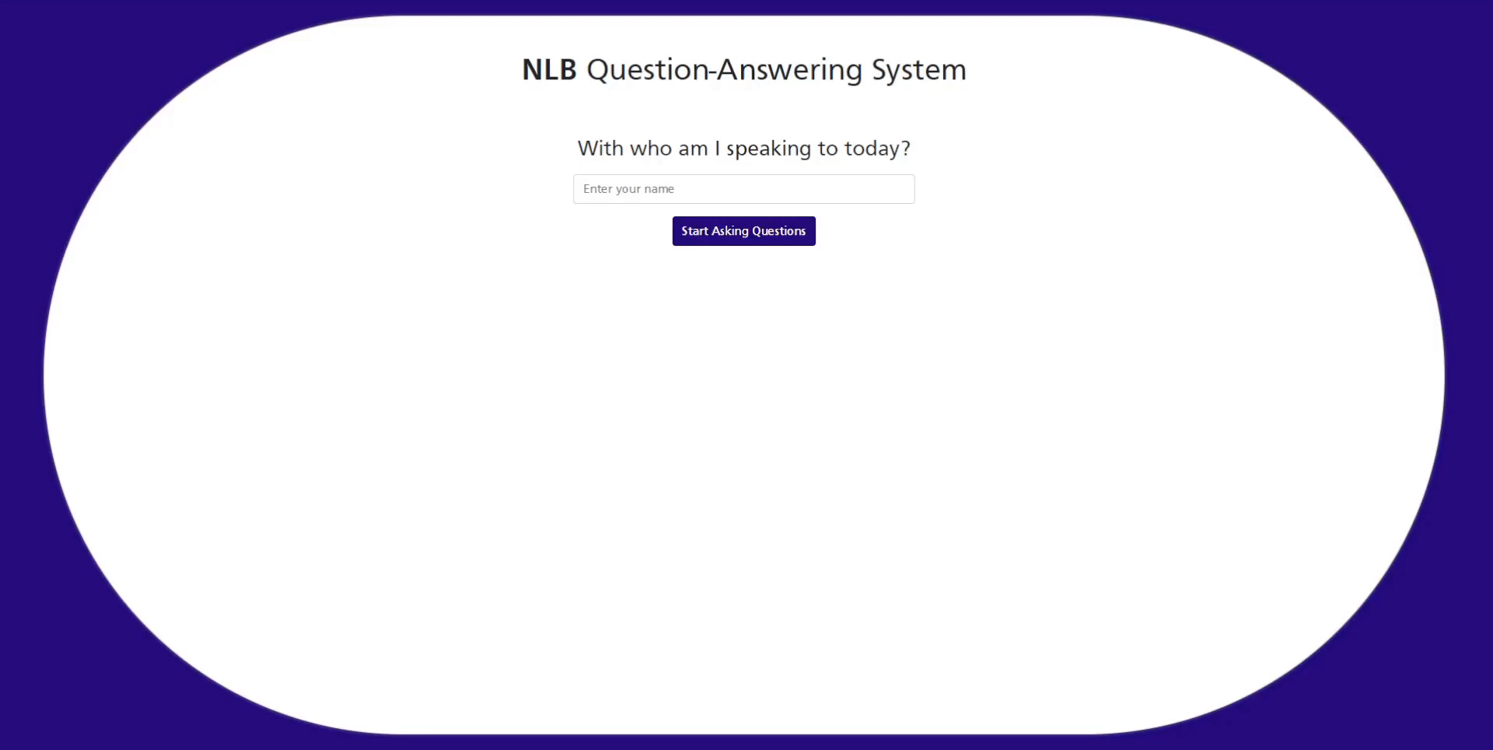
Demo

Slide 13
Discussion

Slide 14
Findings about the Data​ | More data would be required.​ Fine-tuning on expert data yields the most improvements.​ Specific types of questions​
Model Usefulness​ | Useful for more straightforward questions.​ Highly depended on the DPR model.​ The pipeline requires improvements before production.​
Possible Improvements​ | More high quality data​ DPR improvements​ Larger models​

Slide 15
Thank you for your attention
Special thanks to:
prof. dr. Marko Robnik Šikonja
dr. Branislava Šandrih Todorović, NLB d.o.o
Grega Jerkič and In516ht
Jurij Kodre, NLB d.o.o

