Slide 1
Introduction to Debugging Techniques
Dr Robert Oates
17/03/2014
University of Nottingham Introduction to Software Engineering
Private – Rolls-Royce Proprietary Information

Slide 2
Outline
Recommended Text
Why Debug Software?
General Purpose Guide to Debugging
  Class Exercise – The Dark Room
Debugging Case Study
    Wandering Robot
Techniques for Software Debugging
  Class Exercise – Shuttle Launch
Private – Rolls-Royce Proprietary Information

Slide 3
Recommended Texts
If I Only Changed the Software, Why is the Phone on Fire? : Embedded Debugging Methods Revealed : Technical Mysteries for Engineers, Lisa K. Simone, Newnes (July 2007), ISBN: 0750682183
One copy available from The George Green Library (Main Campus last time I checked) (Ref: QA76.6 SIM)
Amazon £24.19
Private – Rolls-Royce Proprietary Information

Slide 4
Recommended Texts
History’s Worst Software Bugs, Simson Garfinkel, Wired Magazine (November 2005)
  http://www.wired.com/software/coolapps/news/2005/11/69355
London Ambulance Service
  http://www.cems.uwe.ac.uk/teaching/notes/UQI101S2/lascad.htm
Private – Rolls-Royce Proprietary Information

Slide 5
Why Debug Software?
It’s an important work skill
You’re becoming professionals!
It’s an important development skill
It’s an important life skill
Private – Rolls-Royce Proprietary Information

Slide 6
General Purpose Debugging
Understanding
Reproduction and Data Gathering
Hypothesis
Experiment Design
Test
Implementation
  Design
  Implement
  Test
Private – Rolls-Royce Proprietary Information

Slide 7
General Purpose Debugging:
Understanding the System
Look at the system specifications if available
  Inputs
  Outputs
How do the components of the system fit together?
Information Flow
  Output backwards
  Input forwards
Good application for modelling, if one doesn’t exist!
Private – Rolls-Royce Proprietary Information

Slide 8
General Purpose Debugging:
Reproduction and Data Gathering
A hugely important part of debugging
Simple if bug is persistent
Hard if the bug is transient
Opportunity to study the system when the bug is occurring
Private – Rolls-Royce Proprietary Information

Slide 9
General Purpose Debugging:
Reproduction and Data Gathering
Questions to ask
  What state was the system in?
  Operating system
  Program Settings
  When does the bug happen?
  When the system was first turned on
  After years of use
  When OK is clicked
  The program settings in particular will rule out huge swathes of code!
Private – Rolls-Royce Proprietary Information

Slide 10
General Purpose Debugging:
Hypothesis
A hypothesis is an explanation which explains the observed behaviour of the bug IN CONTEXT
i.e. Knowing how the system works!
Sometimes a hypothesis will only explain some of the behaviour
There may be multiple bugs manifesting at the same time!
Private – Rolls-Royce Proprietary Information

Slide 11
General Purpose Debugging:
Experiment Design
Design an experiment which will falsify your hypothesis
If you can falsify it then it is an incorrect hypothesis
If you can’t then it MIGHT be the source of the problem
Private – Rolls-Royce Proprietary Information

Slide 12
General Purpose Debugging:
Test
If your test fails to falsify your hypothesis
  Move on to step 6, implementation
If your test falsifies your hypothesis
  Move to step 3 (hypothesis)
OR
  Move to step 1 (system understanding)
Regardless, this test has given you more information about the nature of the bug
Private – Rolls-Royce Proprietary Information

Slide 13
General Purpose Debugging:
Implementation
Sometimes this makes up part of the Hypothesis and Test phases
  “If I ‘fix’ it and the problem goes away, then the hypothesis isn’t falsified”
Undefined scenarios
  If the bug happens because a customer is using the software in a way you hadn’t predicted
    Requires a whole new design cycle
Private – Rolls-Royce Proprietary Information

Slide 14

Class Exercise:
The Dark Room
Private – Rolls-Royce Proprietary Information

Slide 15
Software Debugging
Traces
  Screen
  Log
Breakpoints
  Code execution
  Watches
  Memory inspection
Private – Rolls-Royce Proprietary Information

Slide 16
Software Debugging:
Traces
Traces are streams of data taken from the system
  On-screen
  Log File
Uses
  Embedded systems with no direct connection
  Any system producing large volumes of data
Private – Rolls-Royce Proprietary Information

Slide 17
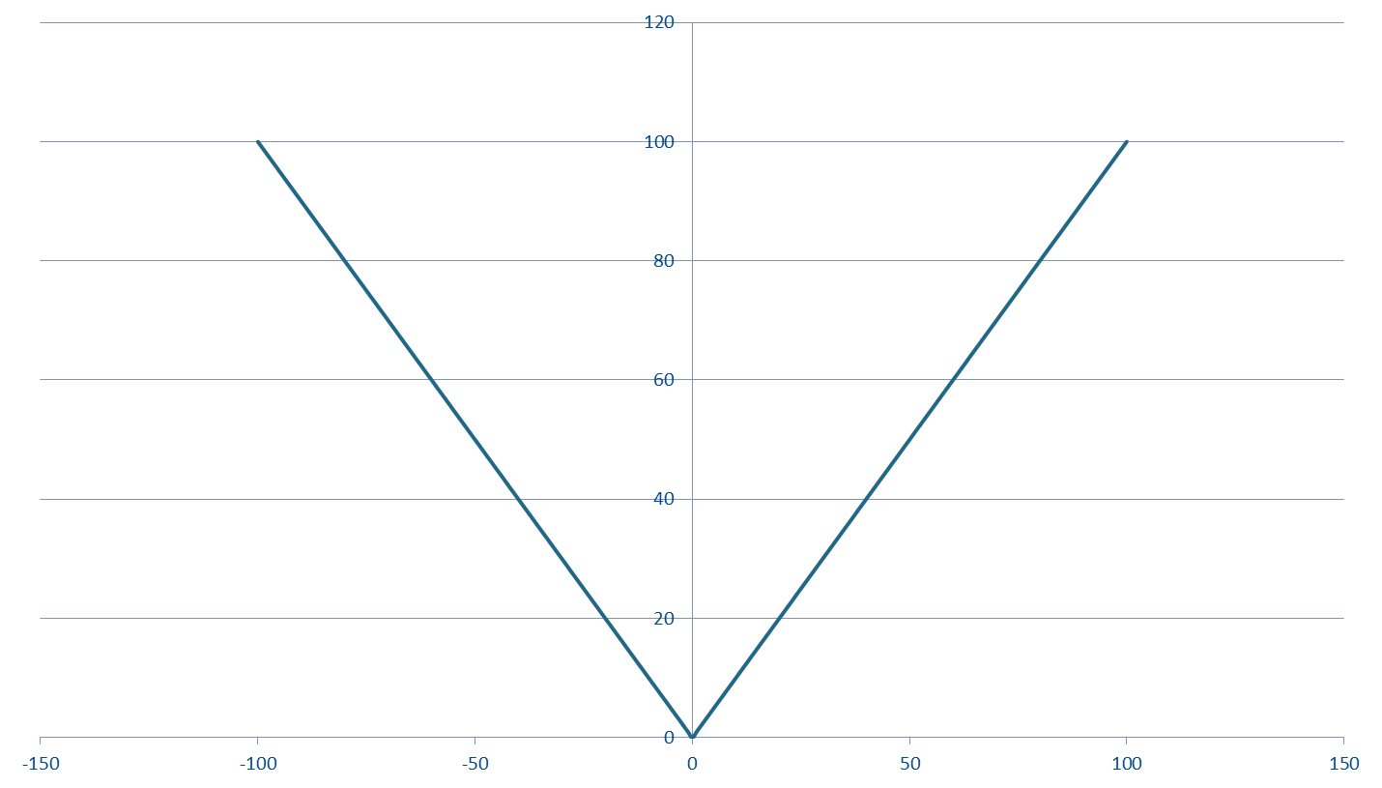
Graphical Representations of Failure:
Sign Confusion
Private – Rolls-Royce Proprietary Information

Slide 18
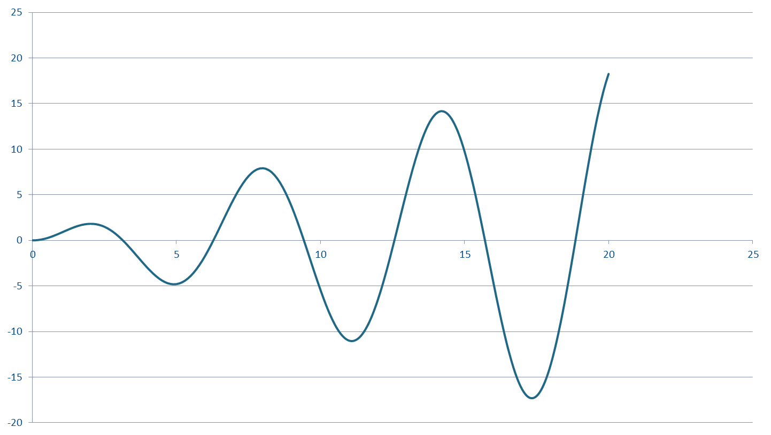
Graphical Representations of Failure:
Integration Errors
Private – Rolls-Royce Proprietary Information

Slide 19
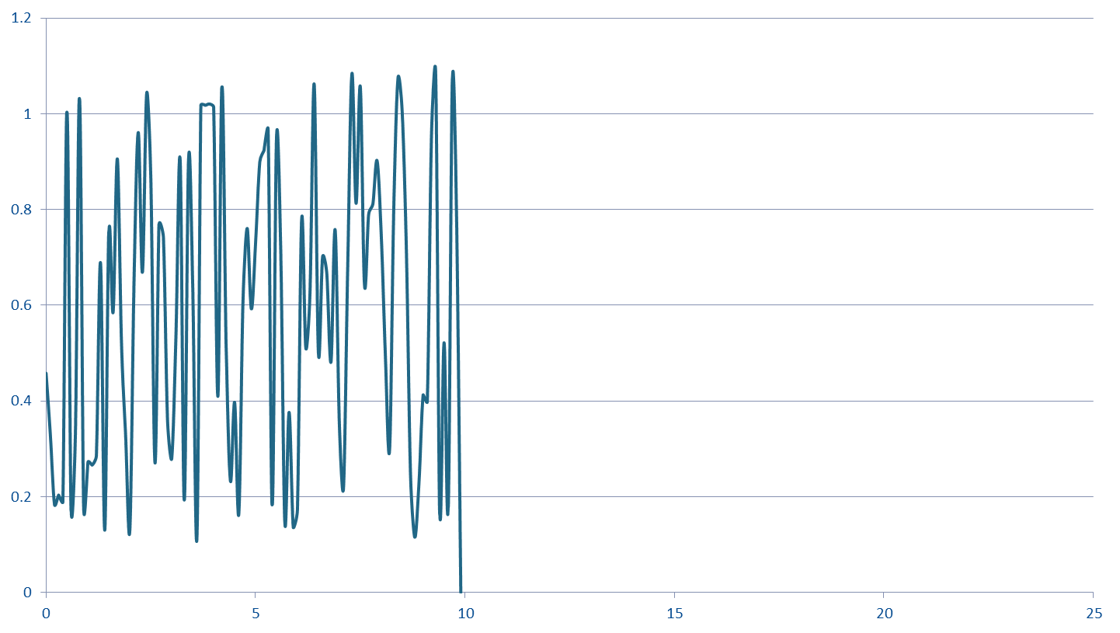
Graphical Representations of Failure:
Divide by Zero
Private – Rolls-Royce Proprietary Information

Slide 20
Case Study:
Wandering Robot
A robot is told to follow a route which makes up a closed circuit
It reports its location and what it can see at that location
What it sees is compared with what it should see according to a mathematical model of the world
Private – Rolls-Royce Proprietary Information

Slide 21
Case Study:
Wandering Robot
Sensor
Data
Robot
Observed
State
Location
Error
Rate
Mathematical Model of Area
Theoretical
State
Private – Rolls-Royce Proprietary Information

Slide 22
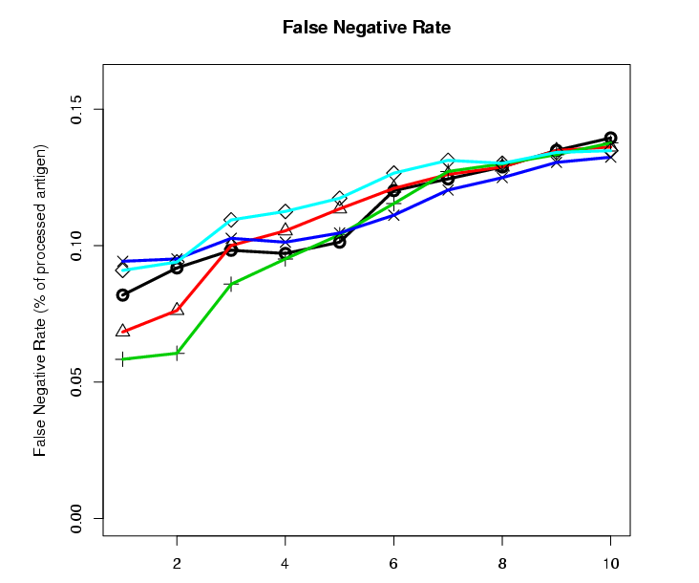
Case Study:
Wandering Robot
Error
rate
Time
(minutes)
Private – Rolls-Royce Proprietary Information

Slide 23

Case Study:
Wandering Robot
Log file containing (x,y) to track the movement of the robot
  3268 entries
Private – Rolls-Royce Proprietary Information

Slide 24
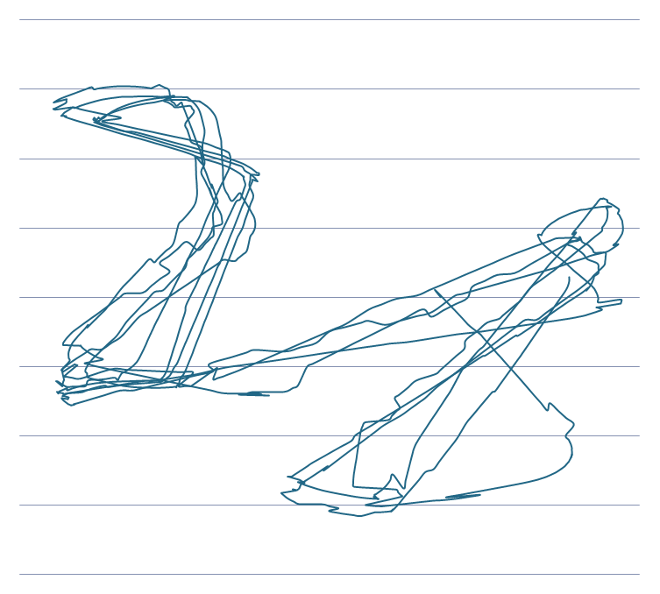
Case Study:
Wandering Robot
After fixing the robot’s localisation
Private – Rolls-Royce Proprietary Information

Slide 25
Class Exercise:
Shuttle Launch
Private – Rolls-Royce Proprietary Information

