Slide 1
SE Pub Quiz
(minus the beer)
Dr. Julie Greensmith

Slide 2

Overview
Revise essential concepts from G51FSE
  Requirements engineering
  Specifications and systems
  Design and Object oriented design
  Implementation best practice
  Methodology roundup
  Testing
  Project management

Slide 3
Learning Outcomes
To be able to define key terms
To understand the different stage of the software lifecycle
To understand the differences between traditional and agile approaches
To understand best practice in implementation, testing and management

Slide 4
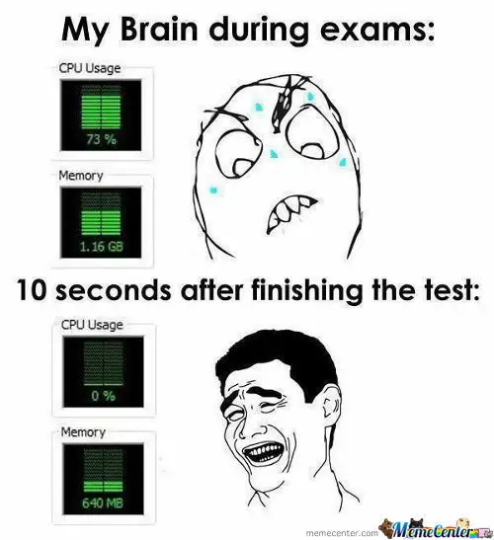

Slide 5
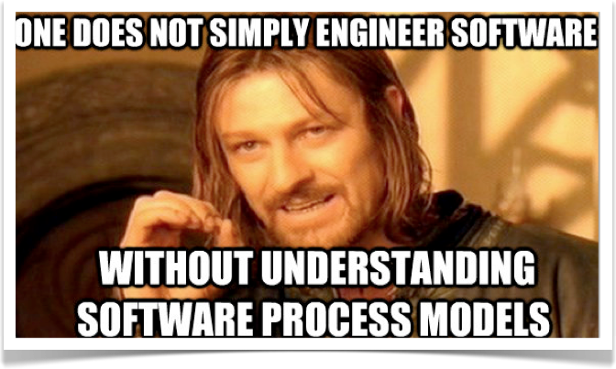
FSE Revision Quiz!

Slide 6
This is for your benefit!
Have a go at the quiz
Fill in the blanks for answers on paper
When finished exchange your paper with person next to you
See which questions you get wrong to guide what you need to refresh
20 questions, one minute per question

Slide 7

Off we go!

Slide 8
Question 1
Software engineering is

Slide 9
Question 2
The four steps in the requirements engineering process are

Slide 10
Question 3
“The user wants the software to calculate the current stock price” is an example of a requirements

Slide 11
Question 4
An SRS document is a

Slide 12
Question 5
A user story has the generic format of

Slide 13
Question 6
A stakeholder is

Slide 14
Question 7
We can use diagrams to design object oriented systems using the

Slide 15
Question 8
In software design classes can be modelled using

Slide 16
Question 9
Running code in debug mode can be halted using

Slide 17
Question 10
The process of hypothesis testing to find errors in code is called

Slide 18
Question 11
The is a top down linear traditional SEM

Slide 19
Question 12
An iterative top down approach which uses loops and assesses risks at many stage is termed a

Slide 20
Question 13
In eXtreme Programming (XP) the coding of the software occurs in

Slide 21
Question 14
In Agile SEMs, and form the documentation

Slide 22
Question 15
Large traditional engineering projects for safety critical software frequently use the

Slide 23
Question 16
Testing cases are where a single function or class is tested is called a

Slide 24
Question 17
testing is the performance of tests without access to source code

Slide 25
Question 18
In project planning we calculate the using

Slide 26
Question 19
The desire to give a program excessive amount of features is called

Slide 27
Question 20
Software engineering is useful to me because

Slide 28
Okay, time is up!
Swap your answer sheet with the person next to you
Mark honestly and fairly!
Allow equivalent words

Slide 29
Answers 1-5
Software engineering is the process of constructing software systems
The four steps are identification, analysis, definition and specification
“The user wants the software to calculate the current stock price” - this is a requirements definition
An SRS document is a software requirements specification
A user story has the generic format of - as a <role>, I want <goal? so that <result>

Slide 30
Answers 6-10
A stakeholder is a party which will be affected by the success/failure of a project
We can design systems using the Unified Modelling Language
In software design classes can be modelled using a class diagram
Running code in debug mode can be halted using breakpoints
The process of hypothesis testing to find errors is called general purpose debugging

Slide 31
Answers 11-15
The waterfall model is a top down linear approach which is a traditional SEM
An iterative top down SEM with many loops is called the spiral model
In XP, software development is performed in pairs
In agile methods, code comments and variable names form the documentation
Large traditional engineering projects for safety critical software frequently use the V-model

Slide 32
Answers 16-19
Testing cases where one class is tested is a unit test
Black box testing is the performance of tests without access to source code
In project planning we calculate the critical path using critical path analysis
The desire to give a program too many features is called feature lust

Slide 33
Question 20
Software engineering is useful to me because....<there is no right answer sometimes in software engineering>
    it will help me get a job/internship
    it will help me develop as a professional
    it will help me to code large complex computer systems
    it will let me develop and test code using an established framework
    it will teach me to be a team player

Slide 34
How did you do?
0-5: spent too much time playing Minecraft
6-10: pick up a textbook over Easter maybe?
11-15: good work remembering
16-19: want to be chief tech officer??
20: would you like to teach next Monday’s lecture??

Slide 35
Questions and topics
Each of the 20 topics in the quiz represent the 18 lectures delivered in FSE
  might want to revise lectures for the questions you got wrong

Slide 36


Monday Guest Lecture: Version Control Systems
James Colley

