Slide 1
Lecture 2 Computer Communications and Networks
Boriana Koleva
Room: C56
Phone: 84 66530
Email: B.Koleva@nottingham.ac.uk

Slide 2
Introduction
Local communication
Encoding data
LANs
Long Distance communication
Modulation
Modems and broadband connections

Slide 3




Transmission Media
Copper Wires
Twisted Pair
Coaxial
Fibre Optic
Radio
Microwave
Infrared
Satellites

Slide 4
Transmitting data over short distance
Changes in electric current used to transmit bits over short distance
E.g. RS-232 (serial port)
Voltage
+
Time
-
1 0 1 0 0 0

Slide 5
Shared Communication Channels
Early local networks used dedicated links between each pair of computers
But poor scalability
Shared LANs invented in the 1960s
Rely on computers sharing a single medium
Computers coordinate their access
Low cost
But not suitable for wide area - communication delays inhibit coordination

Slide 6
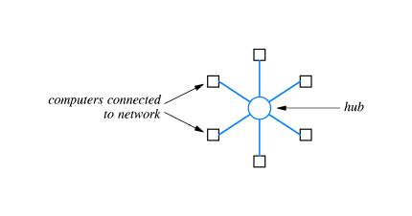
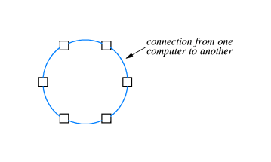
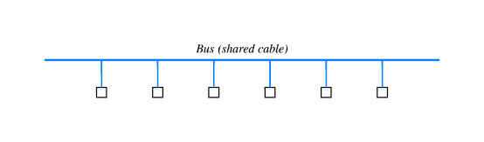
Local Area Network (LAN)
How are computers wired together in a LAN? – 3 common topologies
Star
hub
Ring
Bus (shared cable)

Slide 7
Ethernet
Ethernet is a bus LAN topology
Invented at Xerox PARC in the early ’70s
Developed commercially by 3COM later
Standards controlled by IEEE
Today it is the most widely used network topology for LANs

Slide 8
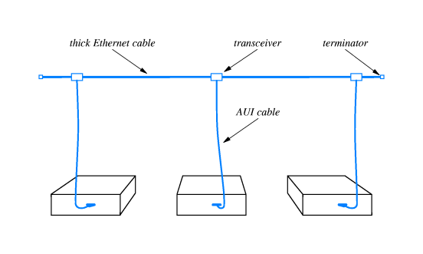
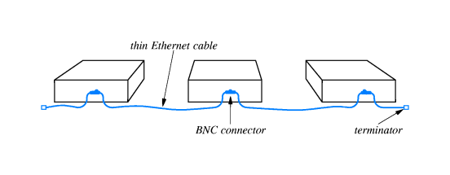
Older Ethernet wiring schemes
“Thick” Ethernet
The original Ethernet standard
Coaxial cable – computers connected via transceivers
“Thin” Ethernet
Coaxial cable – computers directly connected via BNC

Slide 9
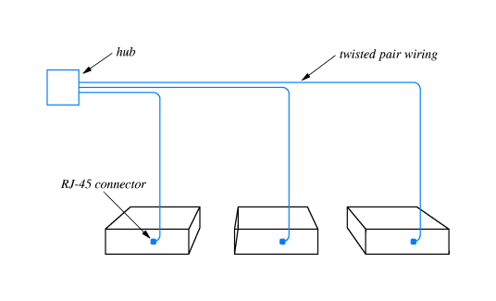
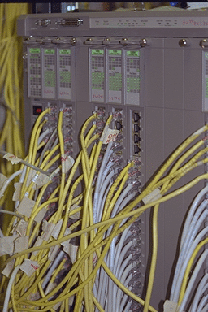
Twisted Pair Ethernet
Is twisted pair Ethernet a bus or star?
Logically it is a bus
Physically it is a star

Slide 10
Sharing the Ether
Data is divided into small chunks called “packets” which may be one of a number of standard types
A packet sent from one computer propagates to either end of the cable
The packet is ignored by every computer on the network except the destination computer

Slide 11
Ethernet Co-ordination
Ethernet systems do not have a central controller telling computers when they can talk
All computers on an Ethernet network use Carrier Sense Multiple Access (CSMA)
The electrical activity that occurs during packet transmission is called the carrier
Before transmitting a packet a computer checks for a carrier and only transmits when the network is quiet
Checking for a carrier is called Carrier Sense
The whole process is CSMA

Slide 12
Collision Detection
CSMA prevents computers from interrupting ongoing transmissions
CSMA does not prevent simultaneous transmissions
Simultaneous signals will interfere – this is called a collision, which will damage data in both packets
Ethernet has collision detection (CD)
The sending computer monitors the signal on the ether
If this signal differs from what was sent a collision must have occurred
The whole system is CSMA/CD

Slide 13
Collision Handling
When CSMA/CD detects a collision, both computers must re-send their data
This does not happed immediately (to avoid another collision)
Both computers wait a random amount of time (the maximum allowed is a part of the Ethernet standard)
The data is sent again, once the network is quite
If there is a second, collision the maximum delay is doubled, etc.
Exponential backoff

Slide 14
Sending bits over long distance
Encoding data as discrete voltage changes does nt work over long distance as the signal attenuates
A continually oscillating wave travels further
Bits of data are modulated onto a carrier wave
Modulation and demodulation is done by a modem

Slide 15
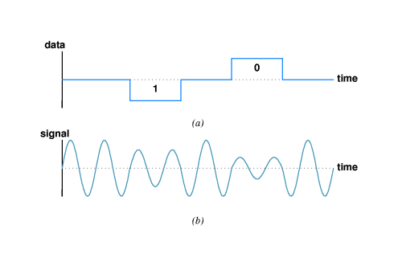
Amplitude Modulation

Slide 16
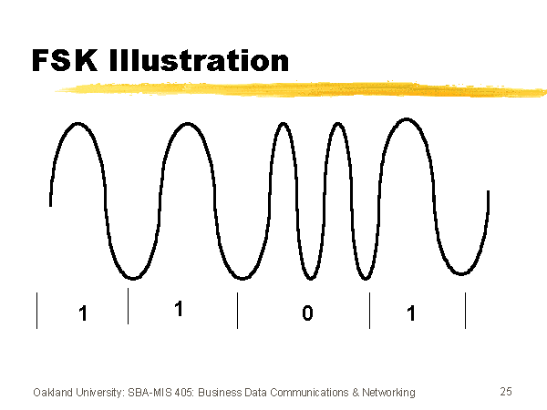
Frequency Modulation

Slide 17
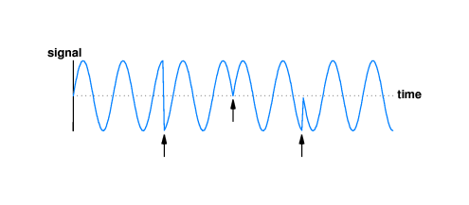
Phase shift modulation

Slide 18
Modems
Hardware that takes bits and applies modulation is a modulator
Hardware that takes a modulated wave and extracts bits is a demodulator
Full duplex communication requires a combined modulator-demodulator (MODEM) at both ends

Slide 19
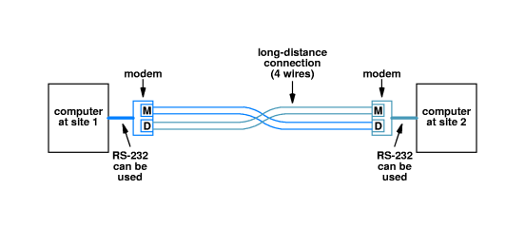
Example modem connection

Slide 20
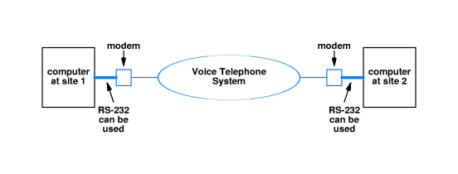
Dial-up modem configuration

Slide 21
Terminology
Bandwidth – the number of signals per second that a medium can accommodate
Multiplexing - several logical connections share a single physical connection
Broadband - a transmission method which supports a relatively wide range of frequencies which may be divided into channels

Slide 22
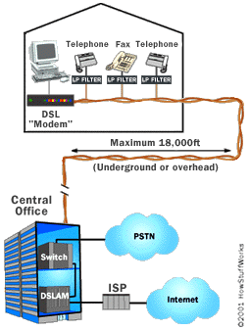
Digital Subscriber Line (DSL)
Uses the two-wire local loop from the local telephone exchange to homes
Normal telephone lines are limited to the frequency range of human voices (0-3400 Hz)
DSL uses the entire bandwidth of the local loop
However, capacity decreases with connection distance
limit 18,000 feet (5,460 m)
Telephone exchange

Slide 23

Digital Subscriber Line (DSL)
DMT (Discrete MultiTone) divides the data into 247 separate channels, each 4 KHz wide
equivalent of 247 modems connected to your computer at once!
Channel 0 is used for voice
Usually 80-90% of the rest of the channels are used for downstream communication (Asymmetrical DSL)

Slide 24
Digital Subscriber Line (DSL)
ADSL speed – max. downstream 8 Mbps and max. upstream 1 Mbps
up to distance of 2 km
ADSL2+ can deliver up to 24 Mbps (downstream)

Slide 25
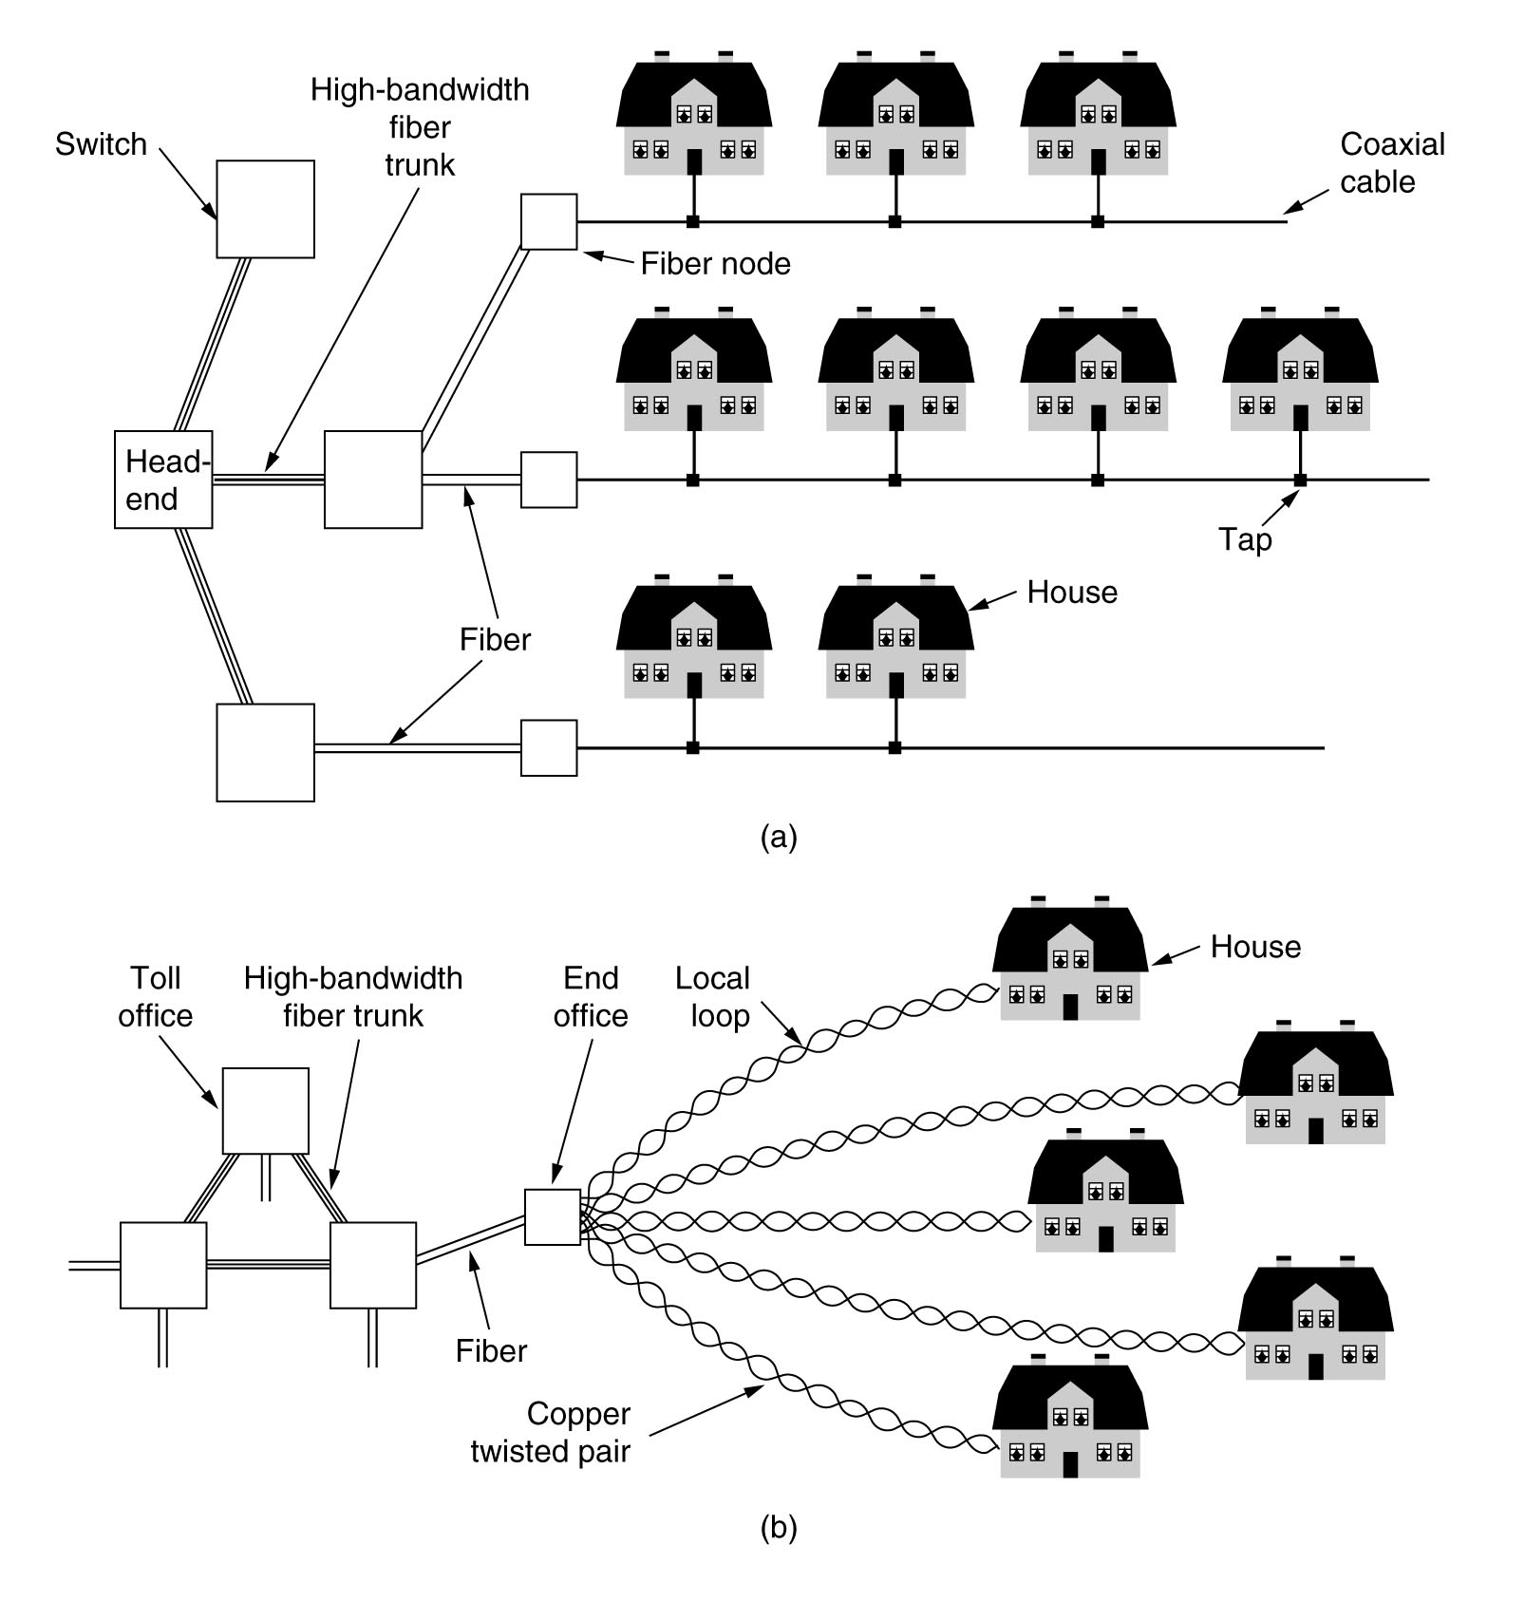
Cable Connection
- A single cable is shared by many houses
+ Bandwidth of coax much higher than TP
Cable television
Fixed telephone system

Slide 26
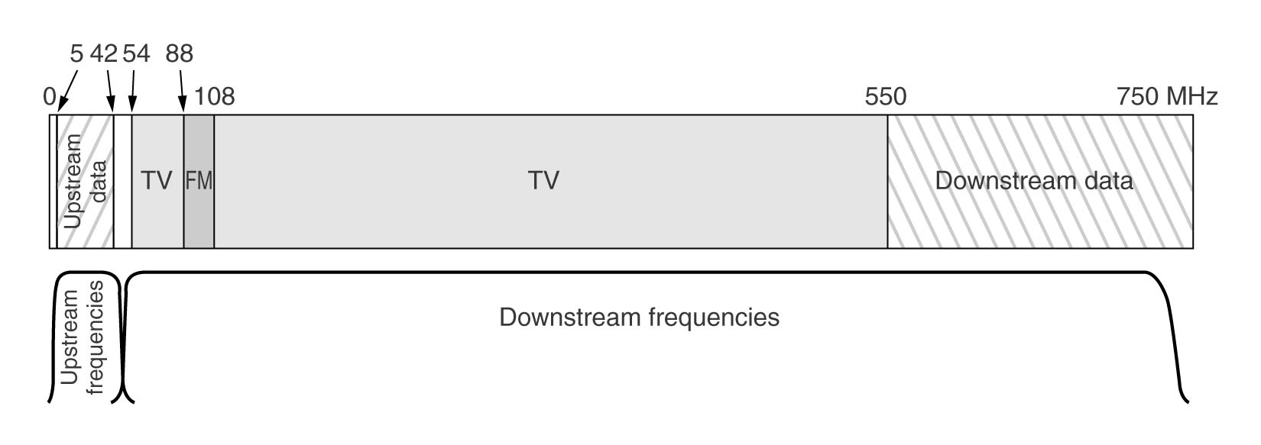
Cable Connection
Sharing the cable for Internet and TV
To cope with long coaxial cables analog modulation is needed
A cable modem connect a computer (through USB or Ethernet interface) to the cable network

Slide 27
Summary
Local communication
Encoding data
LANs
Topologies
Ethernet (wiring schemes and coordination)
Long Distance communication
Modulation
Modems and broadband connections

