Slide 1
Lecture 3
TCP/IP & the Internet
Boriana Koleva
Room: C56
Email:B.Koleva@nottingham.ac.uk

Slide 2
Overview
Protocol design
Overview of TCP/IP
IP addresses and domain names

Slide 3
Network Protocols
Communication hardware transfers raw data (i.e. a steam of bits)
Usually more sophisticated instructions need to be sent over networks
This requires software which needs to follow standards for interoperability
Protocols are the rules that govern communication on networks
Protocols are implemented by protocol software

Slide 4
Stacks of Layers
Protocols are designed according to a layered model
The protocol software on each computer is divided into modules – each corresponding with a layer
Each module only communicates with the modules corresponding to the layer above and the layer below
All the protocol modules on a computer are collectively called a stack or suite
Network communication requires that the same stack is installed on all computers (though the hardware and OS may be different)

Slide 5
The Layering Principle
Layer N software on the destination computer must receive the exact message sent by layer N software on the sending computer

Slide 6
Examples of Protocol Stacks
Vendor | Stack
Novell | Netware
Apple | Appletalk
IBM | SNA
Various (Internet) | TCP/IP

Slide 7
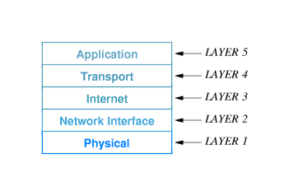
Internet Reference Model (TCP/IP)

Slide 8
TCP/IP
Protocol stack used by the Internet
Originally designed for DARPA (late 1960’s)
Major design features intended for military use
  Multiple contractors
  Simple (basic services)
  Robust - automatic recovery from battlefield damage
These same features make the Internet possible
  Multiple vendors
  Simple (basic services)
  Robust - the Internet is not centrally coordinated
Since early 1980’s TCP/IP has been built into Unix
Now available for, or as part of all major OS

Slide 9
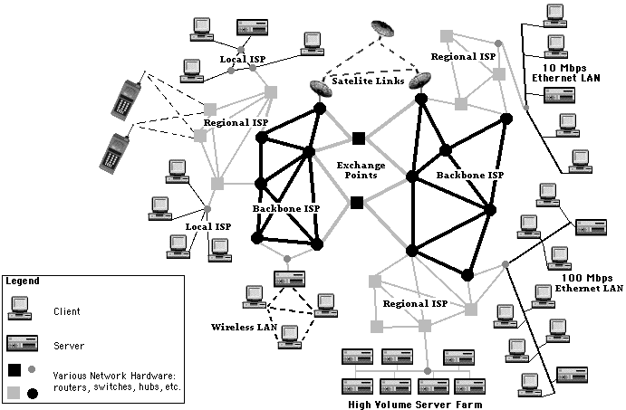
The Internet
A vast network of networks
Figure from “Web Applications”, C. Knuckles and D. Yuen, Wiley

Slide 10
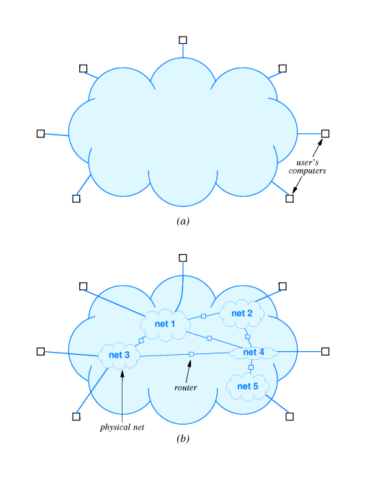
Virtual network
TCP/IP gives illusion that there is a single universal network
Universal service - any two computers should be able to communicate
Hardware: routers connect different networks
Internet protocols: provide universal service by creating a single virtual network

Slide 11
IP (Internet Protocol)
Layer 3 protocol
A packet switching protocol
  packets of data are routed between nodes with no previously established path
  connectionless
IP is responsible for moving packet of data from machine to machine
  IP forwards each packet based on a destination address (the IP number)
  The Internet authorities assign ranges of numbers to different organisations
  Organisations assign their own subsets of numbers to departments
  IP operates on routers that move data from LANs to WANs and global WANs

Slide 12
TCP (Transport Control Protocol)
Layer 4 protocol
Connection-oriented
Data may be sent in a continual stream between two hosts
TCP is responsible for verifying the correct delivery of data between machines
  detection of errors or lost data
  management of retransmission until the data is correct and completely received
  assembles packets of data into the correct order without duplication
  handles multiplexing

Slide 13
TCP/IP Jargon (1)
Host - any system that connects to an Internet and that runs applications
Router - a device that connects independent networks together to form an internetwork
  Forwards packets from one network to another
Both hosts and routers use TCP/IP protocol software
Sockets - the API for TCP/IP software (i.e. the library of functions that a program can use to access TCP/IP facilities)
  For example the Winsock API on Windows

Slide 14
TCP/IP Jargon (2)
Host Name
  all hosts on a TCP/IP network must have a unique name
  this may be a single word (on a small network) or follow a hierarchical convention
Internet Address (IP Number)
  all hosts on the Internet must have a unique identifying number
  32-bit number, usually written as 4 bytes separated by dots (e.g. 128.243.20.172)
Ethernet Address (Media Access Control, MAC)
  a unique number built into each Ethernet subsystem by the manufacturer
  6-byte numbers, usually written in hex separated by dashes (e.g. 02-FE-87-4A-8C-A9)
  if Ethernet is not used (e.g. over a phone line) then the software stack must provide a MAC

Slide 15
IPv4 Addresses
IP number is a unique identifier for TCP/IP
  Analogous to telephone number
IP numbers consist of 4 bytes (i.e. numbers from 0-255)
  This gives a maximum of 255⁴ (4,294,967,296)
  Dotted decimal notation for human readability
    128.242.22.17
Each 32 bit address is divided into two parts:
  prefix: physical network to which the host is attached - the network number
  suffix: a host attached to a given physical network

Slide 16
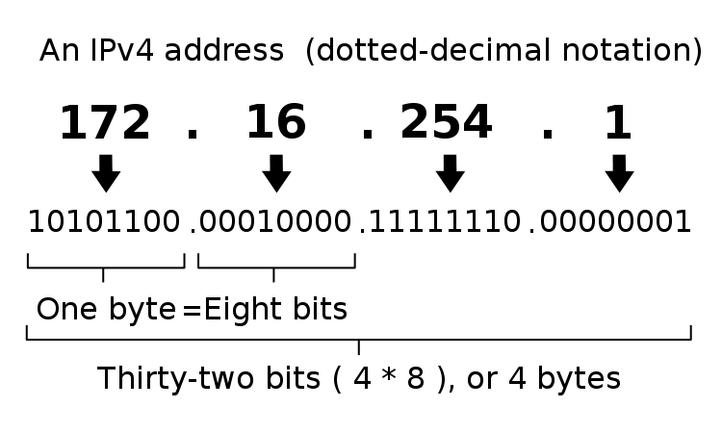

Slide 17
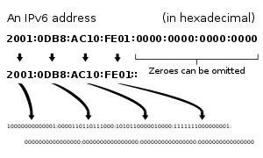
IPv6 Addresses
New addressing system developed in 1995
The IP version 4 address space is rapidly nearing exhaustion of available address blocks
  some parts of the world have already exhausted their IPv4 allocations
Uses 128 bits for the address
  provides the potential for a maximum of 2¹²⁸, or about 3.403×10³⁸ unique addresses
  Hexadecimal notation

Slide 18
Special IP Numbers
Some IP numbers have special meanings, and so are not normally assigned to individual hosts
Broadcast Address – 255
  Listened to by all machines on the network
Loopback Network – 127
  127.0.0.1 - loopback address (localhost)

Slide 19
Host & Domain Names
Domain names are alphanumeric labels assigned to IP numbers
Each host name on a subnet must be unique
There is a hierarchy of domain names
  Top level
    Country (if not US) – e.g. UK, FR, IE
    Category - COM, MIL, GOV, EDU, ORG etc (or CO.UK, AC.UK, GOV.UK, ORG.UK etc)
    NB domain registration does not necessarily correspond to physical location!
  Second level
    Organisation (e.g. NOTT.AC.UK)
  Third level
    Subnet (e.g. CS.NOTT.AC.UK)
Host names may be aliased
Host names are obtained from databases called nameservers

Slide 20
IP Numbers and domain names – a Nottingham Example
JANET (Joint Academic Network)
  *.uk.ac
  128.*.*.*
University of Nottingham
  *.nott.ac.uk (also aliases – e.g. *.nottingham.ac.uk)
  128.243.*.*
Computer Science
  *.cs.nott.ac.uk
  128.243.20.* 128.243.21.* 128.243.22.*
Avon (Linux server)
  avon.cs.nott.ac.uk
  128.243.21.111

Slide 21
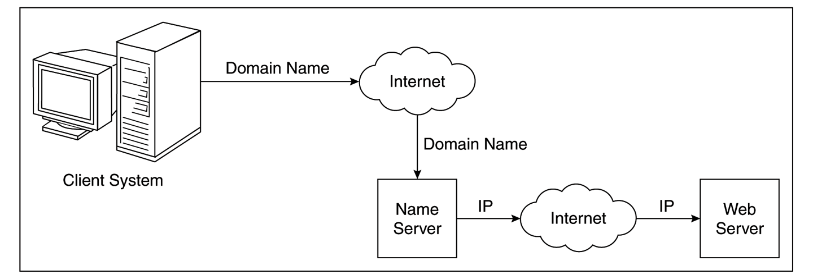
Domain name conversion
Fully qualified domain names must be converted to IP numbers before communication can take place over the Internet
  DNS servers

Slide 22
Summary
Protocol design
TCP/IP overview
IP addresses and domain names

