Slide 1
Lecture 5 HTML
Boriana Koleva
Room: C56
Email:B.Koleva@nottingham.ac.uk

Slide 2
Overview
Origins and evolution of HTML and XHTML
Basic Syntax
Standard document structure
Basic text markup
Images
Hypertext links

Slide 3
Origins and Evolution of HTML
Hypertext Markup Language
Developed for the delivery of hypertext on the WWW
Built using SGML
ASCII “Markup Language”

Slide 4
Recent Versions
HTML 4.0 – 1997
Introduced many new features and deprecated many older features
HTML 4.01 - 1999 - A cleanup of 4.0
XHTML 1.0 - 2000
Just 4.01 defined using XML, instead of SGML
XHTML 1.1 – 2001
Modularized 1.0, and drops frames
XHTML 2.0 – development abandoned
HTML 5.0
W3C Candidate Recommendation (as of December 2012)
HTML and XHTML syntax

Slide 5
HTML versus XHTML
HTML has lax syntax rules, leading to sloppy and sometime ambiguous documents
XHTML syntax is much more strict, leading to clean and clear documents in a standard form
Even minor syntax errors will prevent a document labelled as XML from being rendered fully, whereas they would be ignored in the HTML syntax
HTML compatible with most legacy Web browsers

Slide 6
Editing (X)HTML
Creating HTML documents
Text editors (e.g. Notepad, Emacs, Crimson Editor)
Source code editors (e.g. Notepad++, WebTide)
Authoring tools (e.g. Microsoft Expression Web, Adobe Dreamwaver, KompoZer)
HTML files have .html extension
The filename of your homepage should be index.html
If a browser does not request a specific file in a directory, normal Web server response is to return index.html
http://www.cs.nott.ac.uk/~bnk/

Slide 7
Basic Syntax
Elements are defined by tags (markers)
Tag format:
Opening tag: <name>
Closing tag: </name>
The opening tag and its closing tag together specify a container for the content they enclose
E.g. <p> Hello </p>
Not all tags have content
E.g. <hr>

Slide 8
Basic Syntax 2
The container and its content together are called an element
If a tag has attributes, they appear between its name and the right bracket of the opening tag
E.g. <img src = “c10.jpg”>
Comment form: <!-- … -->
Browsers ignore comments, unrecognizable tags, line breaks, multiple spaces, and tabs
Tags are just suggestions to the browser, even if they are recognized by the browser

Slide 9
HTML Document Structure
An HTML document is composed of 3 parts:
a line containing HTML version information, e.g.:
<!DOCTYPE html PUBLIC "-//W3C//DTD HTML 4.01//EN" "http://www.w3.org/TR/html4/strict.dtd">
Note: <!DOCTYPE html> for HTML5
a declarative header section
Delimited with the <head> tag
The <title>tag is used to give the document a title
normally displayed in the browser’s window title bar
a body containing the document's actual content
Delimited with the <body> tag
After document type declaration, the remainder of an HTML document is contained by the html element

Slide 10
Basic HTML Document
<!DOCTYPE html PUBLIC "-//W3C//DTD HTML 4.01//EN" "http://www.w3.org/TR/html4/strict.dtd">
<html>
<head>
<title> … </title>
<meta http-equiv="Content-Type" content="text/html;charset=utf-8" >
</head>
<body>
…
</body>
</html>

Slide 11
Basic Text Markup
Paragraph Elements: <p>
Text is normally placed in paragraph elements
The browser puts as many words of the paragraph’s content as will fit in each line
<p>
Greetings!
</p>
Simple HTML example
http://www.cs.nott.ac.uk/~bnk/WPS/simple.html

Slide 12
Basic Text Markup 2
Line breaks: <br>
Horizontal rules: <hr>
Headings
Six sizes, 1 - 6, specified with <h1> to <h6>
1, 2, and 3 use font sizes that are larger than the default font size
4 uses the default size
5 and 6 use smaller font sizes
Headings example
http://www.cs.nott.ac.uk/~bnk/WPS/headings.html

Slide 13
Basic Text Markup 3
Blockquotes: <blockquote>
To set a block of text off from the normal flow and appearance of text
Browsers often indent, and sometimes italicize
http://www.cs.nott.ac.uk/~bnk/WPS/blockquote.html
Font Styles and Sizes (can be nested)
Boldface: <b>
Italics: <i>
Smaller: <small>
Larger: <big> (not supported in HTML5)
Monospace: <tt> (not supported in HTML5)

Slide 14
Basic Text Markup 4
Example: The <big> sleet <big> in <big> <i> Crete </i><br /> lies </big> completely </big> in </big> the street
Display: The sleet in Crete
lies completely in the street
Subscripts: <sub> Superscripts: <sup>
Example: x<sub>2</sub><sup>3</sup>
Display: x₂³

Slide 15
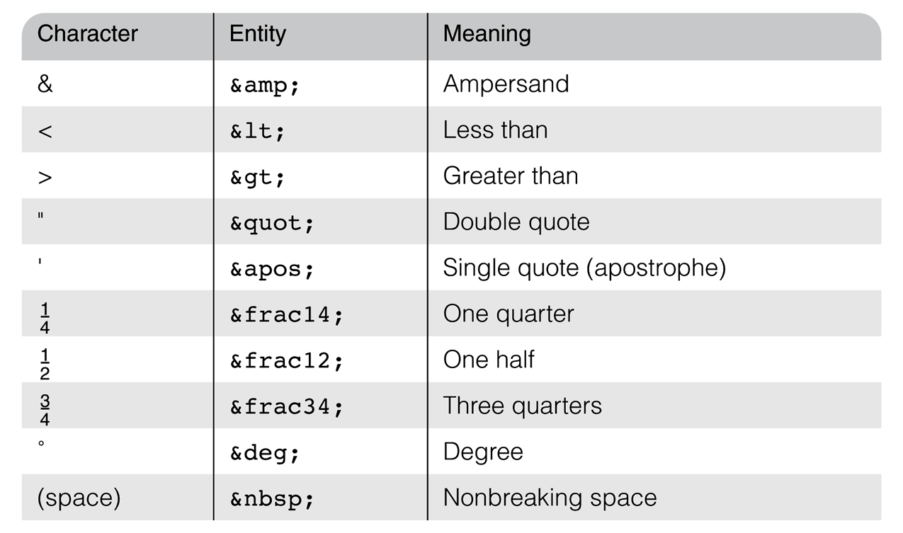
Basic Text Markup 5
Character Entities
the only named character entity references in HTML5

Slide 16
Images
All modern web browsers can display images inline (i.e. embedded in the text)
GIF (Graphic Interchange Format)
8-bit color (256 different colors)
JPEG (Joint Photographic Experts Group)
24-bit colour (16 million different colours)
Portable Network Graphics (PNG)
Relatively new
Designed for transferring images on the Internet

Slide 17
Images 2
Images are inserted into a document with the <img> tag with the src attribute
The alt attribute is required by HTML
(in HTML5 can be omitted when textual desc. not available )
Non-graphical browsers
Browsers with images turned off
<img src = “logo.jpg"
alt = “University of Nottingham Logo" />
The <img> tag has other optional attributes, including width and height (in pixels)
http://www.cs.nott.ac.uk/~bnk/WPS/image.html

Slide 18
Linking on the Web
Source
Anchor
Document 1
Here is a link to document 2
Link (reference)
Destination
Document 2
This is document 2.

Slide 19
Hypertext Links
Hypertext is the essence of the Web!
A link is specified with the href (hypertext reference) attribute of <a> (the anchor tag)
The content of <a> is the visual link in the document
<a href=“target.html”>This is a link</a>
Relative addressing of targets is easier to maintain and more portable than absolute addressing
http://www.cs.nott.ac.uk/~bnk/WPS/link.html

Slide 20
Targets within Documents
If the target is not at the beginning of the document, the target spot must be marked
Target labels can be defined in many different tags with the id attribute
<h1 id = "baskets"> Baskets </h1>
The link to an id must be preceded by a pound sign (#)
target is in the same document,
<a href = "#baskets"> Baskets </a>
target is in a different document
<a href = "myAd.html#baskets”> Baskets </a>

Slide 21
Image Hyperlinks
Links can include images in their content
<a href = "c210data.html“>
<img src = "smallplane.jpg"
alt = "Small picture of an airplane " >
Info on C210 </a>

Slide 22
Validation
W3C HTML Validation Service
http://validator.w3.org/

Slide 23
Syntactic Differences between HTML & XHTML
Case sensitivity
Closing tags
Quoted attribute values
Explicit attribute values
id and name attributes
Element nesting

Slide 24
Summary
Origins and evolution of HTML and XHTML
Basic syntax and standard document structure
Basic text markup
Images
Hypertext links
Validation
HTML vs. XHTML syntax

