Slide 1
Lecture 8 Cascading Style Sheets (CSS)
Boriana Koleva
Room: C56
Email: B.Koleva@nottingham.ac.uk

Slide 2
Overview
Motivation
Levels of style sheets
Style specification formats
Selector forms
Property value forms
Examples of properties – font, list, colour, background images, text alignment
Box model

Slide 3
Motivation
Consider the management of a corporate web site
Site identity (look & feel - e.g. corporate image) must be maintained
Changes in site identity must be implemented across the entire site
A mixture of content and appearance in a data set is difficult to maintain
Stylesheet concept from DTP
HTML necessarily mixes style and content, but stylesheets help the separation

Slide 4
CSS
CSS provides the means to control and change presentation of HTML documents
Style sheets allow you to impose a standard style on a whole document, or even a whole collection of documents
CSS1 specification – 1996
CSS2 specification - 1998
CSS level 2 revision 1 (CSS 2.1) - 2011
CSS3 specification – parts are W3C Recommendation others still under development

Slide 5
Levels of Style Sheets
There are three levels of style sheets
Inline - specified for a specific occurrence of a tag and apply only to that tag
This is fine-grain style, which defeats the purpose of style sheets - uniform style
Document-level style sheets - apply to the whole document in which they appear
External style sheets - can be applied to any number of documents
When more than one style sheet applies to a specific tag in a document, the final level in the cascade has precedence

Slide 6
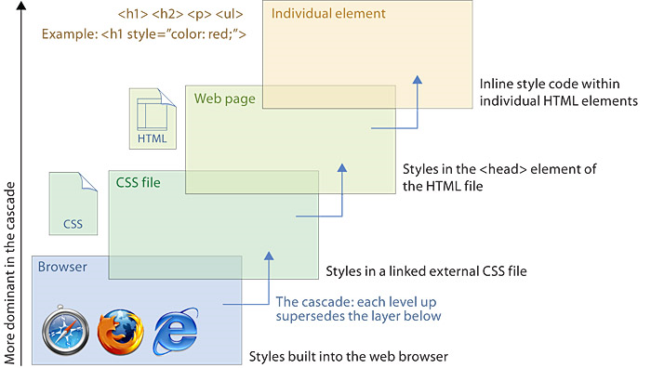
CSS cascade hierarchy
From Web Style Guide: Basic Design Principles for Creating Web Sites, by Patrick J. Lynch and Sarah Horton.
http://webstyleguide.com/wsg3/index.html

Slide 7
Inline Style Specification
Style sheet appears as the value of the style attribute in the tag itself
General form:
style = "property_1: value_1;
property_2: value_2;
…
property_n: value_n;"

Slide 8
Document Style Specification
Style sheet appears as a list of rules that are the content of a <style> tag in the head of the document
The <style> tag must include the type attribute, set to "text/css"
<style type = "text/css">
rule list
</style>
Form of the rules:
selector {property_1:value_1; property_2:value_2; …; property_n:value_n;}

Slide 9
External Style Sheet Specification
External style sheets are in separate files, potentially on any server on the Internet
Written as text files with the MIME type text/css
A <link> tag is used to specify that the browser is to fetch and use an external style sheet file
<link rel = "stylesheet" type = "text/css"
href = "http://www.wherever.org/example.css">
Form is a list of style rules
Like the content of a <style> tag for document-level style sheets

Slide 10
Simple Selector
The selector is a tag name or a list of tag names, separated by commas
Examples:
h1 {font_size: 24pt;}
h2, h3 {font_size: 20pt;}
Contextual selectors
Apply style only to elements in specified position in body of document
List element hierarchy
body p b {font_size: 30pt}

Slide 11
Class Selector
Used to allow different occurrences of the same tag to have different style specifications
A style class has a name, which is attached to a tag name
p.narrow {property/value list}
p.wide {property/value list}
The class you want on a particular occurrence of a tag is specified with the class attribute of the tag
<p class = "narrow"> ... </p>
...
<p class = "wide"> ... </p>

Slide 12
Generic Selectors
A generic class can be defined if you want a style to apply to more than one kind of tag
A generic class must be named, and the name must begin with a period
.really-big { … }
Use in body of doc like normal style class
<h1 class = "really-big"> … </h1>
...
<p class = "really-big"> … </p>

Slide 13
id Selectors
An id selector allow the application of a style to one specific element
General form:
#specific-id {property-value list}
e.g. #section3 {font-size: 20}
In XHMTL doc:
<h2 id = “section3”>
3. Properties for sale
</h2>

Slide 14
Pseudo Classes
Pseudo classes are styles that apply when something happens, rather than because the target element simply exists
Names begin with colons
hover class applies when the mouse cursor is over the element
focus class applies when an element has focus
http://www.cs.nott.ac.uk/~bnk/WPS/pseudo.html

Slide 15
Properties
There are different properties in 12 categories (CSS 2.1) and 28 (CSS3):
Background
Border and outline
Dimension
Font
Generated content
List
Margin
Padding
Positioning
Print
Table
Text

Slide 16
Property Value Forms
Keywords - left, small, …
Length - numbers, maybe with decimal points
Units:
px – pixels
in – inches
cm – centimeters
mm – millimeters
pt – points
pc – picas (12 points)
em – height of the letter ‘m’
ex – height of the letter ‘x’
No space is allowed between the number and the unit specification, e.g. 1.5 in is illegal!

Slide 17
Property Value Forms
Percentage - just a number followed immediately by a percent sign
URL values
url(protocol://server/pathname)
Colors
Color name, e.g. white
Hex form: #XXXXXX, e.g. #FFFFFF
rgb(n1, n2, n3), e.g. rgb(255, 255, 255)
Numbers can be decimal (0-255) or percentages
Property values are inherited by all nested tags, unless overridden

Slide 18
Font Properties
font-family
Value is a list of font names - browser uses the first in the list it has
font-size
Possible values: a length number or a name, such as smaller, xx-large, etc.
font-style
italic, oblique (useless), normal
font-weight - degrees of boldness
bolder, lighter, bold, normal
font - for specifying a list of font properties
font: bolder 14pt Arial Helvetica
Order must be: style, weight, size, font name(s)
http://www.cs.nott.ac.uk/~bnk/WPS/fonts.html
http://www.cs.nott.ac.uk/~bnk/WPS/fonts2.html

Slide 19
List Properties list-style-type
On unordered lists list-style-type can be used to specify the shape of the bullets
disc (default), square, or circle
Set it on either the <ul> or <li> tag
<h3> Fruit </h3>
<ul>
<li style = "list-style-type: disc"> Apple </li>
<li style = "list-style-type: square"> Orange </li>
<li style = "list-style-type: circle"> Pear </li>
</ul>
On ordered lists list-style-type can be used to change the sequence values
http://www.cs.nott.ac.uk/~bnk/WPS/sequence_types.html

Slide 20
Text and Background Colour
The color property specifies colour of text
<style type = “text/css”>
th.red {color: red}
th.orange {color: orange}
</style>
The background-color property specifies the background colour of elements
http://www.cs.nott.ac.uk/~bnk/WPS/back_color.html

Slide 21
Background Images
The background-image property
http://www.cs.nott.ac.uk/~bnk/WPS/back_image.html
background-repeat property
Possible values: repeat (default), no-repeat, repeat-x, or repeat-y
background-position property
Possible values: top, center, bottom, left, or right

Slide 22
Text Alignment
The text-indent property allows indentation
Takes either a length or a % value
The text-align property has the possible values, left (the default), center, right, or justify
Sometimes we want text to flow around another element - the float property
values of left, right, and none (the default)
http://www.cs.nott.ac.uk/~bnk/WPS/float.html

Slide 23
The <span> and <div> tags
One problem with the font properties is that they apply to whole elements, which are often too large
Solution: a new tag to define an element in the content of a larger element – <span>
The default meaning of <span> is to leave the content as it is
<style type = "text/css">
.bigred {font-size: 24pt; font-family: Ariel; color: red}
</style>
…
<p> Now is the <span class = "bigred"> best time </span> ever! </p>

Slide 24
The <span> and <div> tags
The <span> tag is similar to other HTML tags, they can be nested and they have id and class attributes
Another tag that is useful for style specifications: <div>
Used to create document sections (or divisions) for which style can be specified
e.g., a section of five paragraphs for which you want some particular style

Slide 25
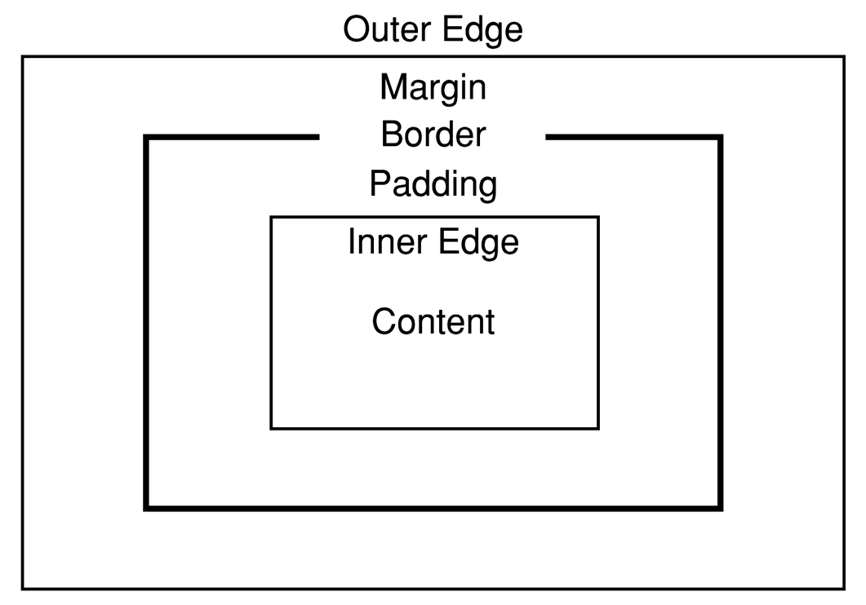
The Box Model
Each element in a document is considered to be a rectangular box consisting of content area, padding, a border and margins

Slide 26
Borders
Every element has a border-style property
Controls whether the element has a border and if so, the style of the border
border-style values:
none, dotted, dashed, solid, double, groove, ridge, inset, outset
border-width values: thin, medium (default), thick, or a length value in pixels
Border width can be specified for any of the four borders (e.g., border-top-width)

Slide 27
Borders
border-color – any color
Border color can be specified for any of the four borders (e.g., border-top-color)
http://www.cs.nott.ac.uk/~bnk/WPS/border.html

Slide 28
Margins
The space between the border of an element and its neighbor element
The margins around an element can be set with margin-left, etc. - just assign them a length value
<img src = "c210.jpg" style = "float: right; margin-left: 0.35in; margin-bottom: 0.35in" />

Slide 30
Padding
The distance between the content of an element and its border
Controlled by padding, padding-left, etc.
http://www.cs.nott.ac.uk/~bnk/WPS/marpads.html

Slide 31
div tags with the box model
An example of a two-column page layout
Left-column navigation
Right-column logo and content
http://www.cs.nott.ac.uk/~bnk/WPS/twocolumn.html

Slide 32
Summary
Motivation
Levels of style sheets
Inline, document, external
Selector forms
Simple, class, generic, id, pseudo classes
Property value forms
Examples of properties
font, list, color, text alignment, background images
<span> and <div> tags
Box model

