Slide 1
Lecture 9 The Basics of JavaScript
Boriana Koleva
Room: C56
Email: B.Koleva@nottingham.ac.uk

Slide 2
Overview
Overview of JavaScript
Object Orientation
Syntactic Characteristics
Primitives, Operations and Expressions
Math, Number, String and Date objects
Screen Output
Control Statements, Arrays and Functions

Slide 3
Origins of JavaScript
Originally developed by Netscape, as LiveScript
Became a joint venture of Netscape and Sun in 1995, renamed JavaScript
Now standardized by the European Computer Manufacturers Association as ECMA-262
An HTML-embedded scripting language
We’ll call collections of JavaScript code scripts, not programs

Slide 4
JavaScript and Java
JavaScript and Java are only related through syntax
JavaScript is dynamically typed
JavaScript’s support for objects is very different
JavaScript is interpreted
Source code is embedded inside HTML doc, there is no compilation

Slide 5
Uses of JavaScript
Transfer of some load from server to client
User interactions through forms
Events easily detected with JavaScript
E.g. validate user input
The Document Object Model makes it possible to create dynamic HTML documents with JavaScript

Slide 6
JavaScript Execution
JavaScript scripts are executed entirely by the browser
Once downloaded there is no exchange of information with the server
NB JavaScript programs can issue HTTP requests and load other pages
JavaScript scripts do not require the Java VM to be loaded
Thus JavaScript scripts tend to be fast

Slide 7
Object Orientation
JavaScript is NOT an object-oriented programming language
Rather object-based
Does not support class-based inheritance
Cannot support polymorphism
JavaScript objects are collections of properties, which are like the members of classes in Java
Data and method properties
JavaScript has primitives for simple types
The root object in JavaScript is Object – all objects are derived from Object

Slide 8
Embedding in HTML docs
Either directly, as in
<script type = “text/javascript”>
-- JavaScript script –
</script>
Or indirectly, as a file specified in the src attribute of <script>, as in
<script type = “text/javascript”
src = “myScript.js”>
</script>

Slide 9
Syntactic Characteristics
Identifier form: begin with a letter or underscore, followed by any number of letters, underscores, and digits
Case sensitive
25 reserved words, plus future reserved words
Comments: both // and /* … */
Semicolons can be a problem
They are “somewhat” optional
Problem: When the end of the line can be the end of a statement – JavaScript puts a semicolon there

Slide 10
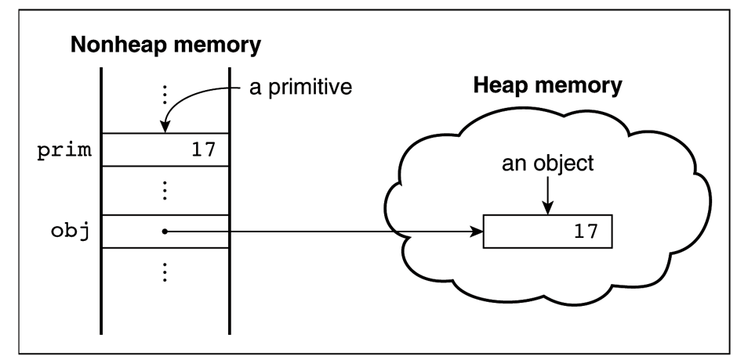
Primitives
All primitive values have one of the five types: Number, String, Boolean, Undefined, or Null
Number, String, and Boolean have wrapper objects
In the cases of Number and String, primitive values and objects are coerced back and forth so that primitive values can be treated essentially as if they were objects

Slide 11
Primitives
All numeric values are stored in double-precision floating point
String literals are delimited by either ' or "
Boolean values are true and false
The only Null value is null
The only Undefined value is undefined

Slide 12
Declaring Variables
JavaScript is dynamically typed – any variable can be used for anything (primitive value or reference to any object)
The interpreter determines the type of a particular occurrence of a variable
Variables can be either implicitly or explicitly declared
var sum = 0,
today = "Monday",
flag = false;

Slide 13
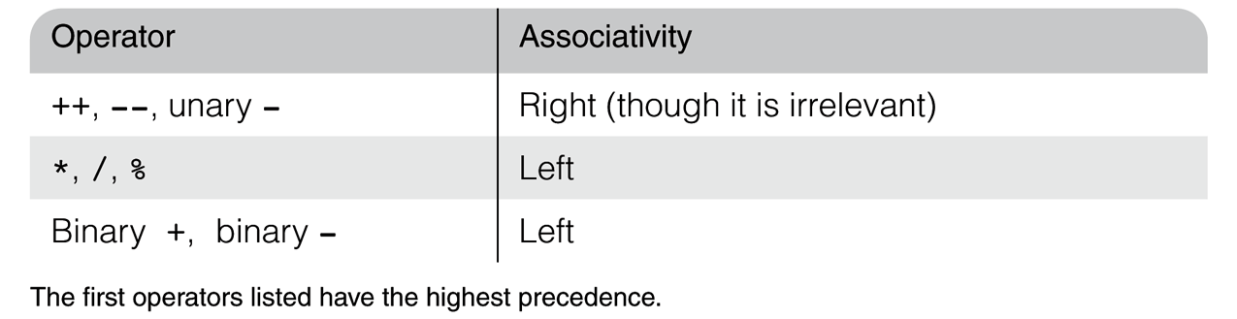
Numeric Operators

Slide 14
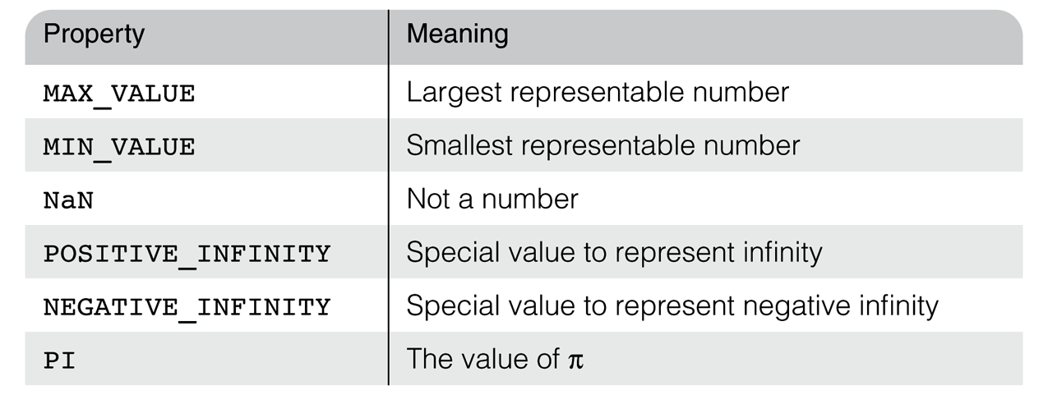
Math and Number Objects
The Math Object provides floor, round, max, min, trig functions, etc.
e.g., Math.cos(x)
The Number Object has some useful properties

Slide 15
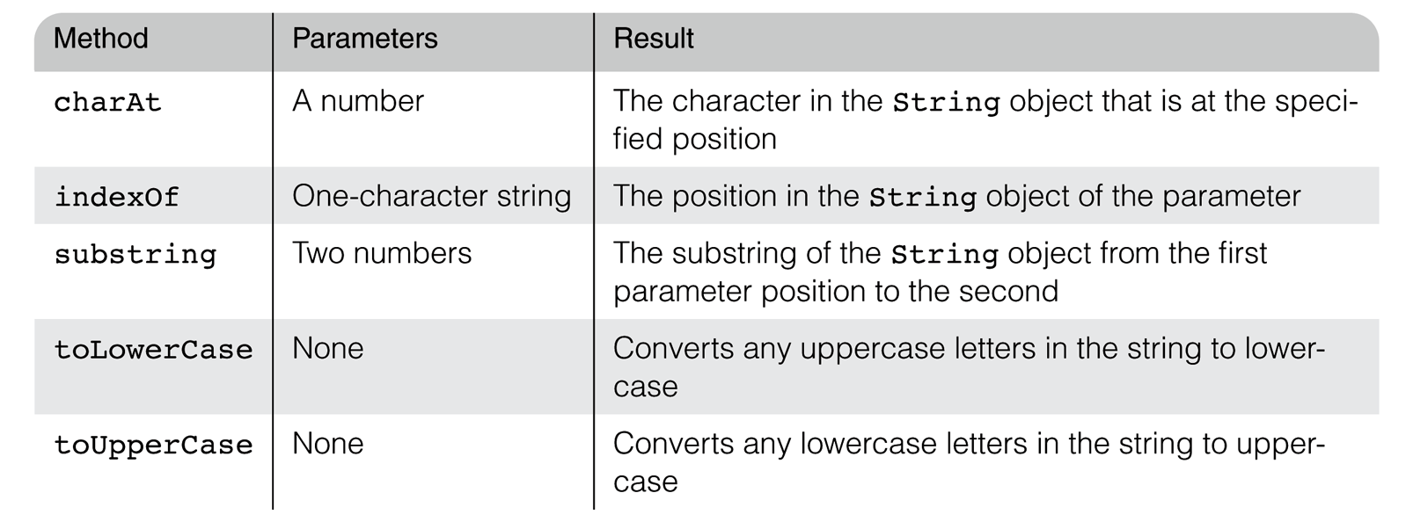
String Object
The number of characters in a string is stored in the length property
var str = “George”;
var len = str.length;
Common methods:

Slide 16
Date Object
Create one with the Date constructor (no params)
var today = new Date();
Local time methods of Date:
toLocaleString – returns a string of the date
getDate – returns the day of the month
getMonth – returns the month of the year (0 – 11)
getDay – returns the day of the week (0 – 6)
getFullYear – returns the year
getTime – returns the number of milliseconds since January 1, 1970
getHours – returns the hour (0 – 23)
getMinutes – returns the minutes (0 – 59)
getMilliseconds – returns the millisecond (0 – 999)

Slide 17
Screen Output
JavaScript models the HTML document with the Document object
The model for the browser display window is the Window object
The Window object has two properties, document and window, which refer to the Document and Window objects, respectively
The Document object has a method, write, which dynamically creates content
The parameter is a string, often concatenated from parts, some of which are variables
document.write("Answer: “, result, "<br>");
The parameter is sent to the browser, so it can be anything that can appear in an HTML document (any HTML tags)

Slide 18
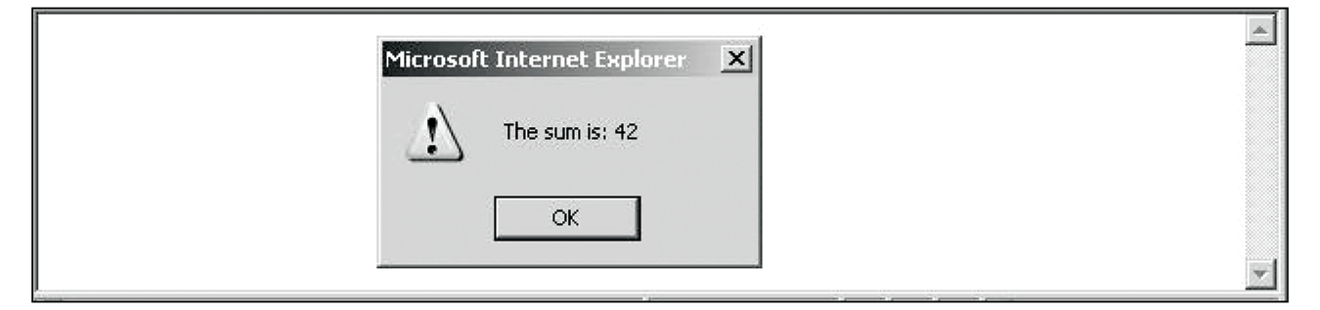
Screen Output
The Window object has three methods for creating dialog boxes
Alert
alert(“The sum is:” + sum + ”\n");
Parameter is plain text, not HTML
Opens a dialog box which displays the parameter string and an OK button
It waits for the user to press the OK button

Slide 19
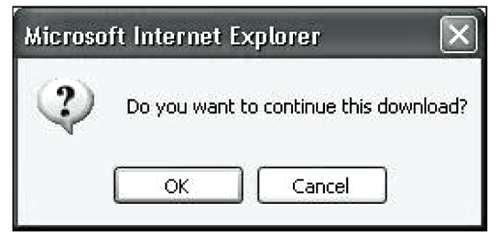
Screen Output
Confirm
var question = confirm("Do you want to continue this download?");
Opens a dialog box and displays the parameter and two buttons, OK and Cancel
Returns a Boolean value, depending on which button was pressed (it waits for one)

Slide 20
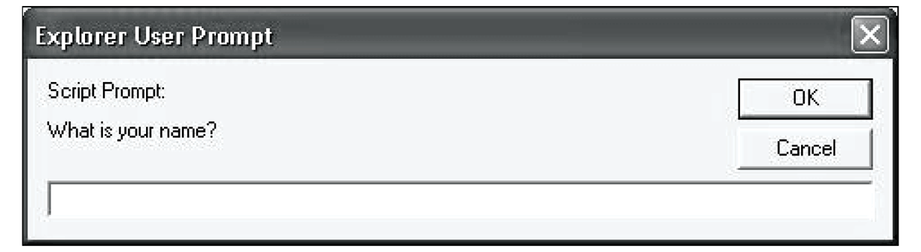
Screen Output
Prompt
prompt("What is your name?", “ ");
Opens a dialog box and displays its string parameter, along with a text box and two buttons, OK and Cancel
The second parameter is for a default response if the user presses OK without typing a response in the text box (waits for OK)
http://www.cs.nott.ac.uk/~bnk/WPS/roots.html

Slide 21
Conditionals
Selection statements – “if” and “if…else“
if (a > b)
document.write(“a is greater than b <br>”);
else {
a = b;
document.write(“a was not greater than b, now they are equal <br>”);
}
The switch statement
http://www.cs.nott.ac.uk/~bnk/WPS/borders.html

Slide 22
Loops
while (control_expression) statement or compound stmt
for (init; control; increment) statement or cmpnd stmt
init can have declarations, but the scope of such variables is the whole script
http://www.cs.nott.ac.uk/~bnk/WPS/date.html
do statement or compound while (control_expression)

Slide 23
Arrays
Array elements can be primitive values or references to other objects
Array objects can be created in two ways, with new, or by assigning an array literal
var myList = new Array(24, "bread", true);
var myList2 = new Array(24);
var myList3 = [24, "bread", true];
Length is dynamic - the length property stores the length
length property is writeable
myList.length = 150;
http://www.cs.nott.ac.uk/~bnk/WPS/insert_names.html

Slide 24
Functions
function function_name([formal_parameters]) {
-- body –
}
Return value is the parameter of return
If there is no return or if return has no parameter, undefined is returned
We place all function definitions in the head of the HTML document
Calls to functions appear in the document body
Variables explicitly declared in a function are local

Slide 25
Functions – parameters
Parameters are passed by value, but when a reference variable is passed, the semantics are pass-by-reference
There is no type checking of parameters, nor is the number of parameters checked
excess actual parameters are ignored, excess formal parameters are set to undefined
All parameters are sent through a property array, arguments, which has the length property
http://www.cs.nott.ac.uk/~bnk/WPS/parameters.html

Slide 26
Summary
Overview of JavaScript
Object Orientation
Syntactic Characteristics
Primitives, Operations and Expressions
Math, Number, String and Date objects
Screen Output
Control Statements, Arrays and Functions

