Slide 1
Lecture 10 JavaScript: DOM and Dynamic HTML
Boriana Koleva
Room: C56
Email: B.Koleva@nottingham.ac.uk

Slide 2
Overview
The Document Object Model (DOM)
HTML element Access in JavaScript
Events and Event Handling
Handling events from Body Elements
Handling events from Button Elements
Handling events from Text Box and Password Elements
Dynamic HTML
Element positioning and moving
Changing Colours and Fonts
Dynamic Content
Reacting to a Mouse Click

Slide 3
JavaScript Execution Environment
The Window object provides the largest enclosing referencing environment for scripts
Implicitly defined Window properties:
document - a reference to the Document object that the window displays
Every Document object has:
forms - an array of references to the forms of the document
Each forms object has an elements array, which has references to the form’s elements
Document also has property arrays for anchors, links, & images

Slide 4
The Document Object Model
DOM 0 is supported by all JavaScript-enabled browsers (no written specification)
DOM 1 was released in 1998
DOM 2 issued in 2000
DOM 3, issued 2004, is the latest W3C specification
The DOM is an abstract model that defines the interface between HTML documents and application programs—an API

Slide 5
The Document Object Model
A language that supports the DOM must have a binding to the DOM constructs
In the JavaScript binding, HTML elements are represented as objects and element attributes are represented as properties
e.g., <input type = "text" name = "address">
would be represented as an object with two properties, type and name, with the values "text" and "address"

Slide 6

DOM Structure
Documents in the DOM have a tree like structure

Slide 7
Finding HTML Elements
Often, with JavaScript, you want to manipulate HTML elements
To do so, you have to find the elements:
Finding HTML elements by id
Finding HTML elements by tag name
Finding HTML elements by class name
Finding HTML elements by HTML object collections

Slide 8
HTML Elements by id
getElementById Method (defined in DOM 1)
Example:
<form action = "">
<input type = "button" id = "pushMe">
</form>
document.getElementById("pushMe")

Slide 9
Checkboxes and radio button have an implicit array, which has their name
<form id = "toppingGroup">
<input type = "checkbox" name = "toppings"
value = "olives" />
...
<input type = "checkbox" name = "toppings"
value = "tomatoes" />
</form>
...
var numChecked = 0;
var dom = document.getElementById("toppingGroup");
for (index = 0; index < dom.toppings.length; index++)
if (dom.toppings[index].checked]
numChecked++;

Slide 10
HTML Elements by Tag or Class Name
getElementsByTagName()
returns all elements with a specified tag name
document.getElementsByTagName("p");
getElementsByClassName()
to find all elements with the same class name
document.getElementsByClassName ("intro");

Slide 11
HTML Elements by HTML Object Collections
var x = document.getElementById("frm1");
var txt = "";
for (var i=0;i<x.length;i++){
txt = txt + x.elements[i].value + "<br>";
}
document.getElementById("demo").innerHTML=txt;
The following HTML object collections are accessible:
document.anchors
document.forms
document.images
document.links

Slide 12
Events and Event Handling
An event is a notification that something specific has occurred, either with the browser or an action of the browser user
An event handler is a script that is implicitly executed in response to the appearance of an event
The process of connecting an event handler to an event is called registration
Don’t use document.write in an event handler, because the output may go on top of the display

Slide 13
Events and their Tag Attributes
Event Tag Attribute
blur onblur
change onchange
click onclick
focus onfocus
load onload
mousedown onmousedown
mousemove onmousemove
mouseout onmouseout
mouseover onmouseover
mouseup onmouseup
select onselect
submit onsubmit
unload onunload

Slide 14
Events, Attributes and Tags
The same attribute can appear in several different tags
e.g., The onclick attribute can be in <a> and <input>
A text element gets focus in three ways:
When the user puts the mouse cursor over it and presses the left button
When the user tabs to the element
By executing the focus method

Slide 15
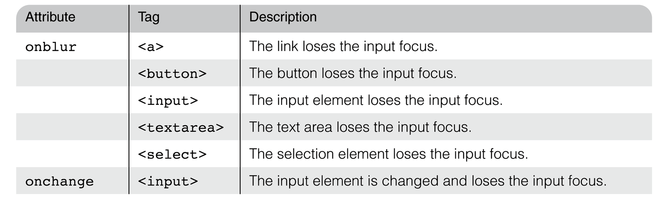
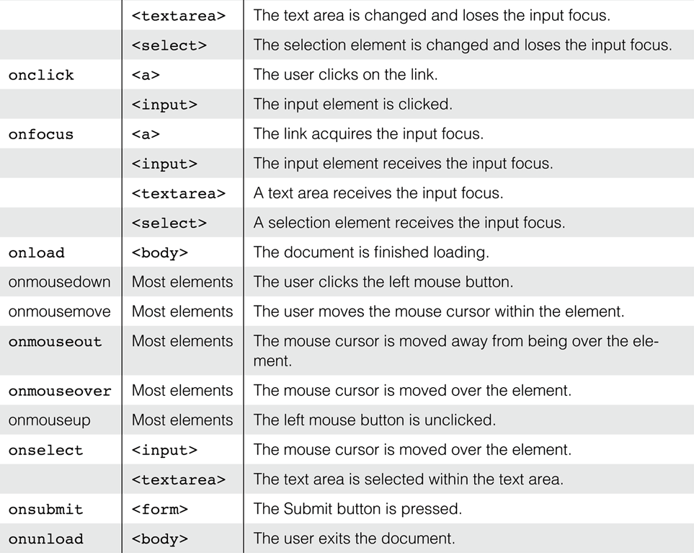

Slide 16
Registration of Event Handler
By assigning the event handler script to an event tag attribute
<input type “button” name = “myButton” onclick = "alert('Mouse click!');“ />
<input type “button” name = “myButton” onclick = "myHandler();" />

Slide 17
Handling Events from Body Elements
Events most often created by body elements are load and unload
Example:
the load event - triggered when the loading of a document is completed
http://www.cs.nott.ac.uk/~bnk/WPS/load.html

Slide 18
Handling Events from Button Elements
Plain Buttons – use the onclick property
Radio Buttons
Example:
http://www.cs.nott.ac.uk/~bnk/WPS/radio_click.html
The handler is registered in the markup, so the particular button that was clicked can be sent to the handler as a parameter

Slide 19
Handling Events from Textbox and Password Elements
Checking Form Input
A good use of JavaScript, because it finds errors in form input before it is sent to the server for processing
Things that must be done:
Detect the error and produce an alert message
Put the element in focus (the focus function) - puts the cursor in the element
Select the element (the select function) - highlights the text in the element
To keep the form active after the event handler is finished, the handler must return false

Slide 20
Handling Events from Password Elements
Example – comparing passwords
The form just has two password input boxes and Reset and Submit buttons
The event handler is triggered by the Submit button
The handler is registered by assigning it to a property of the JavaScript objects associated with the HTML elements
This registration must follow both the handler function and the HTML form
http://www.cs.nott.ac.uk/~bnk/WPS/pswd_chk.html

Slide 21
Handling Events from Textbox Elements
Example – checking the format of a name and phone number
The event handler will be triggered by the change event of the text boxes for the name and phone number
http://www.cs.nott.ac.uk/~bnk/WPS/validator.html

Slide 22
Dynamic HTML
An HTML document whose tag attributes, tag contents, or element style properties can be changed after the document has been and is still being displayed by a browser
Such changes are made with an embedded script (JavaScript) that accesses the elements of the document as objects in the associated DOM structure

Slide 23
Element Positioning
The position of any element is dictated by the three style properties: position, left, and top
The three possible values of position are absolute, relative, and static
<p style = "position: absolute; left: 50px;
top: 100px;">
If position is set to either absolute or relative, the element can be moved after it is displayed
Just change the top and left property values with a script
http://www.cs.nott.ac.uk/~bnk/WPS/mover.html

Slide 24
Changing Colours and Fonts
Colour example:
http://www.cs.nott.ac.uk/~bnk/WPS/dynColors.html
The actual parameter this.value works because at the time of the call, this is a reference to the text box (the element in which the call is made)
So, this.value is the name of the new colour
Changing fonts example
http://www.cs.nott.ac.uk/~bnk/WPS/dynLink.html
We can change the font properties of a link by using the mouseover and mouseout events to trigger a script that makes the changes

Slide 25
Dynamic Content
The content of an HTML element is addressed with the value property of its associated JavaScript object
http://www.cs.nott.ac.uk/~bnk/WPS/dynValue.html

Slide 26
Reacting to a Mouse Click
A mouse click can be used to trigger an action, no matter where the mouse cursor is in the display
http://www.cs.nott.ac.uk/~bnk/WPS/anywhere.html
Uses event handlers for onmousedown and onmouseup to change the visibility attribute of the message

Slide 27
Summary
The Document Object Model (DOM)
Element Access in JavaScript
Events and Event Handling
Handling events from Body Elements
Handling events from Button Elements
Handling events from Text Box and Password Elements
Dynamic HTML
Element positioning and moving
Changing Colours and Fonts
Dynamic Content
Reacting to a Mouse Click

