Slide 1
Lecture 12
PHP Basics
Boriana Koleva
Room: C56
Email: B.Koleva@nottingham.ac.uk

Slide 2
Overview
Overview of PHP
Syntactic Characteristics
Primitives
Output
Control statements
Arrays
Functions
PHP on CS servers

Slide 3
Origins and uses of PHP
Origins - Rasmus Lerdorf - 1994
  Developed to allow him to track visitors to his Web site
PHP is an open-source product
PHP is an acronym for Personal Home Page, or PHP: Hypertext Preprocessor
PHP is used for form handling, file processing, and database access

Slide 4
PHP Overview
PHP is a server-side scripting language whose scripts are embedded in HTML documents
  Similar to JavaScript, but on the server side
PHP is an alternative to CGI, ASP.NET and Java servlets/JSP
The PHP processor has two modes:
  copy (HTML) and interpret (PHP)
PHP syntax is similar to that of JavaScript
PHP is dynamically typed
PHP is interpreted

Slide 5
Syntactic Characteristics
PHP code can be specified in an HTML document internally or externally:
Internally: <?php ... ?>
Externally: include ("myScript.inc")
  the file can have both PHP and HTML
  If the file has PHP, the PHP must be in <?php .. ?>, even if the include is already in <?php .. ?>

Slide 6
Syntactic Characteristics 2
Every variable name begins with a $
  Case sensitive
Comments - three different kinds (Java and Perl)
  // ...
  # ...
  /* ... */
PHP statements terminated with ;
Compound statements are formed with braces
Compound statements cannot define locally scoped variables (except functions)

Slide 7
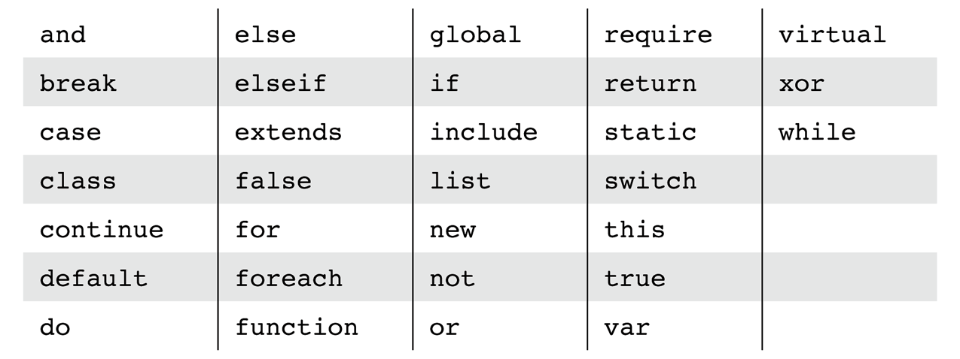
Reserved words of PHP
These are not case sensitive!

Slide 8
Variables
There are no type declarations
An unassigned (unbound) variable has the value NULL
The unset function sets a variable to NULL
The IsSet function is used to determine whether a variable is NULL
error_reporting(15); the interpreter will report when an unbound variable is referenced

Slide 9
Primitives
Four scalar types: Boolean, integer, double, and string
Two compound types: array and object
Two special types: resource and NULL
Integer & double are like those of other languages
Boolean - values are true and false (case insensitive)

Slide 10
Strings
Characters are single bytes
String literals use single or double quotes
Single-quoted string literals
  Embedded variables are NOT interpolated and embedded escape sequences are NOT recognized
Double-quoted string literals
  Embedded variables ARE interpolated and embedded escape sequences ARE recognized

Slide 11
Predefined functions
Arithmetic functions
  floor, ceil, round, abs, min, max, rand, etc.
String functions
  strlen, strcmp, strpos, substr
  chop – remove whitespace from the right end
  trim – remove whitespace from both ends
  ltrim – remove whitespace from the left end
  strtolower, strtoupper

Slide 12
Scalar type conversions
Implicit type conversion – coercion
  String to numeric
    If the string contains an e or an E, it is converted to double; otherwise to integer
    If the string does not begin with a sign or a digit, zero is used
Explicit conversions – casts
  e.g., (int)$total or intval($total) or settype($total, "integer")
The type of a variable can be determined with gettype or is_type function e.g.:
  gettype($total) may return "unknown"
  is_integer($total) returns Boolean value

Slide 13
Output
Output from a PHP script is HTML that is sent to the browser
HTML is sent to the browser through standard output
There are three ways to produce output: echo, print, and printf
  echo and print take a string, but will coerce other values to strings
  echo “Hello there!"; echo(“Hello there!”); echo $sum;
  print "Welcome!"; print(“Wellcome”); print (46);
http://severn.cs.nott.ac.uk/~bnk/WPS/today.php
http://www.cs.nott.ac.uk/~bnk/WPS/today.pdf (too see actual PHP script)

Slide 14
Control statements
Selection
  if, else, else if
  switch
    The switch expression type must be integer, double, or string
Loops
  while, do-while, for
http://severn.cs.nott.ac.uk/~bnk/WPS/powers.php
http://www.cs.nott.ac.uk/~bnk/WPS/powers.pdf
(stored as .pdf file to show PHP script)

Slide 15
Arrays
Not like the arrays of any other programming language
  A PHP array is a generalization of the arrays of other languages
A PHP array is really a mapping of keys to values, where the keys can be numbers (to get a traditional array) or strings (to get a hash)

Slide 16
Array creation
Use the array() construct, which takes one or more key => value pairs as parameters and returns an array of them
  The keys are non-negative integer literals or string literals
  The values can be anything
$list1 = array();
$list2 = array (17, 24, 45, 90);
$list3 = array(0 => "apples", 1 => "oranges", 2 => "grapes")
$list4 = array(“Joe” => 42,“Mary” => 41, “Jan” => 17);

Slide 17
Accessing array elements
Individual array elements can be accessed through subscripting
  $list[4] = 7;
  $list["day"] = "Tuesday";
  $list[] = 17;
  If an element with the specified key does not exist, it is created
  If the array does not exist, the array is created
The keys or values can be extracted from an array
$highs = array("Mon" => 74, "Tue" => 70, "Wed" => 67, "Thu" => 62, "Fri" => 65);
$days = array_keys($highs);
$temps = array_values($highs);

Slide 18
Dealing with arrays
An array can be deleted with unset
unset($list);
unset($list[4]); # No index 4 element now
is_array($list) returns true if $list is an array
in_array(17, $list) returns true if 17 is an element of $list
explode(" ", $str) creates an array with the values of the words from $str, split on a space
implode(" ", $list) creates a string of the elements from $list, separated by a space

Slide 19
Sequential access to array elements
next and prev functions
$citites array(“London”, “Paris”, “Chicago”);
$city = next($cities)
foreach statement – to build loops that process all of the elements in an array
  foreach (array as scalar_variable) loop body
  E.g. foreach ($list as $temp)
    print (“$temp <br />”);
  foreach (array as key=>value) loop body
  E.g. foreach ($lows as $day=>$temp)
    print(“The low temperature on $day was $temp <br />”);

Slide 20
Sorting arrays
sort - to sort the values of an array, leaving the keys in their present order - intended for traditional arrays
  e.g., sort($list);
  Works for both strings and numbers, even mixed strings and numbers
  $list = ('h', 100, 'c', 20, 'a');
  sort($list);
  // Produces ('a', 'c', 'h‘, 20, 100)
asort - to sort the values of an array, but keeping the key/value relationships - intended for hashes
ksort – to sort given array by keys rather than values
http://severn.cs.nott.ac.uk/~bnk/WPS/sorting.php
http://www.cs.nott.ac.uk/~bnk/WPS/sorting.pdf

Slide 21
Functions
function function_name([formal_parameters]) {
…
}
Functions need not be defined before they are called
Function overloading is not supported
  If you try to redefine a function, it is an error
Function names are NOT case sensitive
The return statement is used to return a value
  If there is no return, there is no returned value

Slide 22
Function parameters
If the caller sends too many actual parameters, the function ignores the extra ones
If the caller does not send enough parameters, the unmatched formal parameters are unbound
The default parameter passing method is pass by value (one-way communication)
To specify pass-by-reference, prepend an ampersand to the formal parameter
function addOne(&$param) {
$param++;
}
$it = 16;
addOne($it); // $it is now 17

Slide 23
Scope and Lifetime of Variables
Variables defined in a function have local scope
To access a non-local variable in a function, it must be declared to be global (within the function code) global $sum;
Normally, the lifetime of a variable in a function is from its first appearance to the end of the function’s execution
To support history sensitivity a function must have static local variables
  static $sum = 0;
  Its lifetime ends when the browser leaves the document in which the PHP script is embedded

Slide 24
PHP on CS servers
Put files in public_html directory of your Linux server
HTML files with embedded php script need to have .php extension
You should then be able to access such a file from a web browser with the url:
http://HOST.cs.nott.ac.uk/~USERNAME/fname.php
Eg: http://avon.cs.nott.ac.uk/~abc01u/test.php
PHP scripts are executed under your own user account so generally they do not need to be globally readable
  It is important you ensure they are not if they contain database connection passwords or similar info

Slide 25
Summary
Overview of PHP
Syntactic Characteristics
Primitives
Output
Control statements
Arrays
Functions
PHP on CS servers

