Slide 1
Lecture 15
Web Usability 2
Boriana Koleva
Room: C56
Email: B.Koleva@nottingham.ac.uk

Slide 2
Overview
What NOT to do
  Top 10 Mistakes of Web Design (Jakob Nielsen)
  Web pages that suck (Vincent Flanders)
Web Accessibility
  Legal requirements
  Assistive technologies
  Web Accessibility Initiative
    Web Content Accessibility Guidelines

Slide 3
Web Design Resources
Jakob Nielsen
  www.nngroup.com
Bruce Tognazzinni
  www.asktog.com
Web Pages That Suck
  www.webpagesthatsuck.com
  Book by Vincent Flanders & Michael Willis

Slide 4
Jakob Nielsen’s “Top 10 Mistakes of Web Design” in 1996
Using frames
  frames break the fundamental model of the web page
Gratuitous use of bleeding-edge technology
  wait until some experience has been gained about the appropriate use of new techniques
Scrolling text, marquees, and constantly running animations
  moving images have an overpowering effect on the human peripheral vision
Complex URL’s
  a URL should contain human-readable directory and file names
Orphan pages
  every page should have a link up to your home page

Slide 5
Jakob Nielsen’s “Top 10 Mistakes of Web Design” in 1996
Long scrolling pages
  critical content and navigation options should be on the top part of the page
Lack of navigation support
  communicate the structure of the information space to the user
Non-standard link colours
  use different colours for visited and unvisited links
Outdated information
Overly long download time
  10-15 seconds as the maximum response time before users lose interest

Slide 6
Top 10 Worst Mistakes of Web Design
(of all time)
Bad Search
  Overly literal search engines
  Prioritizing results purely on the basis of how many query terms they contain rather than on each document's importance
PDF Files for Online Reading
  Breaks flow of browsing
  Layouts are not optimised for user's browser window
Not Changing the Colour of Visited Links
  past navigation helps you understand your current locations, makes it easier to decide where to go next
Non-Scannable Text
  Intimidating. Boring. Painful to read.

Slide 7
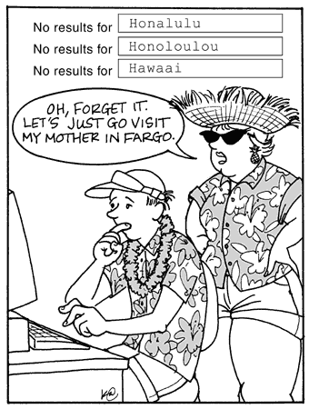
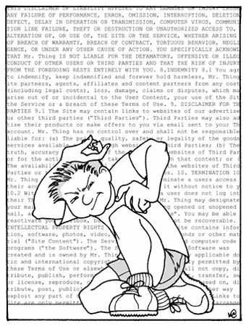

Slide 8
Top 10 Worst Mistakes of Web Design
(of all time)
Fixed Font Size
  CSS allows you to disable a Web browser's "change font size" button and specify a fixed font size
  Respect the user's preferences!
Page Titles With Low Search Engine Visibility
  search is the most important way users discover websites and find their way around individual websites
  The page title is your main tool to attract new visitors
Anything That Looks Like an Advertisement
  Selective attention is very powerful
  Web users have learned to stop paying attention to anything that looks like an ad

Slide 9
Top 10 Worst Mistakes of Web Design
(of all time)
Violating Design Conventions
  consistency – one of the most powerful usability principles
  when things behave the same, users don't have to worry about what will happen
Opening New Browser Windows
  Users often don't notice that a new window has opened
  Disables the Back button
Not Answering Users' Questions
  Users are highly goal-driven on the Web

Slide 10
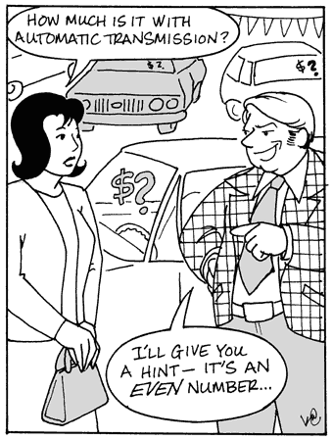

Slide 11
Web Pages That Suck
"Unless you're abnormally gifted, the best way to learn a craft thoroughly is to learn not only its central tenets but also its pitfalls.“
http://www.webpagesthatsuck.com/

Slide 12
Worst Websites of 2013
MIT Center for Advanced Visual Studies
  http://cavs.mit.edu/
HollisWealth
  https://www.holliswealth.com/global/whoweare#!welcome
  “Mystery Meat Navigation (MMN) gone mad. Took me about 5 minutes to find where this newly named financial service is located. Turns out it is in Toronto. You would think that, with all their money, they could do better. Less Flash and more information please.
DS+R
  http://www.dsrny.com/

Slide 13
Worst Websites of 2012
Don Swanson Racing School
  http://donswansonracingschool.com/programs.htm
  animated GIFs, centered bullet lists, questionable color pallet, contrast errors, ...
  Compare with http://www.bondurant.com/
Pacific Northwest X-Ray
  http://www.pnwx.com/
  lack of contrast, imagemaps for no good reason, graphicized text to make sure search engines can't see the navigation, …

Slide 14
Worst Websites of 2012
Leoneck Hotel
  http://www.leoneck.ch/en/
  “The animated cow that follows your cursor on the Flash site is annoying —and amateurish. The "follow the arrows" navigation is a poor choice. Mousing over some of the links activates the cowbell sound.”

Slide 15
Worst Websites of 2012:
They Should Know Better
Marvis Contemporary Toothpaste
  http://www.marvismint.com/
  “It's a typically overwrought Flash site. The time you spend clicking around is not rewarded by useful information.”
iTunes Preview
  The page's background color is #fff and the text color is #898989 which, according to the Colour Contrast Check, fails the WCAG 2.0 contrast ratio formula

Slide 16
Previous Worst Sites
Gates and Fences - http://www.gatesnfences.com/
  “Gimme Focus, tone down the graphics, eliminate unnecessary design items, make your text readable, don't use music files and cut down the file size of the page.”
DPGraph – http://www.dpgraph.com/
  “Just because you can, doesn‘t mean you should,” eliminate unnecessary design items and get somebody else to look at your web site.“

Slide 17
Over the top websites
Constellation 7
  http://www.constellation7.org/Constellation-Seven/Josiah/Index.htm
Association of International Glaucoma Societies
  Winner in category "Site Most Like A Monty Python Skit"
  bobbing heads in upper-left hand corner & no clear explanation of what this organization does on main page
  http://www.youtube.com/watch?v=L9Q31Q_404Q
  Changed a lot, now like this:
  http://www.globalaigs.org/
George Hutchins for U.S. Congress
  http://www.georgehutchins.com/

Slide 18
Web Accessibility
Web accessibility refers to the practice of making Web pages accessible to people with disabilities
Visual impairments
  including blindness, various common types of low vision and poor eyesight, various types of colour blindness
Motor/Mobility
  e.g. difficulty or inability to use the hands, including tremors, muscle slowness, loss of fine muscle control
Cognitive/Intellectual:
  Developmental disabilities, learning disabilities and cognitive disabilities
Auditory
  Deafness and hearing impairments,
Seizures
  Photoepileptic seizures caused by visual strobe or flashing effects

Slide 19
Legal Requirements in UK
Disability Discrimination Act 1995 (DDA)
  makes it illegal to discriminate against people with disabilities
  applies to anyone providing a service; public, private and voluntary sectors
The Code of Practice: Rights of Access - Goods, Facilities, Services and Premises
  published by the government's Disability Rights Commission to accompany the Act
  refers explicitly to websites as one of the "services to the public"

Slide 20
Assistive technologies
Speech recognition software
  useful for those who have difficulty using a mouse or a keyboard
Screen magnification software
  makes it easier to read for vision impaired users
Keyboard overlays
  can make typing easier and more accurate for those who have motor control difficulties

Slide 21
Assistive technologies 2
Screen reader software
  used by blind and vision impaired users and can be helpful for users with reading or learning difficulties
Refreshable Braille displays
  renders text as Braille characters
  used by blind and vision impaired users
Braille keyboard
  Each key is labelled with Braille symbol

Slide 22
Web Accessibility Initiative (WAI)
The World Wide Web Consortium (W3C) launched the Web Accessibility Initiative (WAI) in 1997
  To improve the accessibility of the WWW
  Published the Web Content Accessibility Guidelines (WCAG) 2.0
    http://www.w3.org/TR/WCAG20/
    Defines how to make Web content more accessible to people with disabilities

Slide 23
WCAG 2.0 Layers of Guidance
Principles - four principles that provide the foundation for Web accessibility
  perceivable, operable, understandable, and robust
Guidelines - 12 guidelines provide the basic goals that authors should work toward
Success Criteria - for each guideline, testable success criteria are provided
  3 levels of conformance are defined: A (lowest), AA, and AAA (highest)
Sufficient and Advisory Techniques - for each of the guidelines and success criteria

Slide 24
Principle 1: Perceivable
Information and user interface components must be presentable to users in ways they can perceive
Guideline 1.1 Text Alternatives:
  Provide text alternatives for any non-text content so that it can be changed into other forms people need, such as large print, braille, speech, symbols or simpler language
Guideline 1.2 Time-based Media:
  Provide alternatives for time-based media
Guideline 1.3 Adaptable:
  Create content that can be presented in different ways (e.g. simpler layout) without losing information or structure
Guideline 1.4 Distinguishable:
  Make it easier for users to see and hear content including separating foreground from background

Slide 25
Principle 2: Operable
User interface components and navigation must be operable
Guideline 2.1 Keyboard Accessible:
  Make all functionality available from a keyboard
Guideline 2.2 Enough Time:
  Provide users enough time to read and use content
Guideline 2.3 Seizures:
  Do not design content in a way that is known to cause seizures
Guideline 2.4 Navigable:
  Provide ways to help users navigate, find content, and determine where they are

Slide 26
Principle 3: Understandable
Information and the operation of user interface must be understandable
Guideline 3.1 Readable:
  Make text content readable and understandable
Guideline 3.2 Predictable:
  Make Web pages appear and operate in predictable ways
Guideline 3.3 Input Assistance:
  Help users avoid and correct mistakes

Slide 27
Principle 4: Robust
Content must be robust enough that it can be interpreted reliably by a wide variety of user agents, including assistive technologies
Guideline 4.1 Compatible:
  Maximize compatibility with current and future user agents, including assistive technologies

Slide 28
Summary
What NOT to do
  Top 10 Mistakes of Web Design (Jakob Nielsen)
  Web pages that suck (Vincent Flanders)
Accessibility
  Legal requirements
  Assistive technologies
  Web Accessibility Initiative
    Web Content Accessibility Guidelines

