Slide 1
Lecture 18
Introduction to XML
Boriana Koleva
Room: C56
Email: B.Koleva@nottingham.ac.uk

Slide 2
Overview
Introduction
The Syntax of XML
XML Document Structure
Document Type Definitions
Displaying XML documents

Slide 3
Introduction
SGML is a meta-markup language
  Developed in the early 1980s; ISO standard in 1986
HTML was developed using SGML in the early 1990s - specifically for Web documents
Two problems with HTML:
  1. Fixed set of tags and attributes
    User cannot define new tags or attributes
    So, the given tags must fit every kind of document, and the tags cannot connote any particular meaning
  2. There are no restrictions on arrangement or order of tag appearance in a document

Slide 4
Introduction
One solution to the first of these problems:
  Let each group of users define their own tags (with implied meanings)
  (i.e., design their own “HTML”s using SGML)
Problem with using SGML:
  It’s too large and complex to use, and it is very difficult to build a parser for it
A better solution: Define a lite version of SGML

Slide 5
XML
XML is not a replacement for HTML
  HTML is a markup language used to describe the layout of any kind of information
  XML is a meta-markup language that can be used to define markup languages that can define the meaning of specific kinds of information
XML is a very simple and universal way of storing and transferring data of any kind
XML does not predefine any tags
XML has no hidden specifications
All docs described with an XML-derived markup language can be parsed with a single parser

Slide 6
XML
We will refer to an XML-based markup language as a tag set
  Strictly speaking, a tag set is an XML application, but that terminology can be confusing
An XML processor is a program that parses XML documents and provides the parts to an application
Documents that use an XML-based markup language are XML documents

Slide 7
The Syntax of XML
The syntax of XML is in two distinct levels:
1. The general low-level rules that apply to all XML documents
2. For a particular XML tag set, either a document type definition (DTD) or an XML schema

Slide 8
General XML Syntax
XML documents consist of:
1. Data elements
2. Markup declarations
  instructions for the XML parser
3. Processing instructions
  for the application program that is processing the data in the document
All XML documents begin with an XML declaration:
<?xml version = "1.0" encoding = "utf-8"?>
XML comments are just like HTML comments

Slide 9
General XML Syntax
XML names:
  Must begin with a letter or an underscore
  They can include digits, hyphens, and periods
  There is no length limitation
  They are case sensitive (unlike HTML names)
Syntax rules for XML: same as those of XHTML
  Every XML document defines a single root element, whose opening tag must appear as the first line of the document
An XML document that follows all of these rules is well formed

Slide 10
Simple XML example
<?xml version = "1.0">
<ad>
<year> 1960 </year>
<make> Cessna </make>
<model> Centurian </model>
<color> Yellow with white trim </color>
<location>
<city> Gulfport </city>
<state> Mississippi </state>
</location>
</ad>

Slide 11
XML Attributes
XML document design – add a new attribute to an element or a nested element?
  In XML, you often define a new nested tag to provide more info about the content of a tag
  Nested tags are better than attributes, because attributes cannot describe structure and the structural complexity may grow
  However, attributes should always be used to identify numbers or names of elements (like HTML id and name attributes)

Slide 12
Attribute Example
<!-- A tag with one attribute -->
<patient name = "Maggie Dee Magpie">
...
</patient>
<!-- A tag with one nested tag -->
<patient>
<name> Maggie Dee Magpie </name>
...
</patient>
<!-- A tag with one nested tag, which contains three nested tags -->
<patient>
<name>
<first> Maggie </first>
<middle> Dee </middle>
<last> Magpie </last>
</name>
...
</patient>

Slide 13
XML Document Structure
An XML document often uses two auxiliary files:
  One to specify the structural syntactic rule
  One to provide a style specification
An XML document has a single root element, but often consists of one or more entities
An XML document has one document entity
  All other entities are referenced in the document entity

Slide 14
XML Document Structure
Reasons for entity structure:
1. Makes large documents easier to manage
2. Repeated entities need not be literally repeated
3. Binary entities can only be referenced in the document entities (XML is all text!)

Slide 15
XML Entities
When the XML parser encounters a reference to a non-binary entity, the entity is merged in
Entity names:
  No length limitation
  Must begin with a letter, a dash, or a colon
  Can include letters, digits, periods, dashes, underscores, or colons
A reference to an entity has the form:
&entity_name;

Slide 16
XML Entities
One common use of entities is for special characters that may be used for markup delimiters
These are predefined (as in HTML):
< &lt;
> &gt;
& &amp;
" &quot;
' &apos;
The user-defined entities can be defined only in DTDs

Slide 17
Document Type Definitions (DTDs)
A DTD is a set of structural rules called declarations
  These rules specify a set of elements, along with how and where they can appear in a document
Purpose: provide a standard form for a collection of XML documents and define a markup language for them
Not all XML documents have or need a DTD
The DTD for a document can be internal or external

Slide 18
Document Type Definitions (DTDs)
All of the declarations of a DTD are enclosed in the block of a DOCTYPE markup declaration
DTD declarations have the form:
<!keyword … >
There are four possible declaration keywords:
  ELEMENT – to define tags
  ATTLIST – to define tag attributes
  ENTITY – to define entities
  NOTATION – to define data type notations

Slide 19
Declaring Elements
An element declaration specifies the name of an element, and the element’s structure
If the element is a leaf node of the document tree, its structure is in terms of characters
If it is an internal node, its structure is a list of children elements (either leaf or internal nodes)
General form:
<!ELEMENT element_name (list of child names)>
E.g.:
<!ELEMENT memo (from, to, date, re, body)>

Slide 20
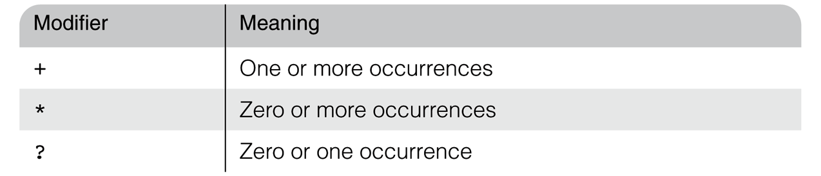
Declaring Elements
Child elements can have modifiers
<!ELEMENT person (parent+, age, spouse?, sibling*)>
Choices
  <!ELEMENT animal (cat | dog)>
  animal element contains either a cat child or a dog child

Slide 21
Declaring Elements
Parentheses
  either a choice or a sequence can be enclosed in parentheses to describe a content model
<!ELEMENT circle (centre, (radius |diameter))>
Leaf nodes specify data types, most often PCDATA (parsable character data)
  Data type could also be EMPTY (no content) and ANY (can have any content)
  Example of a leaf declaration:
  <!ELEMENT name (#PCDATA)>

Slide 22
Declaring Attributes
General form:
<!ATTLIST el_name at_name at_type [default]>
There are ten different attribute types
  CDATA – any string of characters
  ENUMERATION – list of all possible values for the attribute separated by vertical bars
<!ATTLIST date month (January | February | March | April | May | June| July | August | September | October | November | December) #REQUIRED>

Slide 23
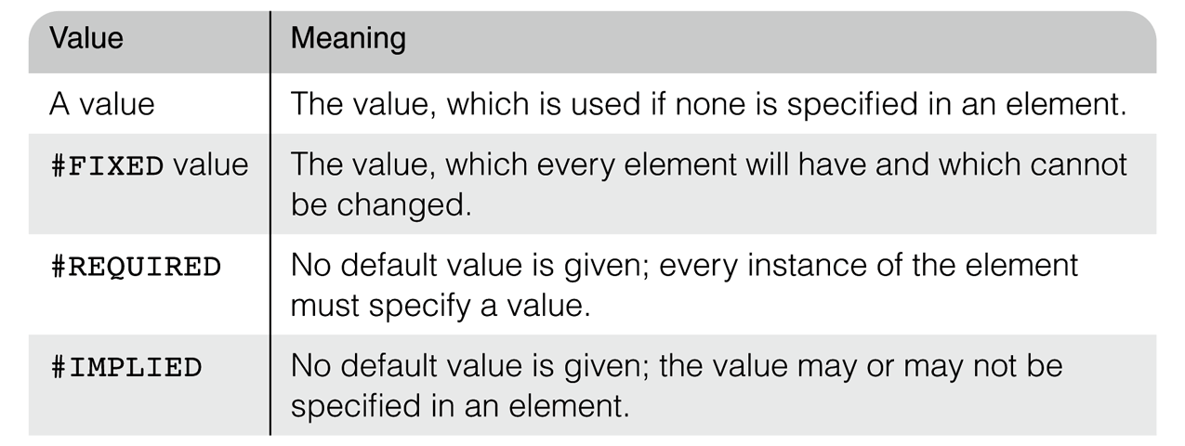
Declaring Attributes
Default values:

Slide 24
Declaring Attributes
Attribute specifications in a DTD:
<!ATTLIST car doors CDATA "4">
<!ATTLIST car engine_type CDATA #REQUIRED>
<!ATTLIST car price CDATA #IMPLIED>
<!ATTLIST car make CDATA #FIXED "Ford">
An XML element that is valid for above DTD
<car doors = "2" engine_type = "V8">
...
</car>

Slide 25
Declaring Entities
A general entity can be referenced anywhere in the content of an XML document
General form of declaration:
<!ENTITY [%] entity_name "entity_value">
e.g. <!ENTITY jfk "John Fitzgerald Kennedy">
A reference: &jfk;
If the entity value is longer than a line, define it in a separate file (an external text entity)
<!ENTITY entity_name SYSTEM "file_location">

Slide 26
A Sample DTD
Example DTD
  http://www.cs.nott.ac.uk/~bnk/Teaching/WPS/planes.dtd
An XML document valid for planes.dtd
  http://www.cs.nott.ac.uk/~bnk/Teaching/WPS/planes.xml
(view source on both)

Slide 27
DTDs
XML Parsers
  Always check for well formedness
  Some check for validity, relative to a given DTD
    Called validating XML parsers
You can download a validating XML parser from:
http://xml.apache.org/xerces-j/index.html
Internal DTDs
<!DOCTYPE root_name [
…
]>
External DTDs
<!DOCTYPE XML_doc_root_name SYSTEM “DTD_file_name”>

Slide 28
Displaying Raw XML Documents
There is no presentation information in an XML document
An XML browser should have a default style sheet for an XML document that does not specify one
  You get a stylized listing of the XML, e.g.:
  http://www.cs.nott.ac.uk/~bnk/Teaching/WPS/planes.xml
It is unusual to display a raw XML doc.

Slide 29
Displaying XML Documents with CSS
A CSS style sheet for an XML document is just a list of its tags and associated styles
The connection of an XML document and its style sheet is made through an xml-stylesheet processing instruction
<?xml-stylesheet type = "text/css" href = "mydoc.css"?>
http://www.cs.nott.ac.uk/~bnk/Teaching/WPS/planes.css
http://www.cs.nott.ac.uk/~bnk/Teaching/WPS/planes1.xml

Slide 30
Summary
Introduction
The Syntax of XML
XML Document Structure
Document Type Definitions
  Declaring elements
  Declaring attributes
  Declaring entities
Displaying XML documents

