Slide 1
Lecture 19
Introduction to Ajax
Boriana Koleva
Room: C56
Email: B.Koleva@nottingham.ac.uk

Slide 2
Overview
What is Ajax
  History
  Goals
How Ajax works
A simple example
  Helps the user fill a form

Slide 3
What is Ajax?
AJAX = Asynchronous JavaScript and XML
Technique for creating fast and dynamic web pages
AJAX allows web pages to be updated asynchronously by exchanging small amounts of data with the server behind the scenes
  it is possible to update parts of a web page, without reloading the whole page
  classic web pages, (which do not use AJAX) must reload the entire page if the content should change
Examples of applications using AJAX: Google Maps, Gmail, Youtube, and Facebook tabs

Slide 4
History
Possibility began with the nonstandard iframe element, which appeared in IE4 and Netscape 4
  An iframe element could be made invisible and could be used to send asynchronous requests
Microsoft introduced XmlDocument and XMLHTTP ActiveX objects in IE5 for asynchronous requests
Two events ignited widespread interest in Ajax:
  The appearance of Google Maps and Google Mail
  Jesse James Garrett named the new technology Ajax

Slide 5
Ajax Goals
To provide Web-based applications with responsiveness near that of desk-top ones
Web applications that benefit from Ajax are those that have frequent interactions between the client and the server
Goals are achieved with two different approaches:
  Client requests are handled asynchronously
  Only small parts of the current document are updated

Slide 6
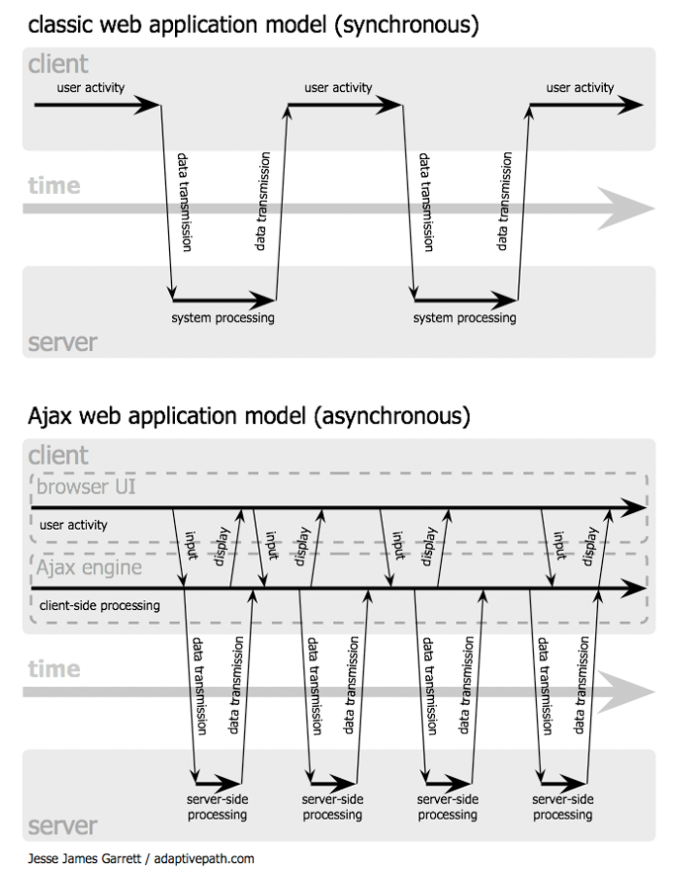
Overview

Slide 7
How AJAX Works
Ajax does not use any new programming languages or markup languages
XMLHttpRequest object (to exchange data asynchronously with a server)
JavaScript/DOM (to display/interact with the information)
CSS (to style the data)
XML (often used as format for transferring data)
  Can also be plain text, HTML, JavaScript code and JavaScript Object Notation (JSON)

Slide 8
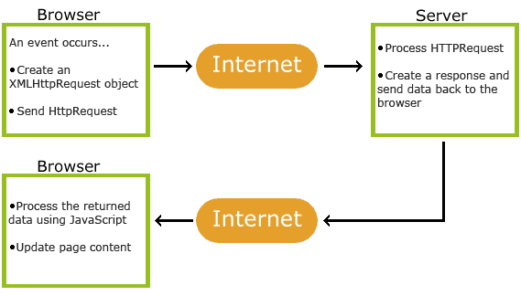
How Ajax works?

Slide 9
A very simple Ajax application
Helps the user fill a form
  asks for the zip code before the names of the city and state
As soon as the zip code is entered, the application sends a request to the server, which looks up the city and state for the given zip code and returns them to the form
  JavaScript event handler constructs an asynchronous request to the server
  PHP script on the server looks up the city and state
  JavaScript code puts the city and state names in the form

Slide 10
The Form
Must reference the JavaScript code in its head
Must register an event handler on the blur event of the zip code text box
Both city and state text boxes must have id attributes
  http://www.cs.nott.ac.uk/~bnk/WPS/popcornA.html

Slide 11
The Request Phase
(The blur handler)
Communication to the server must be made through the XMLHttpRequest object:
var xhr = new XMLHttpRequest();
When the server receives an asynchronous request, it sends a sequence of notices, called callbacks, to the browser (0, …, 4)
  Only the last one is of interest, 4, which indicates that the response is complete
The response function must be registered on the onreadystatechange property of the XHR object
xhr.onreadystatechange = receivePlace;

Slide 12
The Request Phase
(The blur handler)
Next, the handler must call the open method of the XHR object, with parameters:
  HTTP method (GET or POST), quoted
  The URL of the response document on the server
  A Boolean literal to indicate whether the request is to be asynchronous (true) or synchronous (false)
xhr.open("GET", "getCityState.php?zip=" + zip, true);
  (getCityState.php is the response document and the parameter zip code must be attached because GET is used)
  The request is then sent with the send method http://www.cs.nott.ac.uk/~bnk/WPS/popcornA.js

Slide 13
The Response document
So that it is very simple, uses a simple hash of zip codes and names of cities and states
The response data is produced with a print statement
http://www.cs.nott.ac.uk/~bnk/WPS/getCityState.php
To see code
http://www.cs.nott.ac.uk/~bnk/WPS/getCityState.txt

Slide 14
The Receiver Phase
A JavaScript function with no parameters
  Fetch the server response (text), split it into its two parts (city and state), and set the corresponding text boxes to those values
The receiver function must be able to access the XHR object
  If it is global, it would be accessible, but it could be corrupted by simultaneous requests and responses
  The alternative is to register the actual code of the receiver, rather than its name

Slide 15
The Receiver Phase
Actions of the receiver function:
  Put all actions in the then clause of a selector that checks to see if readyState is 4
  Get the response value from the responseText property of the XHR object
  Split it into its two parts
  Set the values of the city and state text boxes
  http://www.cs.nott.ac.uk/~bnk/WPS/popcornA.js

Slide 16
Cross-Browser Support
The example does not work with IE browsers before IE7
IE5 and IE6 support an ActiveXObject named Microsoft.XMLHTTP
xhr = new ActiveXObject("Microsoft.XMLHTTP");

Slide 17
Returning data as HTML
Most common approach is to place an empty div element in the original document
<div id = "replaceable">
The innerHTML property of the div element is assigned the new content
var divDom = document.getElementById("replaceable");
divDom.innerHTML = xhr.responseText;

Slide 18
Summary
What is Ajax?
How Ajax works?
Simple Ajax application
  The form
  The request phase
  The response document
  The receiver phase
  Cross browser support
Returning data as HTML

