Slide 1
Lecture 20
Exam Information and Revision
Boriana Koleva
Room: C56
Email: B.Koleva@nottingham.ac.uk

Slide 2
Overview
Overview of Course Content
Exam details
Revision Multiple Choice Questions
Review of a sample exam paper

Slide 3
Course Content
Web enabling infrastructure
  Networking basics
    transmission media
    local communication (encoding data + LANs)
    long distance comms (modulation + modems)
  TCP/IP protocols
    Protocol design
    Overview of TCP/IP
    IP addresses and domain names
  Client server paradigm, Web browsers and servers, URLs, MIME types, HTTP protocol

Slide 4
Course Content
Mark-up languages
  HTML
    Syntax
    Basic text markup
    Images
    Hypertext links
    Lists
    Tables
    Forms
    HTML 5 features
  XML
    Syntax
    Document Type Definitions
    Displaying XML documents

Slide 5
Course Content
Web document presentation
  CSS
    Levels of style sheets
    Selector forms
    Property value forms
    Examples of properties
  Web design
    Website design (information structure + navigation)
    Webpage design (text, graphics, audio, video)
    What NOT to do
      Top 10 Mistakes of Web Design
      Web pages that suck
    Web Accessibility

Slide 6
Course Content
Client side scripting
  JavaScript
    Syntax
    Dynamic HTML
Server side scripting
  Overview of CGI Perl, Java Servlets, JSP, ASP.NET
  PHP in more detail
Ajax

Slide 7
Coursework
50% of final mark
Marks and feedback will be available on Moodle

Slide 8
Exam
1 hour
Answer 2 out of 3 questions
  Each of these questions focuses on a particular topic
    Web enabling infrastructure
    Mark-up languages + Web document presentation (HTML, XML and CSS)
    Client + Server side scripting (Java Script, PHP and Ajax)

Slide 9
Exam
Material from all lectures examinable
There will be questions only on material we have covered in lectures
  However in the lecture notes there may be just a few bullets or a diagram
  If you have not been taking notes it may be necessary to consult the suggested further reading in order to understand the topic better and be able to provide full answers

Slide 10
Past Exam Papers
Still useful as question subparts are similar
From the portal 3 papers
On Moodle:
  2007-2008
  2009-2010
  2010-2011
  2011-2012
  Sample solutions for 2010-2011 and 2009-2010 papers

Slide 11
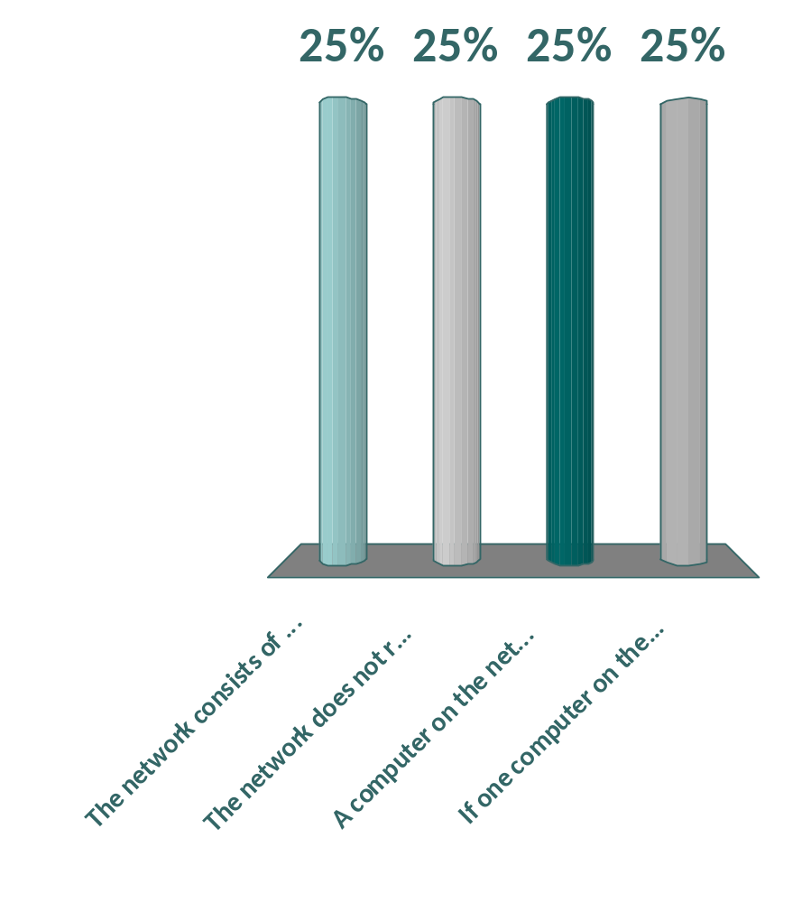
Which of the following statements is true about a network laid out using a bus topology?
The network consists of a closed loop of computers
The network does not require any coordination by software
A computer on the network can directly send data to any other computer on the network
If one computer on the network fails then the entire network fails

Slide 12

Which of the following is not true about the CSMA/CD protocol used by Ethernet networks?
CSMA/CD is used to sense the state of the carrier
CSMA/CD prevents simultaneous transmissions
CSMA/CD prevents computers from interrupting ongoing transmissions
CSMA/CD is used to detect packet collisions

Slide 13

What is the Internet?
Network of networks using the TCP/IP protocol
A system of interlinked, hypertext documents accessed via web clients
A large homogenous network where all computers are identified via their MAC address
A large network of computers linked via point-to-point connections

Slide 14

What is an IP number?
A unique number that identifies each network
32 bit unique number assigned to hosts and routers that use the TCP/IP stack
A unique number built into each Ethernet subsystem by the manufacturer
A name that consists of a sequence of alphanumeric segments, separated by period and following a hierarchical convention

Slide 15
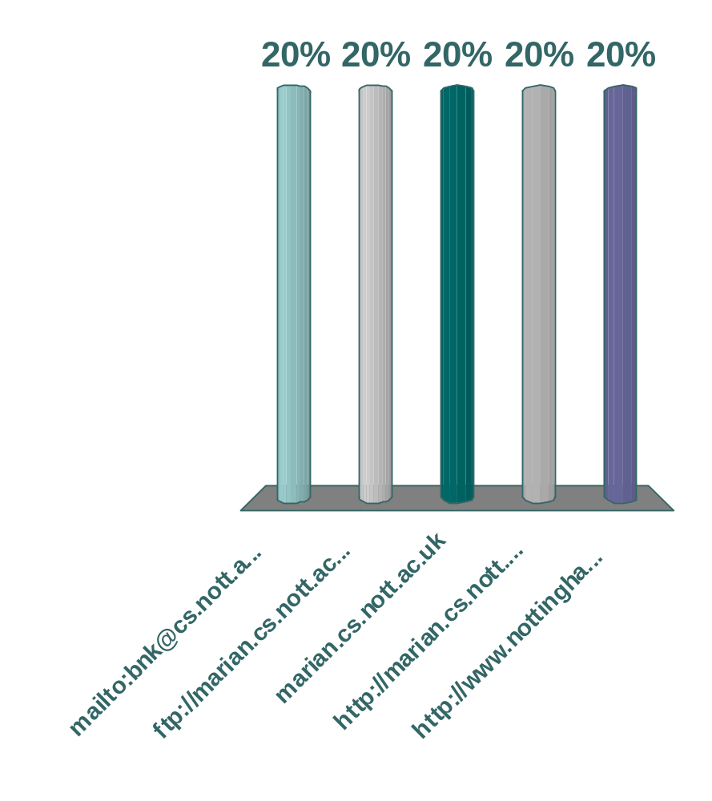
Which of the following is not a valid URL format?
mailto:bnk@cs.nott.ac.uk
ftp://marian.cs.nott.ac.uk/
marian.cs.nott.ac.uk
http://marian.cs.nott.ac.uk/~bnk/cgi-bin/db?number=43
http://www.nottingham.ac.uk:80/

Slide 16
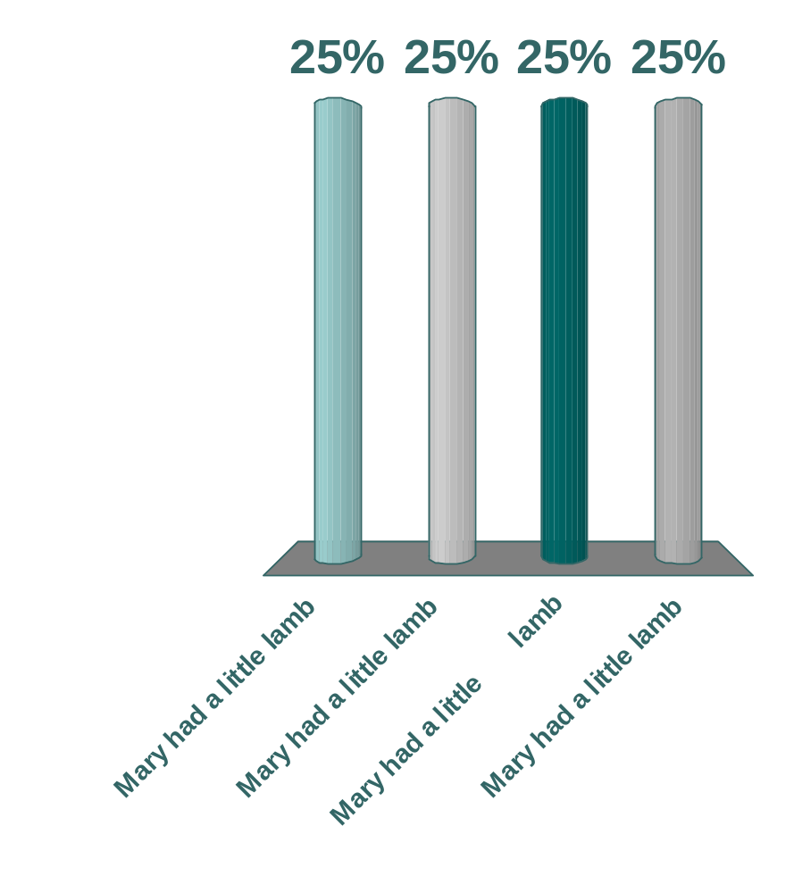
How will this fragment of HTML be displayed by a web browser?
Mary <big> had <big> a <b> little lamb </b> </big> </big>
Mary had a little lamb
Mary had a little lamb
Mary had a little lamb
Mary had a little lamb

Slide 17
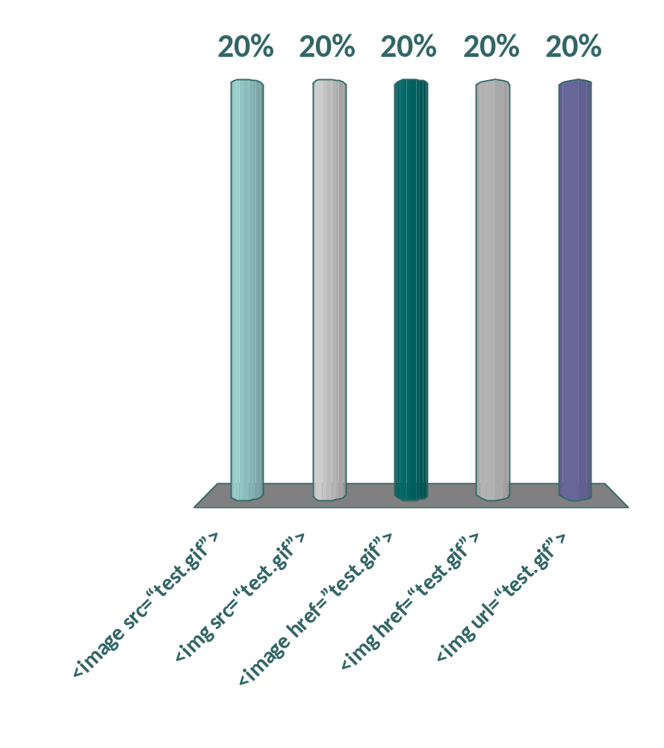
Which of the following is the correct HTML script for including the image test.gif?
<image src=“test.gif”>
<img src=“test.gif”>
<image href=”test.gif”>
<img href=“test.gif”>
<img url=“test.gif”>

Slide 18
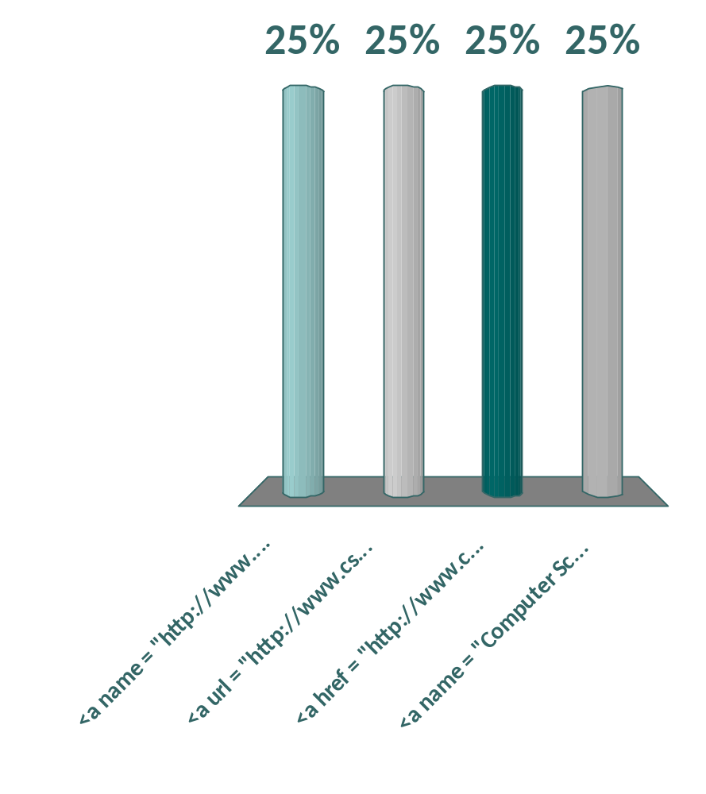
Which of the following is the correct HTML script for making a hyperlink?
<a name = "http://www.cs.nott.ac.uk/">Computer Science </a>
<a url = "http://www.cs.nott.ac.uk/"> Computer Science </a>
<a href = "http://www.cs.nott.ac.uk/">Computer Science </a>
<a name = "Computer Science"> http://www.cs.nott.ac.uk/ </a>

Slide 19
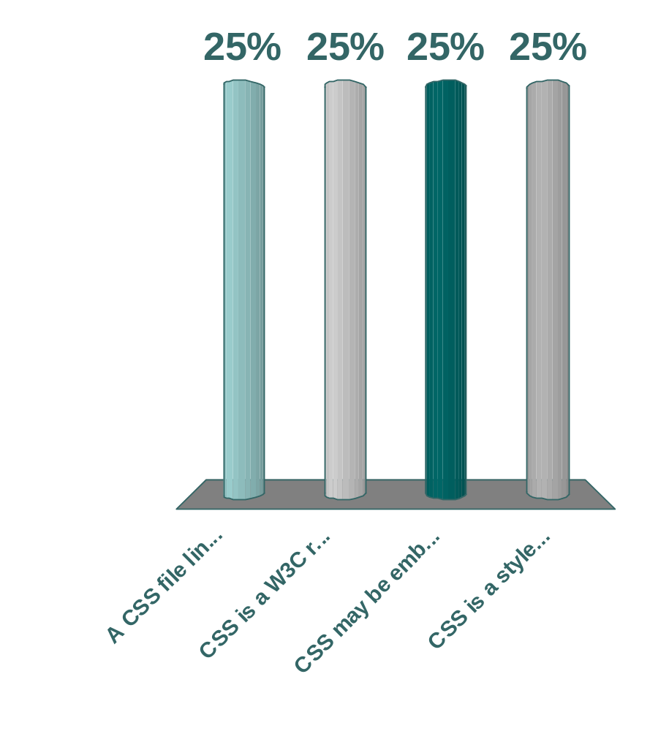
Which of the following statements is not true about Cascading Style Sheets (CSS)?
A CSS file linked to a HTML document via the <LINK> tag can control the appearance of only that document and no others
CSS is a W3C recommendation, and is now very widely used
CSS may be embedded into HTML using the <STYLE> tag or stored in a separate file
CSS is a style language developed for HTML that can also be used with XML

Slide 20
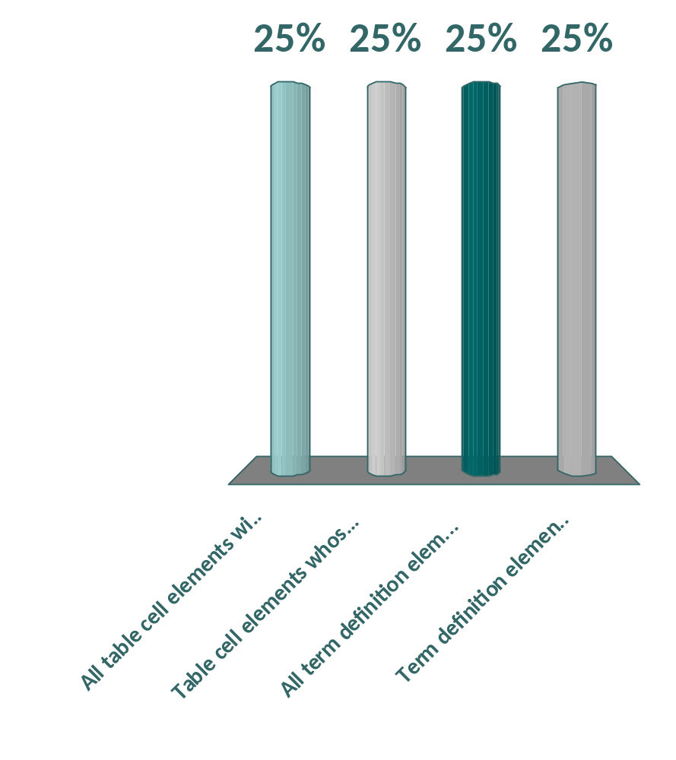
What will be the effect of the following CSS rule: td.red {color: red}
All table cell elements will appear in red font
Table cell elements whose class has been set to ‘red’ will appear in red font
All term definition elements (in a definition list) will appear in red font
Term definition elements whose class has been set to ‘red’ will appear in red font

Slide 21
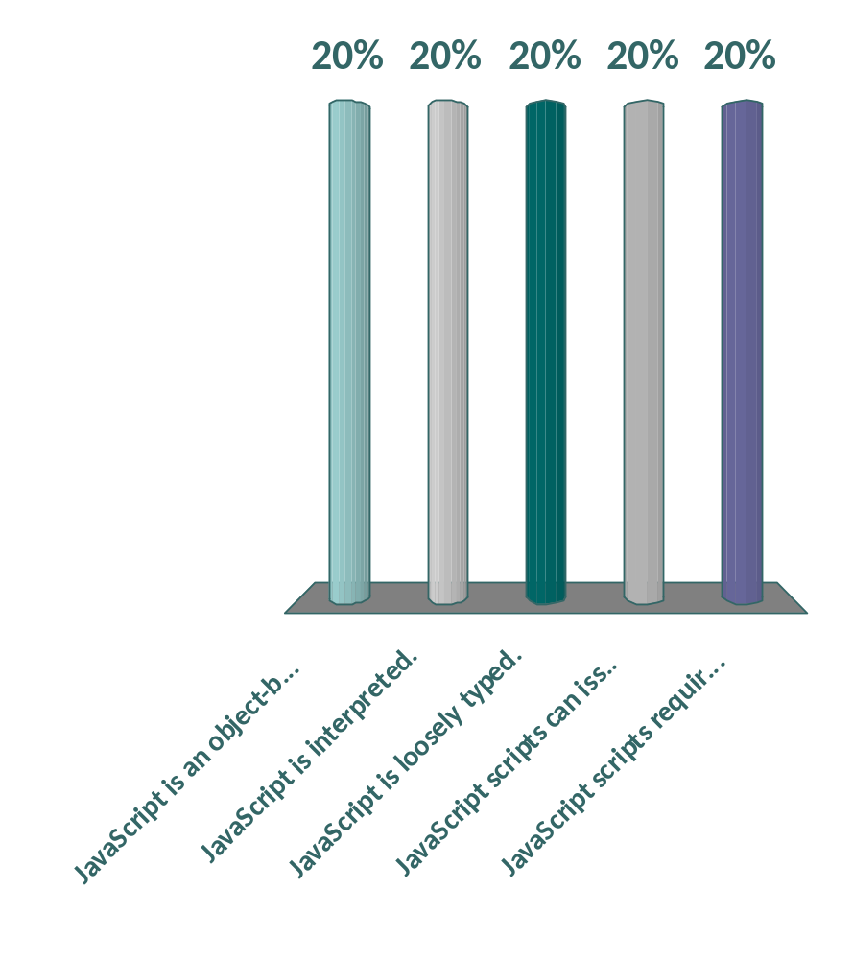
Which of the following statements is not true about Java Script?
JavaScript is an object-based scripting language.
JavaScript is interpreted.
JavaScript is loosely typed.
JavaScript scripts can issue HTTP requests and load other pages.
JavaScript scripts require the Java Virtual Machine to be loaded.

Slide 22

One of the differences between Java and JavaScript is that Java is said to be a “strongly typed” language whereas JavaScript is “loosely typed”. Which of the following is the most appropriate description of this distinction?
In JavaScript all variables are accessible within an HTML document (effectively global), whereas in Java scoping is tightly controlled
In Java the data type of variables must always be specified, whereas in JavaScript data types are not declared, even when variables are
In JavaScript it is never necessary to declare variables before they are used, whereas in Java this is essential
In Java variables are a property of a class, whereas in JavaScript they are a property of a document

Slide 23
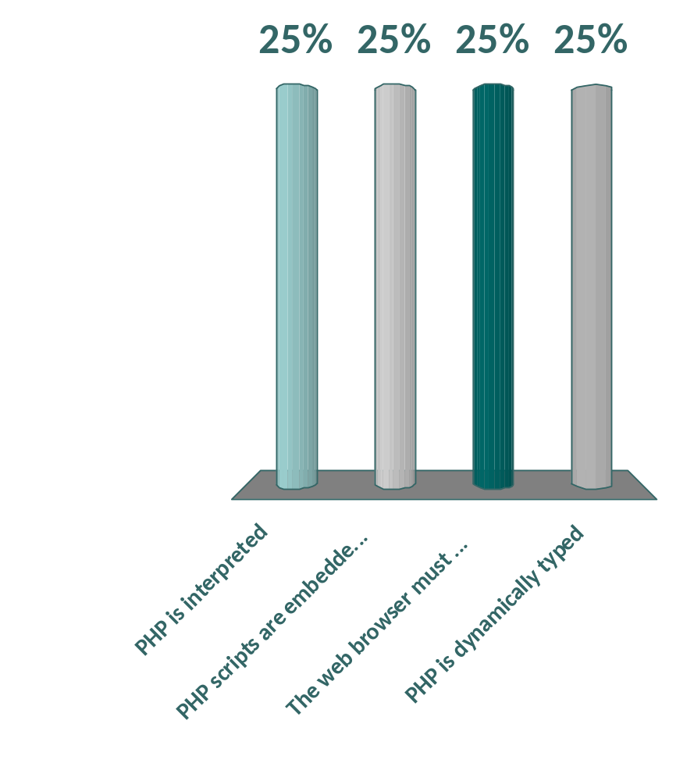
Which of the following statements is not true about PHP?
PHP is interpreted
PHP scripts are embedded in XHTML documents
The web browser must support the PHP system in order to display the result of PHP scripts
PHP is dynamically typed

Slide 24
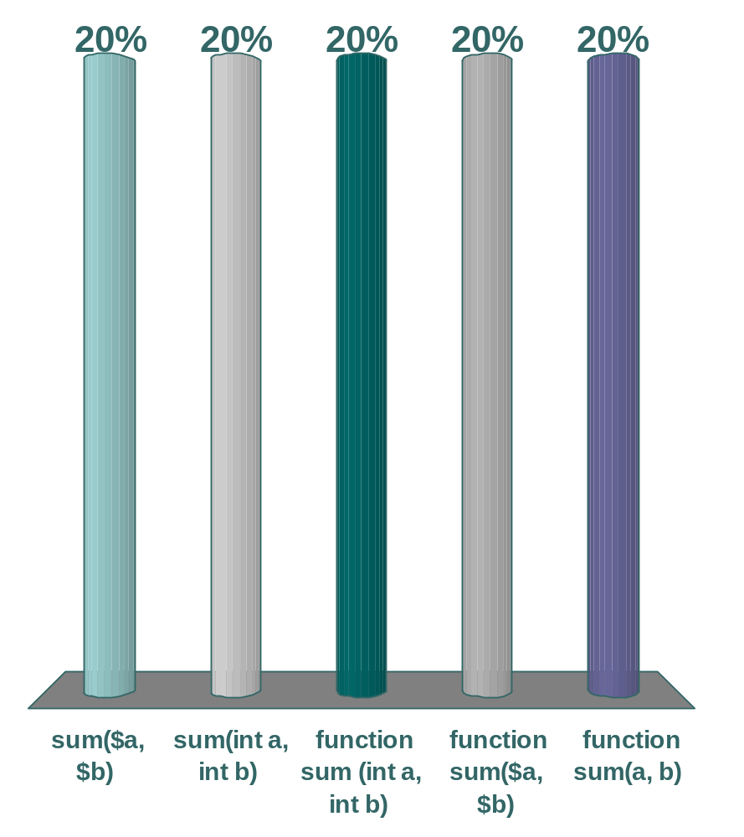
Which of the following is the correct way to define a PHP function with name “sum” that should take and add together 2 integer parameters named “a” and “b”
sum($a, $b)
sum(int a, int b)
function sum (int a, int b)
function sum($a, $b)
function sum(a, b)

Slide 25
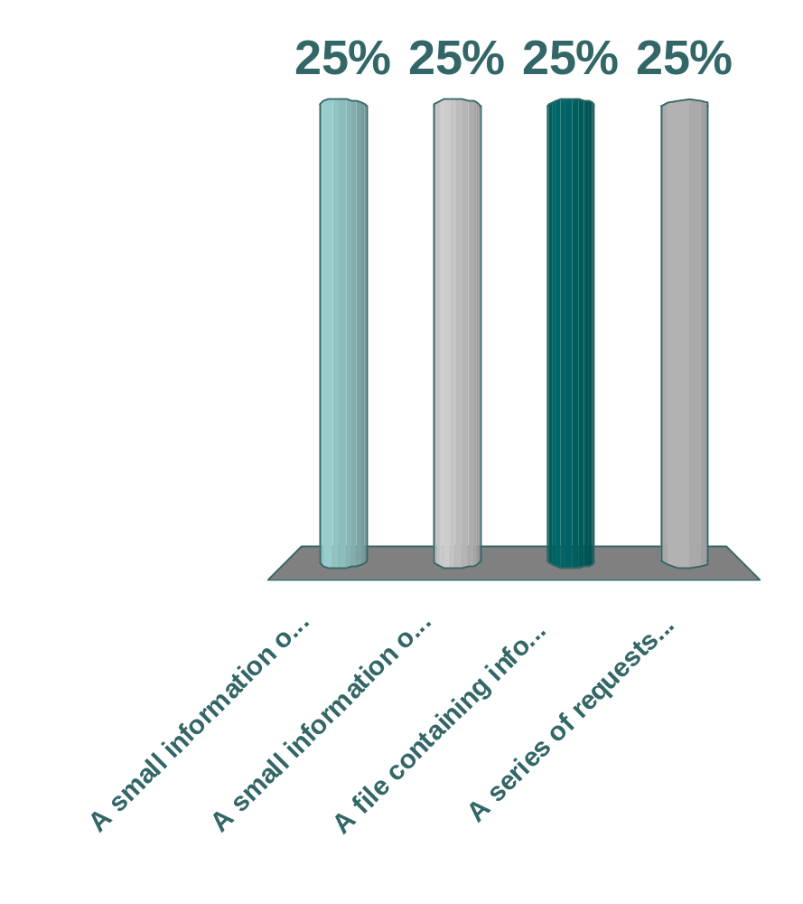
What is a cookie?
A small information object consisting of a name and a textual value stored on the client
A small information object consisting of a name and a textual value stored on the server
A file containing information about clients stored on the server
A series of requests between a client and a server

Slide 26

Which of the following statements is not true about XML?
XML is a metalanguage
XML was designed for the WWW, but is also applicable in many other areas
XML allows you to define a set of tags appropriate to your domain
XML is a display format

Slide 27
We will now look at the sample exam paper

