Slide 1
Lecture 19
Web Application Frameworks
Boriana Koleva
Room: C56
Email: B.Koleva@nottingham.ac.uk

Slide 2

Overview
Web applications overview
Introduction to Model-View-Controller (MVC)
Overview of web application frameworks
Introduction to CakePHP
  video2Wiki

Slide 3
WPS so far
Technologies:
  HTML
  CSS
  JavaScript
  DOM, Dynamic HTML
  PHP
  XML
  Ajax
May seem complicated already
But still not everything (not by far!)
How to possibly get it all under one hood?

Slide 4
Webapps summary
Accessed with a Web Browser (client)
Over a network
Code is mainly run on server
Exception: JavaScript (also:Flash, Java applets..)
Data is mainly stored on server
Webapps can be updated easily…
..without updating the clients!

Slide 5
General 3 tiered structure
First tier: client side code (web-browser), e.g. (X)HTML, JavaScript
Second tier: server side code, e.g. C/C++, Perl, PHP, Java, Ruby, Python
Third tier: server side database

Slide 6
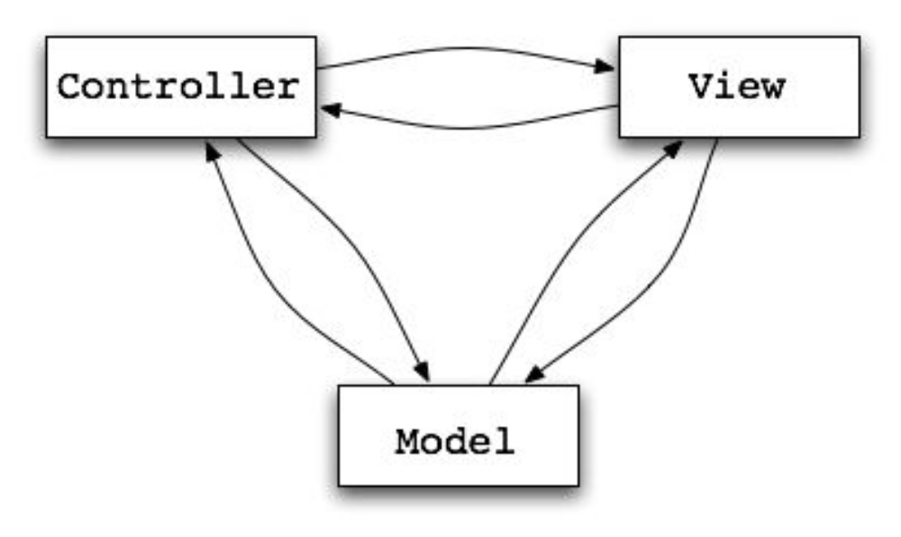
Model View Controller
Architectural Pattern from Smalltalk (1979)
Decouples data and presentation
Eases the development

Slide 7
Server
Client
Database
First thought (ok, but not far enough):
  Tier 1: View (Client)
  Tier 2: Controller (Server)
  Tier 3: Model (Database)

Slide 8
Presentation
Data
Database
Presentation:
  View is the user interface (e.g. button)
  Controller is the code (e.g. callback for button)
Data:
  Model is the database

Slide 9
Example Control Flow in MVC
User interacts with the VIEW UI
CONTROLLER handles the user input (often a callback function attached to UI elements)
CONTROLLER updates the MODEL
VIEW uses MODEL to generate new UI
UI waits for user interaction

Slide 10
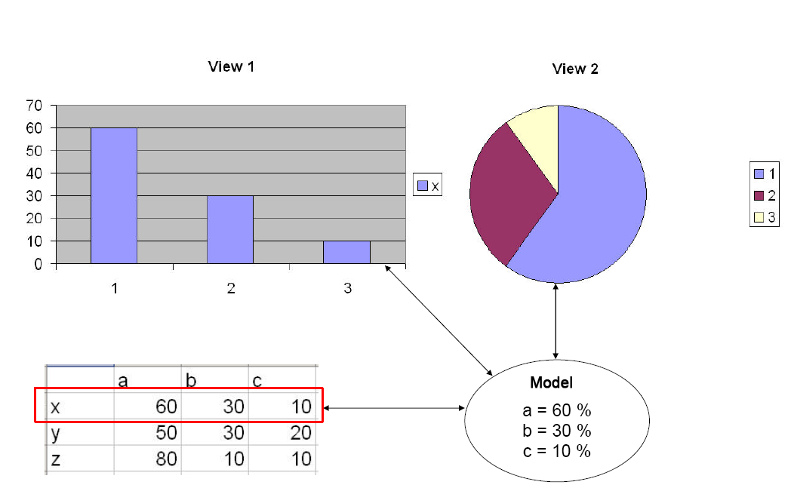
MVC – general example

Slide 11
Web application framework
Software framework that is designed to support the development of dynamic websites
Aims to alleviate the overhead associated with common activities
  libraries for database access
  templating
  session management
  code reuse

Slide 12
Web App Framework Architecture
Most frameworks follow the Model View Controller (MVC) architectural pattern
Most MVC frameworks follow a push-based architecture
  use actions that do the required processing, and then "push" the data to the view layer to render the results
Alternative pull-based architecture
  start with the view layer, which can then "pull" results from multiple controllers as needed

Slide 13
Popular web application frameworks
http://en.wikipedia.org/wiki/Ruby_on_rails (Ruby)
  http://rubyonrails.org/screencasts
http://en.wikipedia.org/wiki/Cake_php (PHP)
  http://tv.cakephp.org/
http://en.wikipedia.org/wiki/Turbogears (Python)
  http://showmedo.com/videos/series?name=TurboGears20MinWiki
  http://showmedo.com/videotutorials/series?name=3tyehcfn2
http://en.wikipedia.org/wiki/Django_%28web_framework%29 (Python)
  https://code.djangoproject.com/wiki/DjangoScreencasts
http://en.wikipedia.org/wiki/Google_App_Engine (Python, Django)
  http://www.youtube.com/watch?v=3Ztr-HhWX1c

Slide 14
Introduction to CakePHP
Open source web application framework
Written in PHP
Modeled after the concepts of Ruby on Rails
Distributed under the MIT License
Started in April 2005

Slide 15

Let‘s get started by watching a video
http://tv.cakephp.org/video/mgroves/2011/01/10/cakephp_your_first_bite

Slide 16
Benefits
Build quickly
  Code generation and scaffolding features
Features built into the framework:
  Translations, database access, caching, validation, authentication
No configuration
  No XML or YAML files (just set up the database)
Clean MVC conventions
  a set of conventions to guide you in developing your application

Slide 17
Summary
Web applications
  Client, Server, Database
  Easy to maintain, harder to write
Model – View – Controller
  Eases web application development
CakePHP
  http://cakephp.org/

