Slide 1
G52ADS 2014-15 Algorithms and Data Structures Formalities & Introduction
Lecturer: Andrew Parkes
Email: ajp@cs.nott.ac.uk
http://www.cs.nott.ac.uk/~ajp/

Slide 2
Issues in Teaching
This module is for you, not me!
Attend lectures, study the lecture notes (available on Moodle);
if still stuck, have questions, etc, then ask in labs (or contact me)
general feedback, constructive criticism, is welcome; contact me, or speak to your personal tutor

Slide 3
Textbook
M. T. Goodrich and R. Tamassia, Data Structures and Algorithms in Java, 4th edition.
Textbook website is http://java.datastructures.net
Slides (which we will use in highly modified form)
Algorithm animations
etc

Slide 4
Other textbooks
The field of algorithms and data structures is well established.
There are lots of good textbooks which cover more or less the same material. For example:
Cormen et al., Introduction to Algorithms.
Aho et al., Data Structures and Algorithms.
Shaffer, A Practical Introduction to Data Structures and Algorithm Analysis, Java Edition.
Weiss, Data Structures and Algorithm Analysis in Java.
Lafore, Data Structures and Algorithms in Java.
Sahni, Data Structures, Algorithms, and Applications in Java

Slide 5
More sources
Any other standard textbook you can find.
Also useful (but not sufficient on their own):
Harel, Algorithmics: The spirit of computing.
Bailey, D. A. Java Structures.
Robert Sedgewick & Kevin Wayne: Introduction to Programming in Java
There are many resources on the internet
Many similar modules around the world
Wikipedia can be good (up to usual caveats of social networking media)

Slide 6
“Pre-requisite knowledge”
“First year programming, C / Java”
Will use Java code for implementation examples.
Coursework involves writing Java programs Revision: Goodrich and Tamassia or java.sun.com, etc.
“Mathematics for Computer Scientists”
Logarithms, Recursion, Proofs by induction
Revision:
Current and previous G51MCS modules (or equivalent)
“Tutorial”
Ask in labs, or make an appointment with me if you need help with maths for understanding the module

Slide 7
Assessments
75 % written exam
90 minutes
(probably) “Answer question ONE and TWO of the other THREE questions”
25 % formal courseworks
Coursework ONE: 8%
Coursework TWO: 7%
Coursework THREE: 10%

Slide 8
Lecture Pattern
Lectures and C/Ws schedule is biased towards first half of term:
3 lectures / week during first half
0-2 lectures / week during second half
For all lecture and C/W dates: Keep an eye on Moodle and emails!
Aim: Reduce ‘end of term’ rush that is common this semester, finish before other modules and their big C/Ws
Note that the ‘challenging’ material is earliest
Deliberate! To give more time to ‘digest’ it.
Work in ‘big-Oh’ generally needs time to ‘click’ – don’t panic ☺

Slide 9
C/W ONE 8%
“Experimental analysis of programs”
- Easy programming & experiments
- Written report
Deadline: (tentative!) Wed 15-OCT 4pm
Feedback:
Written: both individual and overall
Also quick individual/small-group personal interviews in “lab” time

Slide 10
C/W TWO 8%
In-class Multiple Choice Questions (MCQ) under ‘exam conditions’ Date: (tentative) Tue 04-NOV during the lab.
Feedback:
Written: both individual and overall
Also individual personal ‘interviews’ in “lab” time

Slide 11
C/W THREE 10%
“Program and Report”
Write a program; implementing some data structure,
do experiments
write a written report
Deadline: (tentative) Wed 19-NOV 4pm
Feedback:
Written – both individual and also overall

Slide 12
Other Activities
A 1-hour tutorial/lab some weeks (not all)
LABS: Tuesdays 5-6p A32 – but not during first teaching week
Usual system; tutors available, work on exercises and coursework
Opportunity to get individual feedback! Use it!
“TUTORIALS”: (revision lectures / informal exercise classes): (They will also support C/W 1.)
Week 1: Maths (logs, etc)
Week 2: Graphs & ‘data analysis’ in Excel
Week 3: Java & Programming Revision
Possibly additional “catch-up” tutorials during lab sessions – ask if you want them!

Slide 13
Study Skills Suggestion
Often problems arise from going too fast
Likely to often need to backtrack or start again
This is normal not a failure
Learn to identify when need to “fix a bug in ‘thinking’ ”
Allows to make better overall progress
Rebuilding ‘internal models’ is positive!

Slide 14
What are Algorithms?
Algorithm: a step-by-step procedure for solving a problem in a finite amount of time.
For example:
a procedure for returning web pages containing given keywords
a procedure for computing n! given n
an instruction for assembling a piece of furniture
various sorting and searching algorithms

Slide 15
What are Data Structures?
Ways in which to store data in a well-defined and structured fashion so as to allow algorithms to:
make better use of it
maintain it more easily
We will need to also define “better” and “more easily”

Slide 16
Data Structures in Everyday Life?
Know of any good examples that might include non-trivial data structures?

Slide 17
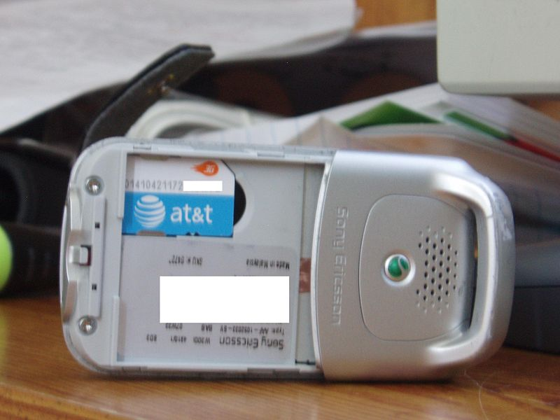
Data Structure Examples:
Address book
List of text messages
Predictive text algorithms

Slide 18
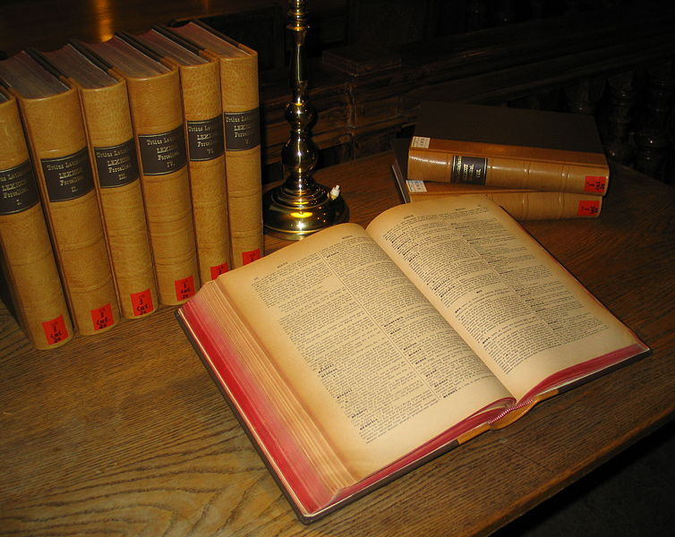
Data Structure Examples:
Dictionary
Organising the data correctly helps to find it

Slide 19
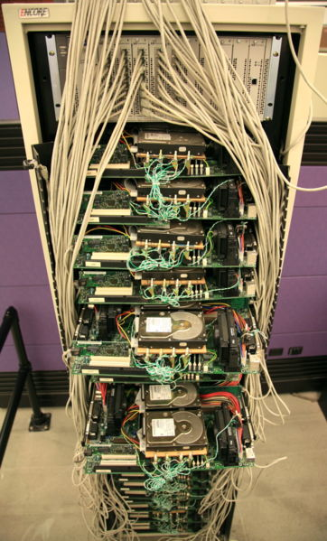
Data Structure Examples:
Any guesses as to what this is?
Google’s first server

Slide 20
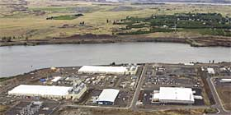
Data Structure Examples:
A more modern Google data farm

Slide 21

SATNAV:
Shortest path in a graph!

Slide 22

Buggy data or buggy algorithms?

Slide 23
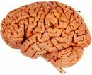
Data Structure Examples:
Our most useful “data structure and algorithm” ?
Homework: Think about which parts you would know how to implement in Java ☺

Slide 24
Aims and objectives of the course
Aim of the course: understanding of issues involved in program design; good working knowledge of some common algorithms and data structures
Objectives:
be able to identify the functionality required of the program in order to solve the task at hand;
design data structures and algorithms which express this functionality in way that makes efficient use of
time
memory
(and so indirectly: grid electricity usage, and battery usage)
be able to evaluate a given implementation in terms of its efficiency and correctness.

Slide 25
Why care about correctness?
Suppose your program crashes or gives incorrect answers 1 time in 100,000
Does this matter for:
Low usage webpage?
High usage webpage?
Banking system?
Aircraft jet engine control system?

Slide 26
Why care about efficiency?
Beware:
Recent history is that hardware improved rapidly
This compensated for many poor programs
3GHz desktop with 2GB RAM on a small “G51PRG”-style program
almost any implementation will work ‘instantly’
These might give a false sense that efficiency does not matter.

Slide 27
Why care about efficiency?
But:
Clock speeds are ‘stuck’
Not all programs can exploit multi-core, GPGPU, clouds, but must run on the single core
Mobile devices are much less powerful
Also ‘inefficient’ consumes more energy
poorly written apps will drain the mobile device battery
2% (?) of world electricity goes in server farms

Slide 28
Problem Oriented Approach
The module has ‘maths’ and ‘theory’
But these are designed to help with solving real problems/tasks
What kinds of tasks? …

Slide 29
Example task
What method would you use to look up a word in a dictionary?

Slide 30
Example task (offline exercise)
You are given a list of numbers. When you reach the end of the list you will come back to the beginning of the list (a circular list). Write the most efficient algorithm to find the minimum # in this list. Find any given # in the list. The numbers in the list are always increasing but you don’t know where the circular list begins, e.g.: 38, 40, 55, 89, 6, 13, 20, 23, 36.

Slide 31
Example task
Write a function f(a, b) which takes two character string arguments and returns a string containing only the characters found in both strings in the order of a. Write a version which is order N-squared and one which is order N.

Slide 32
Example task
Describe the algorithm for a depth-first graph traversal.

Slide 33
Example task
“Tree search algorithms. Write BFS and DFS code, explain run time and space requirements. Modify the code to handle trees with weighted edges and loops with BFS and DFS, make the code print out path to goal state.”

Slide 34
Example task
There is an array A[N] of N numbers. You have to compose an array Output[N] such that Output[i] will be equal to multiplication of all the elements of A[N] except A[i]. For example Output[0] will be multiplication of A[1] to A[N-1] and Output[1] will be multiplication of A[0] and from A[2] to A[N-1]. Solve it without division operator and in O(n).

Slide 35
Example task
How long it would take to sort 1 billion numbers? Come up with a good estimate.
Billion is 10⁹ (US and modern UK usage)
EXERCISE: Think about this now

Slide 36
Previous “Example tasks” are irrelevant?
If you think the previous were irrelevant then be aware:
They were taken (mostly) from
“Google Interview Questions: Software Engineer”
http://blog.seattleinterviewcoach.com/2009/02/140-google-interview-questions.html#software_engineer

Slide 37
Interview Question
Question: “There is an array A[N] of N numbers. … Solve it … in O(n).”
What happens if your answer is
“what does ‘O(n)’ mean?”

Slide 38
Rough Context within “Programming”
“Low-level” Programming
for, while loops etc
Algorithms & Data Structures (G52ADS)
trees, search algorithms, etc
code: “small but difficult” (each line might be ‘hard’)
Object-oriented design
software reuse, inheritance, etc
Software systems architecture design
designing software components and interactions, etc
code: “easy but large” (design is hard, but each line is ‘easy’)

Slide 39
Rough Contents of the course
Basics:
Algorithm analysis, “big-Oh”
(Revision) Recursion
Abstract vs. Concrete Data Types
(Revision) Stacks, queues, lists, trees
Using invariants to help correctness of algorithms
Standard data structures
Priority queues, Heaps, Hash tables
Sorting Algorithms:
Bubble-sort, …, mergesort, quicksort
Graphs & Algorithms:
Minimum Spanning Trees, Shortest Paths (Dijkstra’s algorithm)
Search trees:
Maps, binary search trees, balanced vs. unbalanced trees

Slide 40
Maths needed includes:
Tutorial 1:
Properties of inequalities:
Reasoning about efficiency involves comparisons
Properties of logarithms and exponents
Usd to describe efficiency
(Generally don’t need sin/cos etc).
Arithmetic and Geometric Series
Tutorial 2:
Function fitting
“Regression” a.k.a. “trend lines in Excel”

Slide 41
Maths needed includes:
Properties of inequalities:
a < b implies 2a < 2b
a ≤ b implies 2a ≤ 2b
a < b implies -a > -b
a ≤ b implies -a ≥ -b
etc

Slide 42
Maths needed includes:
Properties of exponentials: (examples)
a^{(b+c)} = a^{b} a ^{c} a⁰ = 1
a^{bc} = (a^{b})^{c} a^{b} / a^{c} = a^{(b-c)}
Properties of logarithms:
b = a ^{log}_{a}^{b} (“definition of ‘log base a’ ”)
(Exercise: derive the following)
b^{c} = a ^{c*log}_{a}^{b}
log_{b}(xy) = log_{b}x + log_{b}y
log_{b}(x/y) = log_{b}x - log_{b}y
log_{b} xª = a log_{b}x
log_{x} a = log_{x}b log_{b}a

Slide 43
Maths: “Geometric and Arithmetic Series”
Without using a calculator What are:
“Geometric”
1 + 2 + 4 + 8 + 16 + 32 + 64 + 128 + 256 + 512
“Arithmetic”
1 + 3 + 5 + 7 + 9 + 11 + 13 + 15 + 17 + 19

Slide 44
Note on Maths “Tutorial”
If you found the previous maths fragments obvious then you (probably) do not need the tutorial.

Slide 45
“Exercises” & Hints
Will often put “Exercise” in slides
DO THEM!!
They are not assessed, but are vital
They might well be a vital part of an exam question
Hints:
If stuck because of ‘algebra’ then “generate your own examples” simply insert small numbers. E.g. put a=2, etc.
I strongly encourage to start with the very simplest examples and work ‘upwards’
Many problems arise from failure to focus on the basics first

Slide 46
Summary
Main point of module:
Develop habit of thinking about efficiency
Develop skills (mostly ‘big-Oh’) to
describe efficiency
reason about efficiency
But note:
This does not mean you always have to write the most efficient program
The skills (big-Oh) will not be a panacea; they do not answer all questions about efficiency (but this does not mean they are irrelevant)

