Slide 1
Linked Lists (intro)
Lecturer: Andrew Parkes
Email: ajp ‘at’ cs.nott.ac.uk
http://www.cs.nott.ac.uk/~ajp/

Slide 2
Note
This short set of slides is just a quick introduction to linked lists, and not everything you need to know.
Hopefully, most of it is revision

Slide 3
“Revision”
It is generally assumed that you will have done singly and doubly linked lists
Please revise them, if not then these slides just cover the basic ideas
Our goal in this module is to be more careful about their efficiency, that is, to to observe the complexity, O(1) versus O(n), of the various standard operations

Slide 4
Singly Linked List
A singly linked list is a concrete data structure consisting of a sequence of nodes
Each node stores
element e.g.
Reference to an Object
A primitive date type (int,…)
“link”: a reference (pointer) to the next node
next
elem
Node
Head
∅
A
B
C
D

Slide 5
A Node Class for List Nodes
The relevant code usually looks like:
public class Node {
// Instance variables:
private Object element;
private Node next; // reference (“pointer”) to a ‘Node’
/** Creates a node with the given element and next node. */
public Node(Object e, Node n) {
element = e;
next = n;
}

Slide 6
The Node Class for List Nodes
// Accessor methods:
public Object getElement() {
return element;
}
public Node getNext() {
return next;
}
// Modifier methods:
public void setElement(Object newElem) {
element = newElem;
}
public void setNext(Node newNext) {
next = newNext;
}
} // end of class Node

Slide 7
Usage?
In a simple linked list, all the data is accessible from the head by just “walking along the list”
Hence, it is clear (hopefully) that all “standard” operations (insert/delete etc) are implementable
The key question is what operations are implementable efficiently!?
Head
∅
A
B
C
D

Slide 8
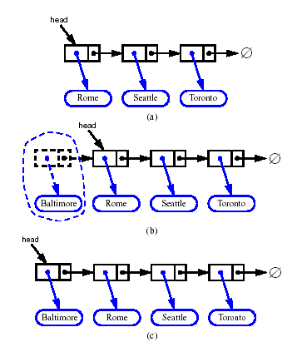
Inserting at the Head
Allocate a new node
Insert new element
Have new node point to old head
Update head to point to new node
What is the complexity (with n elements in list)?
Answer: O(1)
Very efficient!

Slide 9
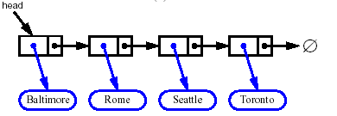


Removing at the Head
Update head to point to next node in the list
Allow garbage collector to reclaim the former first node
Again the operation is O(1), and so efficient

Slide 10
A SinglyLinkedList Class
class SinglyLinkedList {
private Node head;
public SinglyLinkedList() {
} // head automatically set to null by Java
public void insertAtHead(Object newElem) {
Node newHead = new Node(newElem,head);
head = newHead;
}
// etc
}

Slide 11
Doubly Linked List
A doubly linked list provides a natural extension of a singly linked list
Nodes store:
element
link to the next node
link to the previous node
prev
next
elem
node
nodes/positions
head
tail
elements

Slide 12
Doubly Linked List (version 2)
A doubly linked list provides a natural implementation of a List
Nodes implement “Position” and store:
element
link to the previous node
link to the next node
Special trailer and header nodes for convenience (an alternative)
prev
next
elem
node
header
nodes/positions
trailer
elements

Slide 13
Insertion
We visualize operation addAfter(p, X), which returns position v
p
A
B
C
p
A
B
v
C
X
p
v
A
B
X
C

Slide 14
Insertion Algorithm
Algorithm addAfter(p,e):
Create a new node v
v.setElement(e)
v.setPrev(p) {link v to its predecessor}
v.setNext(p.getNext()) {link v to its successor}
(p.getNext()).setPrev(v) {link p’s old successor to v}
p.setNext(v) {link p to its new successor, v}
return v {the position for the element e}

Slide 15
Minimum Expectations
It is generally assumed that you will be familiar with singly and doubly linked lists
You should be aware of the complexity, O(1) versus O(n), of the various standard operations, and how to implement them.

