Slide 1
Stacks and Queues by Using Linked Lists
Andrew Parkes
http://www.cs.nott.ac.uk/~ajp/
G52ADS 2014-15

Slide 2
Objectives
ADT: Abstract Data Type (“interface”)
CDT: Concrete Data Type (“implementation”)
Queues and Stacks are ADTs and so need some choice of CDT.
Previous lecture showed how to use an array for their CDT
Here we look at using linked lists as the CDT for Stacks and Queues

Slide 3
Recall: Singly Linked List
A singly linked list is a concrete data structure consisting of a sequence of nodes
Each node stores
element (e.g. reference to an Object)
link: reference to the next node
next
elem
Node
Head
∅
A
B
C
D

Slide 4
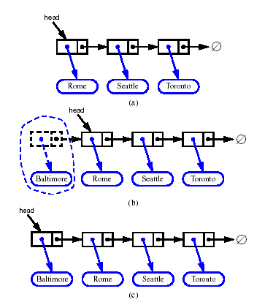
Recall: Inserting at the Head
Allocate a new node
Insert new element
Have new node point to old head
Update head to point to new node
What is the complexity (with n elements in list)?
Answer: O(1)
Very efficient!

Slide 5
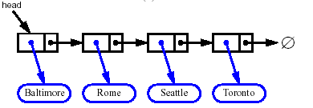


Recall: Removing at the Head
Update head to point to next node in the list
Allow garbage collector to reclaim the former first node
Again the operation is O(1), and so efficient

Slide 6
Usage of Simplest Linked List
In principle, could use them for any ADT
Observe that insertion and removal at head are very efficient, O(1).
If insert two elements then remove two elements, we get “Last In First Out” behaviour
Hence, most natural usage is as a Stack

Slide 7
Stack with a Singly Linked List
We can implement a stack with a singly linked list
The top element is stored at the first node of the list
The space used is O(n) and each operation of the Stack ADT takes O(1) time
Exercise (online): Spot the deliberate mistake
nodes
t
∅
elements

Slide 8
Stack size() operation?
If given only the “head”, we need to walk the list to find the size()
Fixes?
Take size() out of the Stack ADT
most of the time we only use “size() > 0” and so could use !isEmpty() instead (i.e. just test if the head is null)
In the list implementation, add a size counter private int nbElements;
maintenance and access is O(1) as desired (Exercise: verify this)

Slide 9
Linked List usable as a Queue?
Queue needs access to “both ends”
To do this efficiently, as well as the ‘head’ we also need to store and maintain a ‘tail’
Head
Tail
∅
A
B
C
D

Slide 10
Queues from singly-linked lists
The arrows (pointers) flow from head to the tail, so
the new arrivals are placed at the head
deletions are made at the tail.
(So that the flow follows the arrows).
What are the complexities of the operations?
already seen that insertion at the head is O(1)
Notes:
NOTE: this slide deliberately presents the wrong thing to do, as it is an easy mistake to make – as will be clear in later slides. Beware merely memorising slides!!!

Slide 11
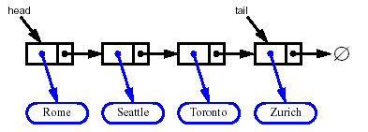
Removing at the Tail
Removing at the tail of a singly linked list is not efficient!
To find new tail have to walk list from head
There is no constant-time way to update the tail to point to the previous node
Complexity: O(n)

Slide 12
Linked Lists:
So far:
Insertion at head: O(1)
Removal at tail: O(n)
Are we done yet? Can we do better?

Slide 13
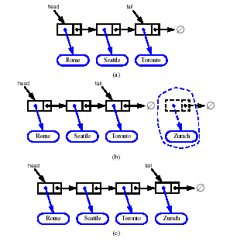
Inserting at the Tail
Allocate a new node
Insert new element
Have new node point to null
Have old last node point to new node
Update tail to point to new node
Complexity: O(1)

Slide 14
Spot the Error!
“The arrows (pointers) flow from head to the tail, so
the new arrivals are placed at the head
deletions are made at the tail.”
Exercise: where did I ‘lie’ to you!? ☺
The flow of items does not necessarily follow the flow of the pointers.
(Analogy: queues on motorways move backwards.)

Slide 15
Backwards is Better!
Insert at the tail: O(1)
Remove at the head: O(1)
Much better!

Slide 16
Tailed Linked List usable as a Queue?
Insertion at head is O(1)
Removal at head is O(1)
Insertion at tail is O(1)
Removal at tail is O(n)
Could implement Queue by insert at head and remove at tail, but this should get you sacked
Notice how the big-Oh analysis helps us make sensible design decisions!
Notice that did not need all the constant factors; the big-Oh gives a useful level of abstraction

Slide 17
Linked List vs. Array based CDTs
Array
Con: Fixed size – might need a lot of unused space
Pro: Contiguous in memory
Localised memory access
Gives better use of the (CPU) cache – e.g. machine level “pre-fetch” will tend to do the right thing
Linked List
Pro: size grows and shrinks automatically
Con: can be scattered around memory, and give poor usage of the cache
Con: storage of the “next” references doubles the space usage

Slide 18
Remarks
Data structure design is an incremental process
Can include judicious use of
Addition of new fields or Objects to store data that is otherwise expensive to re-compute
Removal of fields or Objects when the are not needed
Use of big-Oh analysis of operations
Expectation is that you will know why each part of an ADT/CDT is there, and not just that you have memorised them!

Slide 19
Remarks
Linked lists are a very common structure and all programmers are expected to be totally comfortable
using them directly, and
using the ideas to build more complex data structures not provided in standard libraries
Exercise (offline) Implement all these in Java

