Slide 1
G53FUZ Fuzzy Sets and Systems
Revision Lecture

Slide 2
Module Overview
Six main topic areas
fuzzy sets and operations
linguistic variables and fuzzy logic
Mamdani inference and defuzzification
TSK inference and fuzzy control
fuzzy model identification and tuning
ANFIS
lectures 8 & 9 (‘applications’ and ‘non-standard fuzzy inference’) are not examinable

Slide 3
1. Fuzzy Sets and Operations
Concept and formal definition of a fuzzy set
basic notation
Properties
alpha-cuts, support, normality, convexity
meaning of membership values (not probabilities)
Operations
basic complement, intersection, union
operator axioms and families

Slide 4
2. Linguistic Variables and Logic
Concept and formal definition of linguistic variables
(quintuple) aspects of variables
terms and membership functions
Membership function types
piecewise linear (triangular, trapezoidal), Gaussian, sigmoids
Linguistic truth and ‘full’ fuzzy logic
logical and; logical or

Slide 5
3. Mamdani and Defuzzification
Concept and basis of Mamdani inference
essential methodology
complete worked example
Defuzzification
numeric and linguistic defuzzification
centre-of-gravity, mean-of-maxima, etc.
problems with defuzzification
additional metrics provide more information
linguistic defuzzification using similarity measures

Slide 6
4. TSK and Control
Concept and basis of TSK inference
essential methodology
zeroth order, first order, worked examples
differerences between Mamdani and TSK
Control examples
controlling a DC motor; PID control
fuzzy approach to control
example systems: 4 rules and 9 rules

Slide 7
5. Model Identification and Tuning
Model identification
structure and parameter identification
performance metrics and model evaluation
Tuning methods
exhaustive search; monte carlo
hill climbing; stochastic local search
simulated annealing; simplex method
Case study
tuning umbilical acid-base analysis system

Slide 8
6. ANFIS
Concept and methodology
description of the layers (1-5)
overview of tuning processes
Case study
complete worked example on iris data
fully automated approach
hand-crafted approach
hybrid (semi-automated) approach

Slide 9
Exam
Q1, and one from two questions
multi-part free response
each question carries equal weighting (30 marks)
Top tips
look carefully at the mark distribution of all parts
the marks awarded are a clear indicator of the amount of ‘stuff’ to write / number of key points to make
read all Q2 & Q3 carefully before choosing one

Slide 10
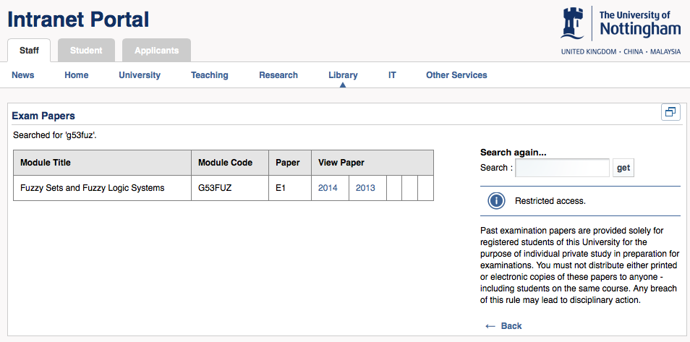
Past Exam Papers
Previous papers are available

