Slide 1
Kolloquium
Maximum Multi Commodity Flow Problem

Slide 2
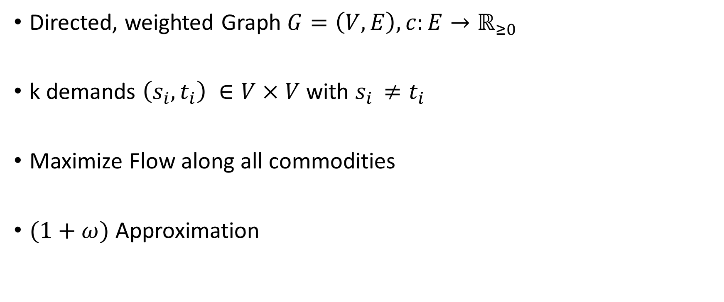
Problem Definition
Directed, weighted Graph $G=\left(V,E\right), c:E→ℝ_{≥0}$
k demands $\left(s_{i},t_{i}\right) ∈V×V$ with $s_{i }≠t_{i}$
Maximize Flow along all commodities
$(1+ω)$ Approximation

Slide 3

Formulation as a Linear Program
$P=\{p⊆E : "p is a path from any source to its sink"\}$
$X=\{x : x : P→ ℝ_{≥0}\}$
$P_{e}=\{p∈P:e∈p$}

Slide 4
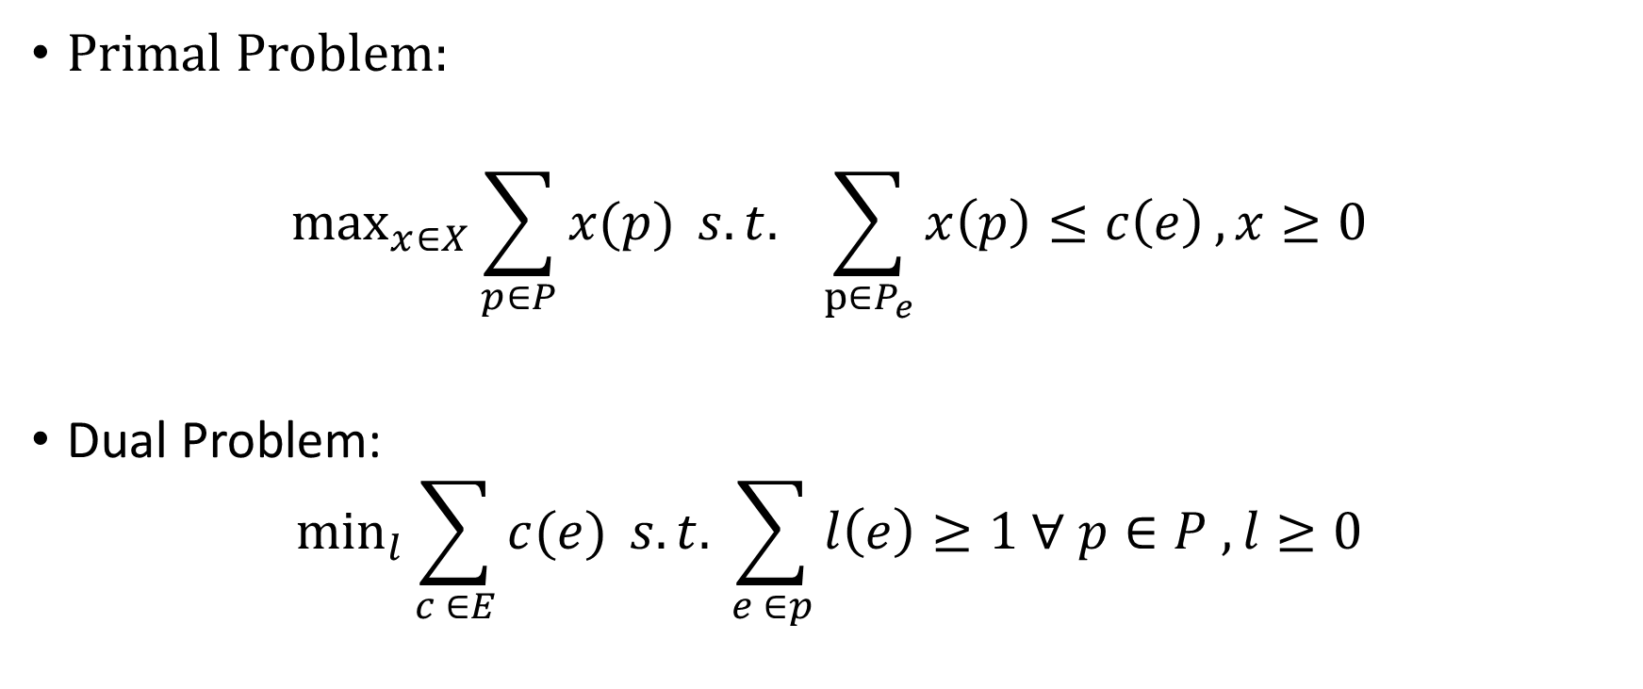
Formulation as a Linear Program
Primal Problem:
$$\max_{x∈X}{\sum_{p∈P}{x(p)}} s.t. \sum_{p∈P_{e}}{x\left(p\right)≤c\left(e\right)}, x≥0$$
Dual Problem:
$$\min_{l}{\sum_{c ∈E}{c(e)} s.t. \sum_{e ∈p}{l\left(e\right)≥1 ∀ p∈P , l≥0}}$$

Slide 5
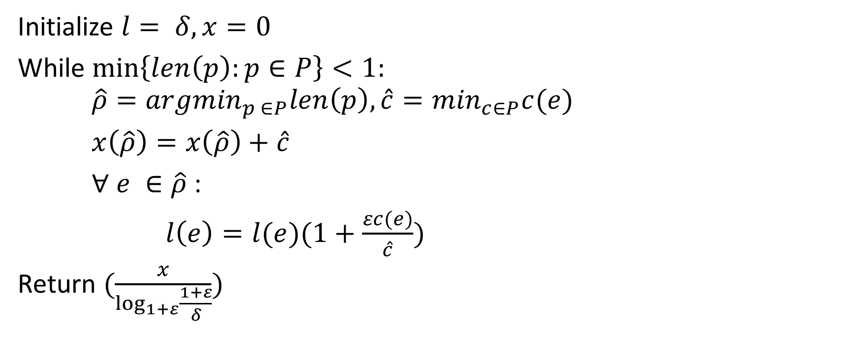
Algorithm
Initialize $l= δ, x=0$
While $\min\left\{len\left(p\right):p∈P\right\}<1:$ $\hat{ρ}={argmin}_{p ∈P}len\left(p\right), \hat{c}=\min_{c∈P}c(e)$
$x\left(\hat{ρ}\right)=x\left(\hat{ρ}\right)+\hat{c}$
$∀ e ∈\hat{ρ}$ :
$l\left(e\right)=l(e)(1+\frac{εc(e)}{\hat{c}})$
Return $(\frac{x}{\log_{1+ε}{\frac{1+ε}{δ}}})$

