Slide 1
Kolloquium
Maximum Multi Commodity Flow Problem (Approximation Scheme)

Slide 2
The Maximum Multi Commodity Flow Problem
A Case Study of an Approximation Scheme
Notes:
Vorstellung des Themas, meiner Aufgabe und Erawehnung von JgraphT

Slide 3
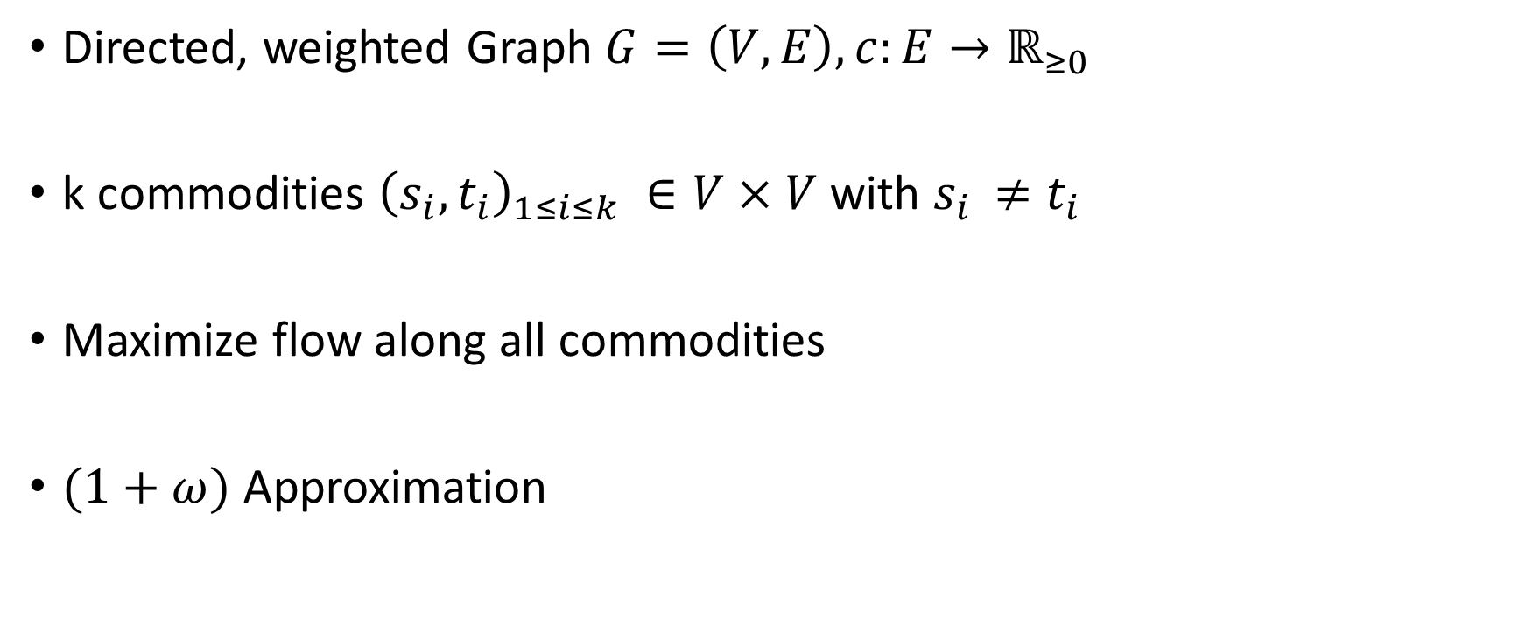
Maximum multicommodity flow
Directed, weighted Graph $G=\left(V,E\right), c:E→ℝ_{≥0}$
k commodities ${\left(s_{i},t_{i}\right)}_{1≤i≤k} ∈V×V$ with $s_{i }≠t_{i}$
Maximize flow along all commodities
$(1+ω)$ Approximation

Slide 4

Maximum multicommodity flow problem
Given:
Directed, weighted Graph $G=\left(V,E\right)$
$Capacities$ $c:E→ℝ_{≥0}$
k commodities ${\left(s_{i},t_{i}\right)}_{1≤i≤k} ∈V×V$ with $s_{i }≠t_{i}$
Task:
Maximize flow along all commodities
Notes:
(s,_i,t_i ) sind source und sink

Slide 5

Commodities: $\left(a,c\right),(b,d)$
a
3/3
c
0/2
b
2/2
d

Slide 6

MMCFP vs MFP: Example1
Commodities: $\left(a,c\right),(b,d)$
capacities
flow
a
3/3
c
0/2
b
2/2
d

Slide 7

MMCFP vs MFP: Example2
Commodities: $\left(a,c\right),(a,e)$
b
3
3
a
d
1
e
1
3
c

Slide 8

Polynomial-time approximation scheme
Algorithm:
Input:
Problem instance, accuracy $ω$
Output :
Solution not worse than $(1−ω)$ times the optimal
Running time:
Polynomial in size of problem instance (not in $ω^{−1}$)

Slide 9
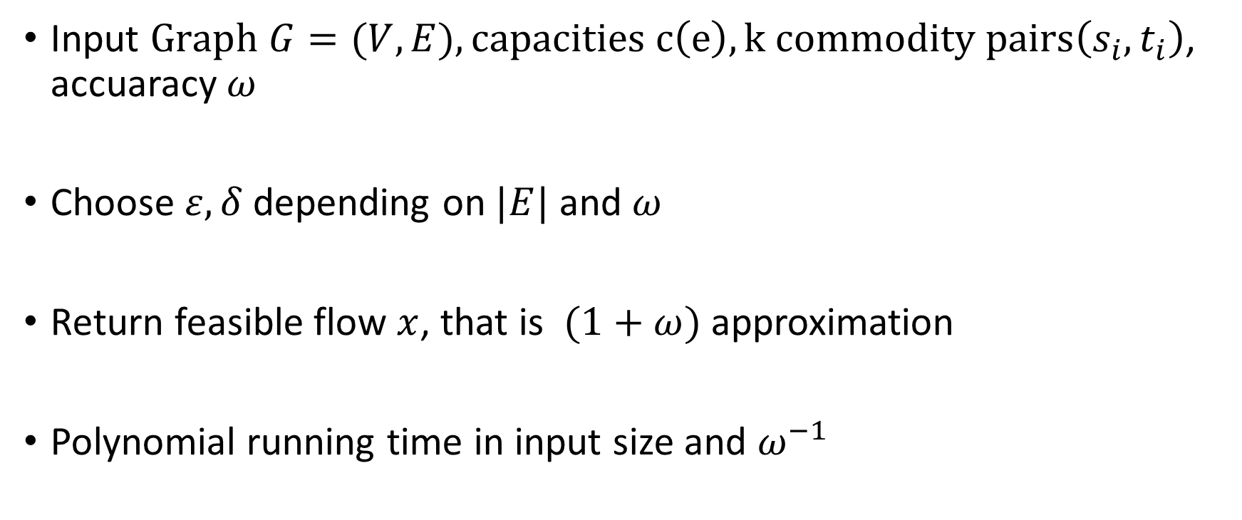
Garg and Koenemann Algorithm
Input $Graph G=(V,E), capacities c\left(e\right), k commodity pairs\left(s_{i},t_{i}\right)$, accuaracy $ω$
Choose $ε,δ$depending on $|E|$ and $ω$
Return feasible flow $x$, that is $(1+ω)$ approximation
Polynomial running time in input size and $ω^{−1}$

Slide 10
Garg and Koenemann Algorithm
Polynomial-time approximation scheme for MMCFP
Motivation:
Faster than previous known algorithms for a fixed or moderately small ω.
Idea:
Formulate MMCFP as a Linear Program, solve the dual problem and compute the solution for the primal as a byproduct.

Slide 11

Formulation as a Linear Program
$P=\{p⊆E : "p is a path from any source to its sink"\}$
$X=\{x : x: P→ ℝ_{≥0}\}$
$P_{e}=\{p∈P:e∈p$}
$L=\{l : l: E →ℝ_{≥0}\}$

Slide 12
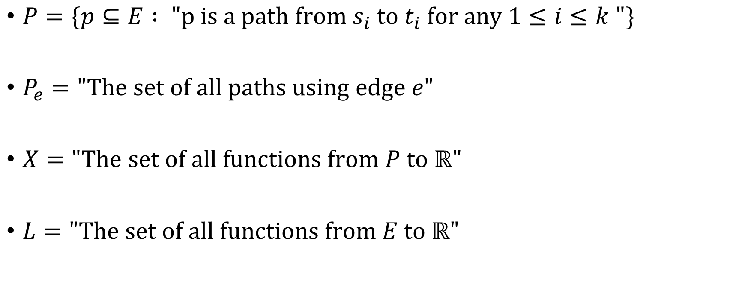
Formulation as a Linear Program
$P=\{p⊆E : "p is a path from s_{i} to t_{i} for any 1≤i≤k "\}$
$P_{e}="The set of all paths using edge e"$
$X="The set of all functions from P to ℝ"$
$L="The set of all functions from E to ℝ"$

Slide 13
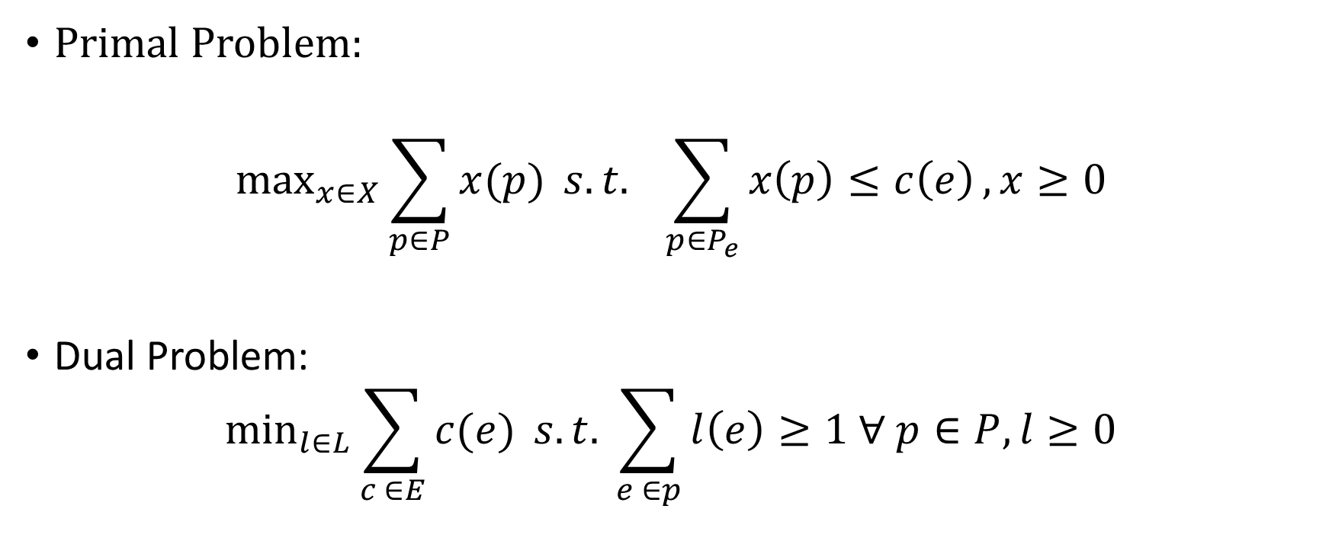
Formulation as a Linear Program
Primal Problem:
$$\max_{x∈X}{\sum_{p∈P}{x(p)}} s.t. \sum_{p∈P_{e}}{x\left(p\right)≤c\left(e\right)}, x≥0$$
Dual Problem:
$$\min_{l∈L}{\sum_{c ∈E}{c(e)} s.t. \sum_{e ∈p}{l\left(e\right)≥1 ∀ p∈P, l≥0}}$$

Slide 14
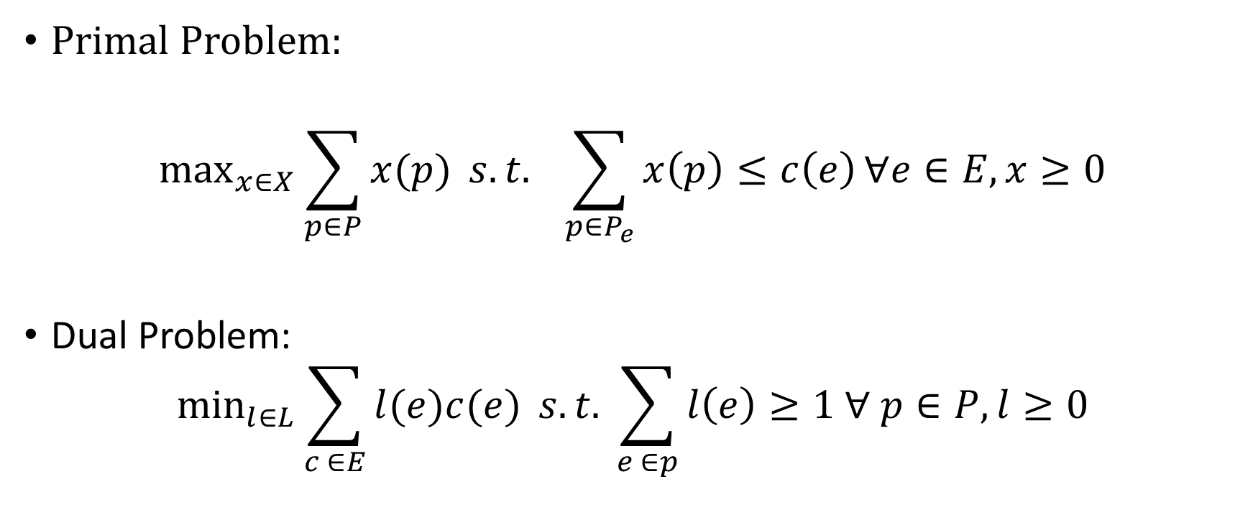
Formulation as a Linear Program
Primal Problem:
$$\max_{x∈X}{\sum_{p∈P}{x(p)}} s.t. \sum_{p∈P_{e}}{x\left(p\right)≤c\left(e\right)}∀e∈E, x≥0$$
Dual Problem:
$$\min_{l∈L}{\sum_{c ∈E}{l(e)c(e)} s.t. \sum_{e ∈p}{l\left(e\right)≥1 ∀ p∈P, l≥0}}$$

Slide 15
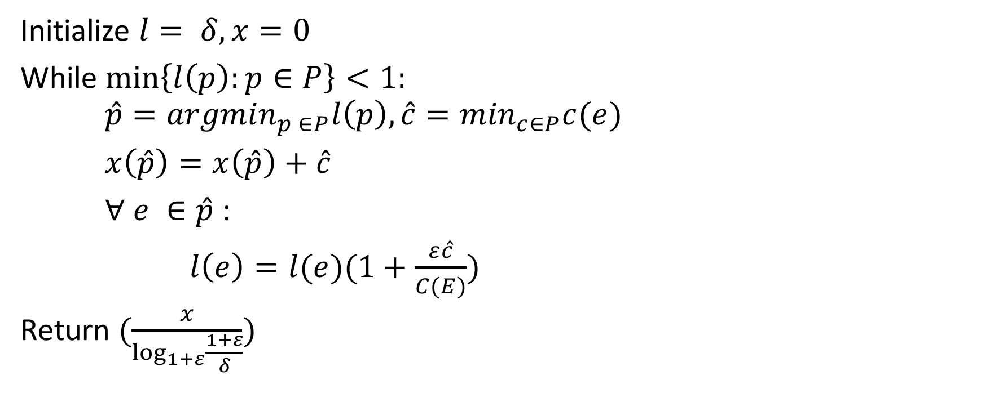
Algorithm
Initialize $l= δ, x=0$
While $\min\left\{l\left(p\right):p∈P\right\}<1:$ $\hat{p}={argmin}_{p ∈P}l\left(p\right), \hat{c}=\min_{c∈P}c(e)$
$x\left(\hat{p}\right)=x\left(\hat{p}\right)+\hat{c}$
$∀ e ∈\hat{p}$ :
$l\left(e\right)=l(e)(1+\frac{ε\hat{c}}{C(E)})$
Return $(\frac{x}{\log_{1+ε}{\frac{1+ε}{δ}}})$

Slide 16
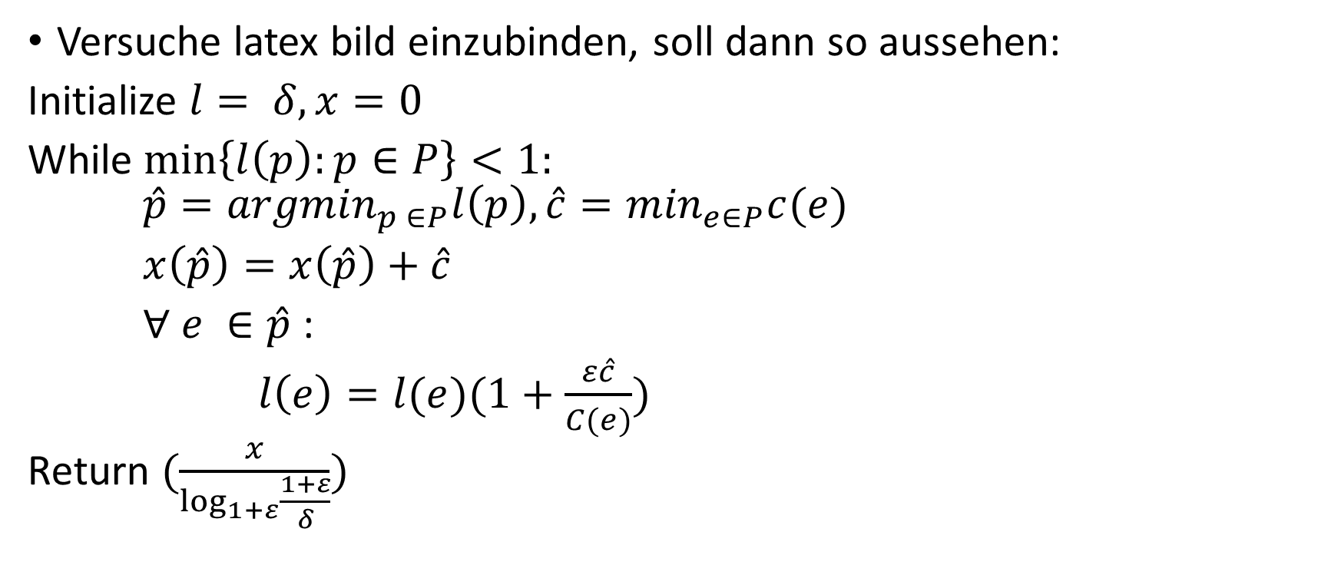
Algorithm
Versuche latex bild einzubinden, soll dann so aussehen:
Initialize $l= δ, x=0$
While $\min\left\{l\left(p\right):p∈P\right\}<1:$ $\hat{p}={argmin}_{p ∈P}l\left(p\right), \hat{c}=\min_{e∈P}c(e)$
$x\left(\hat{p}\right)=x\left(\hat{p}\right)+\hat{c}$
$∀ e ∈\hat{p}$ :
$l\left(e\right)=l(e)(1+\frac{ε\hat{c}}{C(e)})$
Return $(\frac{x}{\log_{1+ε}{\frac{1+ε}{δ}}})$

Slide 17






Commodities: $\left(a,b\right), (e,g)$
capacities
a
$$2$$
b
$$4$$
c
$$8$$
d
a
$$3$$
b
$$4$$
c

Slide 18






Problem Instance
Commodities: $\left(a,b\right), (e,g)$
capacities
a
b
c
d
$$3$$
$$3$$
$$3$$
e
f
g
$$3$$
$$4$$

Slide 19










Initialization
capacities
length
flow
a
$$δ$$
b
$$δ$$
c
$$δ$$
d
$$0/3$$
$$0/3$$
$$0/3$$
e
$$δ$$
f
$$δ$$
g
$$0/3$$
$$0/4$$

Slide 20




First Iteration completed
capacities
length
flow
a
$$δ$$
b
$$δ$$
c
$$δ$$
d
$$0/3$$
$$0/3$$
$$0/3$$
$$δ(1+\frac{3}{4} ε)$$
e
$$δ(1+ε)$$
f
g
$$3/3$$
$$3/4$$

Slide 21
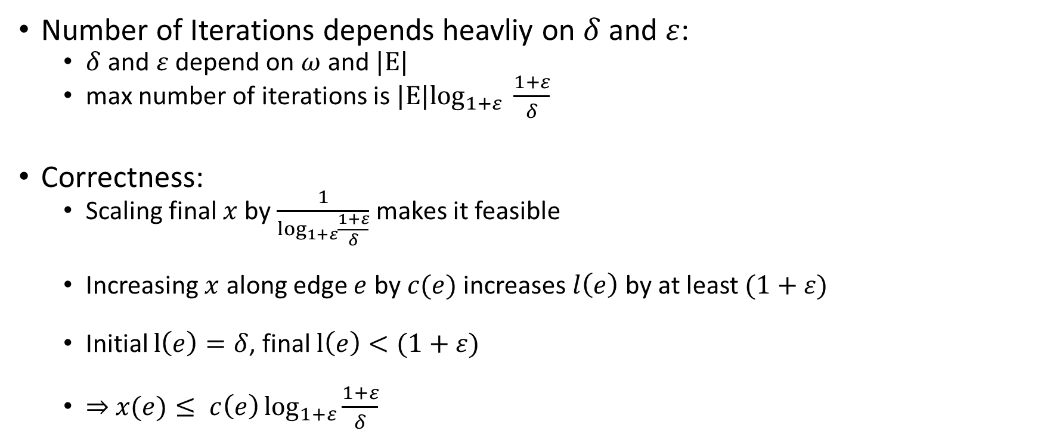
Analysis
Number of Iterations depends heavliy on $δ$ and $ε$:
$δ$ and $ε$ depend on $ω$and $|E|$
max number of iterations is $|E|\log_{1+ε} \frac{1+ε}{δ}$
Correctness:
Scaling final $x$ by $\frac{1}{\log_{1+ε}{\frac{1+ε}{δ}}}$ makes it feasible
Increasing $x$ along edge $e$ by $c(e)$ increases $l\left(e\right)$ by at least $(1+ε)$
Initial $l\left(e\right)=δ$, final $l\left(e\right)<(1+ε)$
$⇒$ $x(e)≤ c\left(e\right)\log_{1+ε}{\frac{1+ε}{δ}}$

Slide 22

Analysis
Correctness:
$v(x)≔\sum_{p∈P}{x\left(p\right)}≥opt(1−ω)$
$⇔ \frac{v(x)}{}$
Running time: $\tilde{O}(ω^{−2}k m^{2})$ (ignoring logarithmic dependencies)

Slide 23

Implementation Difficulties
Small initialization values for big $|E|$ and high accuracy
Huge variety of edge lengths

Slide 24

Modifications
Stop earlier if primal dual ratio is already smaller than $(1+ω)$
Group commodities with the same sink

Slide 25




Modifications
Stop earlier if primal dual ratio is already smaller than $(1+ω)$
a
$$δ(1+ε)$$
b
$$δ(1+ε)$$
c
2/2
$$2/2$$

Slide 26

Modifications
Group commodities: $\left(d,c\right), \left(a,c\right) →(e,c)$
d
2
c
d
2
c
∞
e
2
∞
2
a
2
b
a
2
b

